Slide 1

Eastern Nile Technical Regional Office (ENTRO)
Consultancy service for the Development of the Eastern Nile Water Resources Models and Tools
Nile Cooperation for Climate Resilience
Validation Workshop
12-14 June 2025

Slide 2
Project background and objectives
The activities will focus on the area covered by ENTRO, namely Egypt, Ethiopia, Sudan and South Sudan, specifically on the watersheds of the Blue Nile, the Atbara, the Baro-Akobo-Sobat, and the main Nile downstream of Khartoum
The objectives are:
Review of all the existing models, tools, data, platforms and elaborate a comprehensive and complete picture of the current situation;
Unify the approach and make all the information readily accessible;
Implement improved and more robust models, toolkits, databases and platforms to allow for better planning and informed decision making in the future; and
Train the counterpart staff on the developed models, tools and platforms.

Slide 3
Methodological approach
Several models, tools, database, platforms are in place with a huge amount of information already available; the issue is related to the scattered and not readily accessible characteristics of such information
The project main scope will consist in creating a robust and comprehensive framework under which all the models, the tools and the platforms will be re-designed, and the data and the information will be managed.
Update/improvement of the models, improvement of data accessibility and improvement of communication tools will be a benefit for water resources planning in the Eastern Nile basin.
The basic pillar of the proposed methodology is the use of free analytical tools and open source software. Our plan is to take stock of open-source / freeware modelling (i.e. QGIS, HEC-HMS, HEC-RAS, HEC-ResSim, …). The same approach will be followed for the development of the IT web platform expected to access/disseminate outputs and key tools. The utilization of free and open-source codes and tools has clear mid- and long-term advantages for the sustainability of the project and for the hand-over of the tools and maps to ENTRO staff.
Models and data
Platforms
Tools
Updated framework
and DB

Slide 4
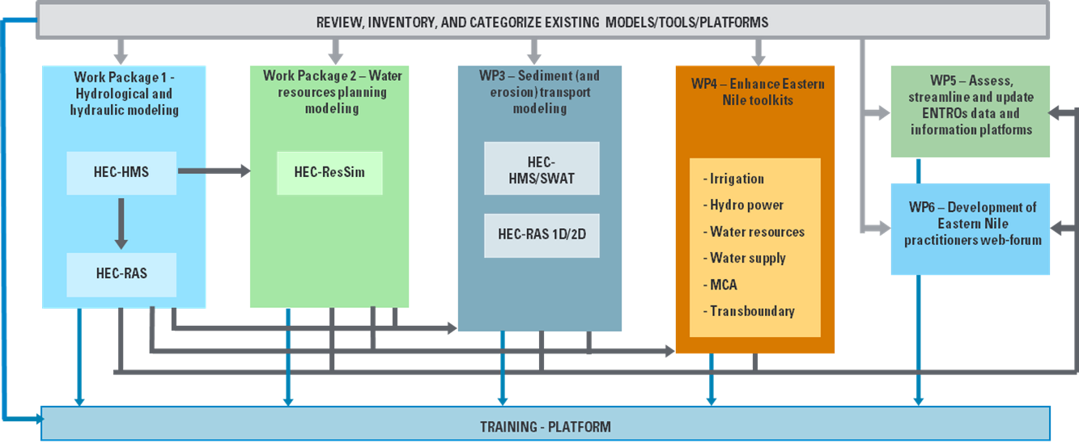

Methodological approach
Schematization of the integrated approach pursued by the Consultant

Slide 5
Workshop Agenda
Time (hrs) | Presentation / Activity | Responsible Person
 | June 12, 2025 - Day 1
8:30 – 9:00 | Registration | All
9:00 – 9:10 | Welcome Remarks by ENTRO AED | Eng. Teshome Atnafie
9:10 – 9:20 | Opening Remarks by Sudan ENSAPT leader | Dr. Hassan Aboelbashr
9:20 – 9:30 | Opening Remark by South Sudan ENSAPT leader | Eng. Thomas Jang
9:30 – 9:40 | Opening Remark by Ethiopia ENSAPT leader and declare opening of the workshop. | Dr. Zebene Lakew
9:40 – 10:00 | Self-Introduction of participants | All
10:00 – 10:15 | Overview of the Eastern Nile Water Resources Models and Tools, workshop Objective and expected outputs | Dr. Muna Musnad (ENTRO)
10:15 – 10:30 | Presentation on the summary of development of the EN Models and Tools | HydroNova (Consultant)
10.30 – 11:00 | Health Break | ALL
11:00 – 13:00 | Presentation on WP5 and WP6: Platform and web forum Presentation | HydroNova (Consultant)
13.00 – 14:00 | Lunch Break | Hotel
14.00 – 15:30 | Interactive session on WP5 and WP6: Platform and web forum | All
15:30-16:00 | Health Break | Hotel
16:00-17:00 | Presentation and interactive session on WP4 | HydroNova (Consultant)
17:00 – 17:30 | General discussions and Recommendation | All

Slide 6
Workshop Agenda
Time (hrs) | Presentation / Activity | Responsible Person
 | June 13, 2025 - Day 2 | Chair: To be assigned
9:00 – 9:10 | Recap of Day 1 | HydroNova/ ENTRO
9:10- 10:30 | Presentation on the development of Hydrological model | HydroNova (Consultant)
10:30 – 11:00 | Health Break | ALL
11:00-13:00 | Interactive session on hydrological model | All
13.00 – 14:00 | Lunch Break | Hotel
14:00 – 15:30 | Presentation on the development of Hydraulic model | HydroNova (Consultant)
15:30-16:00 | Health Break | Hotel
16:00-17:00 | Interactive session on hydraulic model | ALL
16:30- 17:30 | Feedback and Recommendations on WP1 | ALL

Slide 7
Workshop Agenda
Time (hrs) | Presentation / Activity | Responsible Person
 | June 14, 2025 - Day 3 | Chair: To be assigned
09:00 –09:10 | Recap of Day 2 | HydroNova/ ENTRO
09:10- 10:00 | Presentation on WP2: Water resources planning model | HydroNova (Consultant)
10:00-11:00 | Interactive session on water resources planning model | All
11:00 – 11:30 | Health Break | Hotel
11:30-12:00 | Presentation on WP3: Sediment and erosion transport model (HEC-HMS) | HydroNova (Consultant)
12:00-13:00 | Interactive session on Sediment and erosion transport model (HEC-HMS) | All
13.00 – 14:00 | Lunch Break | Hotel
14:00 – 15:00 | Presentation on WP3: Sediment and erosion transport model (SWAT) | HydroNova (Consultant)
15:00-16:00 | Interactive session on Sediment and erosion transport model (SWAT) | All
16:00-16:30 | Health Break | Hotel
16:30- 17:00 | Feedback and recommendations on WP3 | All
17:00-17:30 | Closing remarks and a way forward | ENTRO/ENSAPT

Slide 8
Specific Topics
DAY 1. WP5 – WP6
Platform components | Platform Overview System infrastructure Front-end structure Users management strategy Key Functionalities for ENTRO/Registered Users Authentication and Authorization Protocol Contact Us section Forum Hardware
Data Management | Data reporting: dashboards Data maintenance strategy
Manuals

Slide 9
Specific Topics
DAY 1 – WP4
Tools overview | Irrigation & Drainage Toolkit Eastern Nile Watershed Management Toolkit Eastern Nile Power Toolkit Eastern Nile Irrigation Toolkit Information Management System CAPMAS Agriculture Database Model

Slide 10
Specific Topics
DAY 2. WP1 – HEC HMS
Data Sources and retrieval | Rain ET DEM Hydrologcal stations Scenarios
Calibration | Method Results
Simulation | Scenario 0 Scenario 1 and 2

Slide 11
Specific Topics
DAY 2. WP1 – HEC RAS
Data Sources and retrieval | Available DTMs DTM Data processing Inflow HEC-HMS Model set-up
Calibration
Simulation | Representative years Scenario 0 Scenario 1 Scenario 2

Slide 12
Specific Topics
DAY 3. WP2 – HEC RESSIM
Data Sources and retrieval | Inflow HEC-HMS Evaporation from water surfaces Reservoir physical data Hydrological stations Scenarios
Calibration | Method Results
Simulation | Scenario 0 Scenario 1 Scenario 2

Slide 13
Specific Topics
DAY 3. WP3 – HEC HMS SEDIMENT
Data Sources and retrieval | Soil Database Land cover Hydrological stations Scenarios
Calibration | Method Results
Simulation | Scenario 0 Scenario 1 and 2

Slide 14
Specific Topics
DAY 3. WP3 – SWAT SEDIMENT
Introduction
Data Sources and retrieval | Digital Terrain Model Land cover database Soil database Rainfall Other Climate data Subcatchments and rivers
Simulation | Scenario 0 Scenario 1 Scenario 2

Slide 15
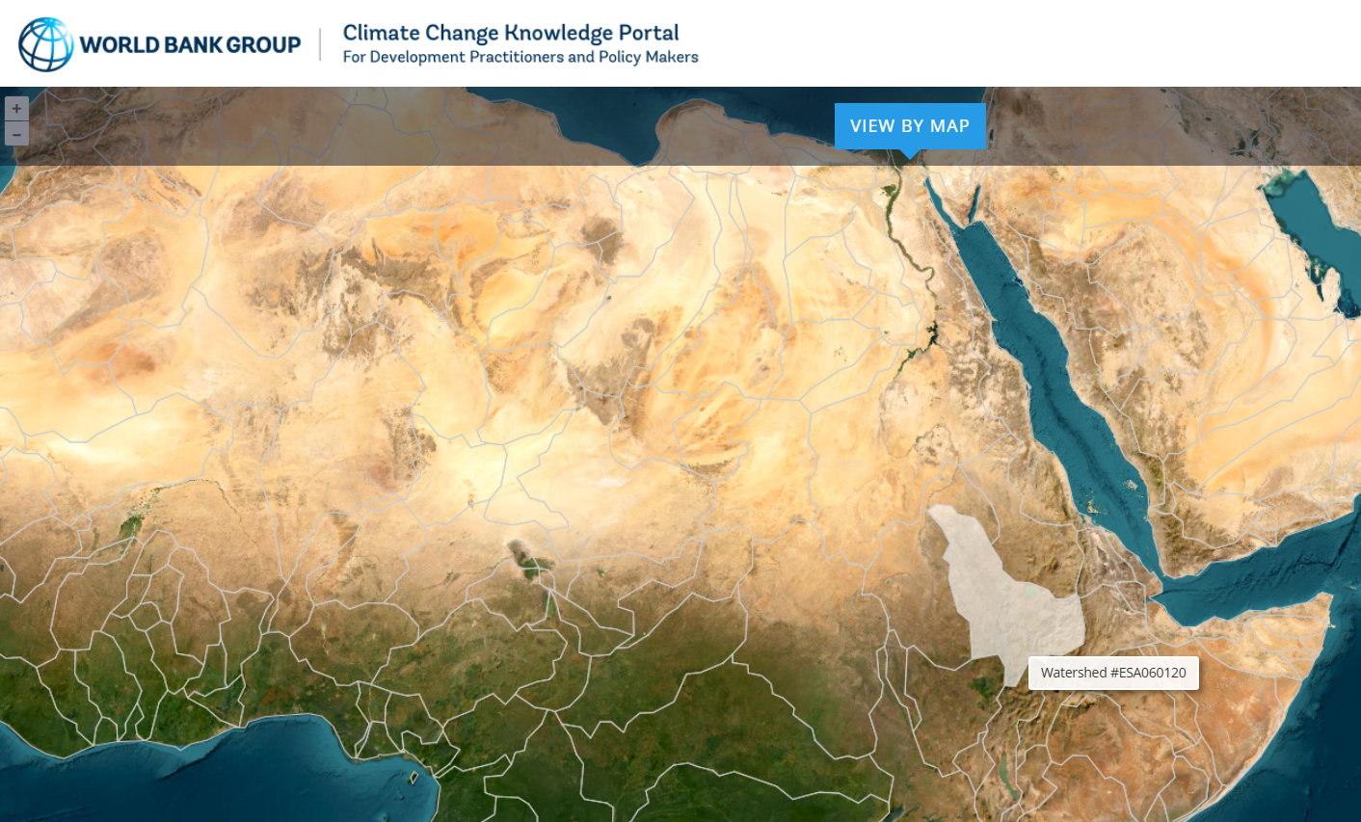
Modelling scenarios
Modelling scenarios encompass climate change impacts affecting precipitation and evaporation, which are the main meteorological parameters affecting the tools developed within the present project
We consider two preselected scenarios: SSP2-4.5 and SSP3-7.0 at 2060 time horizon. We used the World Bank Climate Change Knowledge Portal as the source of information where to retrieve precipitation and temperature forecast data, based on the subbasin scale.
https://climateknowledgeportal.worldbank.org/#watershed-map

Slide 16
Modelling scenarios
Scenario 0 – Current conditions: Rainfall and temperature for evaporation calculation are derived from ERA5 data portal, as agreed in the previous phases of the project, for the time window 1972-2023.
Scenario 1 – 2060 – SSP2-4.5: Rainfall and temperature used in scenario 0 impacted according to seasonal forecast and to subbasin spatial forecast, according to SSP2 scenario.
Scenario 2 – 2060 – SSP3-7: Rainfall and temperature used in scenario 0 impacted according to seasonal forecast and to subbasin spatial forecast, according to SSP3 scenario.

Slide 17
Modelling scenarios
The values show an average increase in precipitation of about 8 % in SSP2 climate projection and of 11 % in SSP3 projection.

Slide 18
Modelling scenarios
Evapotranspiration shows that on average the Potential Evapotranspiration will increase of 10 % in SSP2 and of 30 % in SSP3.

