Slide 1

Eastern Nile Technical Regional Office (ENTRO)
Consultancy service for the Development of the Eastern Nile Water Resources Models and Tools
Nile Cooperation for Climate Resilience
Validation Workshop
12-14 June 2025

Slide 2
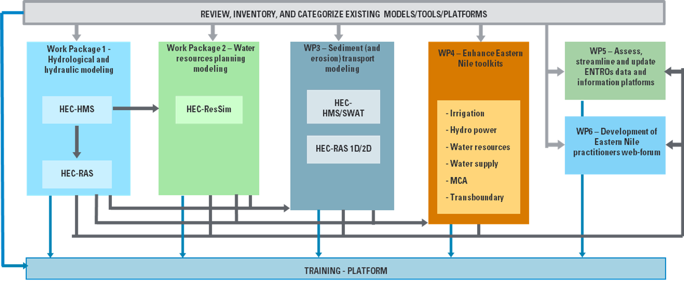

Methodological approach
Schematization of the integrated approach pursued by the Consultant

Slide 3
Workshop Agenda
Time (hrs) | Presentation / Activity | Responsible Person
 | June 14, 2025 - Day 3 | Chair: To be assigned
09:00 –09:10 | Recap of Day 2 | HydroNova/ ENTRO
09:10- 10:00 | Presentation on WP2: Water resources planning model | HydroNova (Consultant)
10:00-11:00 | Interactive session on water resources planning model | All
11:00 – 11:30 | Health Break | Hotel
11:30-12:00 | Presentation on WP3: Sediment and erosion transport model (HEC-HMS) | HydroNova (Consultant)
12:00-13:00 | Interactive session on Sediment and erosion transport model (HEC-HMS) | All
13.00 – 14:00 | Lunch Break | Hotel
14:00 – 15:00 | Presentation on WP3: Sediment and erosion transport model (SWAT) | HydroNova (Consultant)
15:00-16:00 | Interactive session on Sediment and erosion transport model (SWAT) | All
16:00-16:30 | Health Break | Hotel
16:30- 17:00 | Feedback and recommendations on WP3 | All
17:00-17:30 | Closing remarks and a way forward | ENTRO/ENSAPT

Slide 4
Specific Topics
DAY 3. WP3 – SWAT SEDIMENT
Introduction
Data Sources and retrieval | Digital Terrain Model Land cover database Soil database Rainfall Other Climate data Subcatchments and rivers
Simulation | Scenario 0 Scenario 1 Scenario 2

Slide 5
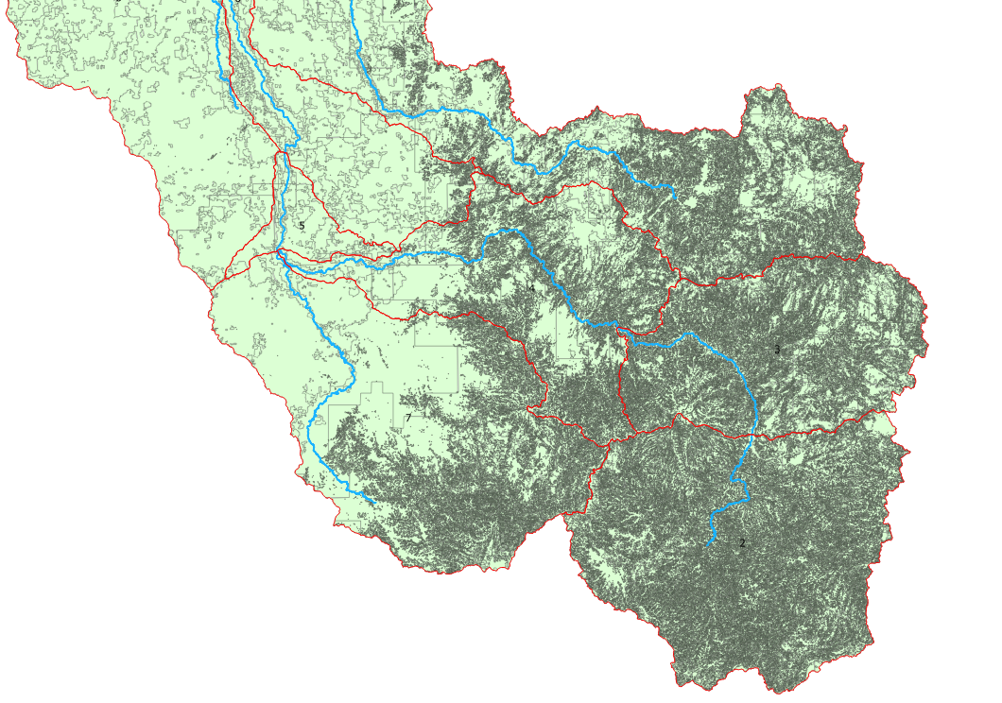
WP3 – Sediment and erosion transport models development
SWAT introduction
SWAT is a spatially distributed model that simulates sediment yield and streamflow. SWAT also divides a basin into sub-basins, with each sub-watershed being divided into an HRU based on surface, land use, soil, and slope
SWAT works in a QGIS environment and many of the analyses are done within QGIS software
Digital elevation model, soil, land use/land cover are the required maps for the models. Daily rainfall and temperature are the climatic data needed. Others were relative humidity, wind speed, and solar radiation

Slide 6
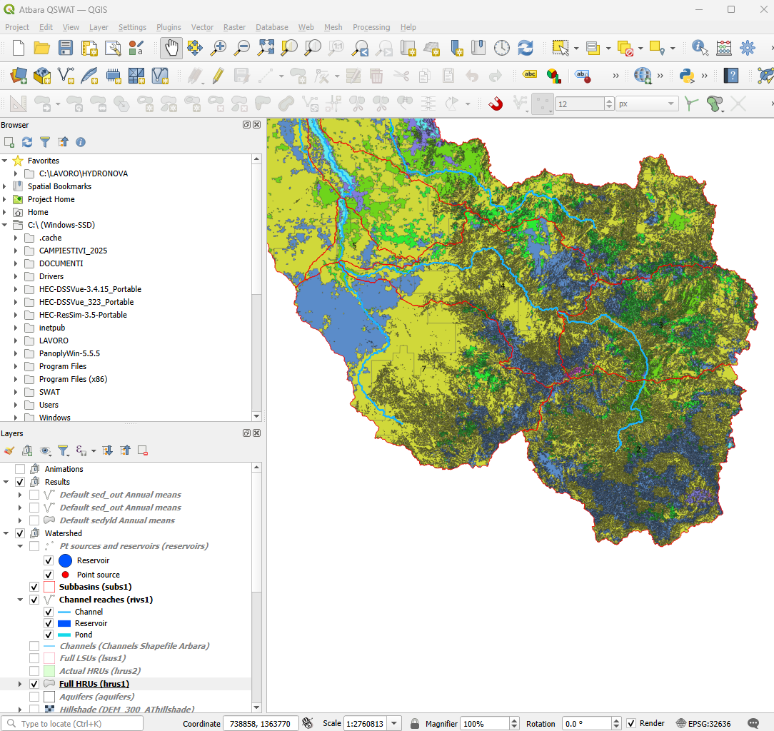
WP3 – Sediment and erosion transport models development
SWAT introduction
SWAT works in a QGIS environment and many of the analyses are done within QGIS software
Digital elevation model, soil, land use/land cover are the required maps for the models. Daily rainfall and temperature are the climatic data needed. Others were relative humidity, wind speed, and solar radiation

Slide 7
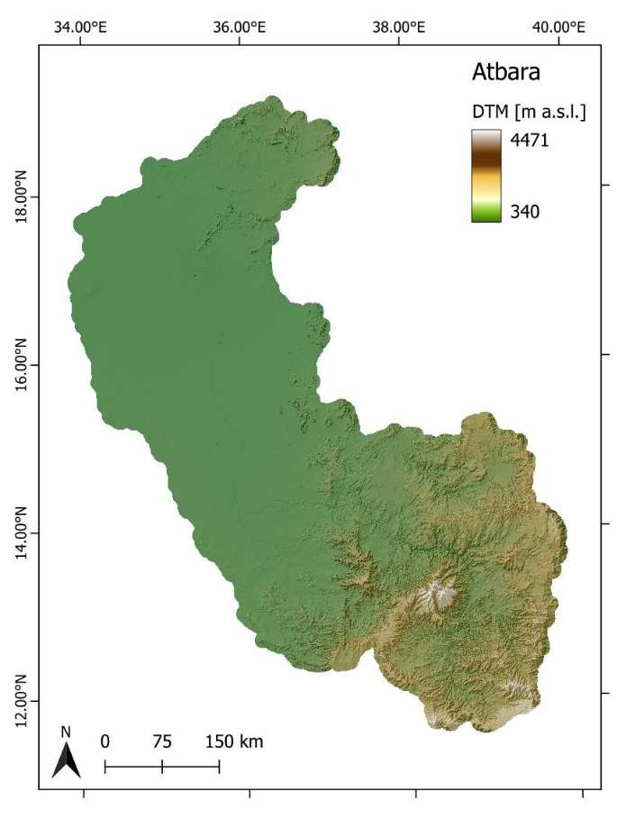
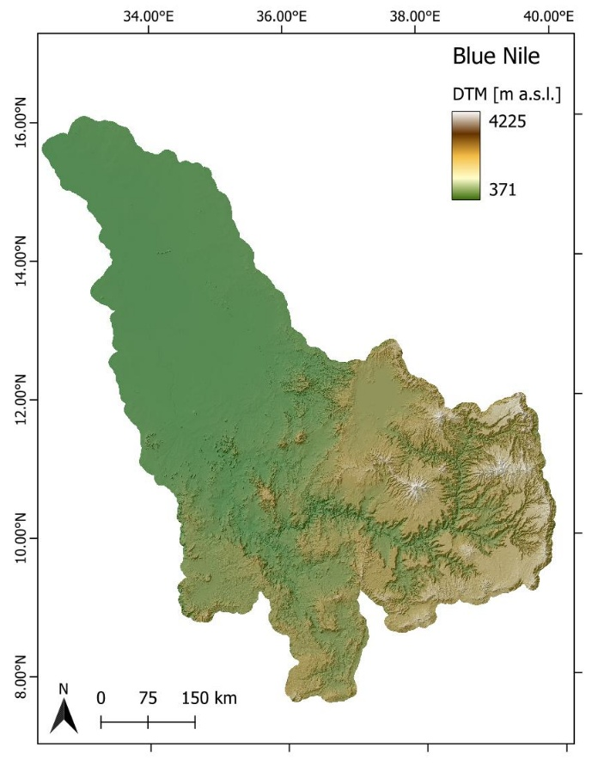
WP3 – Sediment and erosion transport models development
Data sources and retrieval - DTM
The DTM used for the morphological analysis and the definition of the subcatchments was based on the COP 30 digital elevation model, made available by the European Space Agency at a resolution of 30 metres.
https://dataspace.copernicus.eu/explore-data/data-collections/copernicus-contributing-missions/collections-description/COP-DEM

Slide 8
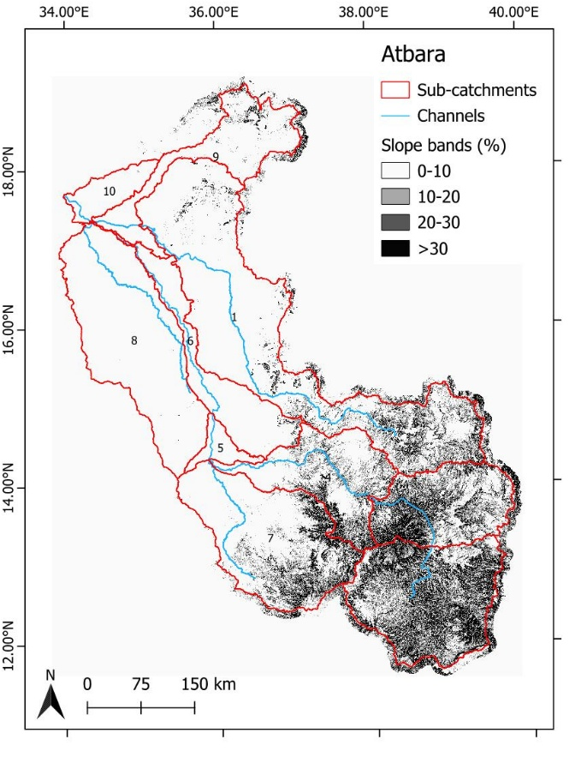
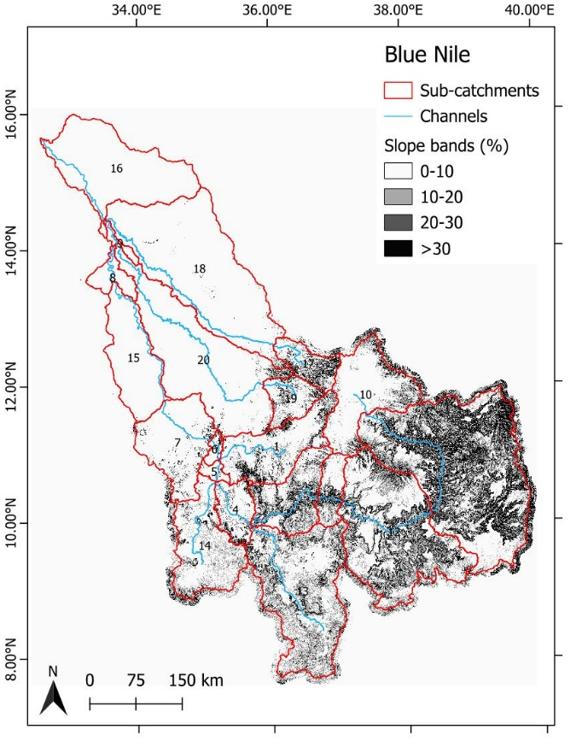
WP3 – Sediment and erosion transport models development
Data sources and retrieval - DTM
The DTM is used to calculate the slope

Slide 9
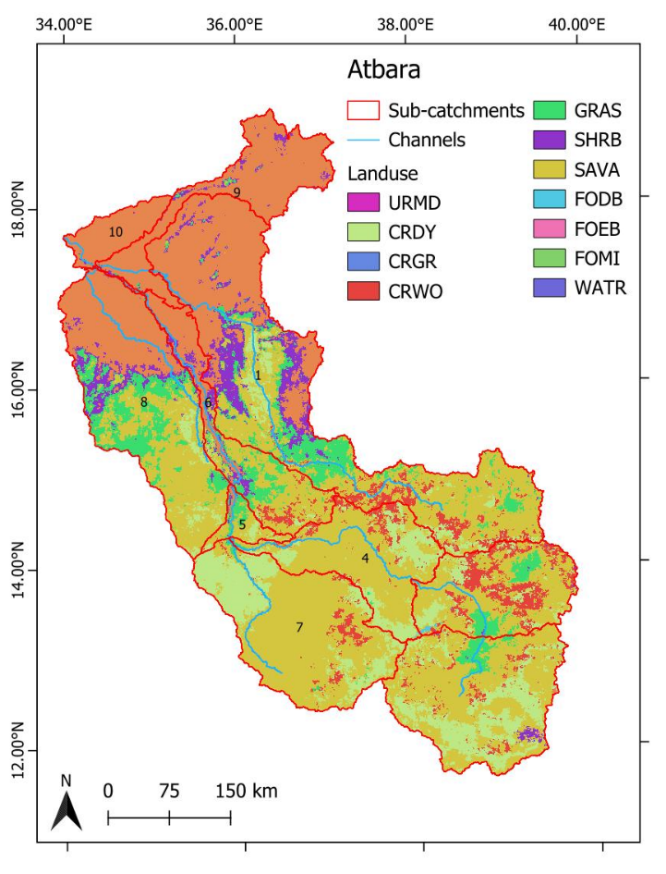
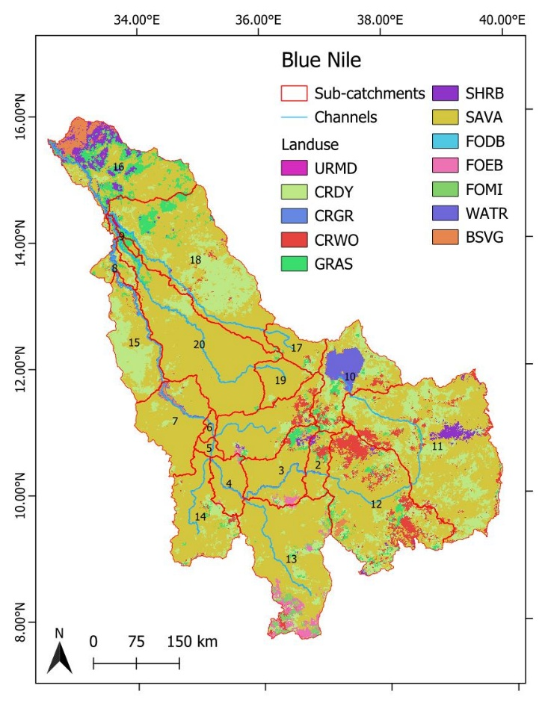
WP3 – Sediment and erosion transport models development
Data sources and retrieval – LAND COVER
GLCC Land Cover maps are provided on a continent-by-continent basis (Africa, North America, South America, Eurasia, and Australia/Pacific) at a spatial resolution of 400 meters
https://www.usgs.gov/centers/eros/science/usgs-eros-archive-land-cover-products-global-land-cover-characterization-glcc?qt-science_center_objects=0#qt-science_center_objects
Code | Landuse | Detail
11 | WATR | Water
21 | URML | Urban Medium Density
22 | URHD | Urban High Density
23 | UCOM | Urban Commercial
24 | UINS | Urban Institutional
25 | UIDU | Urban Industrial
26 | UTRN | Urban Transportation
31 | SWRN | South Western Range + Bare Rock
32 | SWRN | South Western Range + Quarries/Mines
33 | SWRN | South Western Range
41 | FRSD | Deciduous Forest
42 | FRSE | Evergreen Forest
43 | FRST | Mixed Forest
51 | RNGB | Range Shrubland
61 | ORCD | Orchards/Vineyard
71 | RNGE | Grasslands/Herbaceous
81 | PAST | Pasture/Hay
82 | AGRR | Row Crops
83 | AGRC | Small Grains
85 | AGRL | Generic
91 | WETF | Woody Wetlands
92 | WETN | Emergent/Herbaceous Wetlands

Slide 10
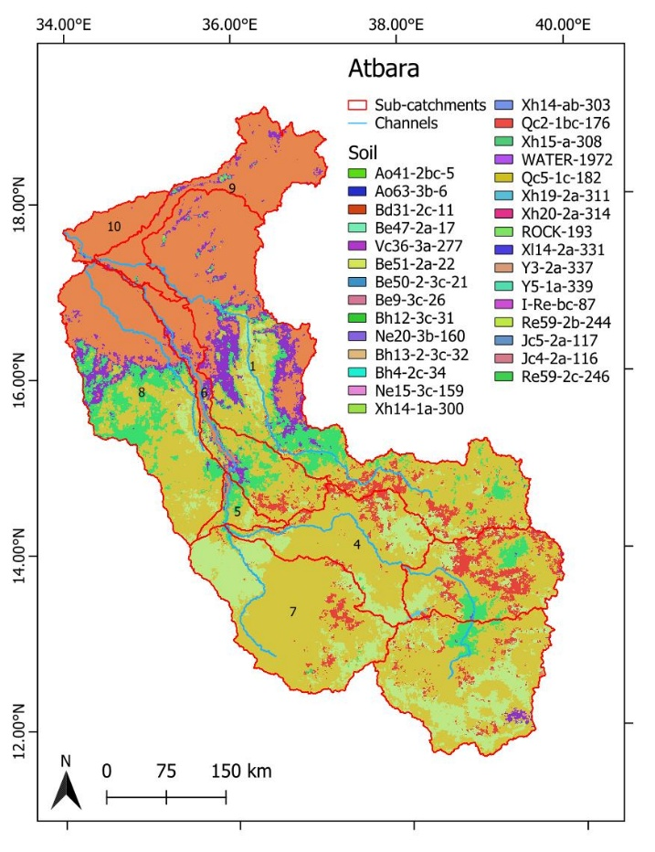
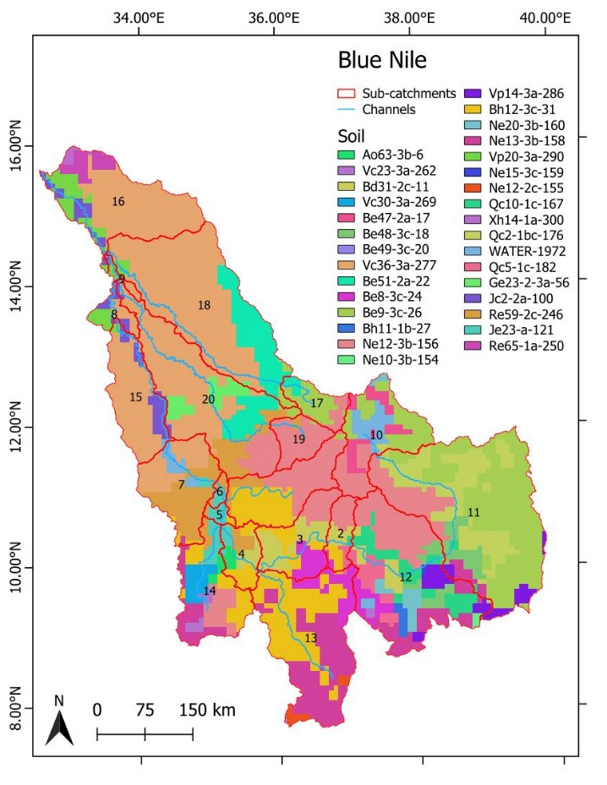
WP3 – Sediment and erosion transport models development
Data sources and retrieval – SOIL MAP
The FAO-UNESCO Soil Map of the World comprises 106 soil units grouped in twenty-six major soil groupings
https://www.fao.org/soils-portal/data-hub/soil-maps-and-databases/faounesco-soil-map-of-the-world/en/

Slide 11
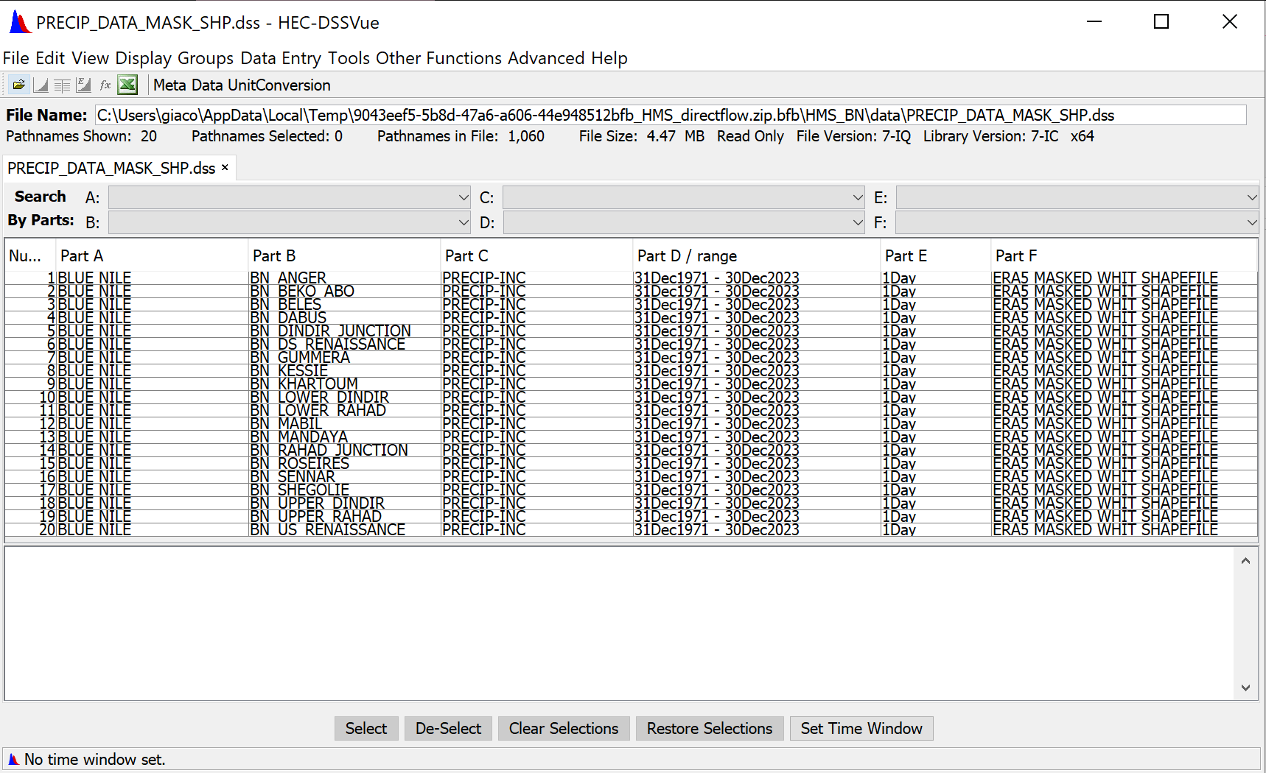
WP3 – Sediment and erosion transport models development
Data sources and retrieval – RAINFALL
The rainfall data used in the SWAT model has been the same as the HEC-HMS model.

Slide 12
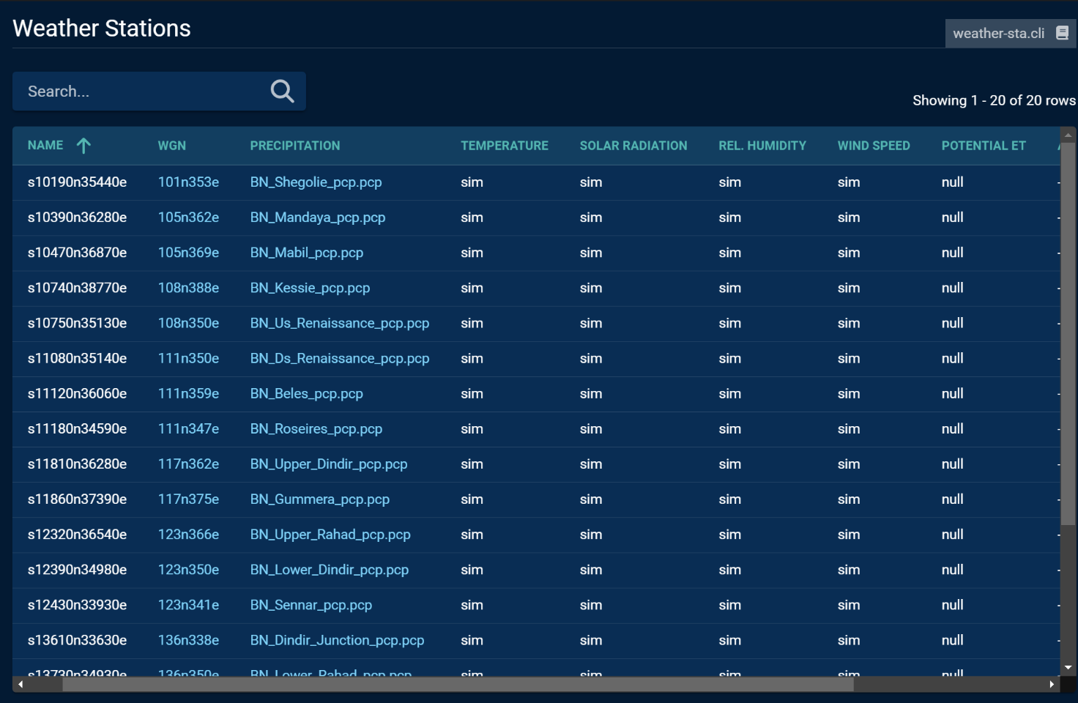
WP3 – Sediment and erosion transport models development
Data sources and retrieval – Other Climate Data
Other parameters are considered for the calculations in the SWAT model:
Temperature
Solar radiation
Relative humidity
Wind speed
Obtained from a weather generator embedded in the SWAT Editor software, that simulates the values for the sub-catchments of the Nile subbasins

Slide 13
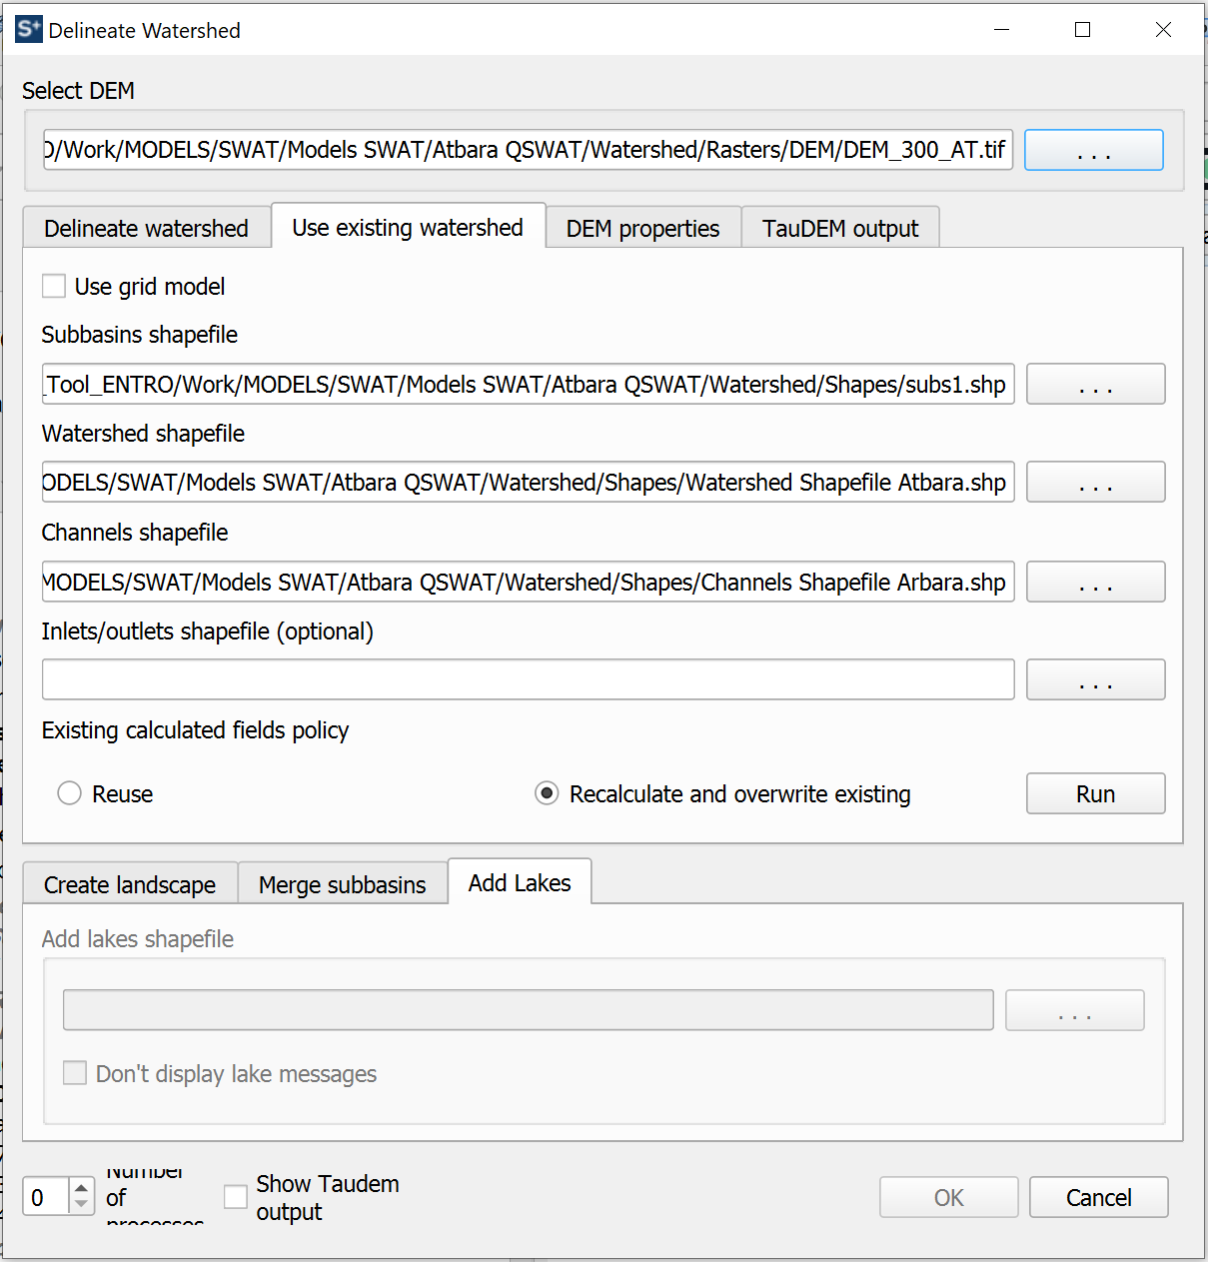
WP3 – Sediment and erosion transport models development
Data sources and retrieval – Subcatchments and rivers
In order to have comparable results, SWAT model uses the same watershed and rivers obtained by HMS in the GIS preprocessing
The process of the use of an existing watershed in SWAT

Slide 14
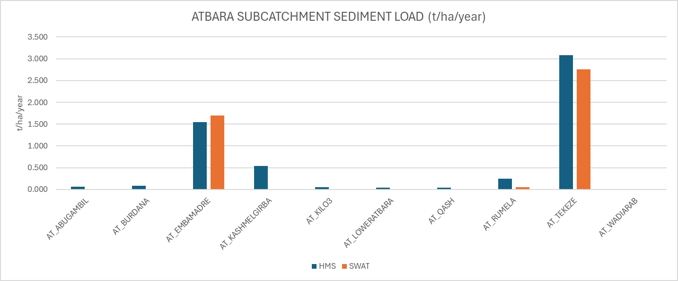
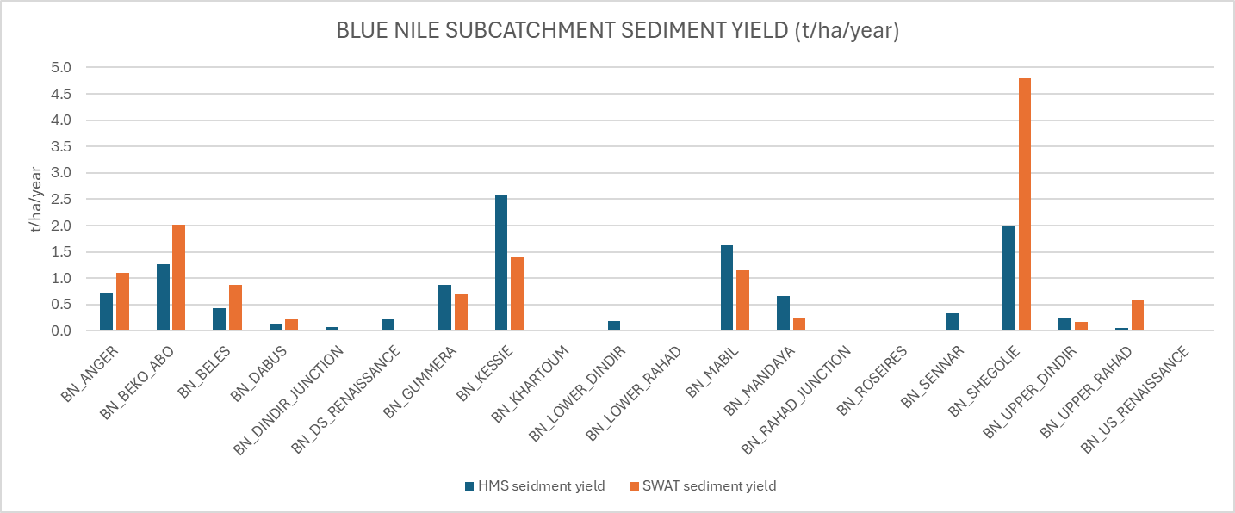
WP3 – Sediment and erosion transport models development
Simulation 0 – current conditions
Subcatchment erosion

Slide 15
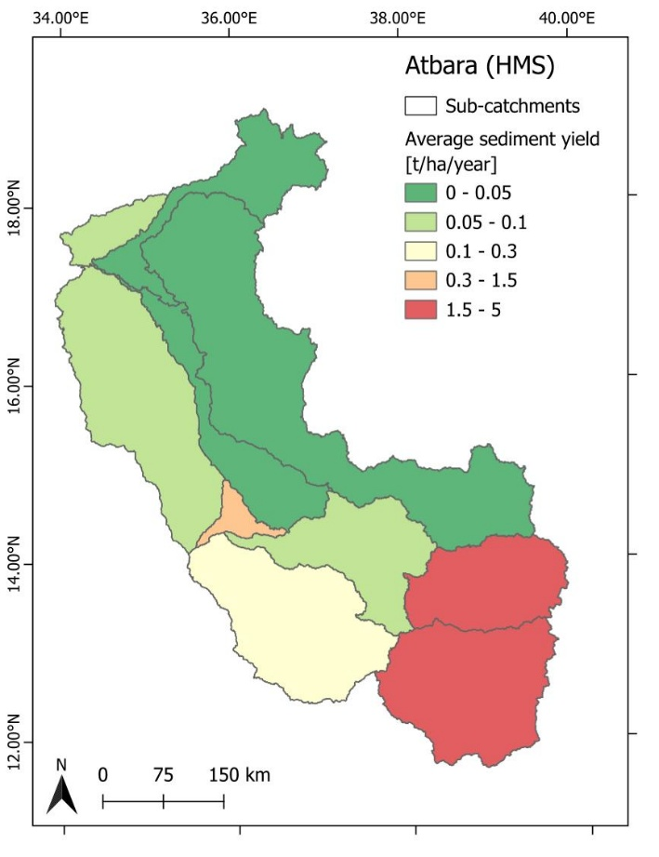
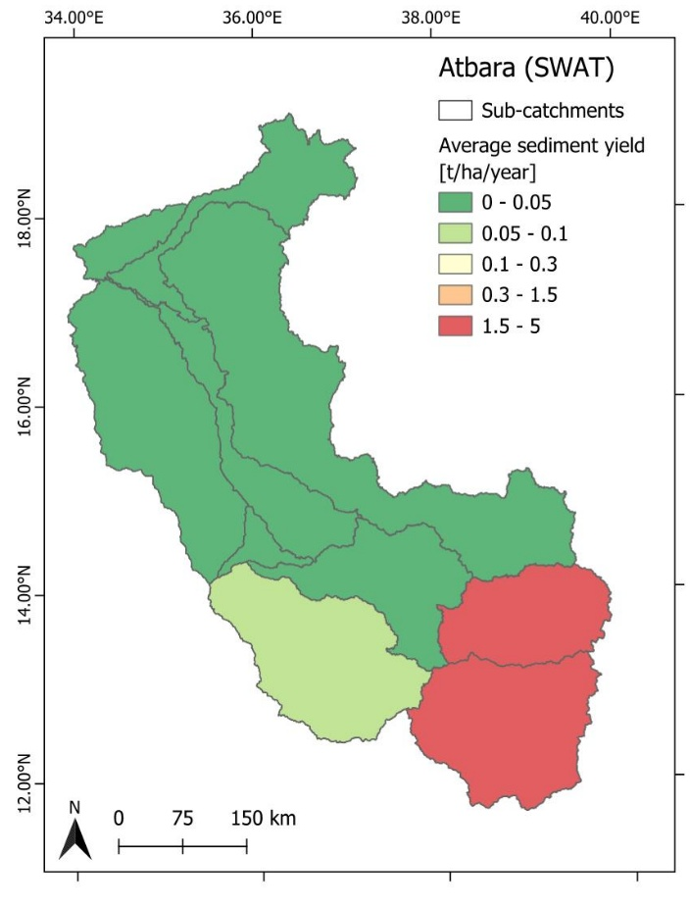
WP3 – Sediment and erosion transport models development
Simulation 0 – current conditions
Subcatchment erosion in the Atbara subbasin

Slide 16
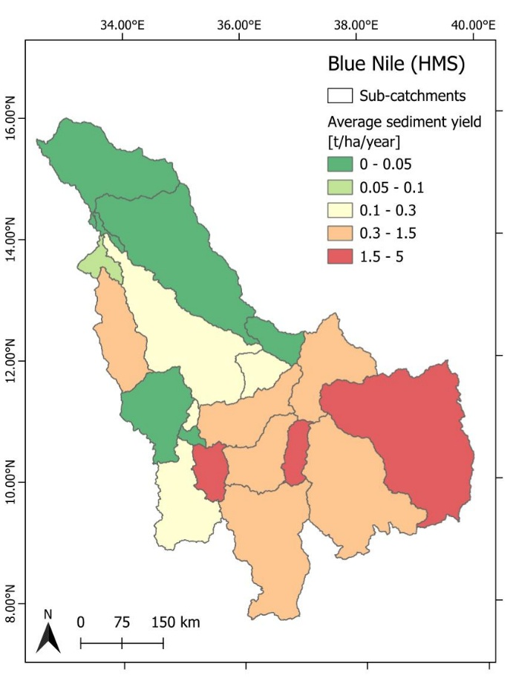
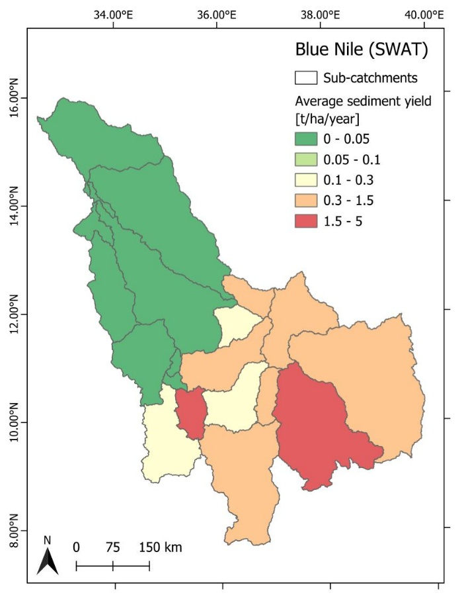
WP3 – Sediment and erosion transport models development
Simulation 0 – current conditions
Subcatchment erosion in the Blue Nile subbasin

Slide 17
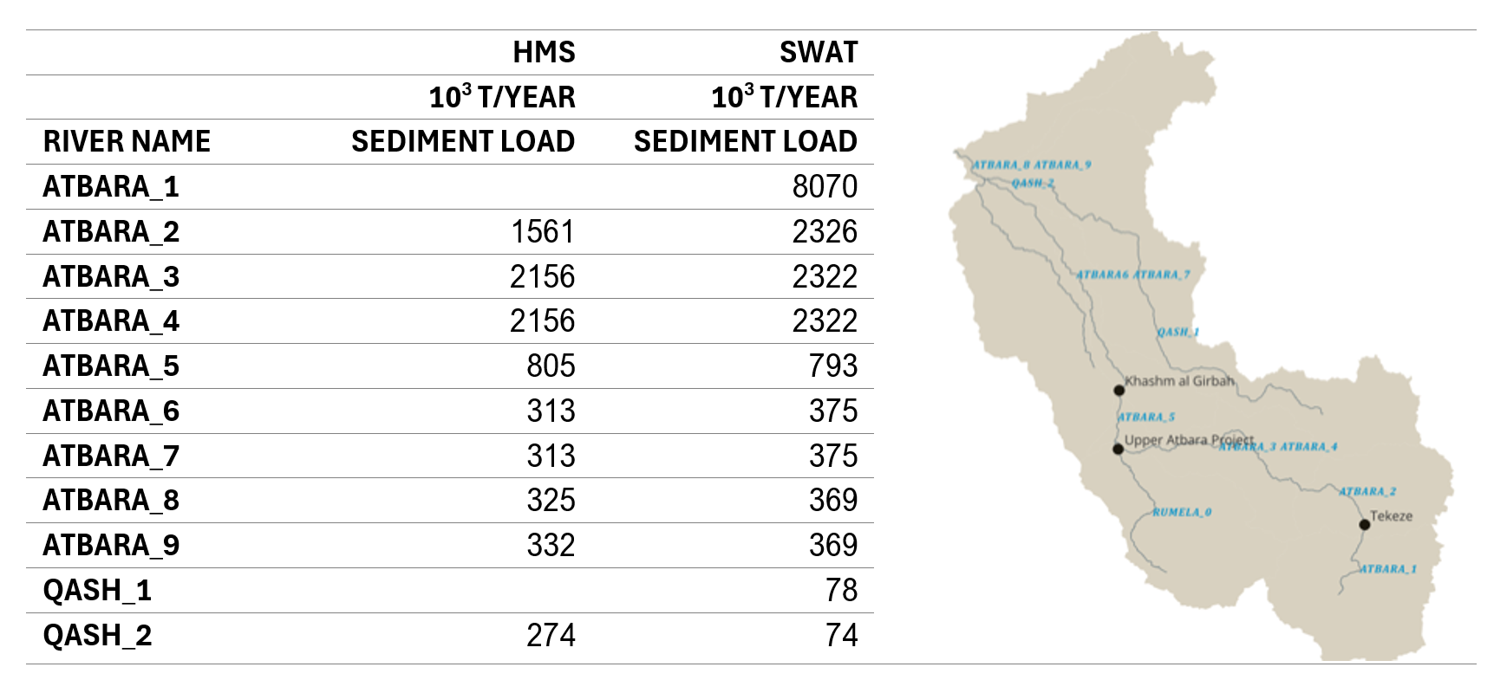
WP3 – Sediment and erosion transport models development
Simulation 0 – current conditions
River transport. Considered the amount of erosion in the subcatchemnt, the sediment trap into the reservoirs and the routing method chosen, the results in the Atbara rivers are:

Slide 18
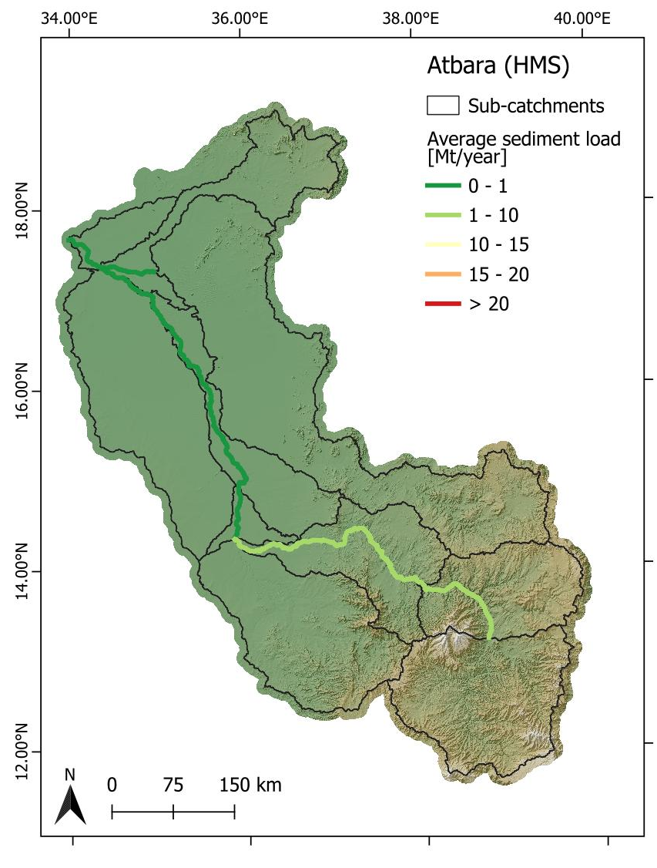

WP3 – Sediment and erosion transport models development
Simulation 0 – current conditions
River transport. Considered the amount of erosion in the subcatchemnt, the sediment trap into the reservoirs and the routing method chosen, the results in the Atbara rivers are:

Slide 19
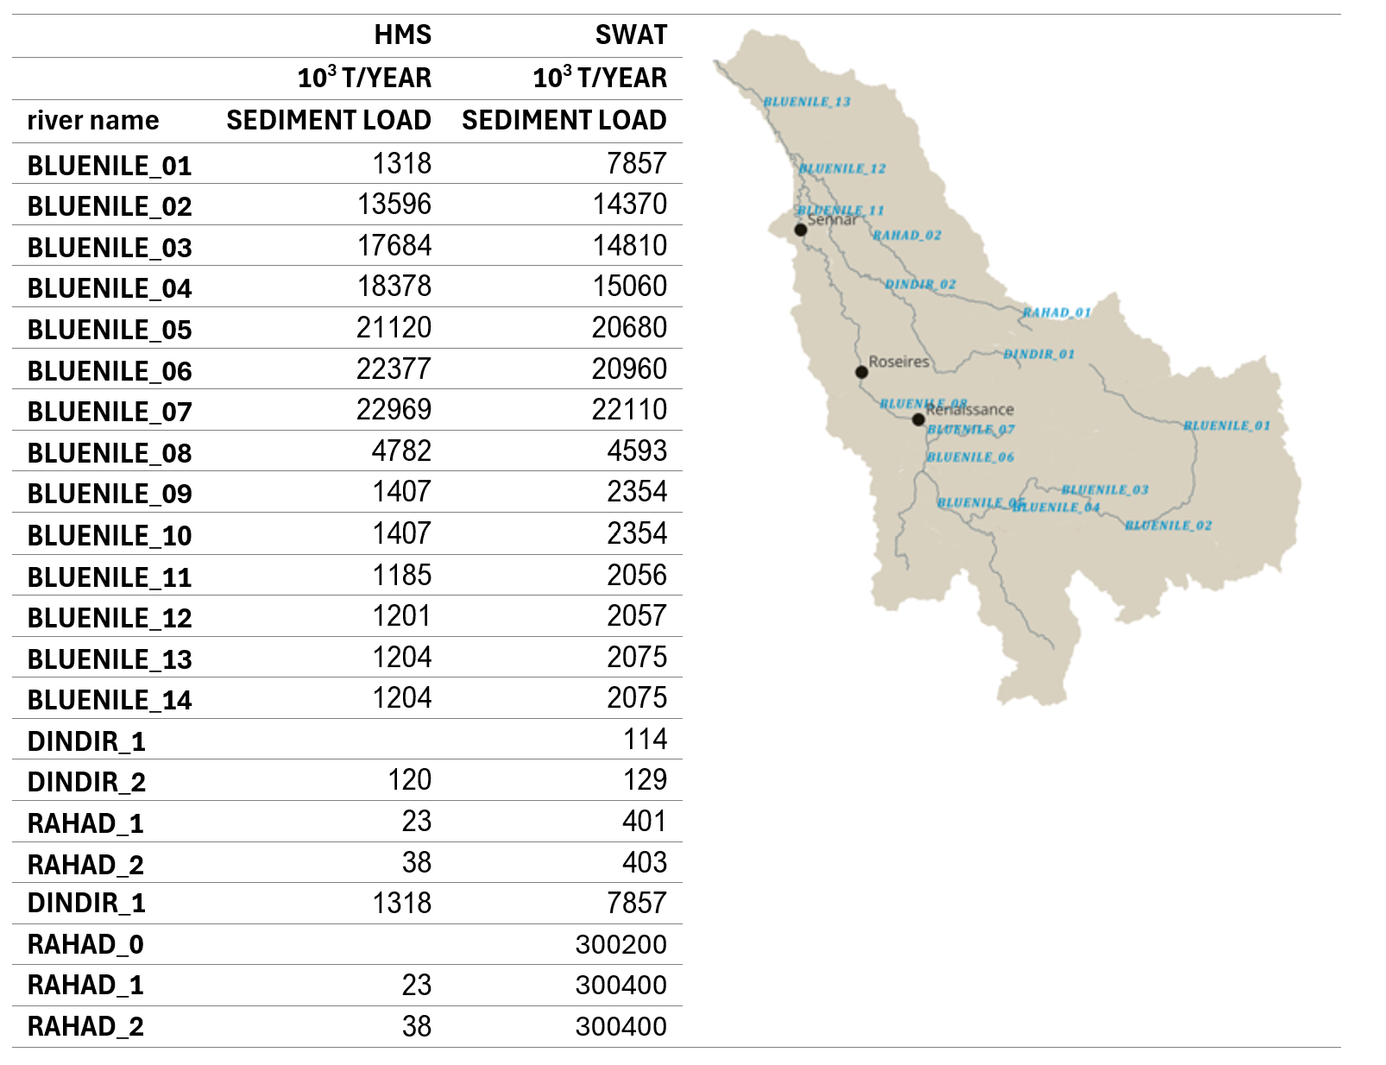
WP3 – Sediment and erosion transport models development
Simulation 0 – current conditions

Slide 20
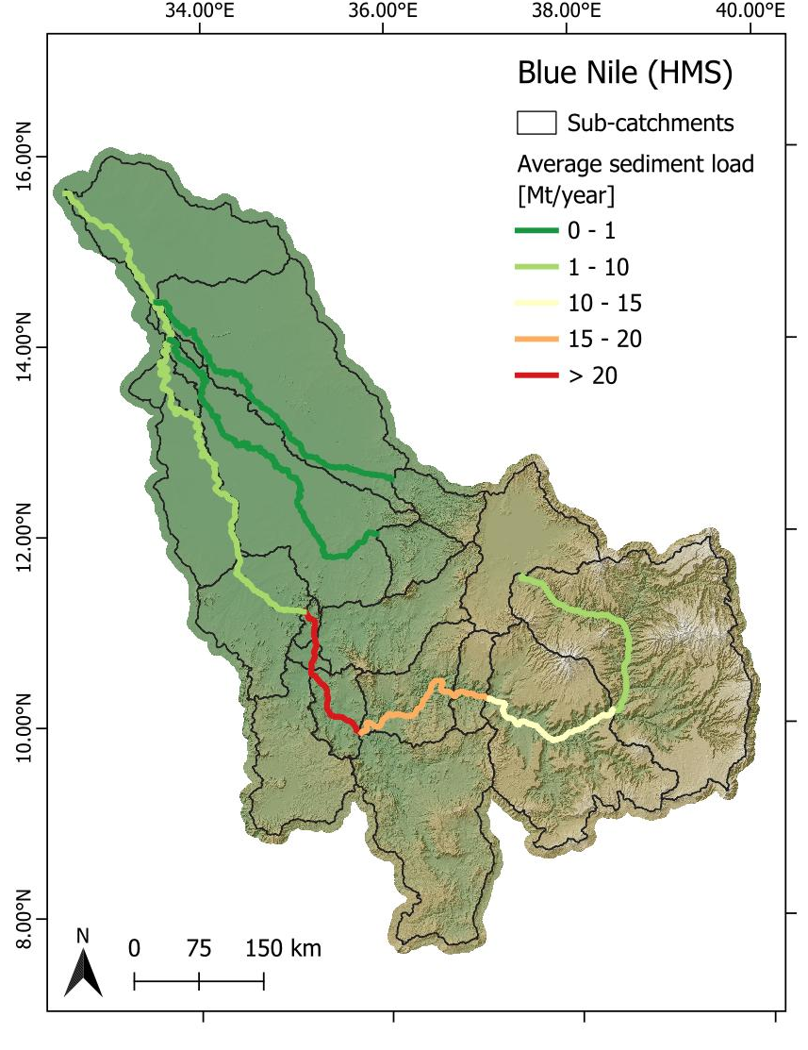

WP3 – Sediment and erosion transport models development
Simulation 0 – current conditions

Slide 21
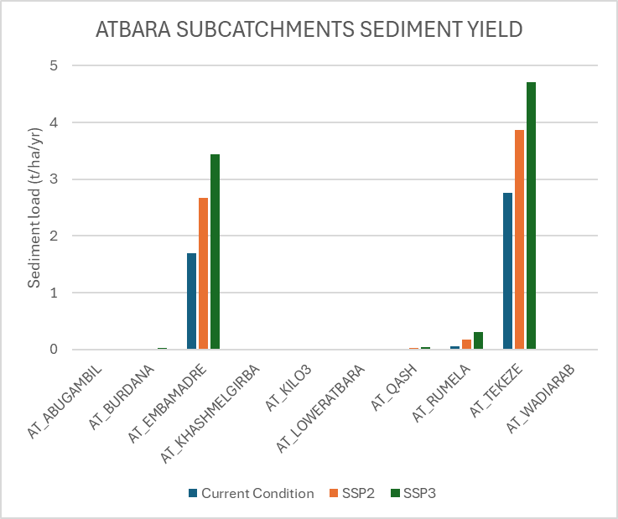
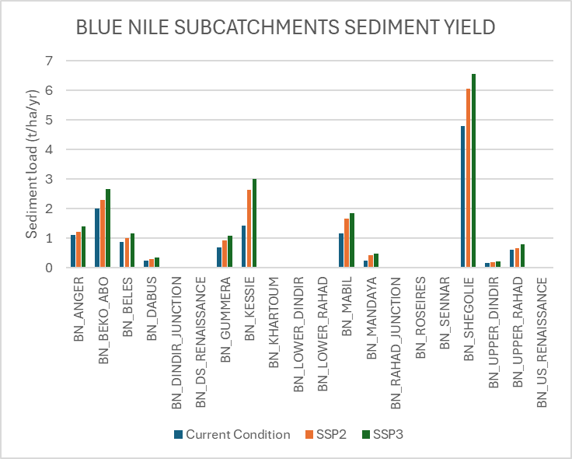
WP3 – Sediment and erosion transport models development
Simulation 1 and 2 – future conditions

Slide 22
WP3 – Sediment and erosion transport models development
Simulation 1 and 2 – future conditions

