Slide 1

Eastern Nile Technical Regional Office (ENTRO)
Consultancy service for the Development of the Eastern Nile Water Resources Models and Tools
Nile Cooperation for Climate Resilience
Validation Workshop
12-14 June 2025

Slide 2
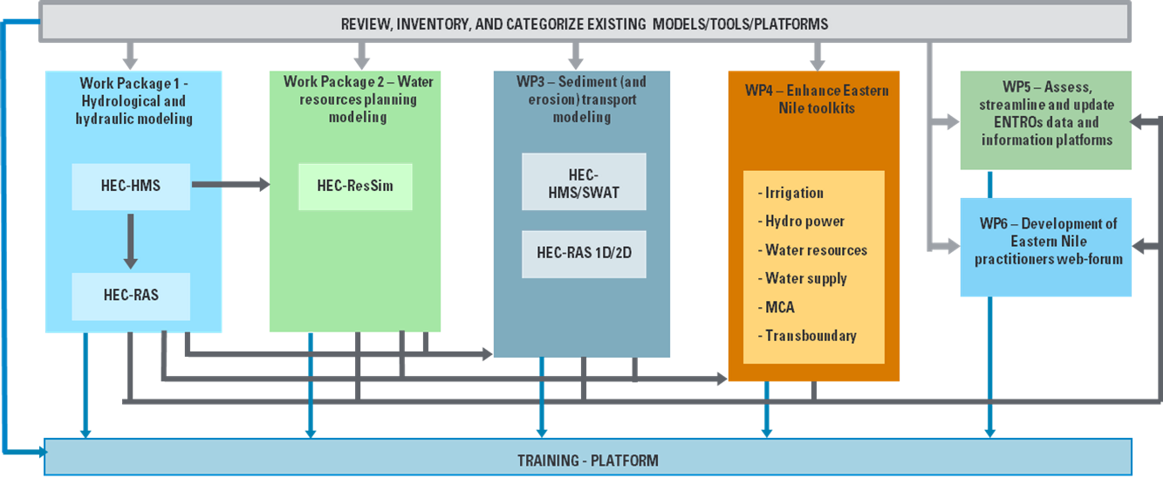

Methodological approach
Schematization of the integrated approach pursued by the Consultant

Slide 3
Workshop Agenda
Time (hrs) | Presentation / Activity | Responsible Person
 | June 14, 2025 - Day 3 | Chair: To be assigned
09:00 –09:10 | Recap of Day 2 | HydroNova/ ENTRO
09:10- 10:00 | Presentation on WP2: Water resources planning model | HydroNova (Consultant)
10:00-11:00 | Interactive session on water resources planning model | All
11:00 – 11:30 | Health Break | Hotel
11:30-12:00 | Presentation on WP3: Sediment and erosion transport model (HEC-HMS) | HydroNova (Consultant)
12:00-13:00 | Interactive session on Sediment and erosion transport model (HEC-HMS) | All
13.00 – 14:00 | Lunch Break | Hotel
14:00 – 15:00 | Presentation on WP3: Sediment and erosion transport model (SWAT) | HydroNova (Consultant)
15:00-16:00 | Interactive session on Sediment and erosion transport model (SWAT) | All
16:00-16:30 | Health Break | Hotel
16:30- 17:00 | Feedback and recommendations on WP3 | All
17:00-17:30 | Closing remarks and a way forward | ENTRO/ENSAPT

Slide 4
Specific Topics
DAY 3. WP3 – HEC HMS SEDIMENT
Introduction
Data Sources and retrieval | Available sediment data Soil Database DTM Land cover Scenarios
Calibration | Method Results
Simulation | Scenario 0 Scenario 1 and 2

Slide 5
WP3 – Sediment and erosion transport models development
HMS models development
Introduction
Watershed erosion and sediment routing
(HEC-HMS)
Watershed erosion and sediment routing
(HEC-HMS/SWAT)
Reservoir sediment trap
(EXCEL)
Reservoir sediment trap
(EXCEL)
GIS sediment/erosion mapping
QGIS

Slide 6
WP3 – Sediment and erosion transport models development
HMS models development
Introduction
In series to the hydrological model, the sediment/erosion model has been added.
INPUT
MODEL
OUTPUT
Boundary Conditions:
Rain
ET
DEM
HEC-HMS
Surface sediment load
Initial Conditions:
Canopy
Surface
Loss
Baseflow
Transform
Routing
Erosion on subcatchments
Tranport on reaches
COMPARISON
Observed
Sediment Load
CALIBRATION

Slide 7
WP3 – Sediment and erosion transport models development
Data sources and retrieval
Available sediment data
The available information on sediment dynamics within the project basins is fragmented and characterized by low reliability and consistency.
Only for the Blue Nile Sub-basin.
The records are discontinuous: in many cases just a few data is missing, while in others, measurements are limited to a few scattered days per year.
Some datasets lack units of measurement.
Certain sediment load values appear inconsistent when compared to their reported units or the concentration in PPM.
Most data points are concentrated in the summer and autumn months, corresponding to peak river flow conditions. As a result, they cannot be considered representative for calibration over the entire year.

Slide 8
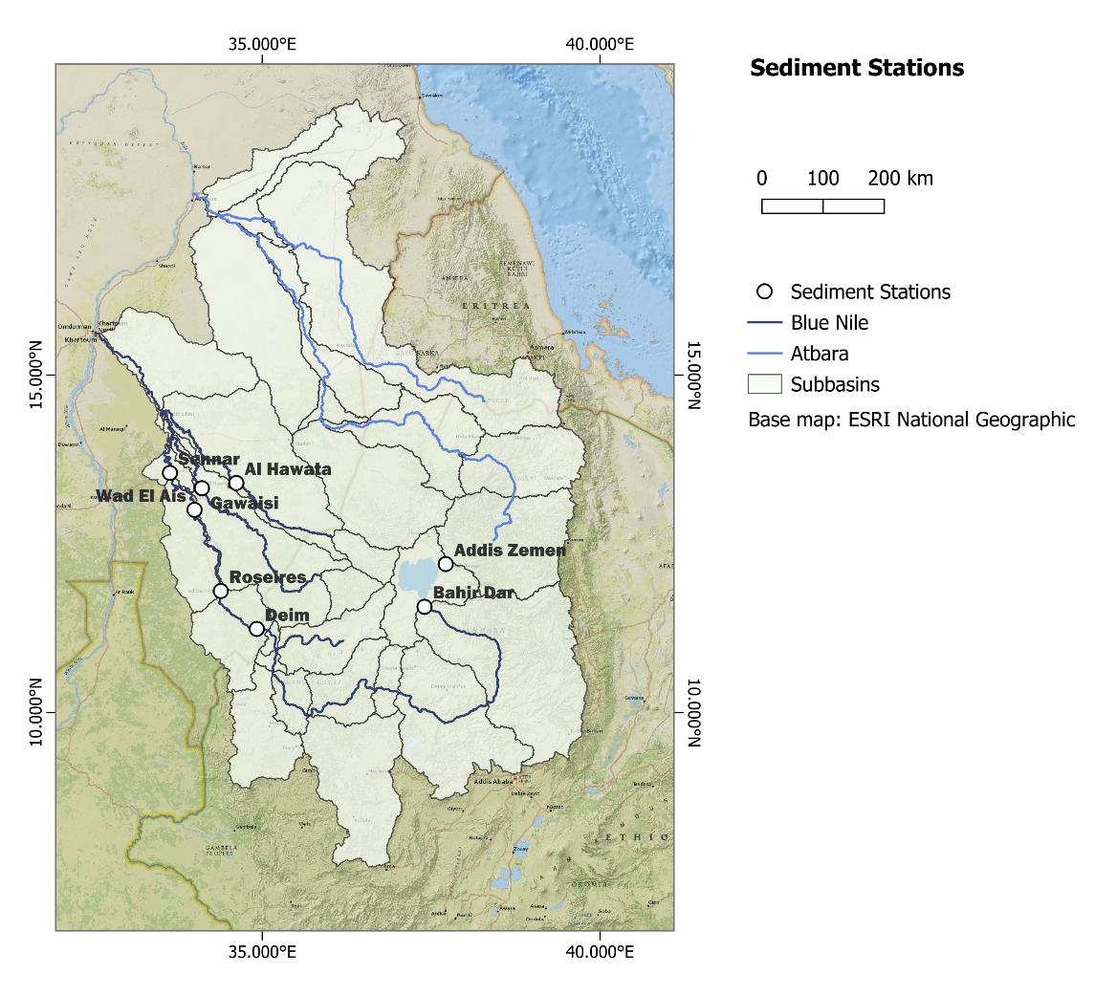
WP3 – Sediment and erosion transport models development
Data sources and retrieval
Available sediment data
Reliable data |  | concentration |  | load
Blue Nile at Bahir dar | scattered data from 1961 to 1996 | 502 | mg/l | 3932 | t/day
Blue Nile at Wad El Ais | 10 oct 2001 - 10 nov 2001 | 434 | ppm | 66.65 | 10^3 t/day
Rahad at Hawata | 21 jul 2001 – 18 oct 2001 | 373 | ppm | 4.244 | 10^3 t/day

Slide 9
WP3 – Sediment and erosion transport models development
Data sources and retrieval
Available sediment data on reservoirs
Roseires dam was constructed in 1966 and had an initial trap efficiency estimated at 79%, dramatically reduced over the year
Assuming a correct gate sluice operation, the Sennar dam (1925) trap efficiency can be estimated as about 25%.
In general, trap efficiency is highly dependent on
operational decisions, which can significantly influence sediment retention and transport dynamics, in addition to
the capacity/inflow ratio: higher ration correspond to higher retention.

Slide 10
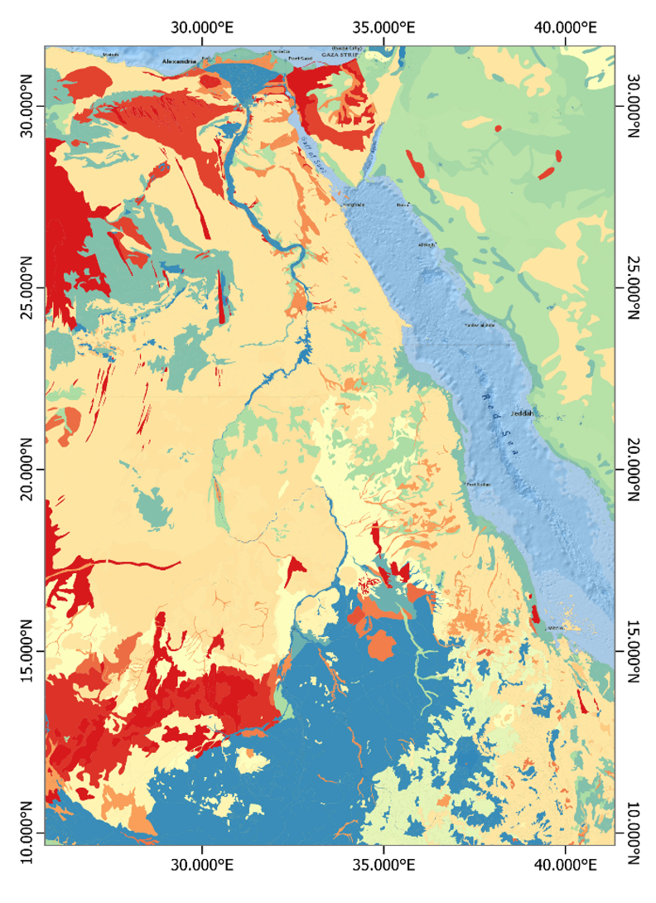
WP3 – Sediment and erosion transport models development
Data sources and retrieval
Soil database
Harmonized World Soil Database by ISRIC.
The HWSD2 has been used as a source for most of the parameters in the sedimentation analysis in HMS
https://data.isric.org/geonetwork/srv/ita/catalog.search#/metadata/54aebf11-ec73-4ff8-bf6c-ecff4b0725ea

Slide 11
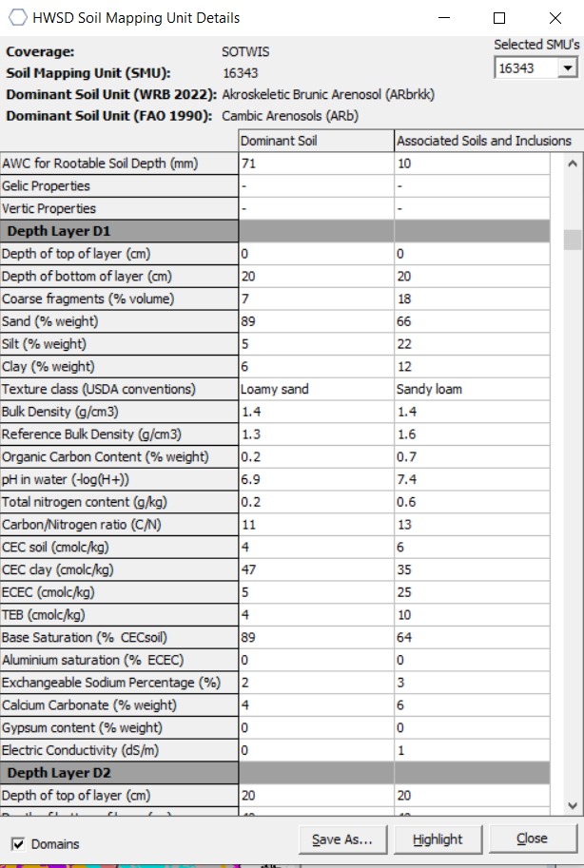
WP3 – Sediment and erosion transport models development
Data sources and retrieval
Soil database
Harmonized World Soil Database by ISRIC.
Soil is divided into units.
Characteristics needed:
Sand, silt, clay percentage
Bulk density
Organic carbon content

Slide 12
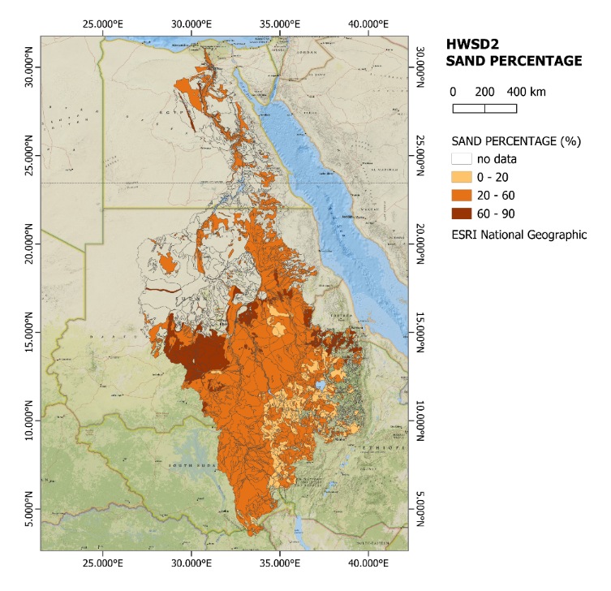
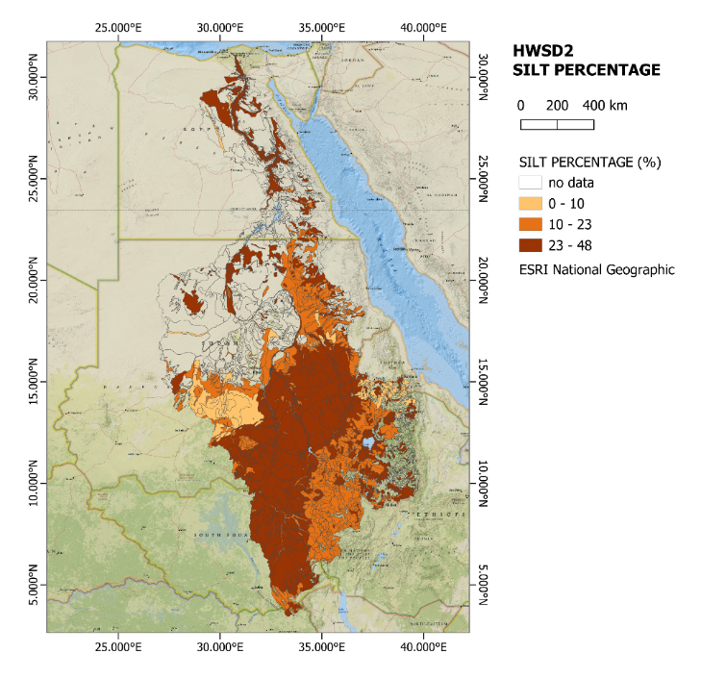
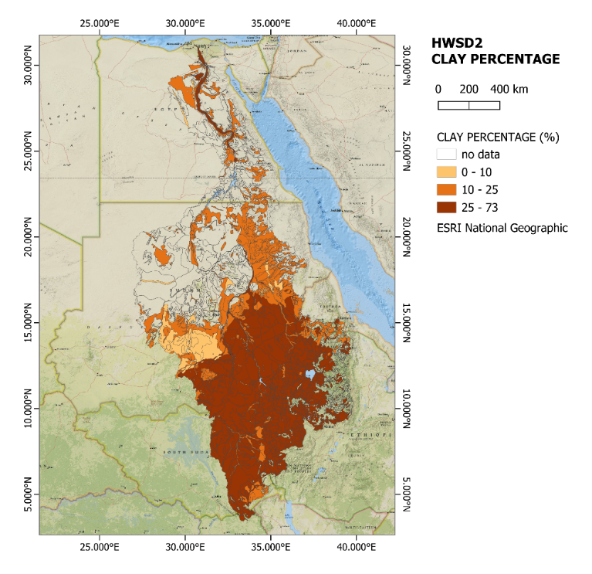
WP3 – Sediment and erosion transport models development
Data sources and retrieval
Soil database – sand, silt, clay percentage

Slide 13
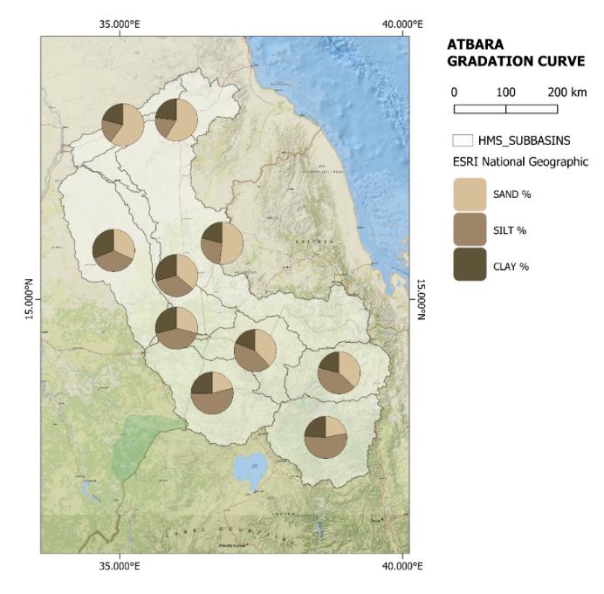
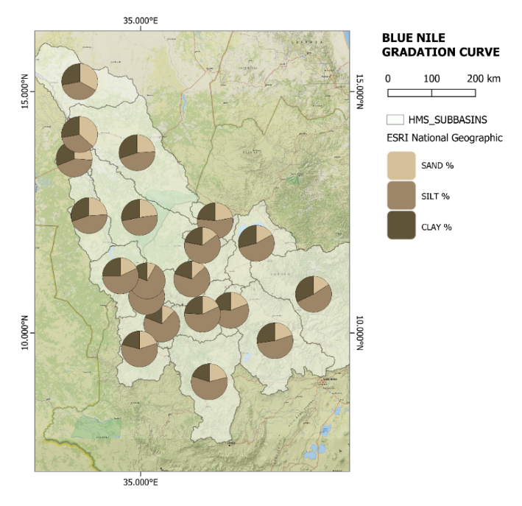
WP3 – Sediment and erosion transport models development
Data sources and retrieval
Soil database – sand, silt, clay percentage

Slide 14
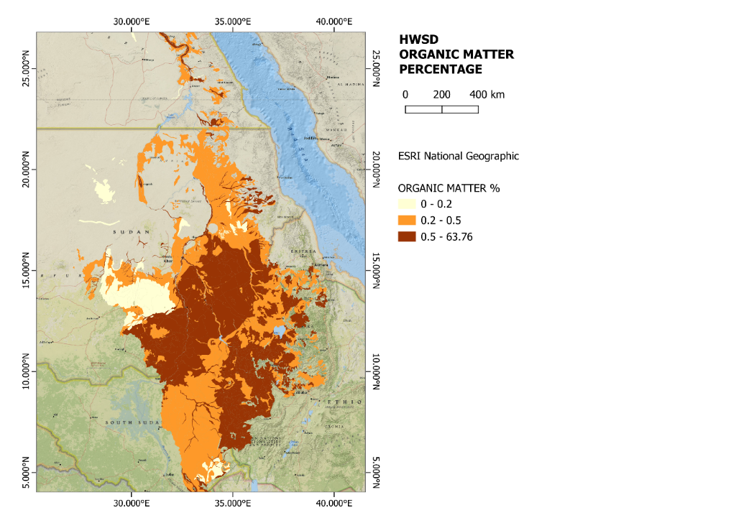
WP3 – Sediment and erosion transport models development
Data sources and retrieval
Soil database – organic content and organic matter
Percentage of organic matter, calculated as OM=OC⋅1.724, where OC is the organic carbon (% weight) available in the HWSD2

Slide 15
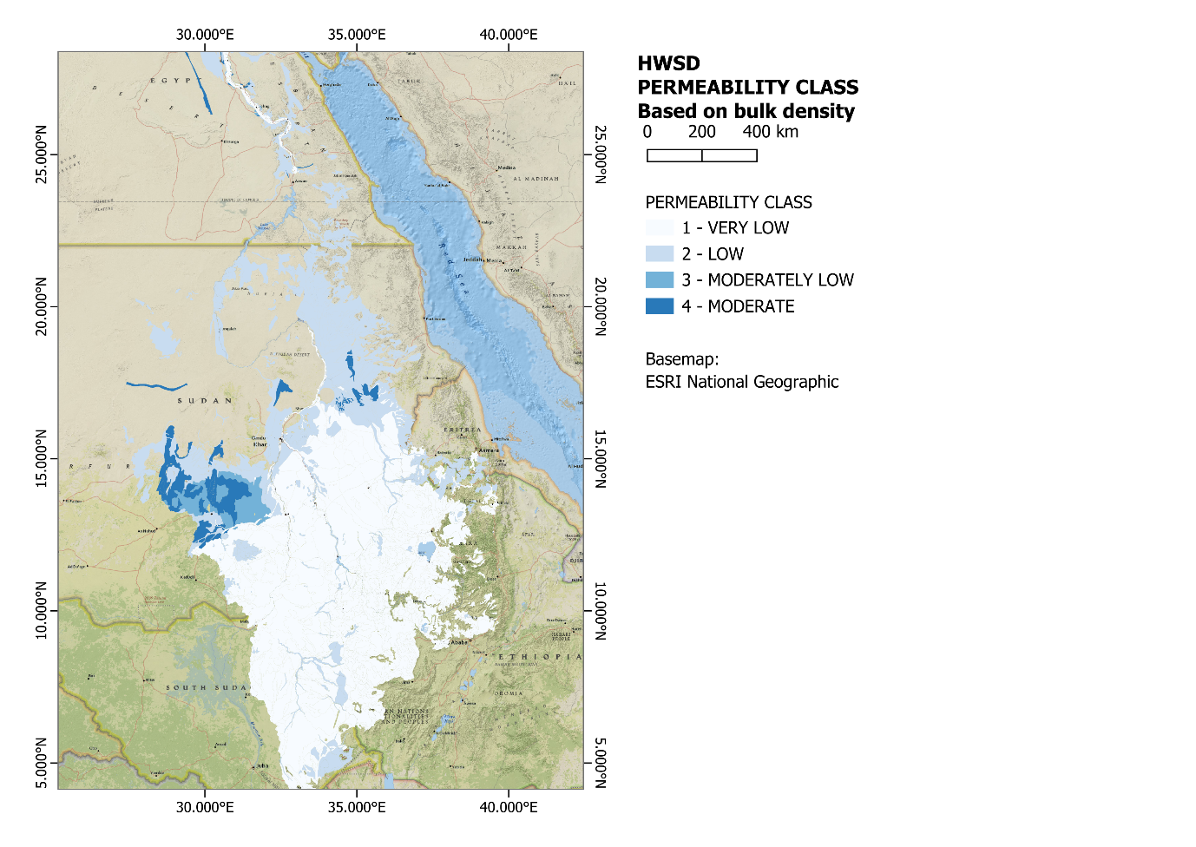

WP3 – Sediment and erosion transport models development
Data sources and retrieval
Soil database – bulk density and permeability class
$$bulk density= \frac{dry mass}{total vlolume (solid+voids)}$$
Bulk Density (g/cm³) | Permeability Class | Description
<1.0 | 6 | Very High
1.0−1.2 | 5 | High
1.2−1.4 | 4 | Moderate
1.4−1.6 | 3 | Moderately Low
1.6−1.8 | 2 | Low
>1.8 | 1 | Very Low

Slide 16
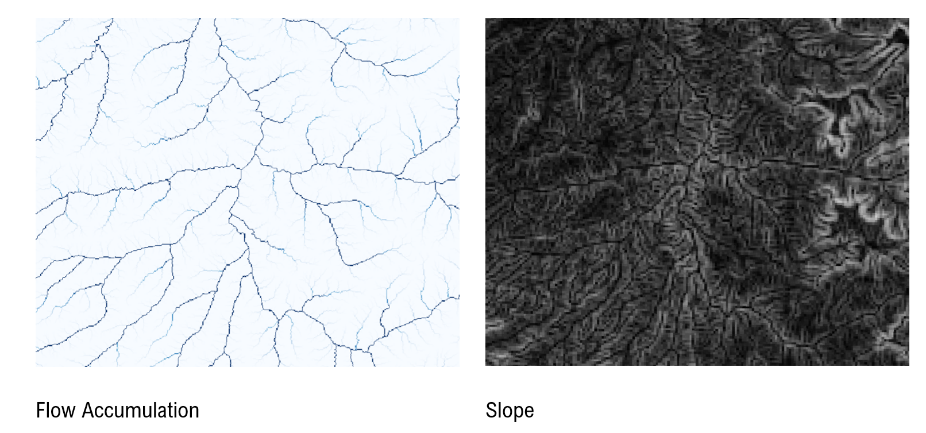
WP3 – Sediment and erosion transport models development
Data sources and retrieval
DTM – FLOW ACCUMULATION AND SLOPE
long slopes have more erosion than short slopes
steep slopes have more erosion than flat slopes

Slide 17
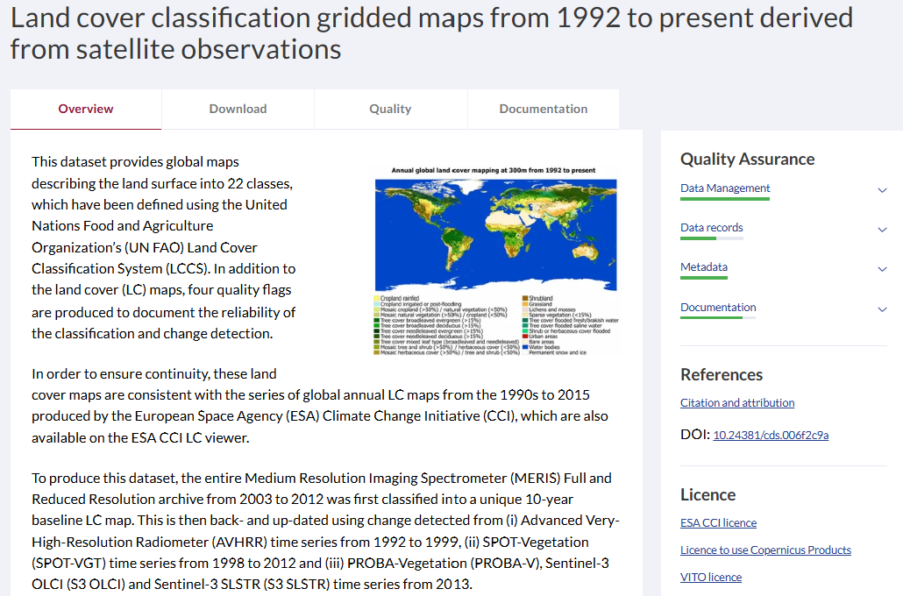
WP3 – Sediment and erosion transport models development
Data sources and retrieval
LAND COVER
This dataset provides global maps describing the land surface into 22 classes, which have been defined using the United Nations Food and Agriculture Organization’s (UN FAO) Land Cover Classification System (LCCS)
Land cover classification gridded maps from 1992 to present derived from satellite observations

Slide 18
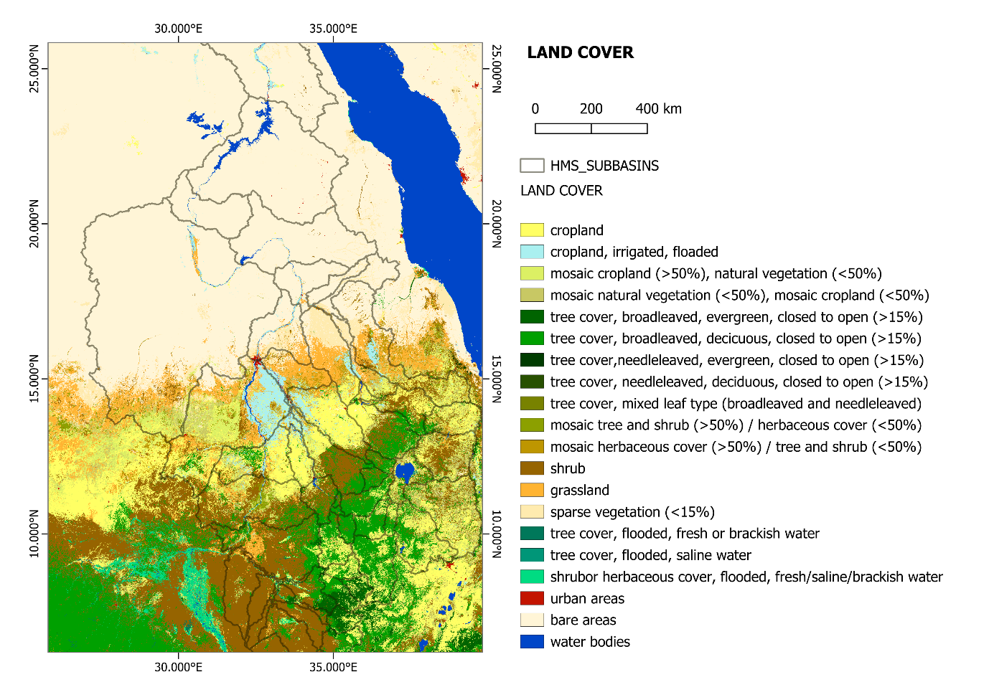
WP3 – Sediment and erosion transport models development
Data sources and retrieval
LAND COVER

Slide 19
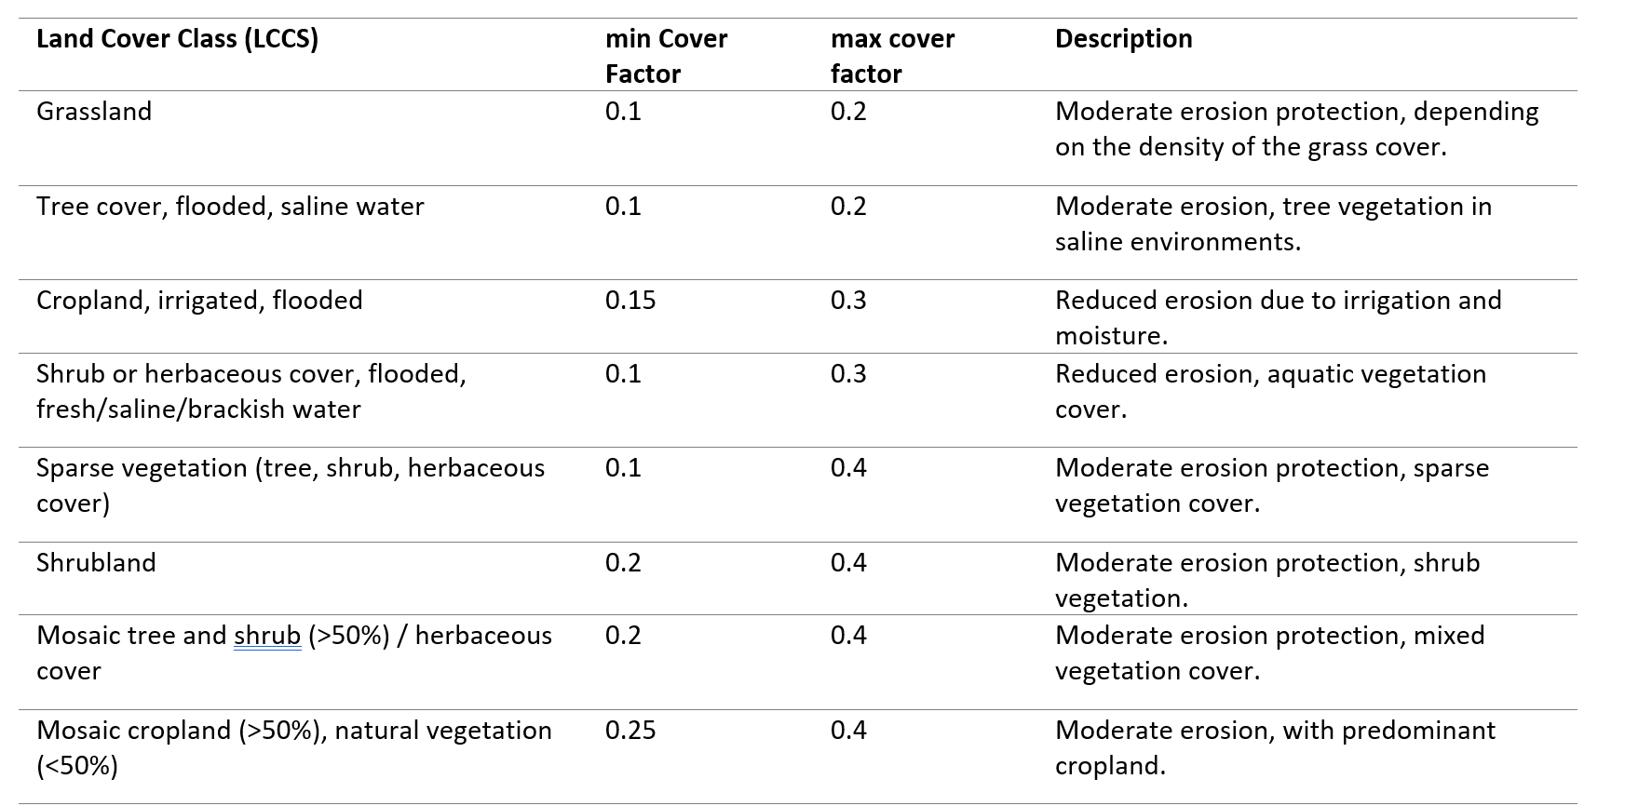
WP3 – Sediment and erosion transport models development
Data sources and retrieval
LAND COVER
The cover factor describes the influence of plant cover on surface erosion. Bare ground is the most susceptible to erosion while a thick vegetation cover significantly reduces erosion. Typical values range from 1.0 for bare ground, to 0.1 for fully mulched or covered soils, to as small as 0.0001 for forest soils with a well-developed soil under a dense tree canopy

Slide 20
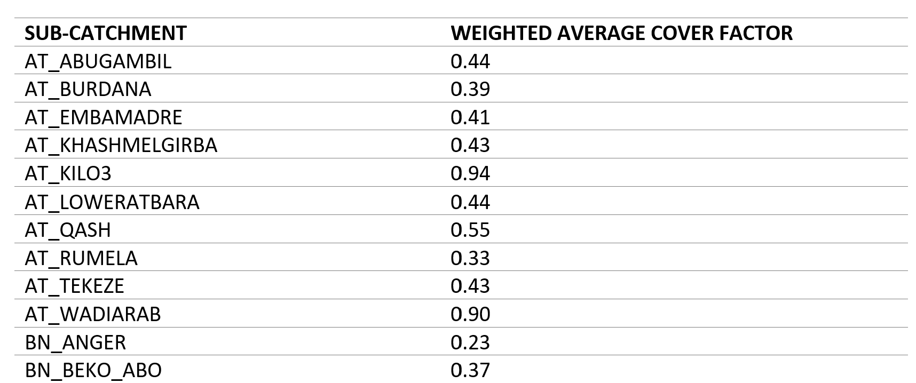
WP3 – Sediment and erosion transport models development
Data sources and retrieval
LAND COVER
A weighted average is calculated based on the area of the cover factor associated with the different land cover classes. Thus, a single cover factor is obtained for each sub-catchment
Example of Land cover classification for a subcatchment in the Atbara basin

Slide 21
WP3 – Sediment and erosion transport models development
Data sources and retrieval
Scenarios – Climate Data Storage (Copernicus)
Scenarios involves meteorological conditions and are the same of the hydrological simulations.
Scenario 0 – Current conditions: Rainfall and temperature for evaporation calculation are derived from ERA5 data portal, as agreed in the previous phases of the project, for the time window 1972-2023.
Scenario 1 – 2060 – SSP2-4.5: Rainfall and temperature used in scenario 0 impacted according to seasonal forecast and to subbasin spatial forecast, according to SSP2 scenario.
Scenario 2 – 2060 – SSP3-7: Rainfall and temperature used in scenario 0 impacted according to seasonal forecast and to subbasin spatial forecast, according to SSP3 scenario.

Slide 22
WP3 – Sediment and erosion transport models development
Calibration - method
Sedimentation and erosion
In addition to the hydrological methods already described yesterday, there are also methods related to sedimentation and erosion
Soil erosion
Stream
Erosion
Transport
Sediment
Reservoir
sediment
Erosion on the subcatchments

Slide 23
WP3 – Sediment and erosion transport models development
Calibration - method
Sedimentation and erosion
When water flows over the land surface and through stream channels, it significantly impacts the landscape through various processes:
Soil erosion: Shallow surface flow erodes soil, transporting sediment overland to headwater streams.
Streambed erosion: In steep headwater streams, high flow velocities lead to the erosion of the streambed.
Sediment transport: Eroded soil and bed material are carried downstream by the flow, moving sediment to lower reaches of the watershed.
Streambed deposition: As flow velocity decreases in the lower reaches, sediment is deposited. Reservoirs within the watershed can trap some or most of the incoming sediment

Slide 24
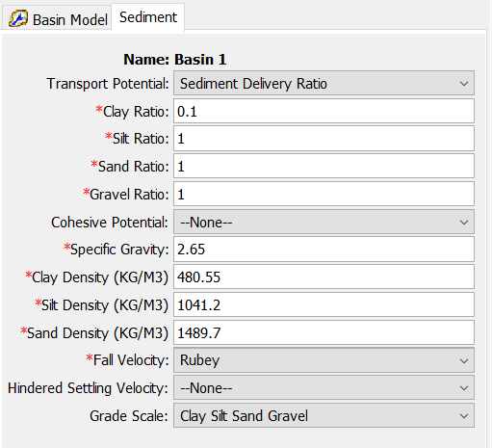
WP3 – Sediment and erosion transport models development
Calibration - method
Sedimentation and erosion – Global properties
Properties that apply globally to all elements in the basin model
The Sediment Transport Potential Functions define the method used to calculate the sediment-carrying capacity of streamflow for non-cohesive sediments.
Sediment Delivery Ratio (SDR) Transport Potential method:
SDR = equilibrium
SDR < 1 sediment retention
SDR > 1 erosion
Clay remains in suspension, while silt, sand and gravel are in equilibrium
Default parameters

Slide 25
WP3 – Sediment and erosion transport models development
Calibration - method
Sedimentation and erosion – sub-catchment erosion
Modified USLE approach
Rain drops cause erosion when they impact the ground surface and break apart the top layer of the soil,
dislodging soil particles to move with the overland flow.
Overland flow also imparts an erosive energy to the ground surface that may further break apart the top soil layer.
As the overland flow rate increases, the flow becomes concentrated in rills which focuses erosive energy and further erodes the surface.
Total erosion is closely linked to precipitation rate, land surface slope, and condition of the surface. In some cases, soil eroded high in the catchment may deposit before reaching the outlet of the subbasin

Slide 26
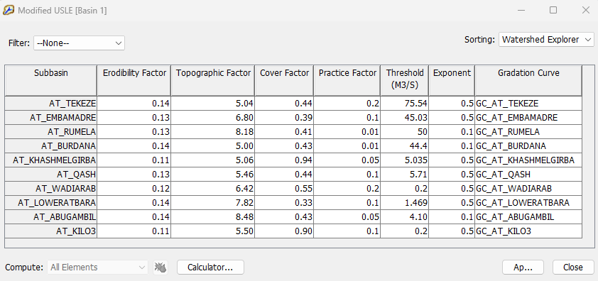

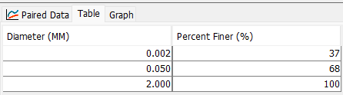
WP3 – Sediment and erosion transport models development
Calibration - method
Sedimentation and erosion – sub-catchment erosion
Modified USLE approach
The sediment Yield is calculated based on some parameters:
Erodibility factor → Soil database
Gradation curve → Soil database

Slide 27

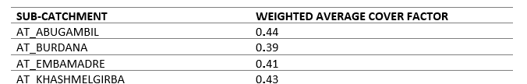
WP3 – Sediment and erosion transport models development
Calibration - method
Sedimentation and erosion – sub-catchment erosion
Modified USLE approach
The sediment Yield is calculated based on some parameters:
LS = topographic factor → DTM, adjusted in phase of calibration
C = cover factor → Land cover
P = practice factor → calibrated parameter
Threshold and exponent → calibrated parameter

Slide 28
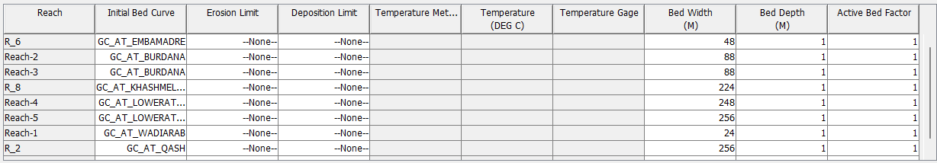
WP3 – Sediment and erosion transport models development
Calibration - method
Sedimentation and erosion – reach transport
Uniform equilibrium method
The Uniform Equilibrium Method simplifies sediment transport calculations by assuming that sediment moves through the reach without delay, making it a straightforward approach within sediment routing modeling.
Parameters:
Gradation curve: it assumed to be the same of the sub-catchments

Slide 29
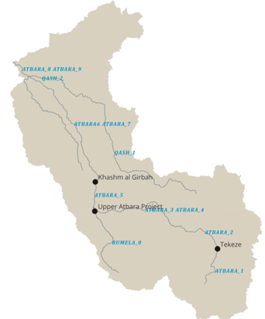
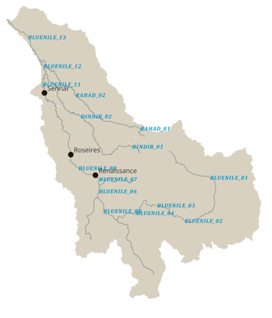
WP3 – Sediment and erosion transport models development
Calibration - method
Sedimentation and erosion – reservoirs sediment trap
Sediment trap
In the reservoirs, where there is minimal horizontal water movement, sediment particles gradually lose their buoyancy and settle to the reservoir's bed. Over time, the cumulative loss of storage space due to sediment accumulation can become substantial.
The river network of the two basins under study for WP3, Blue Nile and Atbara, is impaired by the following reservoirs:
Reinassance, Roseires and Sennar for the Blue Nile;
Tekeze, Upper Atbara Project, Khashm El Girba for Atbara

Slide 30

WP3 – Sediment and erosion transport models development
Calibration - method
Sedimentation and erosion – reservoirs sediment trap
the impact of the reservoirs on sediment load in the reaches was evaluated manually externally from the models developed, to provide an average estimate of the annual sediment load.
In literature sediment traps depends on
C/I = Capacity/Inflow Ratio
Brune approach, best fit with the observed data

Slide 31
WP3 – Sediment and erosion transport models development
Calibration - method
Sedimentation and erosion – reservoirs sediment trap
 | TE - Current condition | TE – SSP2 | TE – SSP3
Reinassance | 79.2% | 79.0% | 78.8%
Roseires | 70.6% | 69.2% | 68.5%
Sennar | 16.4% | 13.5% | 12.1%
Tekeze | 79.3% | 78.9% | 78.5%
Upper Atbara Project | 66.1% | 62.7% | 60.6%
Khashm El Girba | 52.6% | 47.9% | 45.2%

Slide 32
WP3 – Sediment and erosion transport models development
Calibration - results
Available records cannot be used for a proper calibration but their purpose is to provide an order of magnitude useful for comparison for the models results
Blue Nile at Bahir Dar | observed 1961 - 1996 | calculated 1972 – 2023 (simulation period)
Sediment concentration (mg/l) | 502 | 177
Sediment load (t/day) | 3932 | 3584
Average flow (m³/s) | 118 | 234
Blue Nile at Wad El Ais | observed 10 oct 2001 to 10 nov 2001 | calculated 10 oct 2001 to 10 nov 2001
Sediment concentration (mg/l) | 434 | 110
Sediment load (t/day) | 666500 | 18101
Average flow (m³/s) | 1649 | 1900
Rahad at Hawata | observed 21 jul 2001 to 18 oct 2001 | calculated 21 jul 2001 to 18 oct 2001
Sediment concentration (mg/l) | 373 | 47
Sediment load (t/day) | 4244 | 911
Average flow (m³/s) | 145 | 224
attempts were made to achieve the same orders of magnitude in both the SWAT and HMS models

Slide 33
WP3 – Sediment and erosion transport models development
Calibration - results
The models are not able to correctly reproduce sediment load. The causes of these differences may include:
Difficulty in obtaining reliable observed data
Hydraulic structures that alter sedimentation dynamics

Slide 34
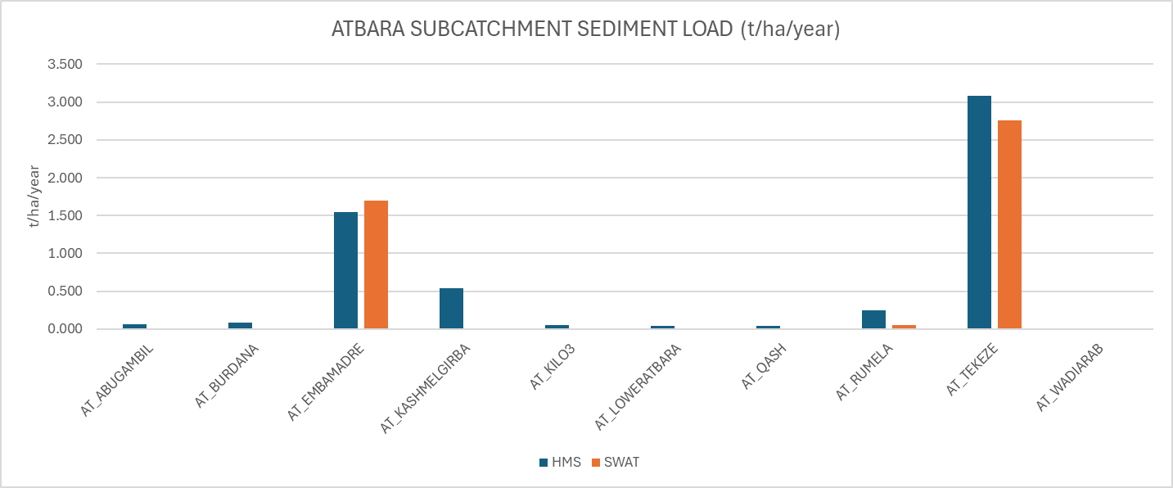
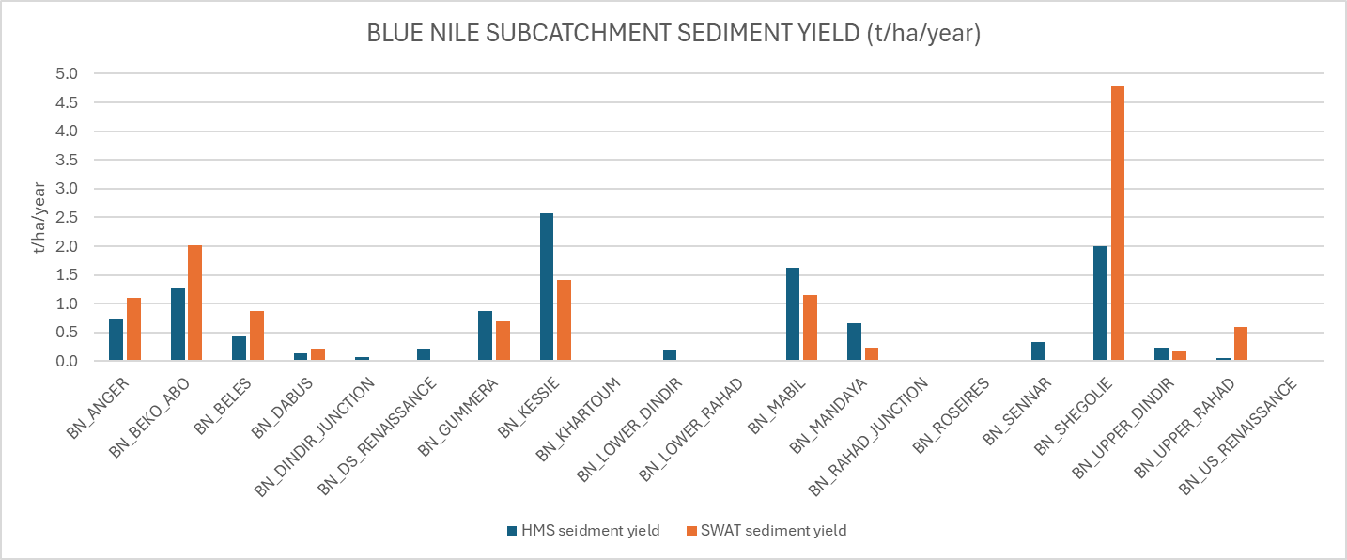
WP3 – Sediment and erosion transport models development
Simulation 0 – current conditions
Subcatchment erosion

Slide 35
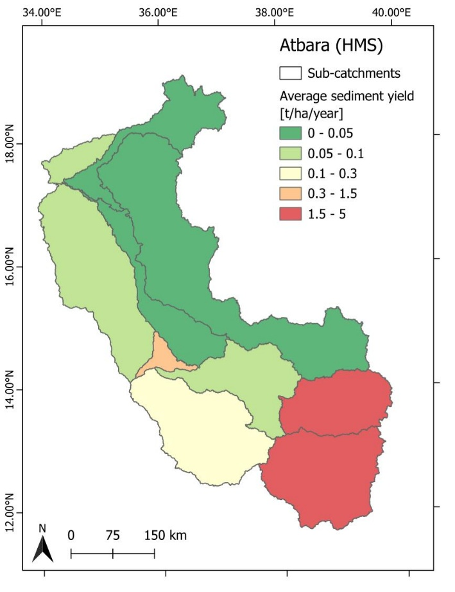
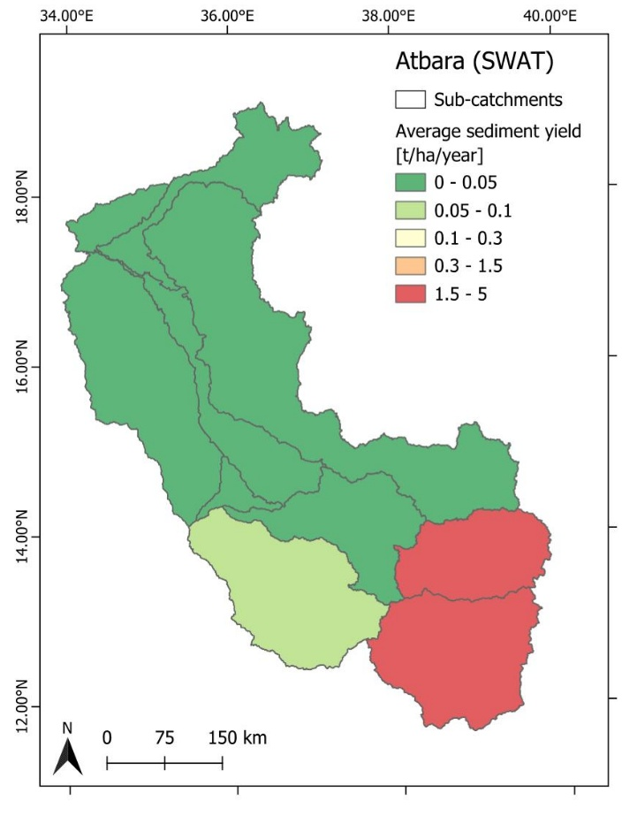
WP3 – Sediment and erosion transport models development
Simulation 0 – current conditions
Subcatchment erosion in the Atbara subbasin

Slide 36
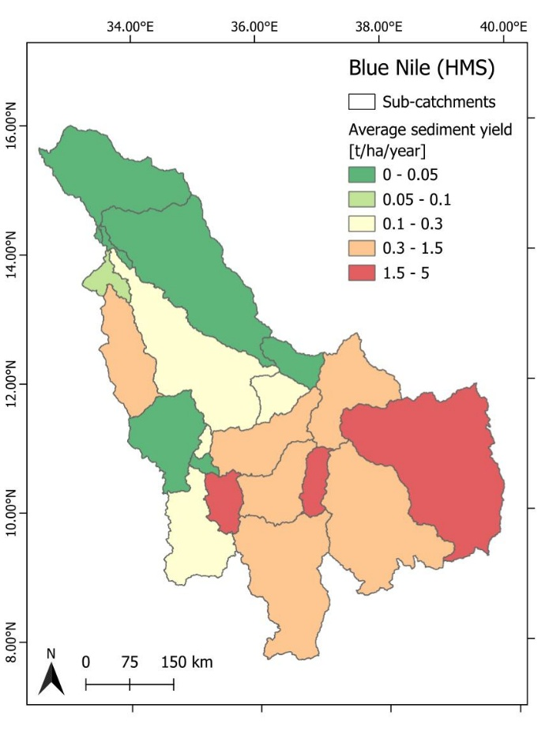
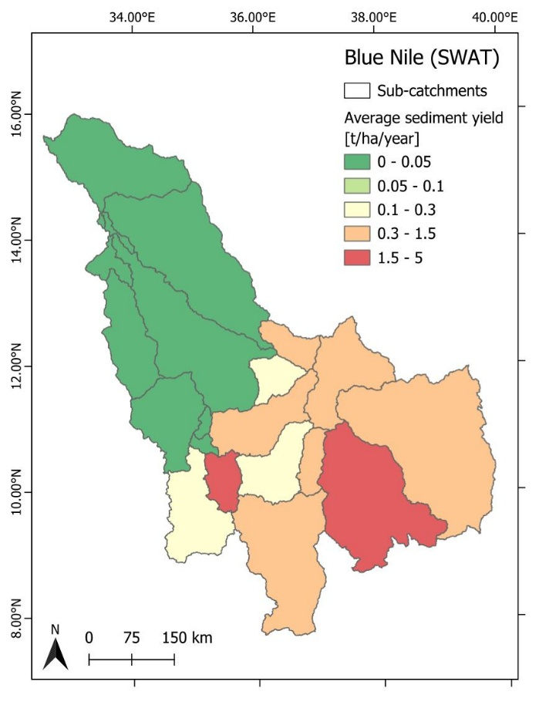
WP3 – Sediment and erosion transport models development
Simulation 0 – current conditions
Subcatchment erosion in the Blue Nile subbasin

Slide 37
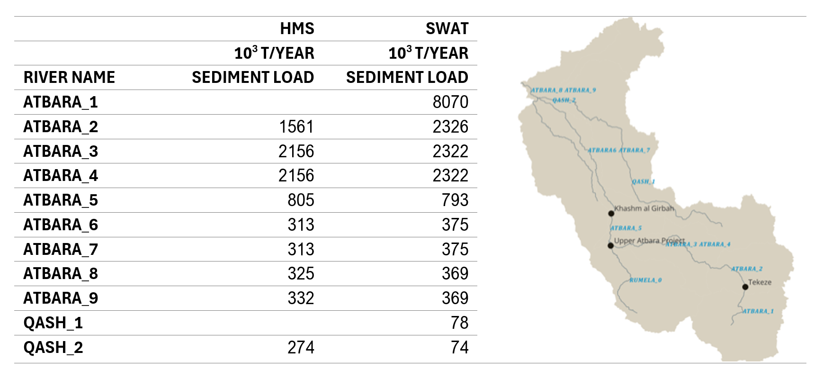
WP3 – Sediment and erosion transport models development
Simulation 0 – current conditions
River transport. Considered the amount of erosion in the subcatchemnt, the sediment trap into the reservoirs and the routing method chosen, the results in the Atbara rivers are:

Slide 38
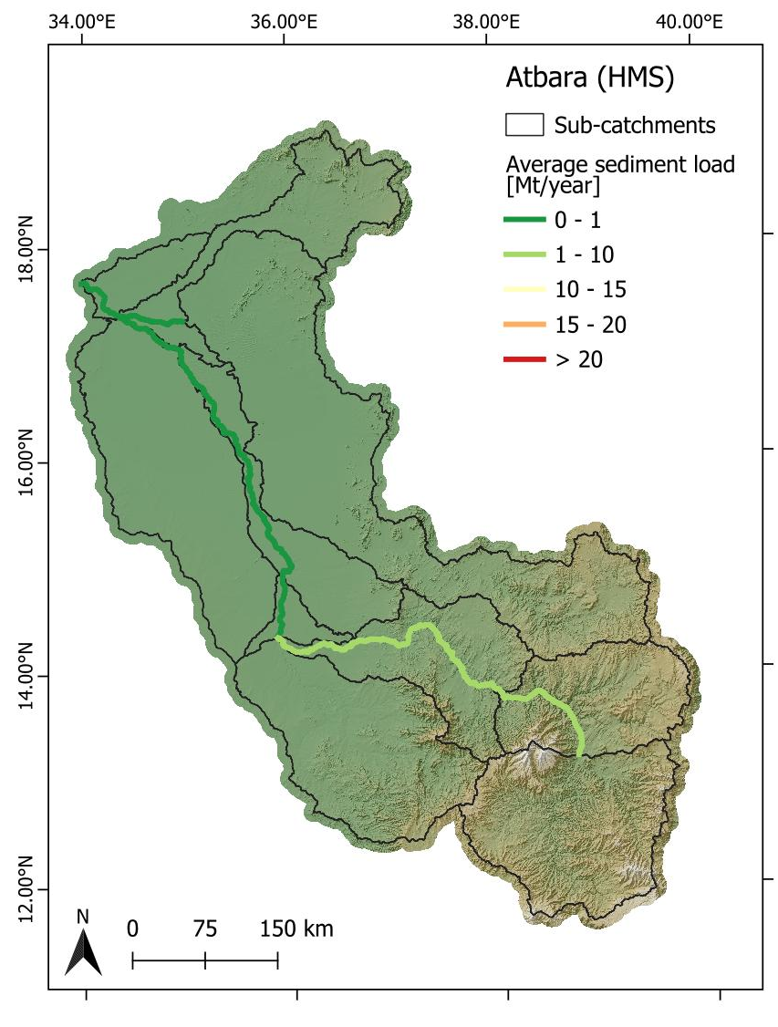

WP3 – Sediment and erosion transport models development
Simulation 0 – current conditions
River transport. Considered the amount of erosion in the subcatchemnt, the sediment trap into the reservoirs and the routing method chosen, the results in the Atbara rivers are:

Slide 39
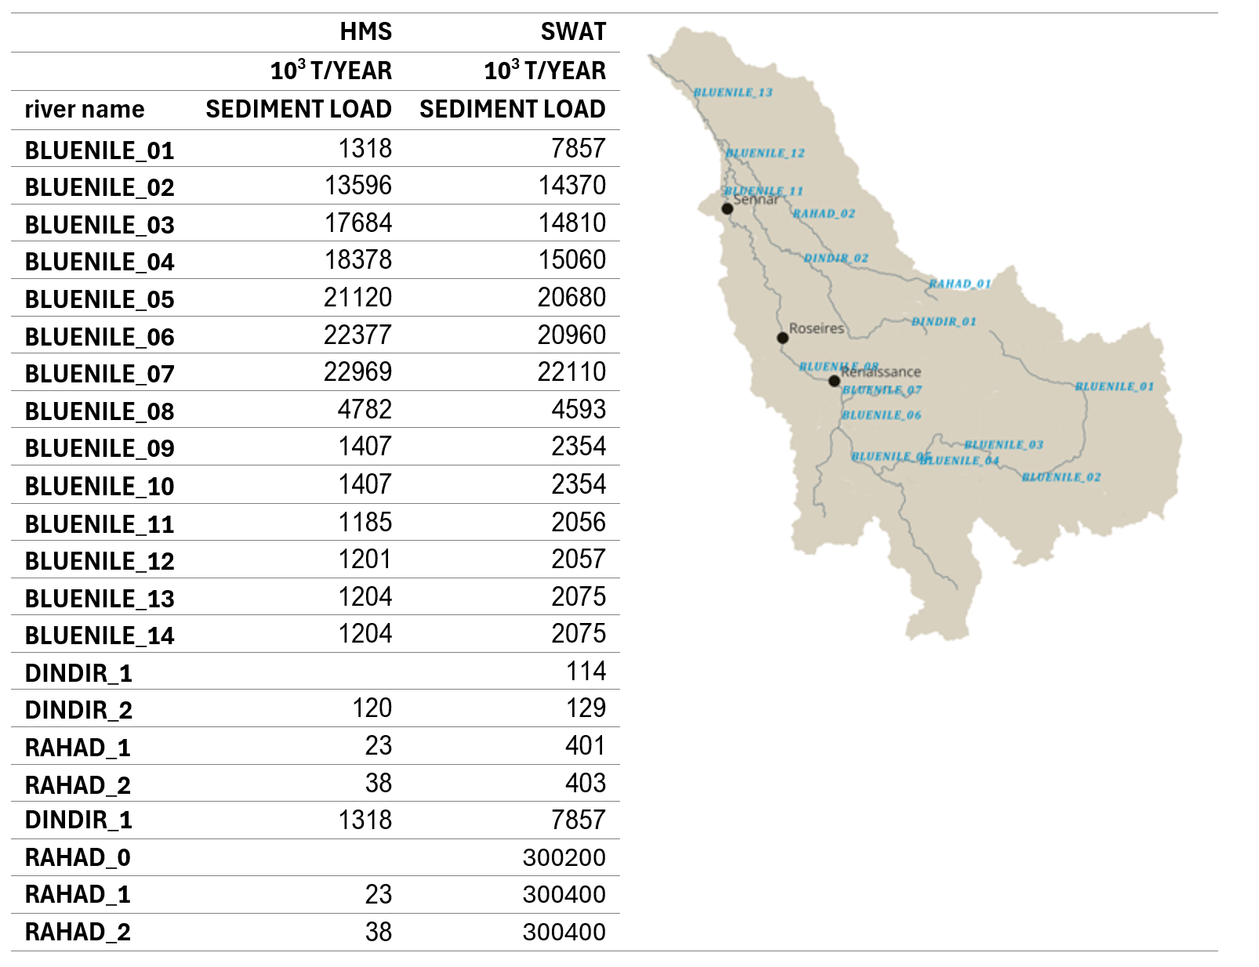
WP3 – Sediment and erosion transport models development
Simulation 0 – current conditions

Slide 40
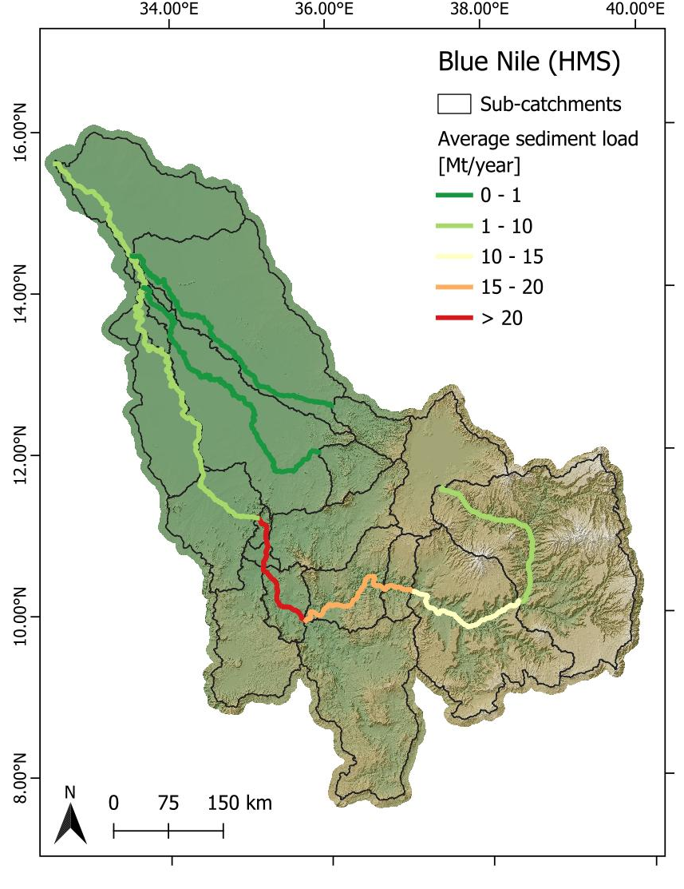

WP3 – Sediment and erosion transport models development
Simulation 0 – current conditions

Slide 41
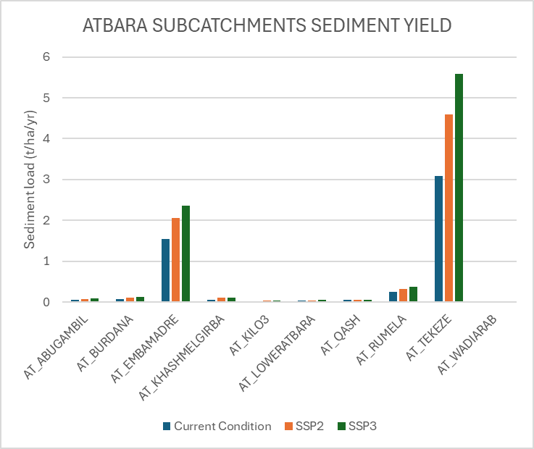
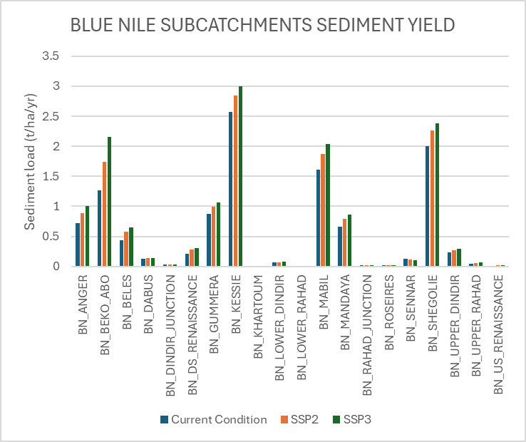
WP3 – Sediment and erosion transport models development
Simulation 1 and 2 – future conditions

Slide 42
WP3 – Sediment and erosion transport models development
Simulation 1 and 2 – future conditions

