Slide 1

Eastern Nile Technical Regional Office (ENTRO)
Consultancy service for the Development of the Eastern Nile Water Resources Models and Tools
Nile Cooperation for Climate Resilience
Validation Workshop
12-14 June 2025

Slide 2
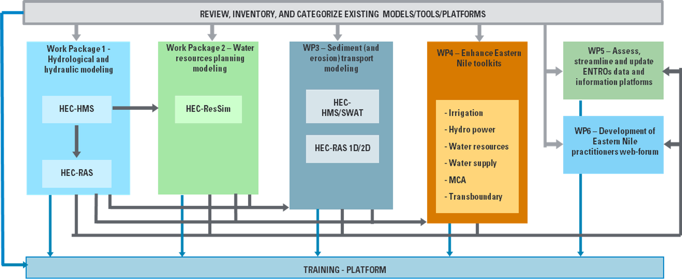

Methodological approach
Schematization of the integrated approach pursued by the Consultant

Slide 3
Workshop Agenda
Time (hrs) | Presentation / Activity | Responsible Person
 | June 14, 2025 - Day 3 | Chair: To be assigned
09:00 –09:10 | Recap of Day 2 | HydroNova/ ENTRO
09:10- 10:00 | Presentation on WP2: Water resources planning model | HydroNova (Consultant)
10:00-11:00 | Interactive session on water resources planning model | All
11:00 – 11:30 | Health Break | Hotel
11:30-12:00 | Presentation on WP3: Sediment and erosion transport model (HEC-HMS) | HydroNova (Consultant)
12:00-13:00 | Interactive session on Sediment and erosion transport model (HEC-HMS) | All
13.00 – 14:00 | Lunch Break | Hotel
14:00 – 15:00 | Presentation on WP3: Sediment and erosion transport model (SWAT) | HydroNova (Consultant)
15:00-16:00 | Interactive session on Sediment and erosion transport model (SWAT) | All
16:00-16:30 | Health Break | Hotel
16:30- 17:00 | Feedback and recommendations on WP3 | All
17:00-17:30 | Closing remarks and a way forward | ENTRO/ENSAPT

Slide 4
Specific Topics
DAY 3. WP2 – RESSIM
1. | Introduction
2. | Data Sources and retrieval | Reservoirs Data Model networks set-up
3. | Calibration
4. | Simulation | Scenario 0 Scenario 1 Scenario 2

Slide 5
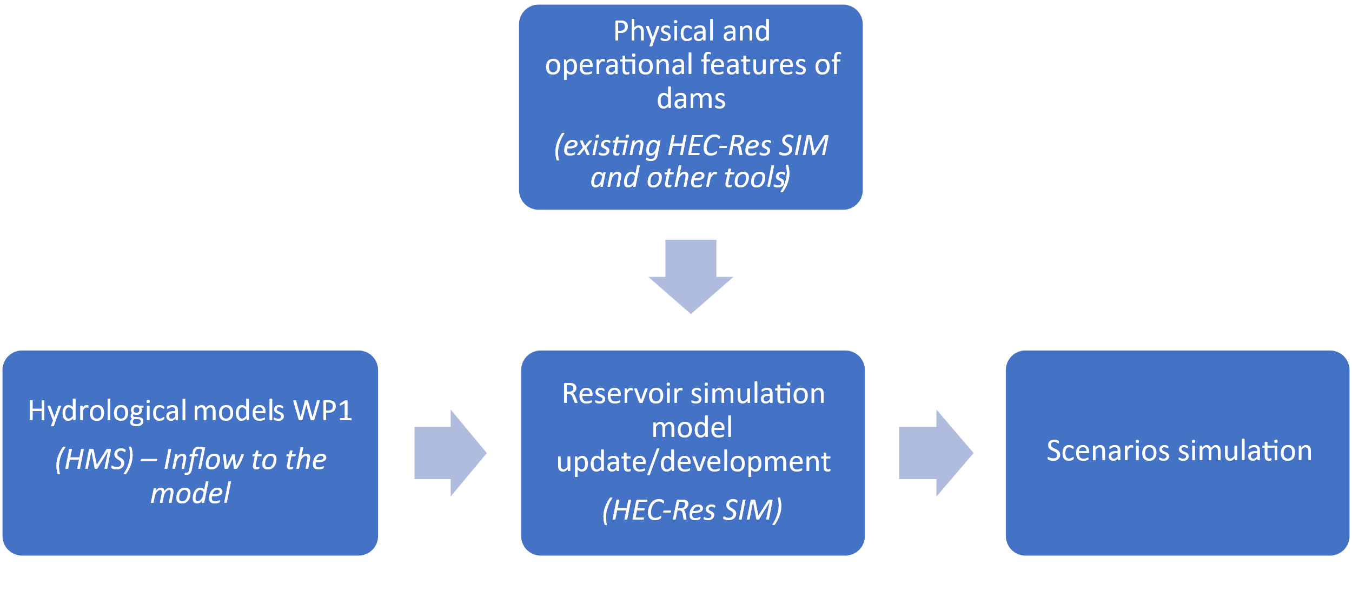
WP2 - Water resources planning models development
ResSim model development
Evaporation
Pool curves
Outlets
Rules
Levels
…..
Levels
Flow
Energy
…….

Slide 6
WP2 - Water resources planning models development
Data source - Reservoirs
A ResSim model was developed in the past by ENTRO. The model have several limitations:
The model is not calibrated over observed flow series;
Inflow time series generally have a monthly timestep;
Rules set for reservoirs appear to be not fully consistent;
Merowe Dam (2009) and Upper Atbara Project (2016) are missing in the model.
Other models and database were developed, useful to extract information that can be used in the development of ResSim model.

Slide 7
WP2 - Water resources planning models development
Data source - Reservoirs
Most of the limitations of the existing ResSim model above identified, appears to be faced using available data in the other existing models and tools, such as:
Riverware: Baseline Development. The model accurately reflects current conditions and potential future conditions using currently established infrastructure.
Ribasim: The model accurately reflects current conditions and potential future conditions for reservoirs using currently established infrastructure.
Power Toolkit: It provides a variety of physical and operational characteristics for many of the existing and proposed reservoirs in the Eastern Nile Region. Information contained in a spreadsheet describes the elevation-volume-surface area relationships, reservoir characteristics, dam characteristics, power plant and turbine characteristics, and spillway characteristics. In addition, information includes environmental demands, tailwater elevations and a wide variety of descriptions related to the economic and environmental impacts of the reservoirs.
Literature (papers, engineering companies).

Slide 8
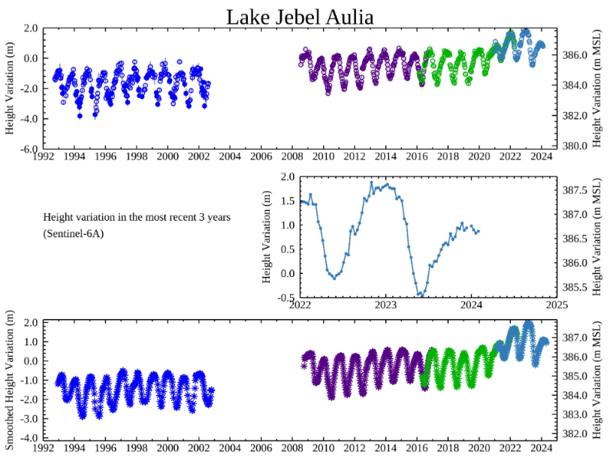
WP2 - Water resources planning models development
Data source - Levels
Reservoirs water levels. In the project domain there are a number of dams as: GERD, TK5, Finchaa, Tana-Beles, Rosaries, Sennar, Jebel Aulia, Merowi, Khashim El Girba and Rumella, High Aswan. While we have collected information of the dams characteristics and on the operation levels so as to correctly inform the modelling, potential gaps could be filled by recurring to remotely sensed water levels, available for most of the reservoirs within the area (https://blueice.gsfc.nasa.gov/gwm/lake/Index); datasets are collected by NASA and updated on monthly basis and on decade basis.

Slide 9
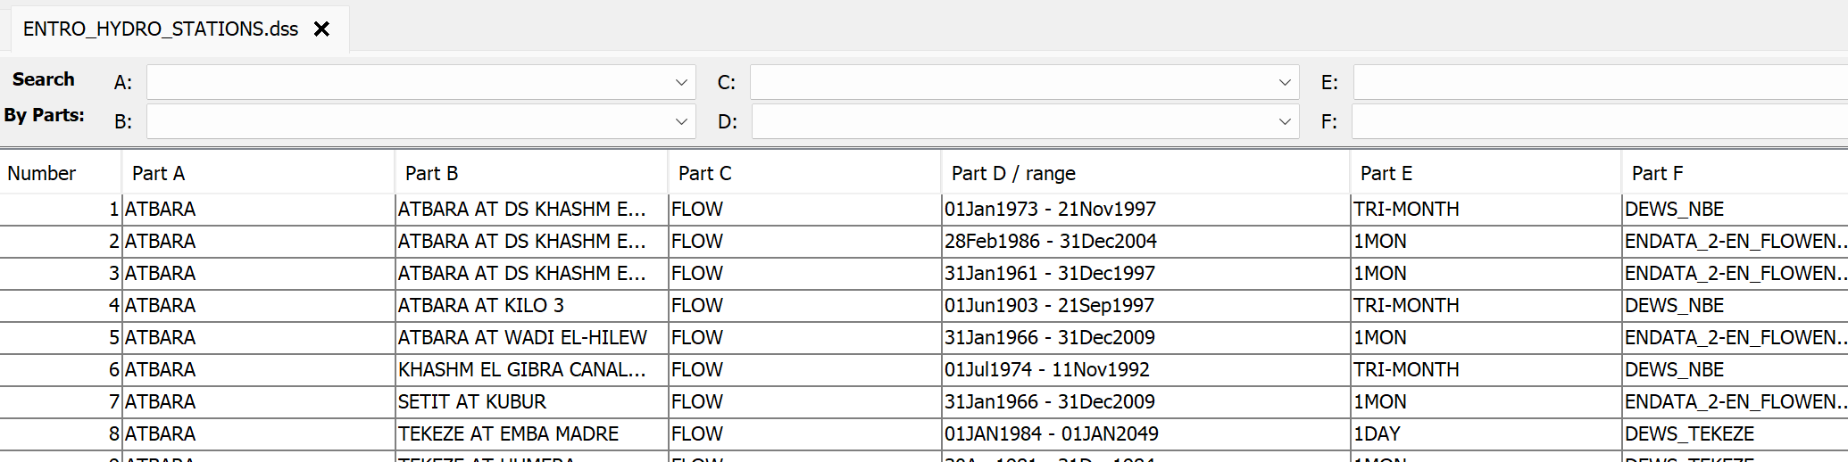
WP2 - Water resources planning models development
Data source – Levels and flows
Hydro database

Slide 10
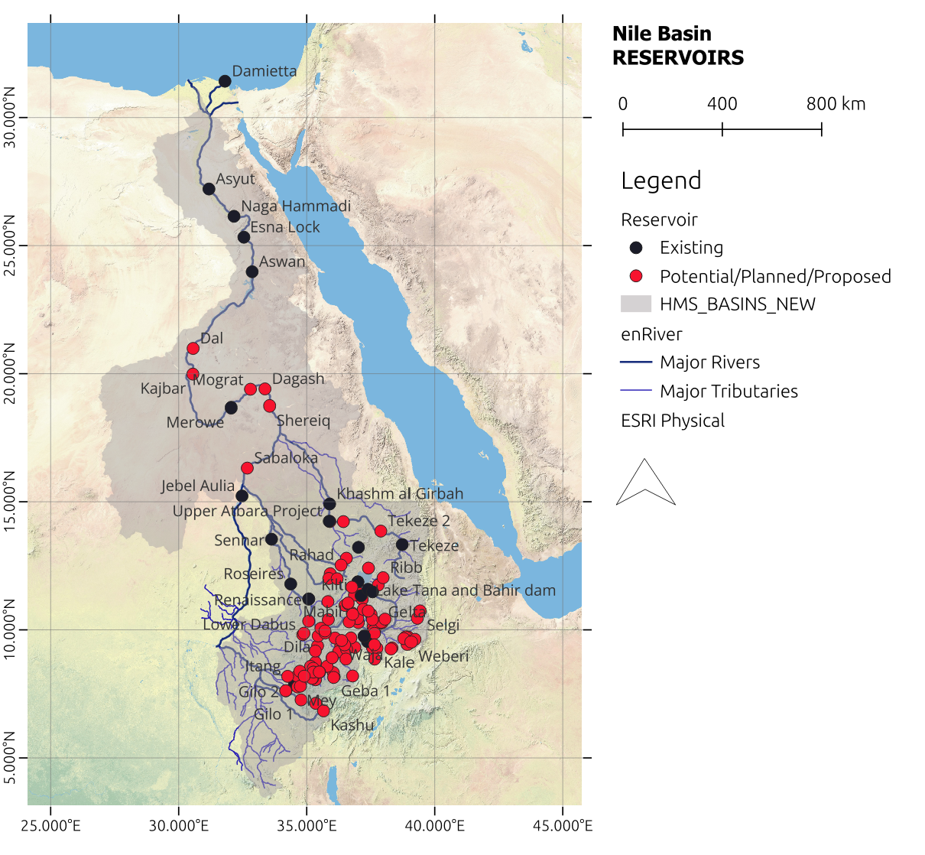
WP2 - Water resources planning models development
ResSim model development – Reservoir selection
Existing data sources include:
Ressim model: 19 reservoirs
Ribasim model: 113 reservoirs
Toolkits: 89 reservoirs
Hydromet: 37 reservoirs
Riverware: 19 reservoirs
According to different sources there are 136 reservoirs either planned or existing. Available information is not complete for all the reservoirs.

Slide 11
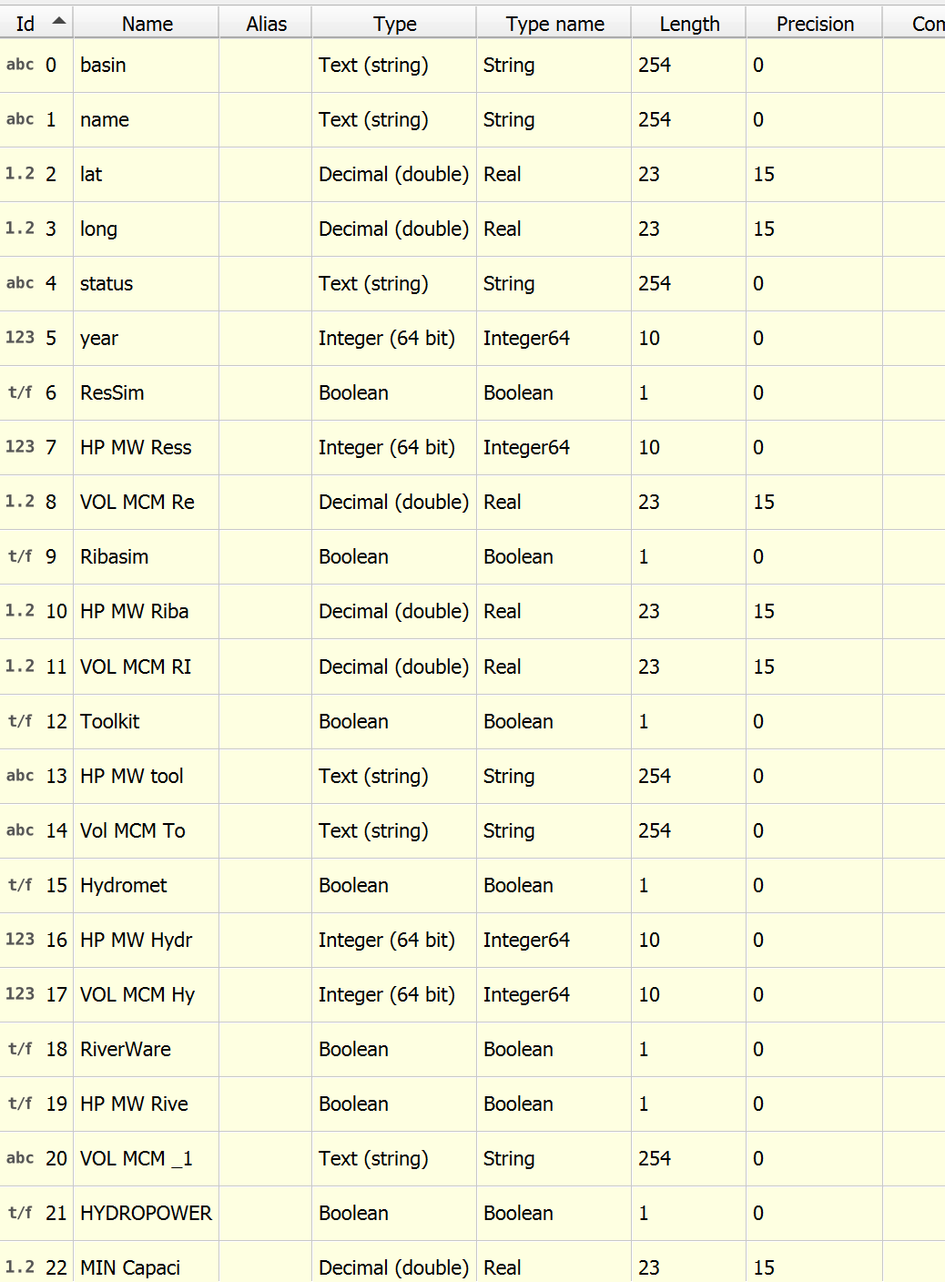
WP2 - Water resources planning models development
ResSim model development – Reservoir selection
For each source maximum volume capacity and power was collected and compared.
Not always the data from different sources matched
There are some missing data (Volume or Power)

Slide 12
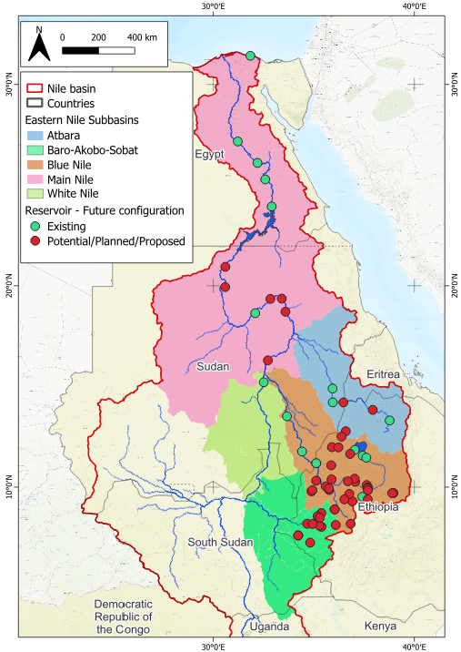
WP2 - Water resources planning models development
ResSim model development
Selection criteria. Among the reservoirs with a consistent set of data, the selected reservoirs have:
OR (Volume > 1000 MCM)
OR (Power > 100 MW)
OR (dam on the main river)
Considering these 51 dams, two different scenarios have been identified:
existing configuration with 18 already existing dams;
future configuration with 18 existing dams and 33 potential/planned/proposed dams.
51 reservoirs

Slide 13
WP2 - Water resources planning models development
ResSim model development
Upper Baro network:
Existing configuration
No dams
Future configuration
Geba A
Geba R
BirBir A
BirBir R
Baro I
Baro II
Tams
Gambella

Slide 14
WP2 - Water resources planning models development
ResSim model development
Other assumptions affect:
outlets data (at least one controlled outlet and one uncontrolled spillway)
crest data (level and length)
EAV curve
operational rules (Minimum flow and priority to hydropower)

Slide 15
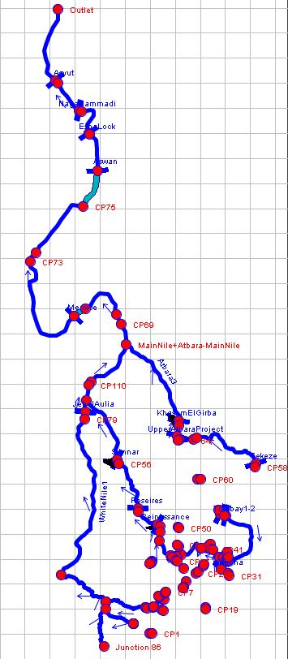
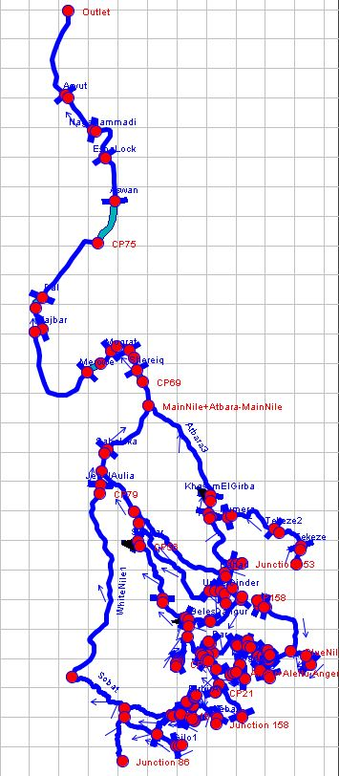
WP2 - Water resources planning models development
ResSim model development
The watershed network at the existing and planned conditions was developed. Main existing information for all the existing reservoirs were gathered and implemented in the model, including:
Pool and Evaporation:
  Elevation-Area-Volume curve
  Evaporation
Dam and Its elements:
  Crest
  Spillway
  Controlled Outlet
  Power Plant

Slide 16
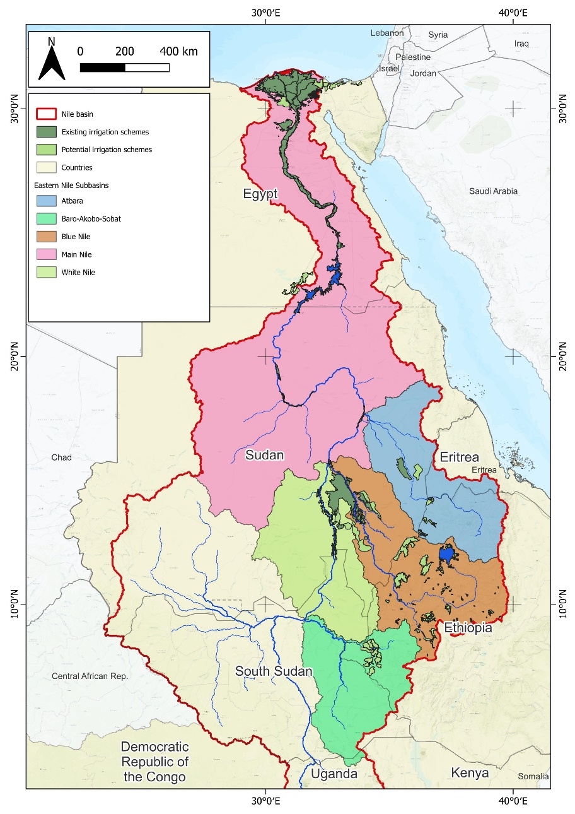
WP2 - Water resources planning models development
ResSim model development
Several diversions were included in the existing network, accounting mainly for the irrigation projects fed by the rivers.

Slide 17
WP2 - Water resources planning models development
ResSim model development – Boundary conditions
Evaporation from the lakes was taken from the Climate data store. For future configurations, in particular for the climate projection SSP2 and SSP3, a factor is applied to the monthly evaporation data. https://cds.climate.copernicus.eu/datasets/reanalysis-era5-land-monthly-means?tab=overview

Slide 18
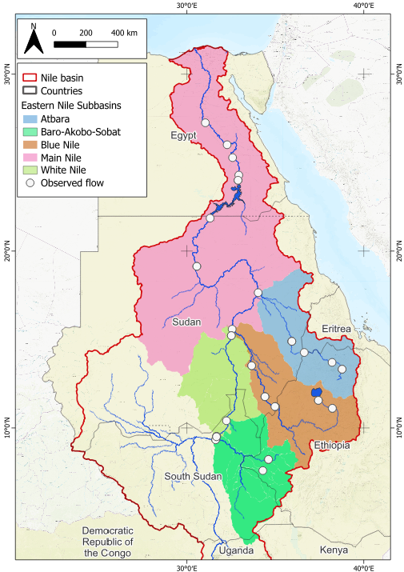
WP2 - Water resources planning models development
ResSim model development – Boundary conditions
Inflow conditions
The inflows are taken from the HEC-HMS model and distributed along the river at control points. The inflows span from 1972 to 2023. The different scenarios taken into consideration with the HMS provides three sets of inflow conditions for ResSim:
Current condition
Climate change condition – SSP2
Climate change condition – SSP3

Slide 19
WP2 - Water resources planning models development
Simulations
In the Ressim model, two geometries have been created: existing and future. These geometries have been coupled with the three scenarios above mentioned: current condition, SSP2, and SSP3, resulting in a total of six simulations.
SIM1: existing geometry with current boundary condition
SIM2: future geometry with current boundary condition
SIM3: existing geometry with with SSP2 boundary condition
SIM4: future geometry with SSP2 boundary condition
SIM5: existing geometry with SSP3 boundary condition
SIM6: future geometry with SSP3 boundary condition

Slide 20
WP2 - Water resources planning models development
Calibration
Given the level of complexity of the system and the scattered information available, it was possible to calibrate the model in a qualitative way, trying to match as much as possible the observed water level and flow at key stations, bearing in mind that
it was based on the calculated inflow from HMS
It strongly depends on the decision process in the reservoirs
the calibration was performed on the observed flow and level values at key stations of the river network.
Observed data used to calibrate the model
Basin | Station | RESSIM Station | Period | Time Step
MAIN NILE | ASWAN | ELEV | 1992 - 2024 | IR-DAY
WHITE NILE | JEBEL AULIA | ELEV | 1992 - 2024 | IR-DAY
BLUE NILE | LAKE TANA | ELEV | 1992 - 2024 | IR-DAY
BLUE NILE | RENAISSANCE | ELEV | 1992 - 2022 | IR-DAY
BLUE NILE | ROSEIRES | ELEV | 2008 - 2024 | IR-DAY

Slide 21
WP2 - Water resources planning models development
Basin | Station | RESSIM Station | Period | Time Step
ATBARA | ATBARA AT DS KHASHM EL GIBRA DAM | KhashmElGirba-Pool – Flow OUT | 1973 - 1997 | TRI-MONTH
ATBARA | ATBARA AT DS KHASHM EL GIRBA DAM 1 | KhashmElGirba-Pool – Flow OUT | 1986 - 2004 | 1MON
ATBARA | ATBARA AT DS KHASHM EL GIRBA DAM 2 | KhashmElGirba-Pool – Flow OUT | 1961 - 1997 | 1MON
ATBARA | ATBARA AT KILO 3 | Atbara3 reach | 1903 - 1997 | TRI-MONTH
ATBARA | TEKEZE AT EMBA MADRE | CP156 | 1984 - 2002 | 1DAY
BARO-AKOBO-SOBAT | BARO AT GAMBELLA | CP18 | 1984 - 2010 | 1DAY
BARO-AKOBO-SOBAT | GILO AT PIGNUDO | CP6 or CP3 | 1984 - 2010 | 1DAY
BARO-AKOBO-SOBAT | SOBAT AT HILLET DOLEIB | DS REACH OF BAS | 1905 - 1983 | TRI-MONTH
BLUE NILE | ABBAY AT BAHIR DAR | LakeTana-Pool Flow | 1984 - 2009 | 1DAY
BLUE NILE | ABBAY AT BAHIR DAR | LakeTana-Pool Flow | 1980 - 2009 | 1MON
BLUE NILE | ABBAY AT KESSIE | US part of Abbay river | 1984 - 2006 | 1DAY
BLUE NILE | ABBAY AT KESSIE | US part of Abbay river | 1953 - 2009 | 1MON
BLUE NILE | ABBAY AT MANDAYA | CP48 | 1954 - 2009 | 1MON
BLUE NILE | BLUE NILE AT DEIM | Reinassance Pool – Flow – CP53 | 1983 - 1997 | TRI-MONTH
BLUE NILE | BLUE NILE AT DEIM | Reinassance Pool – Flow – CP53 | 1920 - 1999 | 1MON
BLUE NILE | BLUE NILE AT DEIM | Reinassance Pool – Flow – CP53 | 1980 - 2006 | 1DAY
BLUE NILE | BLUE NILE AT KHARTOUM | DS reach of Blue Nile River | 1964 - 2010 | 1DAY
BLUE NILE | BLUE NILE AT KHARTOUM AND SOBA | DS reach of Blue Nile River | 1900 - 1997 | TRI-MONTH
BLUE NILE | BLUE NILE AT ROSEIRES DAM | RoseiresPool - FlowOUT | 1973 - 1997 | TRI-MONTH
BLUE NILE | BLUE NILE AT ROSEIRES DAM | RoseiresPool - FlowOUT | 1982 - 2006 | 1DAY
BLUE NILE | BLUE NILE AT ROSEIRES DAM | RoseiresPool - FlowOUT | 1954 - 2009 | 1MON
BLUE NILE | BLUE NILE AT ROSERIES RESERVOIR INFLOW | RoseiresPool - FlowIN | 1912 - 2009 | 1MON
BLUE NILE | BLUE NILE AT SENNAR | SennarPool - FlowOUT | 1980 - 2006 | 1DAY
BLUE NILE | BLUE NILE AT SENNAR DAM | SennarPool - FlowOUT | 1906 - 1997 | TRI-MONTH
MAIN NILE | NILE AT DONGOLA 1 | CP148 | 1965 - 2009 | 1MON
MAIN NILE | NILE AT DONGOLA 2 | CP148 | 1926 - 1999 | 1MON
MAIN NILE | NILE AT DS ASWAN DAM | Aswan-Pool - FlowOUT | 1900 - 2002 | TRI-MONTH
MAIN NILE | NILE AT DS NAG HAMMADI BARRAGE | NagaHammadiPool - FlowOUT | 1940 - 2002 | TRI-MONTH
MAIN NILE | NILE AT ESNA BARRAGE | EsnaBarragePool - FlowOUT | 1933 - 2002 | TRI-MONTH
MAIN NILE | NILE AT GAAFRA | CP76 TO CP 116 | 1938 - 2002 | TRI-MONTH
MAIN NILE | NILE AT HAWATKA - DS ASSIUT | AsyutPool – FlowOUT | 1926 - 2002 | TRI-MONTH
MAIN NILE | NILE AT US ASSIUT BARRAGE | AsyutPool - FlowIN | 1940 - 1966 | TRI-MONTH
MAIN NILE | NILE AT US ASWAN DAM | Aswan-Pool - FlowIN | 1925 - 2002 | TRI-MONTH
WHITE NILE | WHITE NILE AT DS JEBEL AULIA DAM | JebelAulia-Pool Flow | 1966 - 2009 | 1MON
WHITE NILE | WHITE NILE AT MALAKAL | US PART OF WN | 1905 - 1997 | TRI-MONTH
WHITE NILE | WHITE NILE AT MELUT | US PART OF WN | 1940 - 1980 | TRI-MONTH

Slide 22
WP2 - Water resources planning models development
Assumptions
  model reservoirs network implementation
  uncertainty of the inflow conditions calculated from HMS
The results under the qualitative stand point look acceptable, this is particularly valid for:
  Roseries water level
  Sennar flow
  Aswan dam
where the water level and the flow appear in general comparable with the observed data.
The system is not able to reproduce specific dams operations which are not known, but it is definitely ready to be refined and updated with further information in the future.

Slide 23
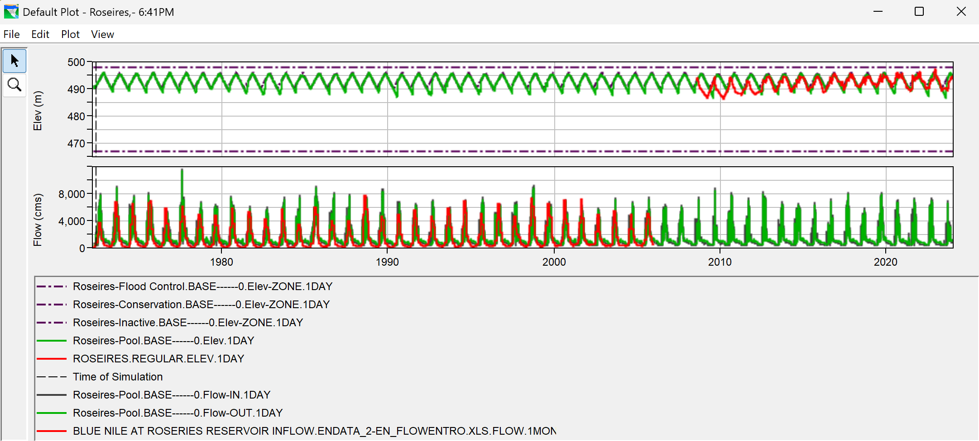
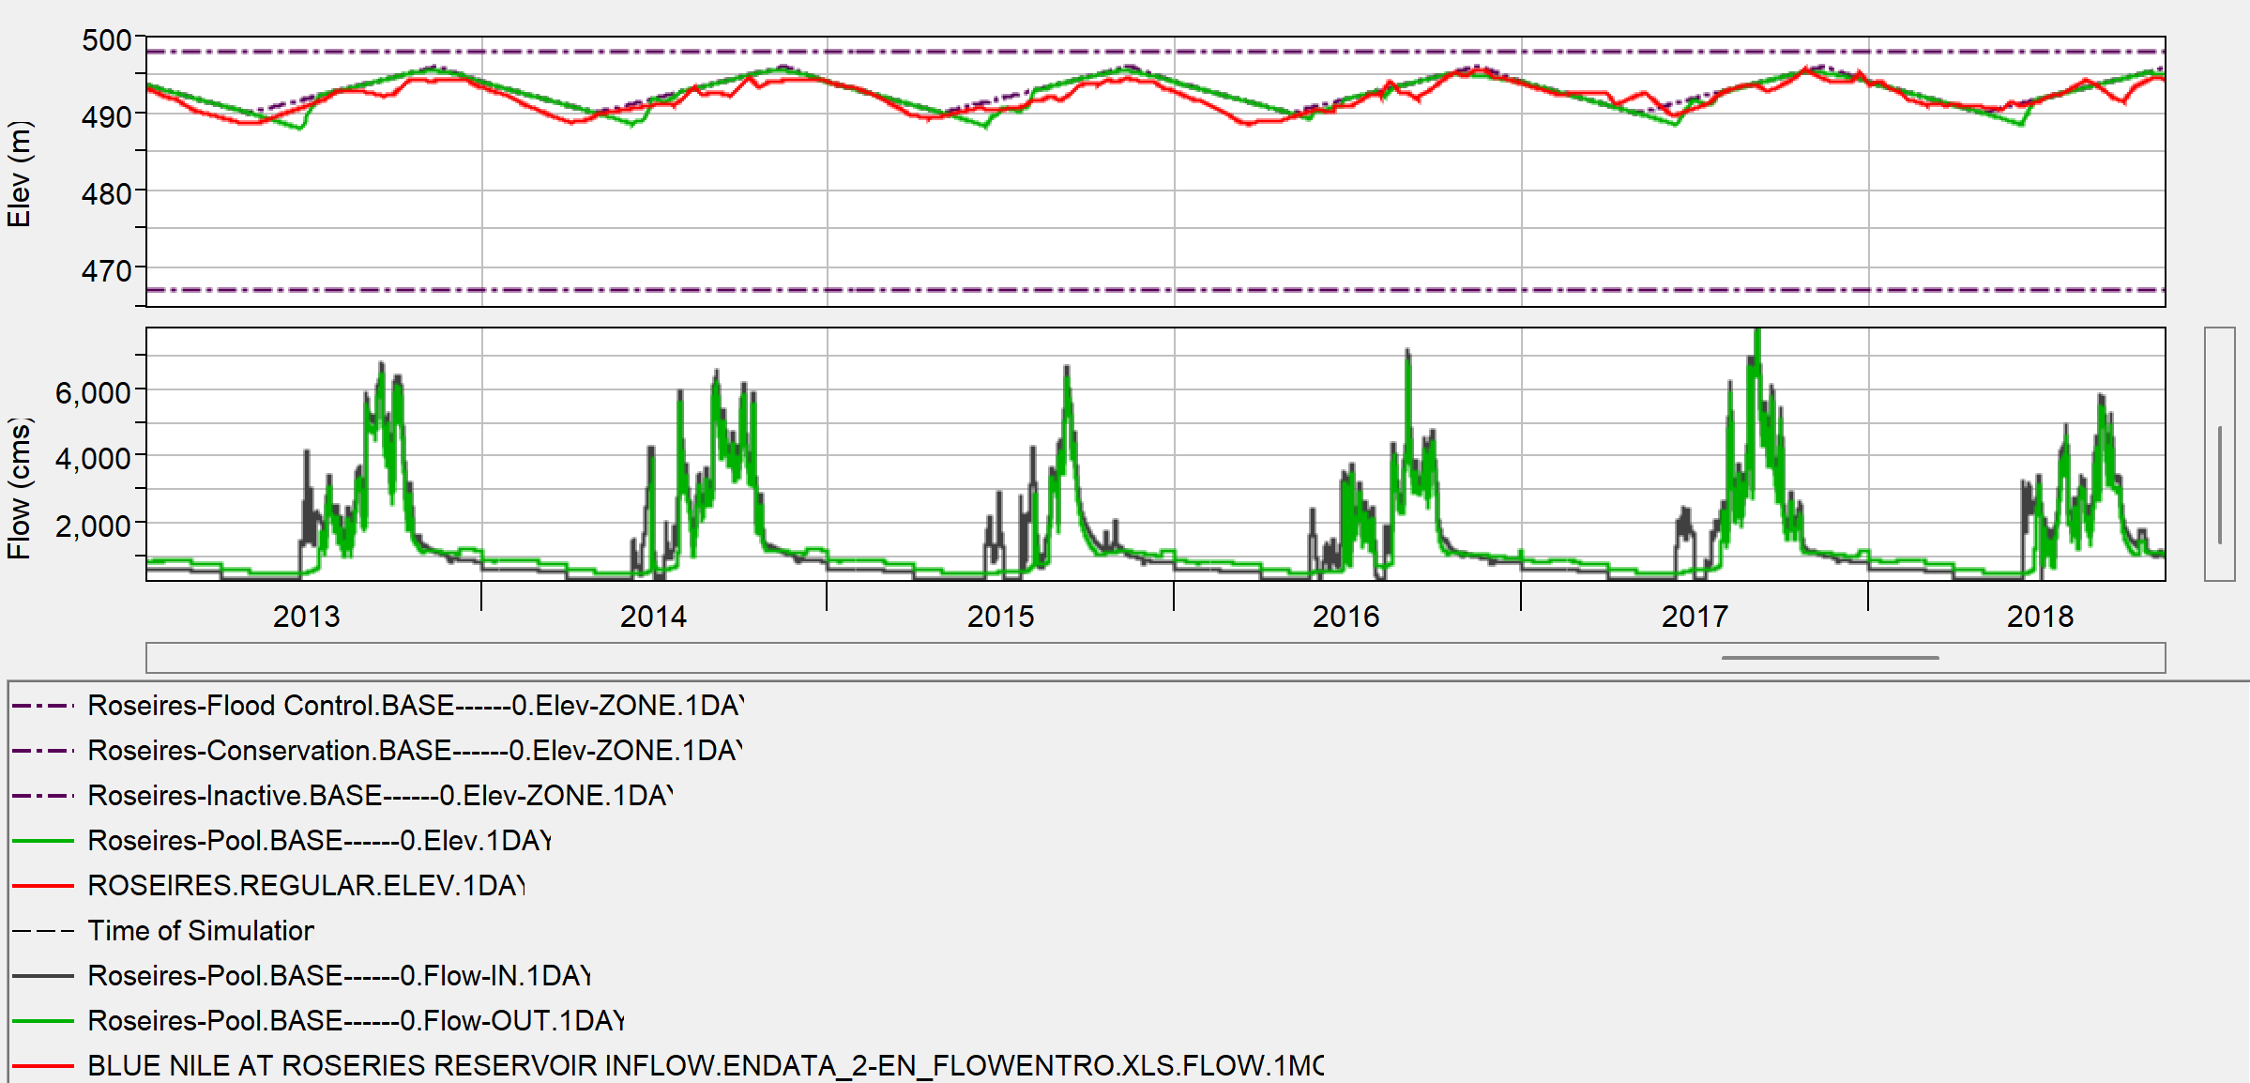
WP2 - Water resources planning models development
Roseires Reservoir

Slide 24
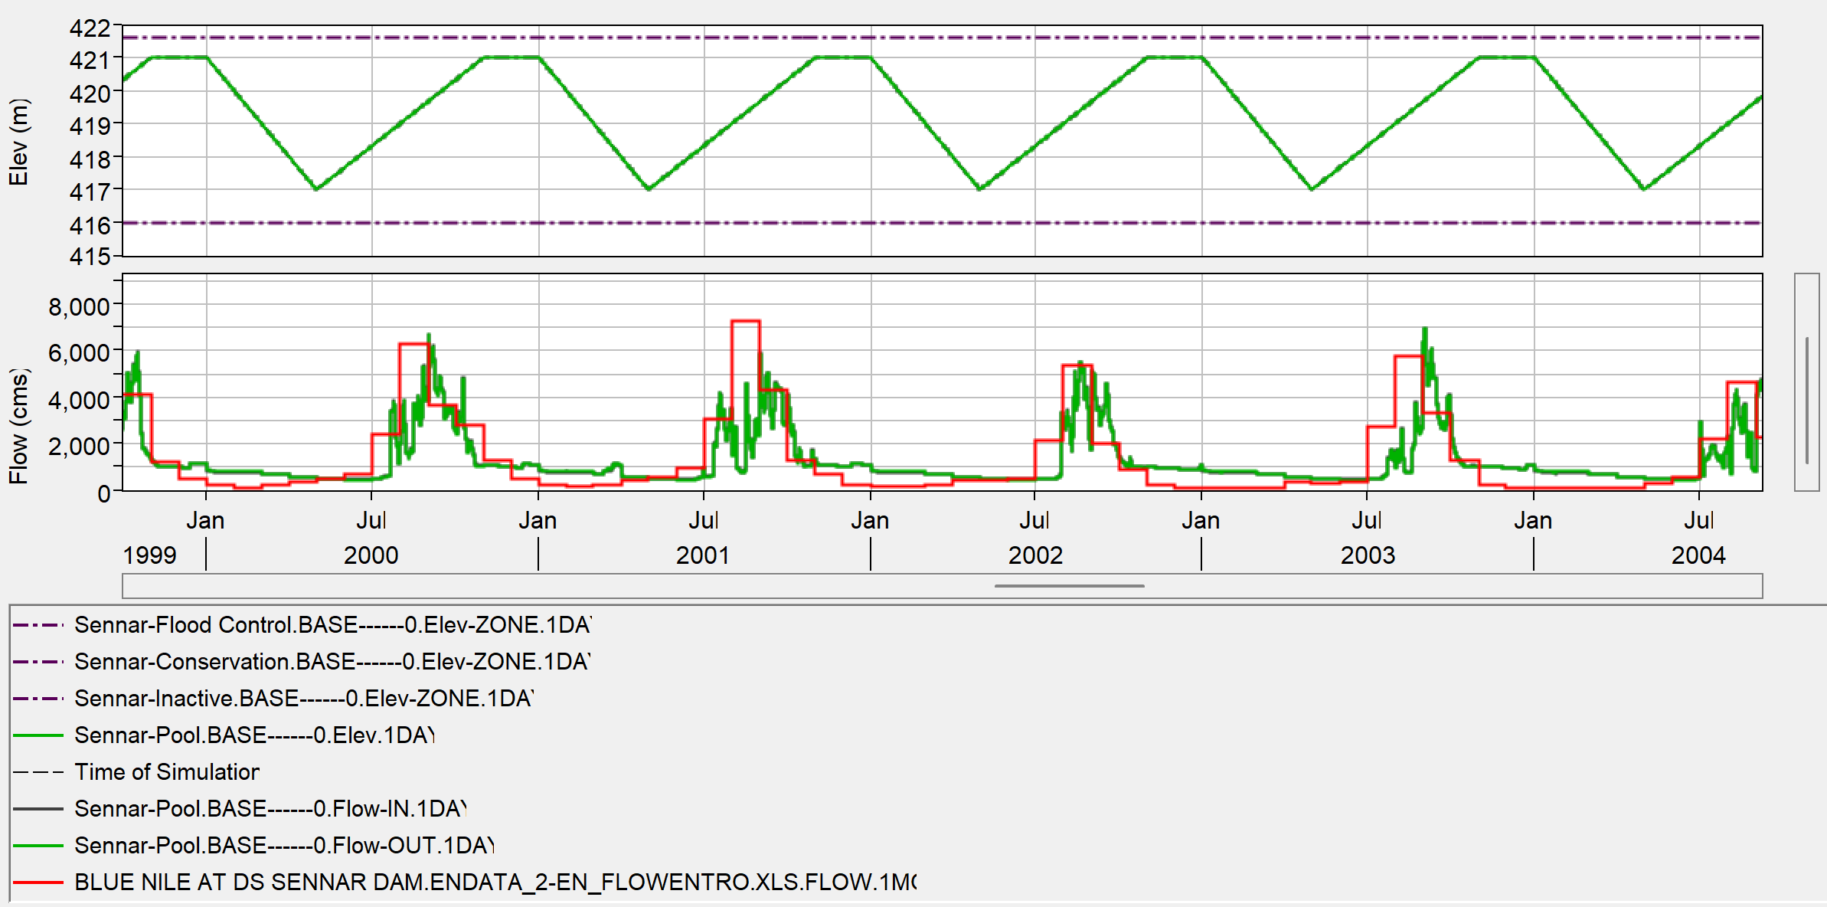
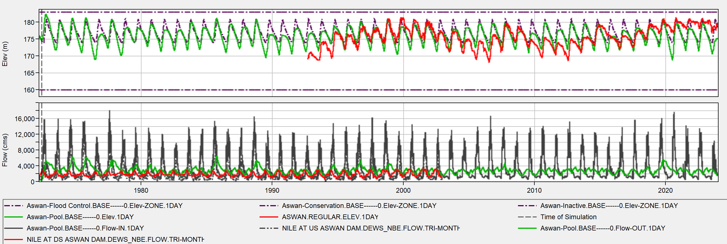
WP2 - Water resources planning models development
Sennar Reservoir
Aswan reservoir

Slide 25
WP2 - Water resources planning models development
Typical ResSim results include the calculation of average parameters for each of the modelled reservoirs, such as
energy generation,
storage volume,
evaporation losses,
etc.
Considering current climate conditions, planned reservoirs are expected to increase significantly the installed capacity for energy generation, particularly in the Blue Nile Subbasin, with a projected increase of more than double.

Slide 26
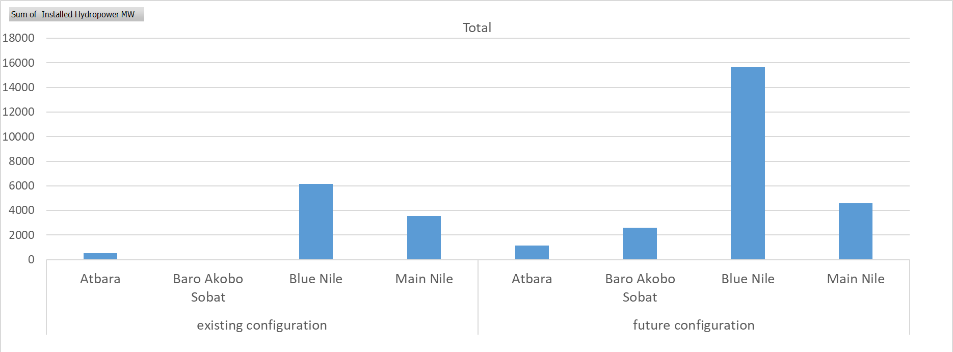
WP2 - Water resources planning models development
Total installed power capacity (MW)

Slide 27
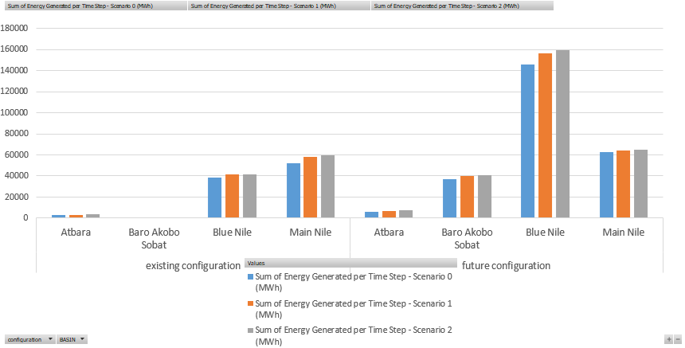
WP2 - Water resources planning models development
Energy generated (MWh)

Slide 28
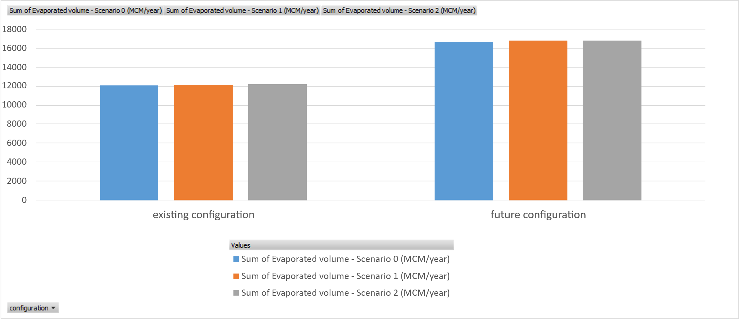
WP2 - Water resources planning models development
Water lost by evaporation in the reservoirs (MCM/year)

Slide 29
WP2 - Water resources planning models development
Stored volume (MCM)

