Slide 1

Eastern Nile Technical Regional Office (ENTRO)
Consultancy service for the Development of the Eastern Nile Water Resources Models and Tools
Nile Cooperation for Climate Resilience
Validation Workshop
12-14 June 2025

Slide 2
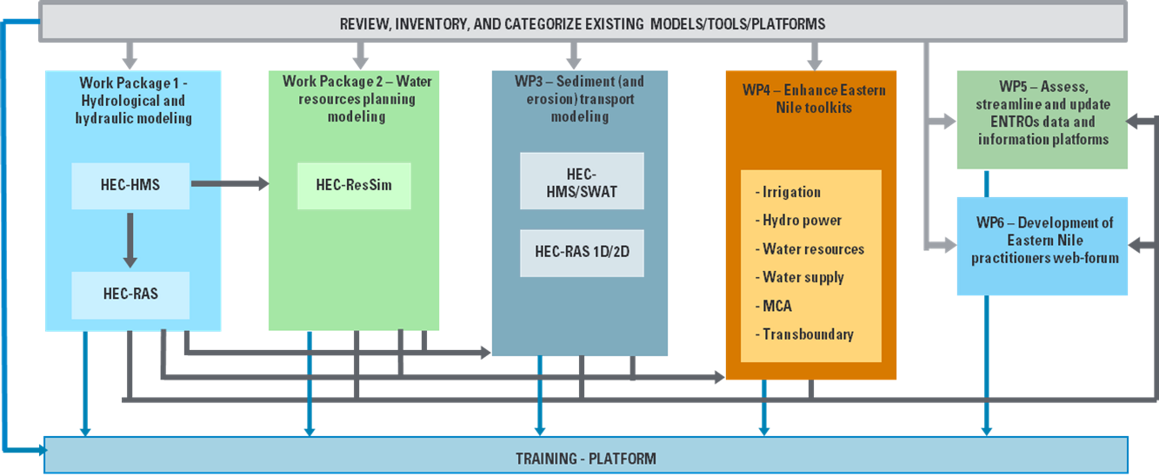

Methodological approach
Schematization of the integrated approach pursued by the Consultant

Slide 3
Workshop Agenda
Time (hrs) | Presentation / Activity | Responsible Person
 | June 13, 2025 - Day 2 | Chair: To be assigned
9:00 – 9:10 | Recap of Day 1 | HydroNova/ ENTRO
9:10- 10:30 | Presentation on the development of Hydrological model | HydroNova (Consultant)
10:30 – 11:00 | Health Break | ALL
11:00-13:00 | Interactive session on hydrological model | All
13.00 – 14:00 | Lunch Break | Hotel
14:00 – 15:30 | Presentation on the development of Hydraulic model | HydroNova (Consultant)
15:30-16:00 | Health Break | Hotel
16:00-17:00 | Interactive session on hydraulic model | ALL
16:30- 17:30 | Feedback and Recommendations on WP1 | ALL

Slide 4
Specific Topics
DAY 2. WP1 – HEC RAS
Data Sources and retrieval
1. | Introduction
2. | Data Sources and retrieval | Available DTMs DTM and topographic data processing Model set-up
3. | Calibration | Method Results
4. | Simulation | Representative years Scenario 0 Scenario 1 Scenario 2

Slide 5
WP1 - Hydrological and hydraulics models development
Hydraulic models development
Introduction
In parallel to the hydrological assessment, hydraulic modeling was developed through the implementation of a 1D hydrodynamic model for all the hydrographic network of the project area. The models were implemented with HEC-RAS.
Identification of the computational domain
Computational domain extension
Topographic data management
Model set-up
River stretches definition
Boundary conditions
Roughness coefficients setting
Simulations
Long term simulations
Output: Water depths and velocities along the rivers and in the floodplain

Slide 6
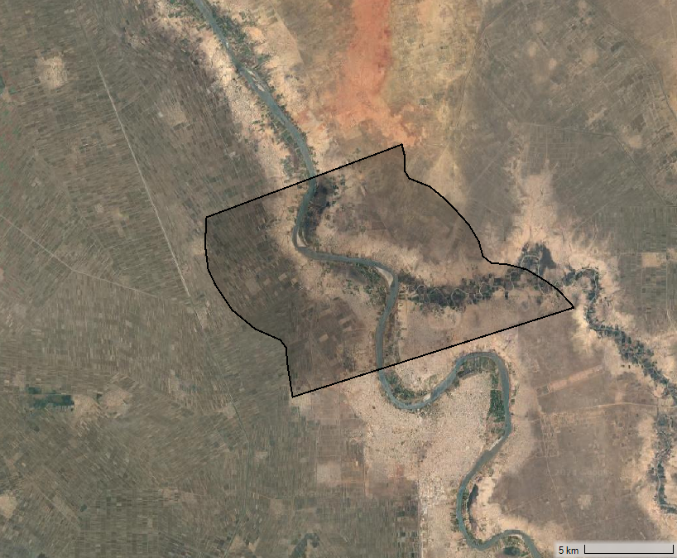
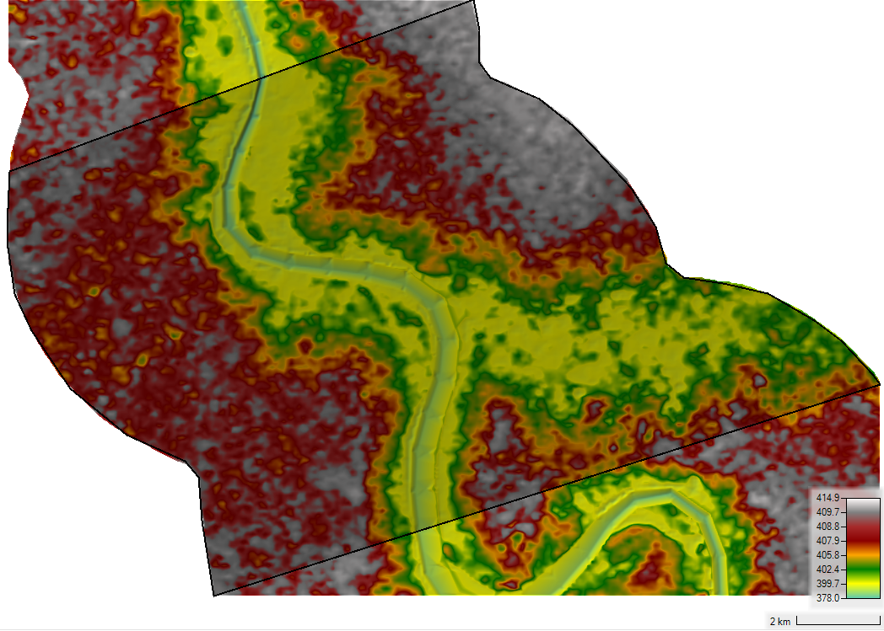
WP1 - Hydrological and hydraulics models development
Hydraulic models development
Existing model and available DTM assessment
Existing model for the Blue Nile (1231 km reach) provided by ENTRO was evaluated. Data collected by ENTRO includes also a TIN DTM
The existing model is not based on surveyed river cross sections, but it is based on global dataset 90 m DTM (SRTM)
The riverbed is modified to account for the underwater portion, which is not captured by satellite topographic datasets, to create the TIN dataset.
The approach used necessarily introduces errors due to the interpolation method
Wad Madani area in Sudan

Slide 7
WP1 - Hydrological and hydraulics models development
Hydraulic models development

Slide 8
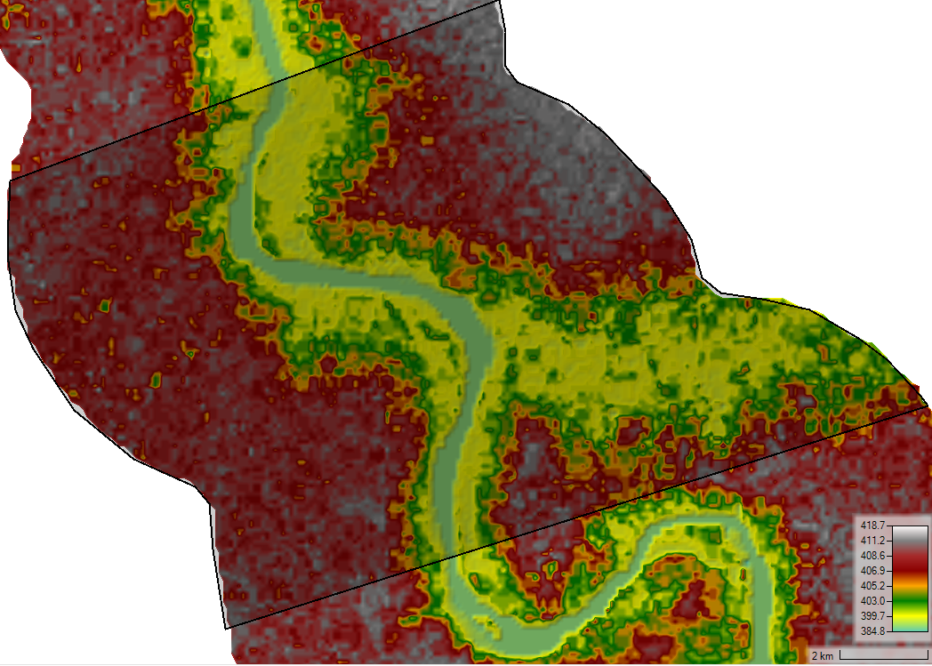
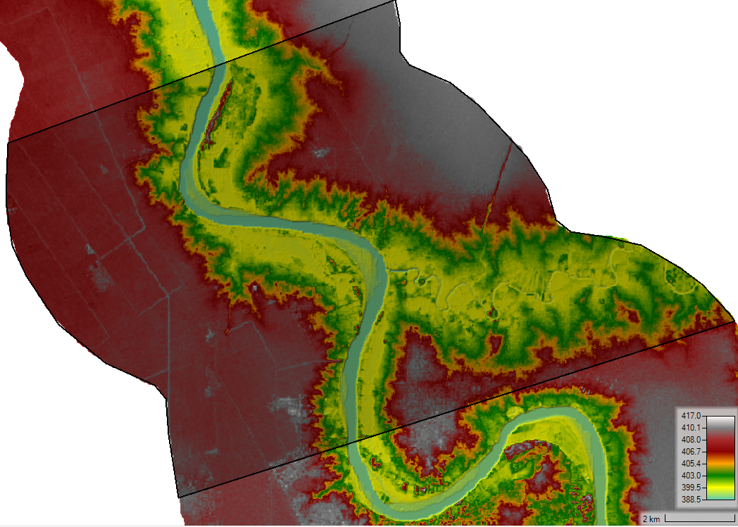
WP1 - Hydrological and hydraulics models development
Hydraulic models development
COP 30 was considered as an additional topographic dataset with 30 m resolution.
Other datasets, i.e. Also-Palsar 12 m resolution was checked as well, but there is no availability in the study area.

Slide 9
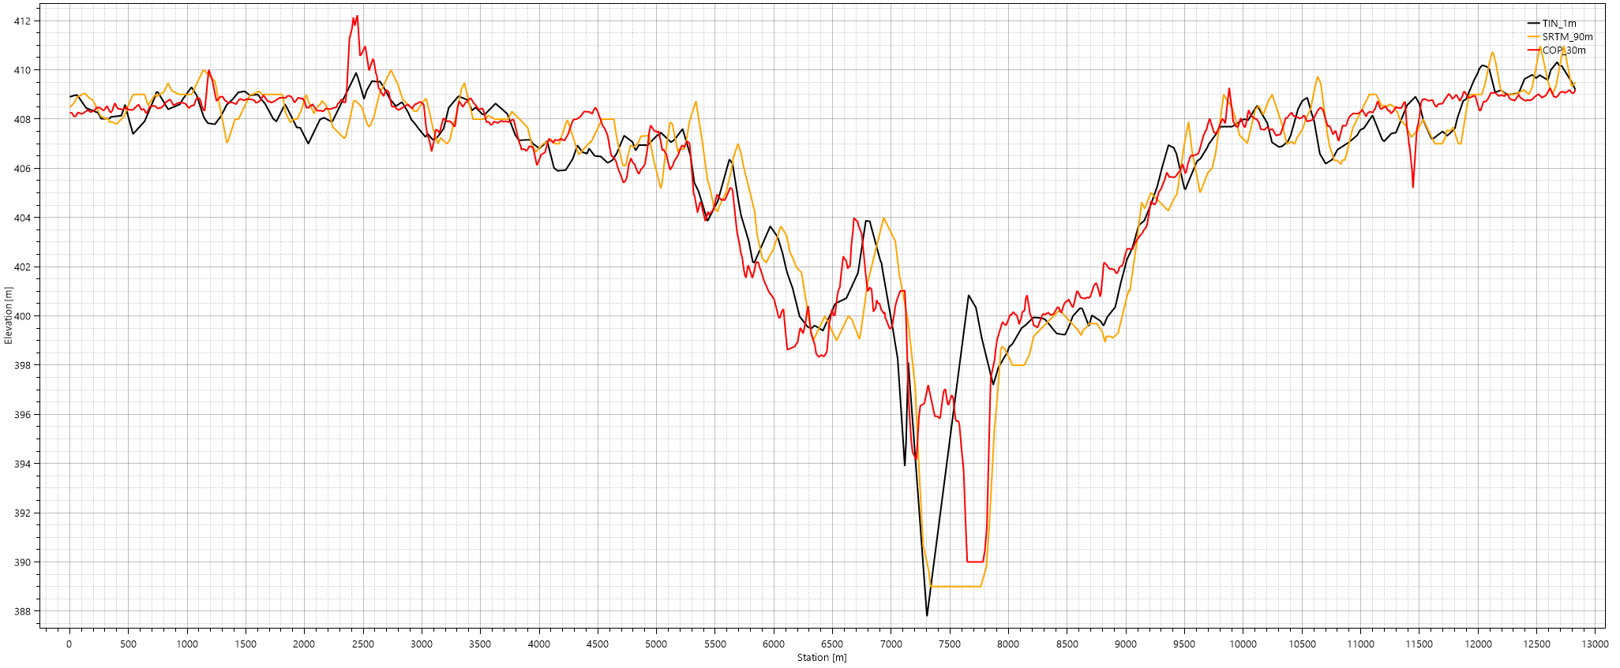
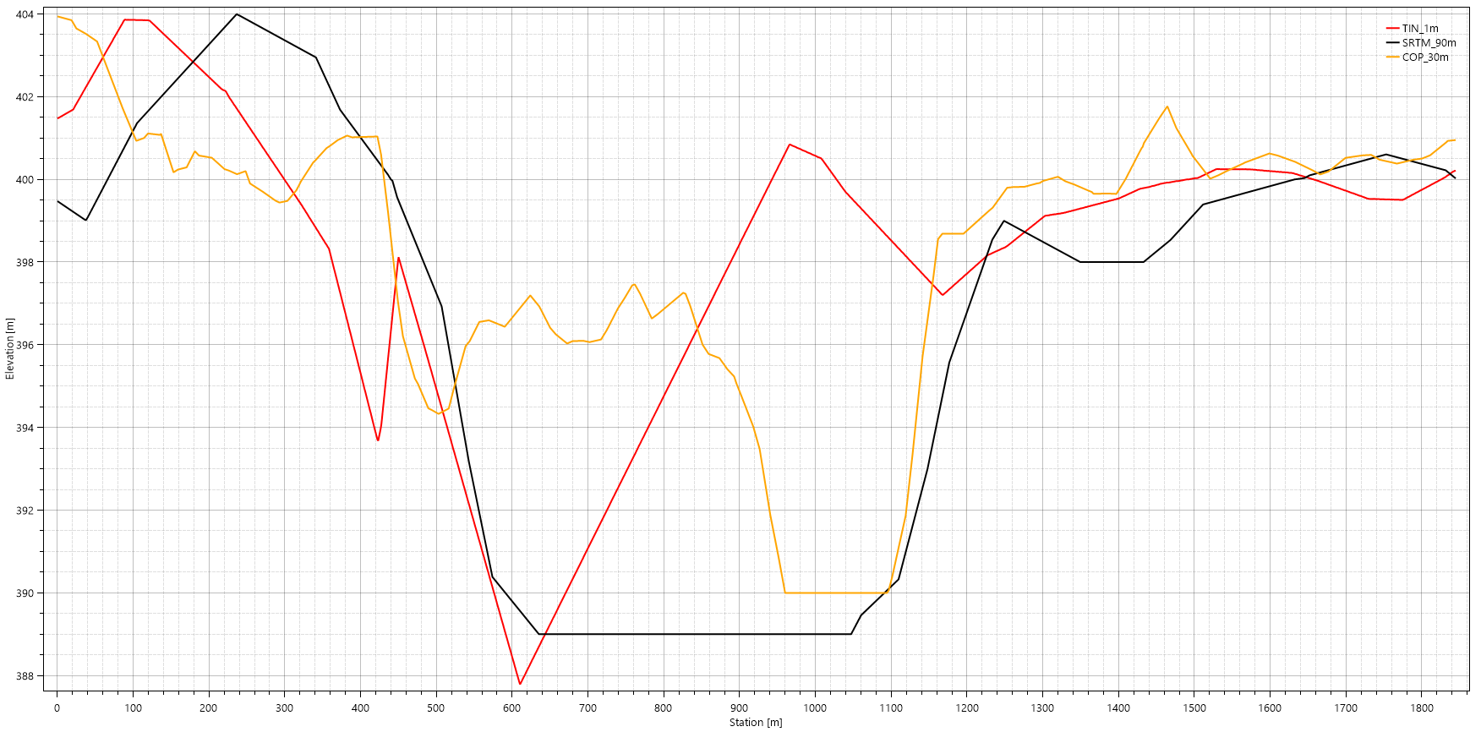
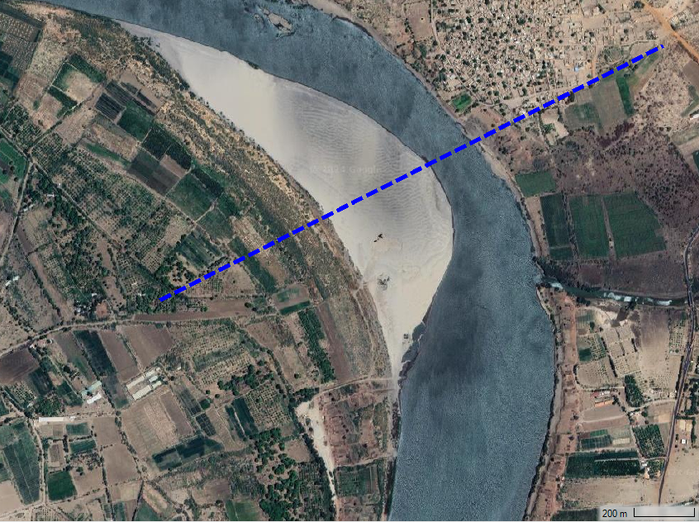
WP1 - Hydrological and hydraulics models development
Hydraulic models development
Assessment on available model and DTM shows that the more representative topographic dataset is the COP 30, representing better the river shape (net of the bottom part, under water).

Slide 10
WP1 - Hydrological and hydraulics models development
Hydraulic models development
Assessment on available model and DTM shows that the more representative topographic dataset is the COP 30, representing better the river shape (net of the bottom part, under water).

Slide 11
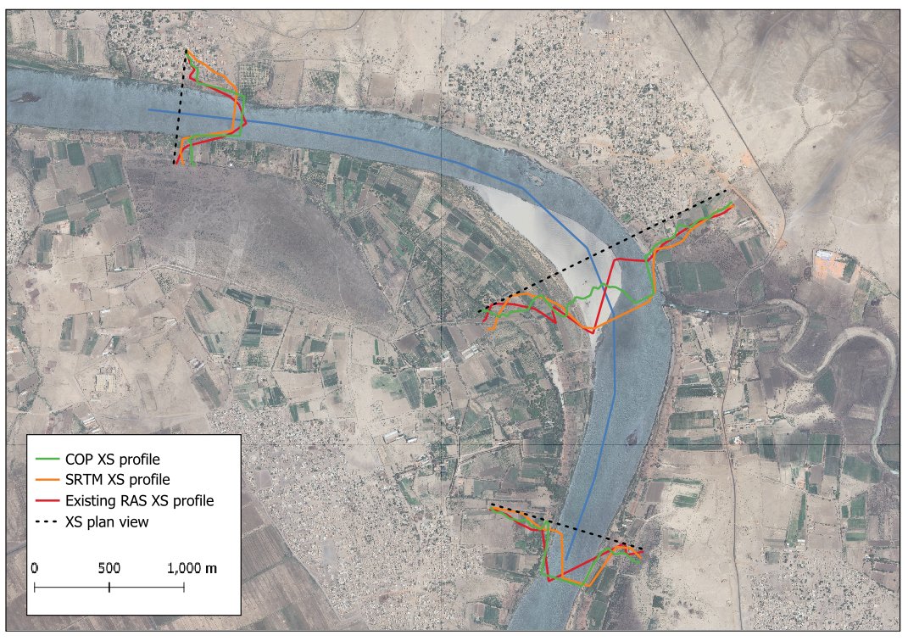
WP1 - Hydrological and hydraulics models development
Hydraulic models development

Slide 12
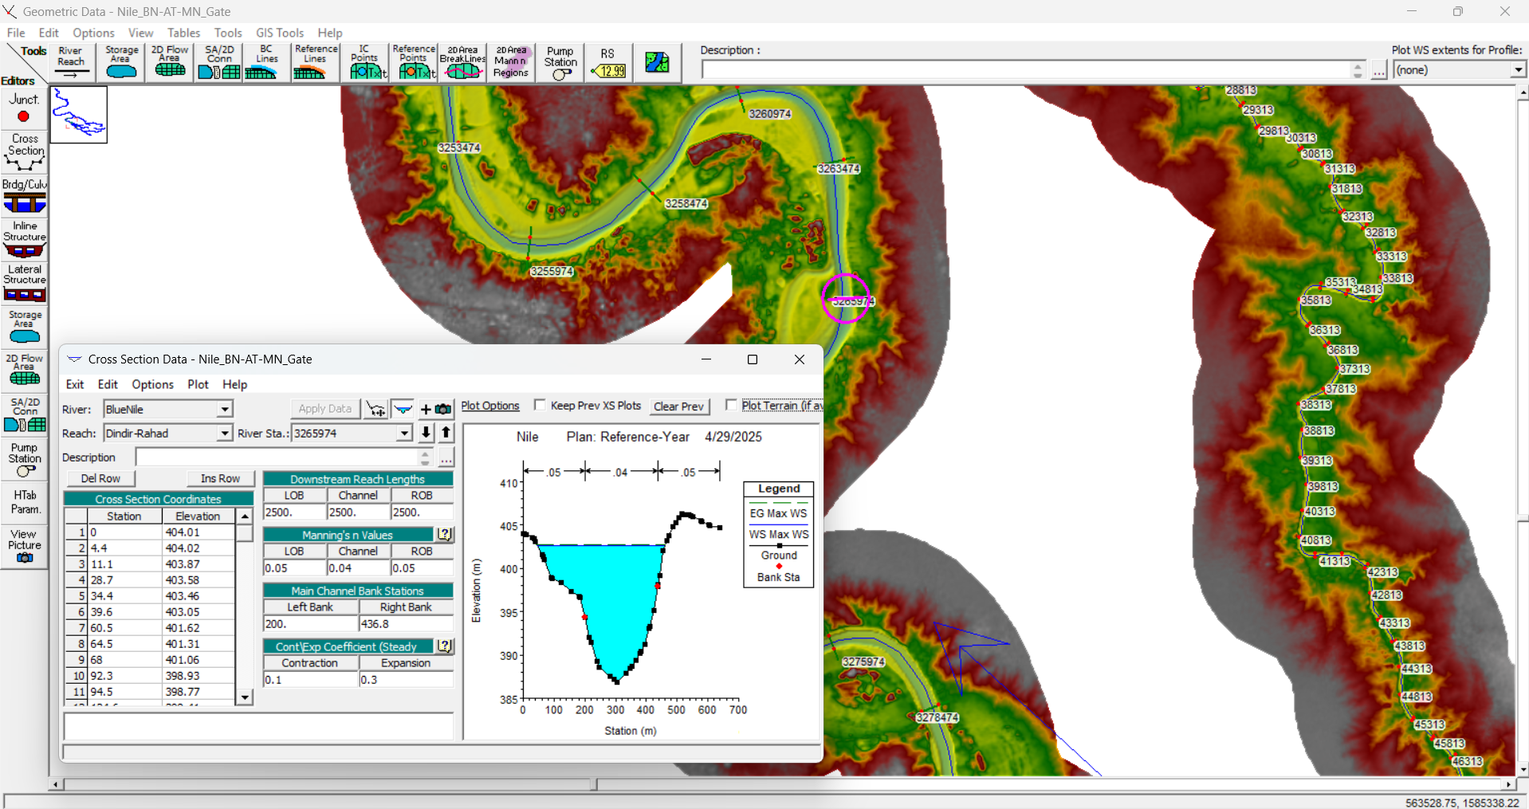
WP1 - Hydrological and hydraulics models development
Hydraulic models development
Bathymetric data along the Blue Nile was actually made available by UNESCO CRW.
For the reach where cross sections are available, this dataset was used for river geometry.

Slide 13
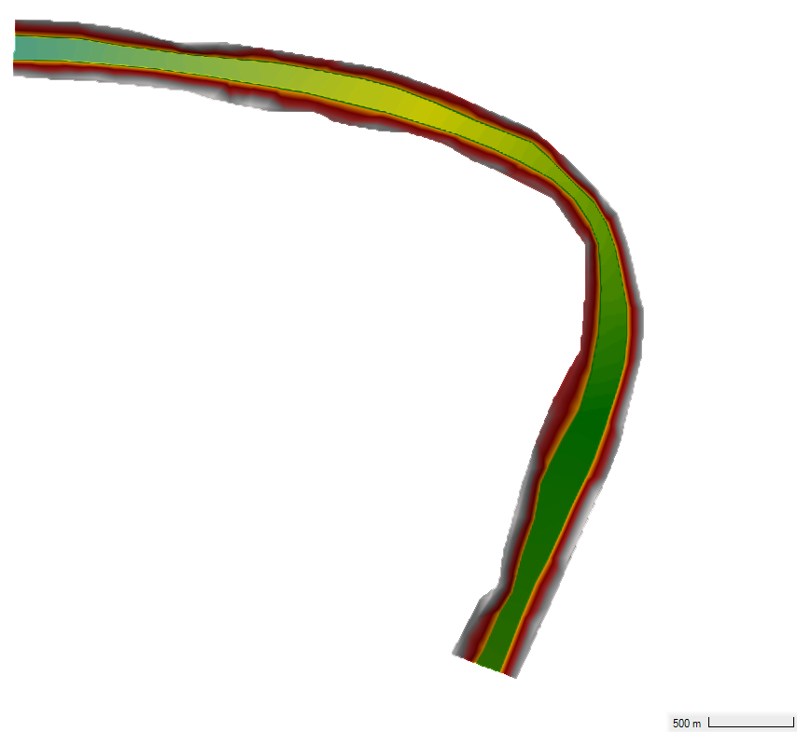
WP1 - Hydrological and hydraulics models development
Hydraulic models development
Approach to derive river network cross sections where cross sections are not available
COP30 dataset;
Digitize river bottom lines defining the underwater portion, lowering the elevation of the riverbanks;
Interpolate bank lines and river bottom lines with TIN technique;
Merge COP 30 terrain dataset with river interpolated part.

Slide 14
WP1 - Hydrological and hydraulics models development
Hydraulic models development
Approach to derive river network cross sections where cross sections are not available
Extract bank elevation from COP30 dataset;
Digitize river bottom lines defining the underwater portion, lowering the elevation of the riverbanks;
Interpolate bank lines and river bottom lines with TIN technique;
Merge COP 30 terrain dataset with river interpolated part.

Slide 15
WP1 - Hydrological and hydraulics models development
Hydraulic models development
Approach to derive river network cross sections where cross sections are not available
Extract bank elevation from COP30 dataset;
Digitize river bottom lines defining the underwater portion, lowering the elevation of the riverbanks;
Interpolate bank lines and river bottom lines with TIN technique;
Merge COP 30 terrain dataset with river interpolated part.

Slide 16
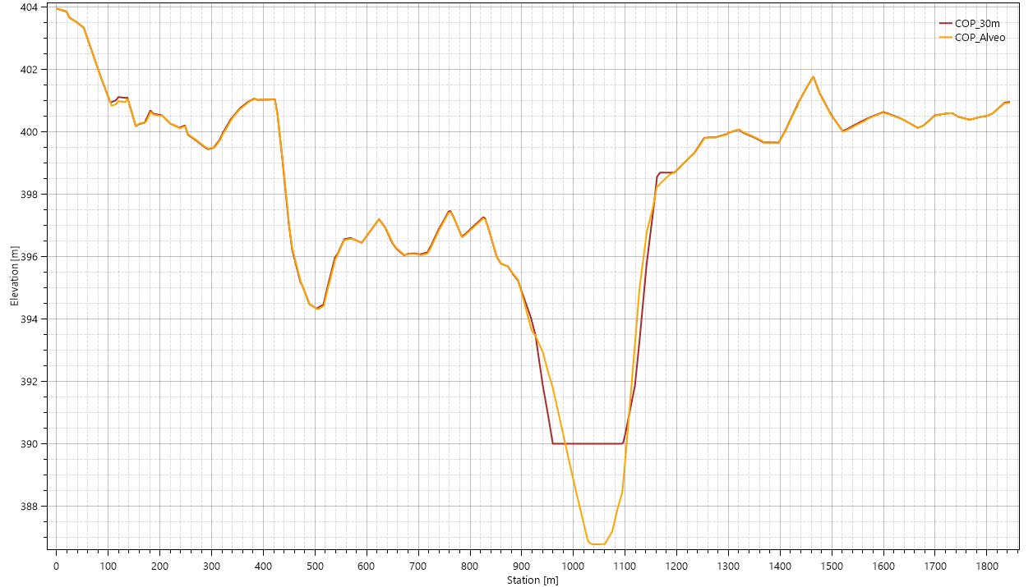
WP1 - Hydrological and hydraulics models development
Hydraulic models development
Approach to derive river network cross sections

Slide 17
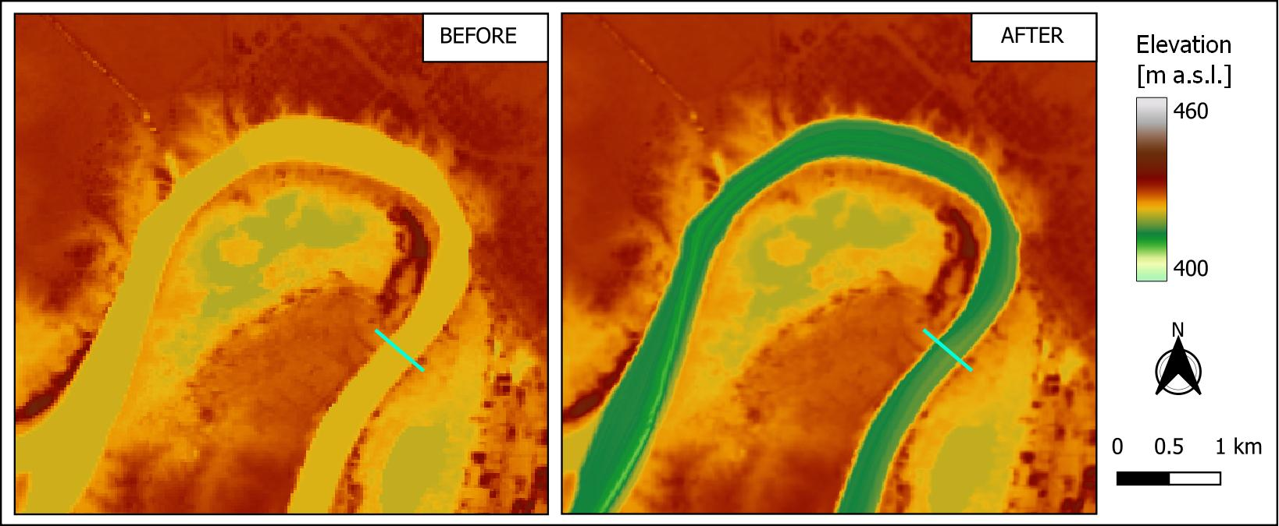
WP1 - Hydrological and hydraulics models development
Hydraulic models development

Slide 18
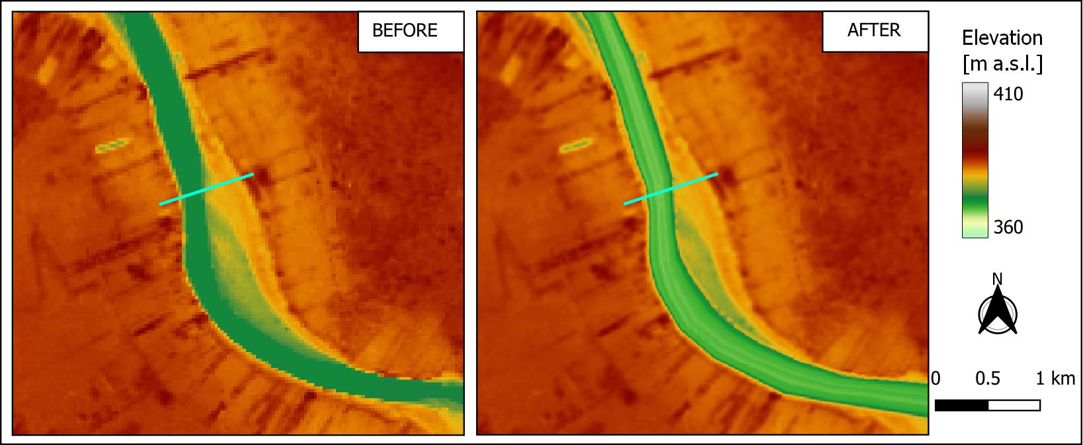
WP1 - Hydrological and hydraulics models development
Hydraulic models development

Slide 19
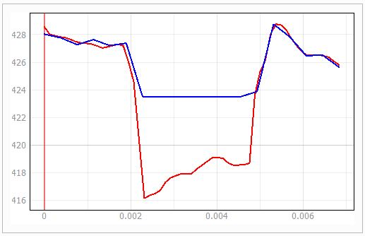
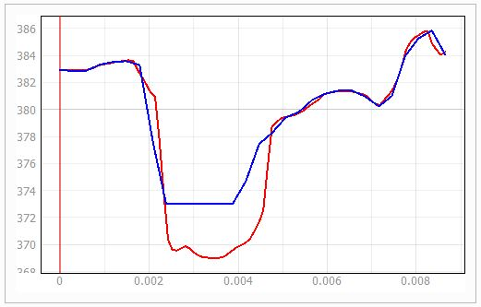
WP1 - Hydrological and hydraulics models development
Hydraulic models development

Slide 20
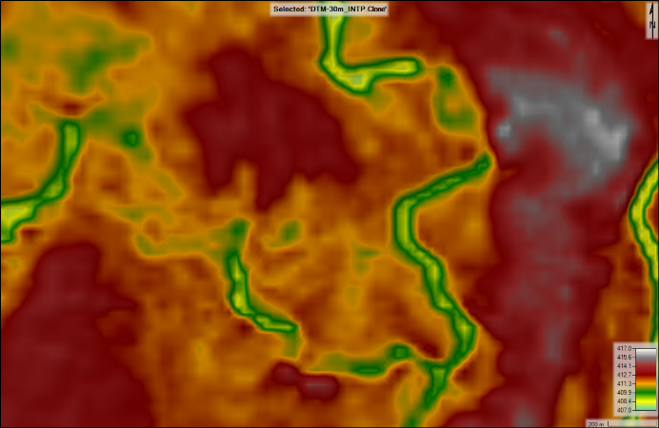
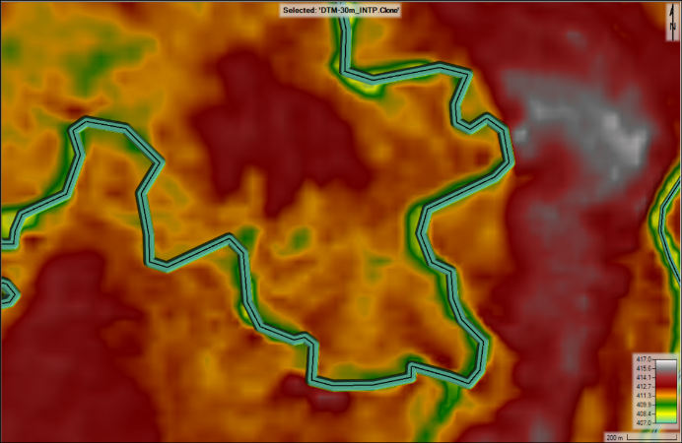
WP1 - Hydrological and hydraulics models development
Hydraulic models development
For some rivers the above approach cannot be applied:
Because of the erratic pattern of the Gash River, this reach was not included in the RAS model network.
Some other reaches have a river width smaller or comparable with DTM resolution: HEC-RAS tool which allows the user to modify the DTM elevation creating simplified channels and banks directly in the model:
  Delineate streamline of the reach;
  Modify the DTM using HEC-RAS tool: edit a channel along the streamlines with a fixed bottom width and side slope;
  Adjust the elevation profile along the streamlines, lowering the terrain elevation.

Slide 21
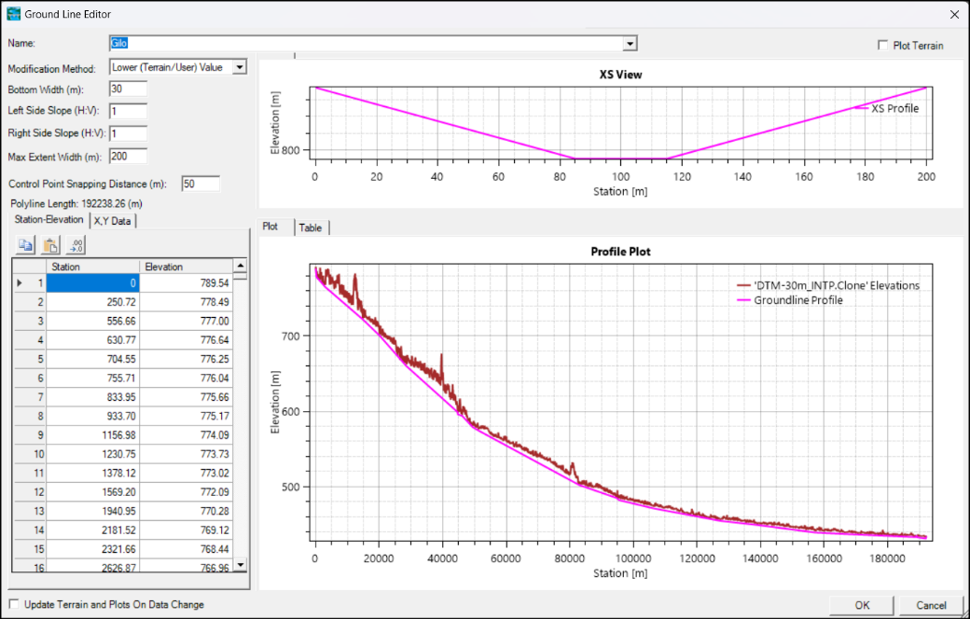
WP1 - Hydrological and hydraulics models development
Hydraulic models development

Slide 22
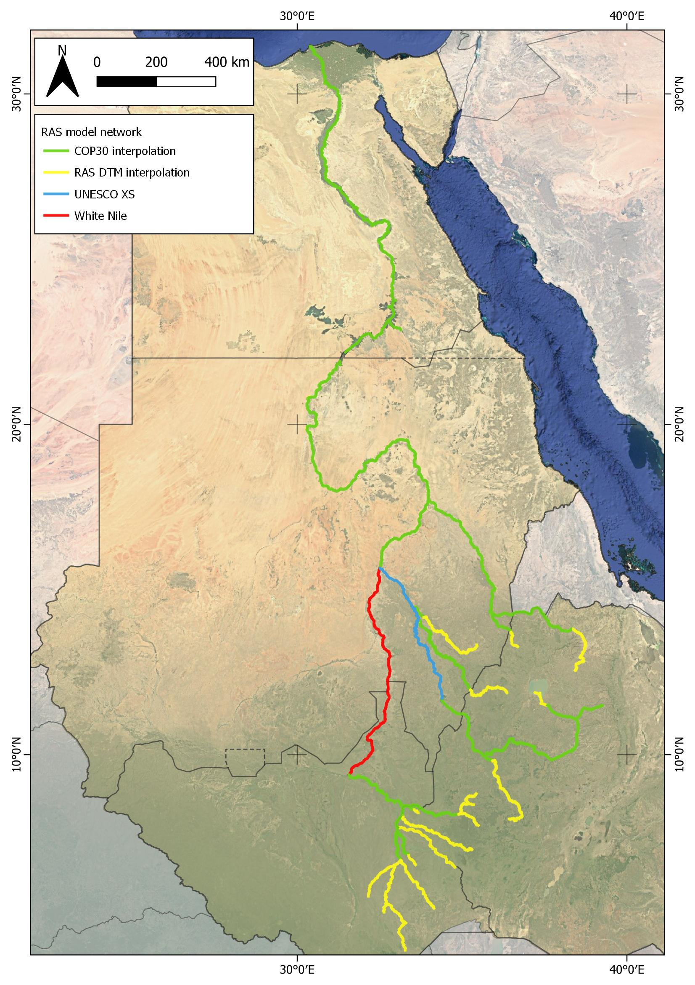
WP1 - Hydrological and hydraulics models development
Hydraulic models development

Slide 23
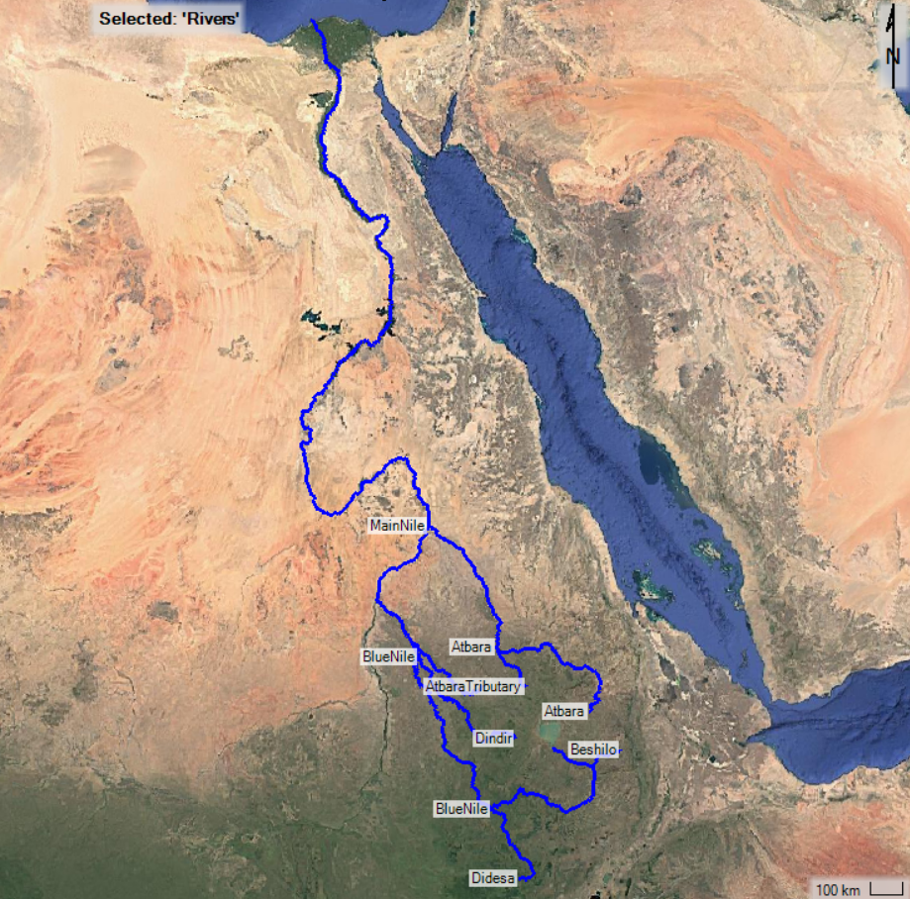
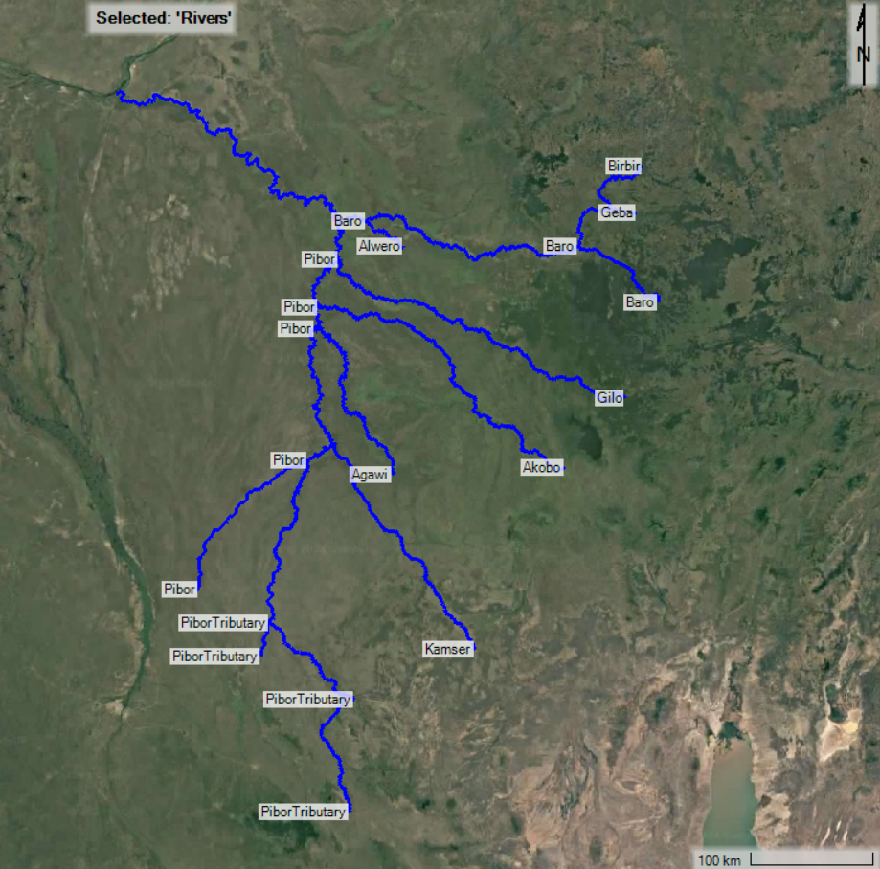
WP1 - Hydrological and hydraulics models development
Hydraulic models development
Model set-up
Two models were created to schematize the river network:
One of them covers the reaches located in Blue Nile, Atbara and Main Nile subbasins
while the other provides the discretization of Baro-Akobo-Sobat subbasin.
This choice is due to the fact that White Nile is not included in the RAS model network, so the two models cannot be directly connected.

Slide 24
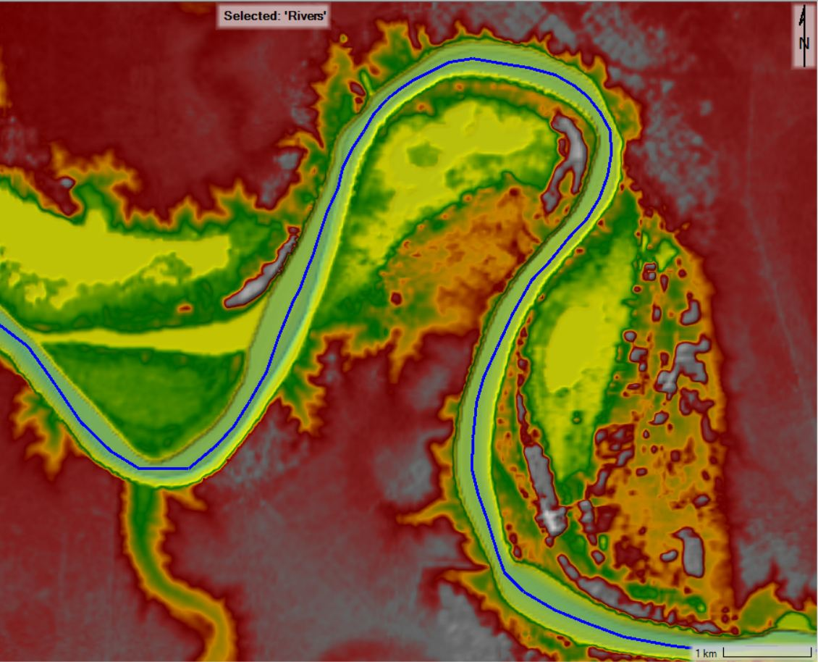
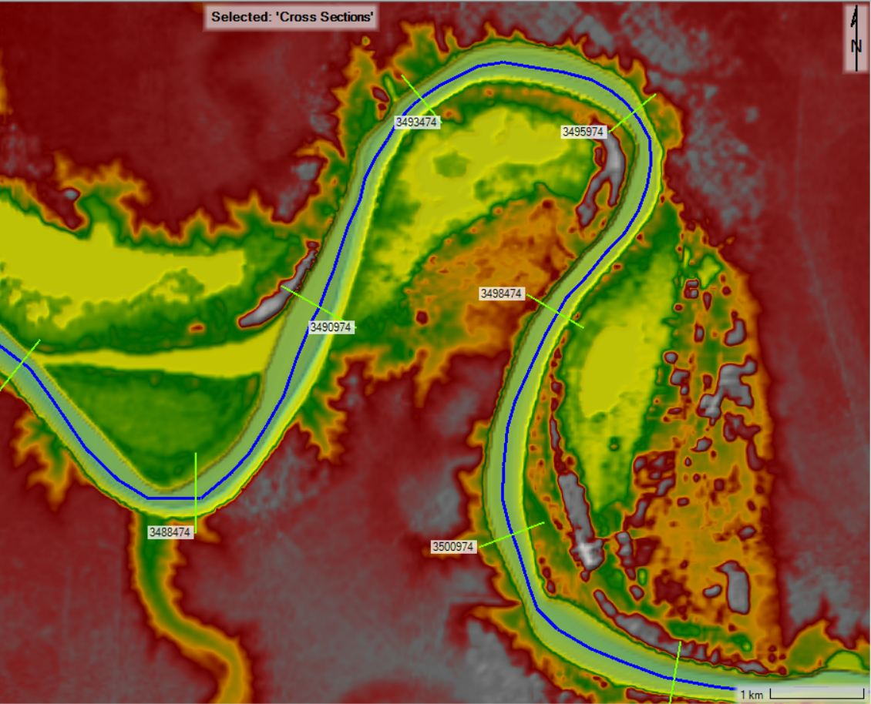

WP1 - Hydrological and hydraulics models development
Hydraulic models development
Model set-up
For each reach included in the hydraulic model, the procedure followed to implement the river geometry is the following:
Define the streamline;
Define the cross sections, which have a suitable extension, are equally spaced and always perpendicular to their streamline;
Set the banks stations for each section, importing the banks lines used in the interpolation process.

Slide 25
WP1 - Hydrological and hydraulics models development
Hydraulic models development
BARO–AKOBO–SOBAT SUBBASIN
RIVER AND REACH | N. CROSS SECTION | LENGTH (km)
Agawi | 592 | 262
Akobo | 989 | 493
Alwero | 118 | 58
Baro | 613 | 394
Alwero-Pibor | 40 | 29
Baro Up | 233 | 115
Birbir-Alwero | 340 | 250
Birbir | 363 | 144
Birbir Up | 219 | 87
Geba-Baro | 144 | 57
Geba | 62 | 24
Gilo | 924 | 461
Kamser | 502 | 250
Pibor | 1064 | 578
Agawi-Akobo | 63 | 37
Akobo-Gilo | 108 | 63
Gilo-Baro | 90 | 53
Kamser-Agawi | 251 | 150
Pibor | 431 | 215
Tributary-Kamser | 121 | 60
PiborTributary | 2430 | 459
Tbt Up-Tbt Down | 445 | 111
Tributary Down | 182 | 36
Tributary Down-Pibor | 1190 | 297
Tributary Up | 52 | 15
Sobat | 467 | 349
TOT | 8124 | 3472
Model set-up
These are the rivers, reaches, n. cross section and total length schematize for each model:
BLUE NILE – ATBARA – MAIN NILE SUBBASINS
RIVER AND REACH | N. CROSS SECTION | LENGTH (km)
Atbara | 1367 | 1164
Atbara Up | 1021 | 630
Tributary-Blue | 346 | 534
AtbaraTributary | 349 | 213
Beshilo | 89 | 132
BlueNile | 1363 | 2055
Beshilo-Didesa | 564 | 563
Didesa-Dindir | 320 | 731
Dindir-Rahad | 27 | 65
LakeTana-Beshilo | 223 | 164
Rahad-Atbara | 229 | 532
Didesa | 815 | 425
Dindir | 1455 | 805
MainNile | 973 | 2708
Atbara-Delta | 973 | 2708
Rahad | 1681 | 692
TOT | 8092 | 8164

Slide 26
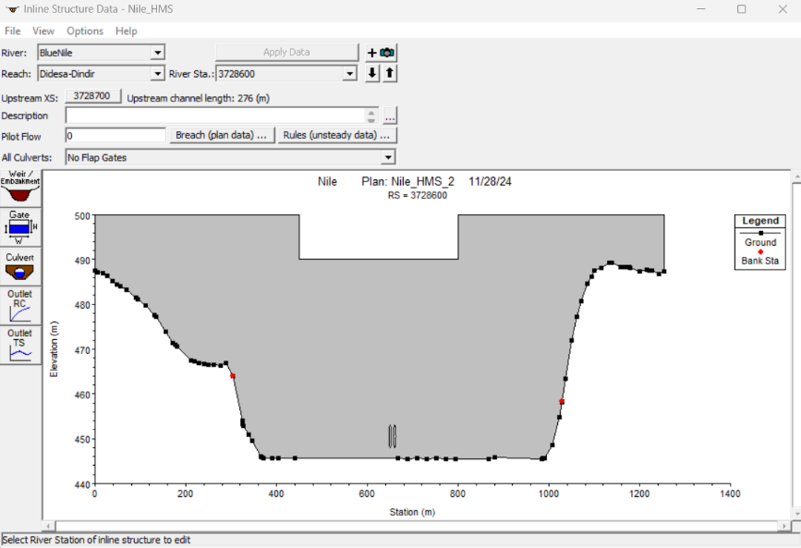
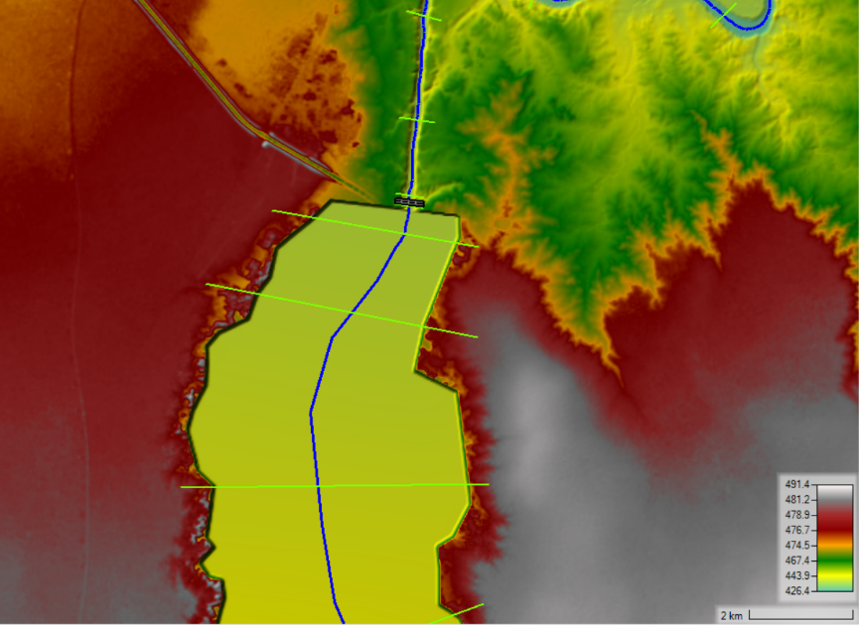
WP1 - Hydrological and hydraulics models development
Hydraulic models development
Model set-up
Hydraulic structures were implemented in the geometry. The RAS model includes the following dams:
Renaissance Dam;
Roseires Dam;
Sennar Dam;
Rumela and Burdana Dams;
Khashm al Girbah Dam;
Merowe Dam;
Aswan Dam.
Some limitations apply. In fact, the operation of the dams in RAS is kind of limited; for this reason, reservoirs management is more correctly addressed by Res-Sim (WP2). Having the dams in the model allows for keeping the whole system in the same geometry and allows the users to run full simulations of the river network.

Slide 27
WP1 - Hydrological and hydraulics models development
Hydraulic models development
Calibration
A proper calibration was not possible to be performed, for the following reasons:
The available observed stage time series are too few;
The presence of the dams impacts the actual water level in the network; the reservoir operation is not known in detail and RAS has anyway limitations in the operation management of the inline structures. Inline structures in RAS were set so as to reproduce as much as possible the reservoirs management defined in WP2 model.

Slide 28
WP1 - Hydrological and hydraulics models development
Hydraulic models development
Calibration
The main governing parameter set for the model is the roughness coefficient, which was set preliminarily following technical literature, as shown in the table below
River name | Reach name | Main channel | Overbanks
Beshilo | Beshilo | 0.06 | 0.08
Didesa | Didesa | 0.06 | 0.08
Blue Nile | Lake Tana – Beshilo | 0.10 | 0.10
 |  | 0.06 | 0.08
 | Beshilo – Didesa | 0.04 | 0.05
 | Didesa – Dindir | 0.04 | 0.05
 | Dindir – Rahad | 0.04 | 0.05
 | Rahad - Atbara | 0.04 | 0.05
Dindir | Dindir | 0.04 | 0.05
Rahad | Rahad | 0.04 | 0.05
Atbara Tributary | Atbara Tributary | 0.04 | 0.05
Atbara | Atbara Upstream | 0.04 | 0.05
 | Tributary - Blue | 0.04 | 0.05
 |  | 0.08 | 0.08
Main Nile | Atbara - Delta | 0.04 | 0.05

Slide 29
WP1 - Hydrological and hydraulics models development
Hydraulic models development
Simulations
Given the computational effort required for long term simulations, and the scope of the tool, the HEC-RAS software has been used to perform simulations on the river network for selected representative years.
A statistical analysis was performed to identify the characteristics of years to be simulated, in particular three different years have been taken into account from the HMS time series of over 50 years.
From this distribution three representative years have been identified:
Dry Year: 25 percentile of the simulated years annual average flow;
Reference Year: 50 percentile of the simulated years annual average flow;
Wet Year: 75 percentile of the simulated years annual average flow.

Slide 30
WP1 - Hydrological and hydraulics models development
Hydraulic models development
Simulations

Slide 31
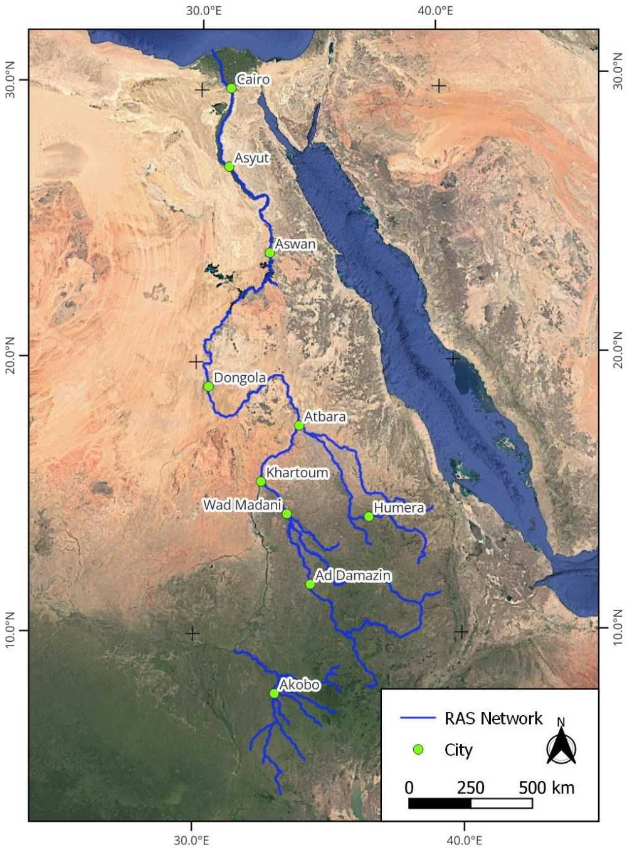
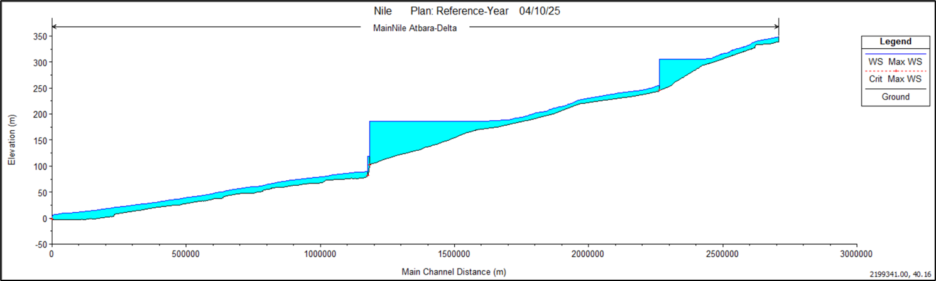
WP1 - Hydrological and hydraulics models development
Hydraulic models development
Simulations
The results of simulations provide the water surface elevation and velocity along the whole network, and the river profiles.

Slide 32
WP1 - Hydrological and hydraulics models development
Hydraulic models development
Model limitations
limitations in the cross section geometry used (except for Blue Nile reach);
scattered data about observed water level;
lack of data about the reservoirs release, and limitations in the RAS capacity to represent reservoirs management.
The models should be regarded as a tool to be updated in the future, when additional data is collected and can be used as a reference when there is a need from any stakeholder to extract a specific river reach and perform 1D hydraulic analysis

