Slide 1

Eastern Nile Technical Regional Office (ENTRO)
Consultancy service for the Development of the Eastern Nile Water Resources Models and Tools
Nile Cooperation for Climate Resilience
Validation Workshop
12-14 June 2025

Slide 2
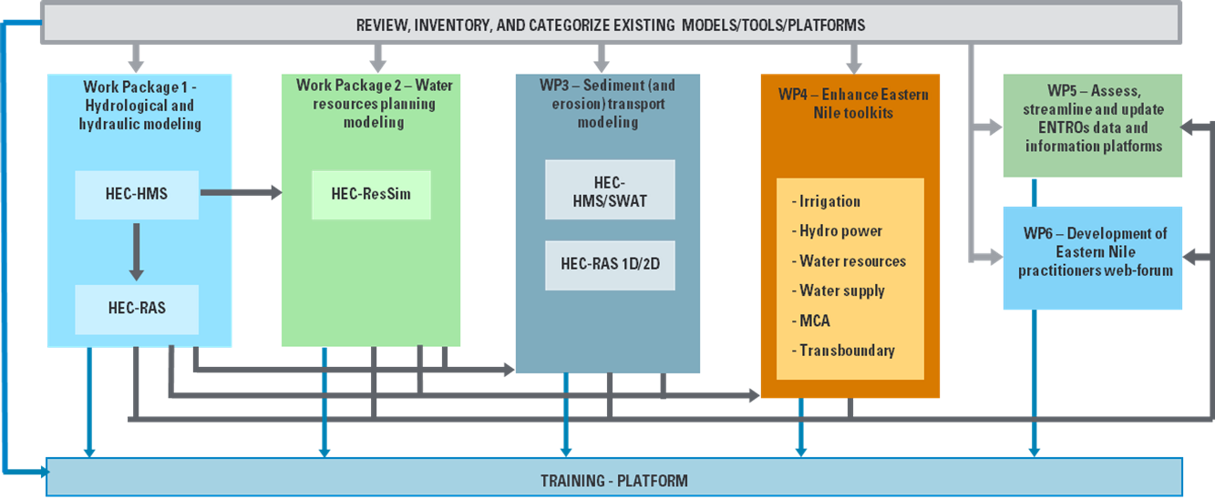

Methodological approach
Schematization of the integrated approach pursued by the Consultant

Slide 3
Workshop Agenda
Time (hrs) | Presentation / Activity | Responsible Person
 | June 13, 2025 - Day 2 | Chair: To be assigned
9:00 – 9:10 | Recap of Day 1 | HydroNova/ ENTRO
9:10- 10:30 | Presentation on the development of Hydrological model | HydroNova (Consultant)
10:30 – 11:00 | Health Break | ALL
11:00-13:00 | Interactive session on hydrological model | All
13.00 – 14:00 | Lunch Break | Hotel
14:00 – 15:30 | Presentation on the development of Hydraulic model | HydroNova (Consultant)
15:30-16:00 | Health Break | Hotel
16:00-17:00 | Interactive session on hydraulic model | ALL
16:30- 17:30 | Feedback and Recommendations on WP1 | ALL

Slide 4
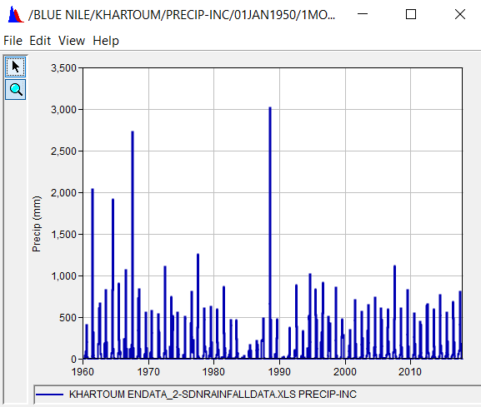
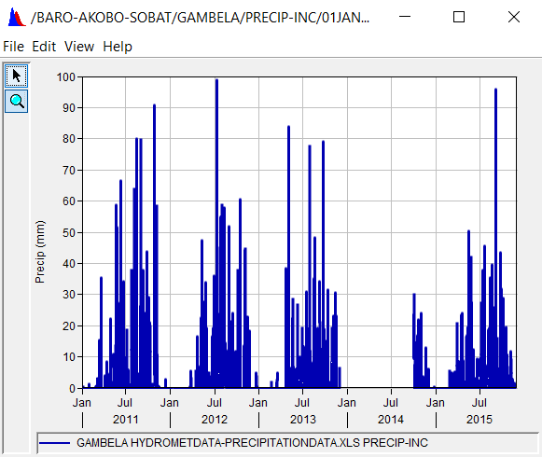
WP1 - Hydrological and hydraulics models development
Hydro-meteo Database implementation
Hydro-meteo data collected can be classified into two main groups: meteorological data (rainfall and temperature) and hydrological time series (flow and water level).
Two separate files were developed one for meteorological dataset and the other for hydrological dataset, in dss format. Each dss file is coupled with a GIS file providing the position of the gauging stations.
Meteorological datasets include 747 records, while hydrological datasets include 163 records.

Slide 5
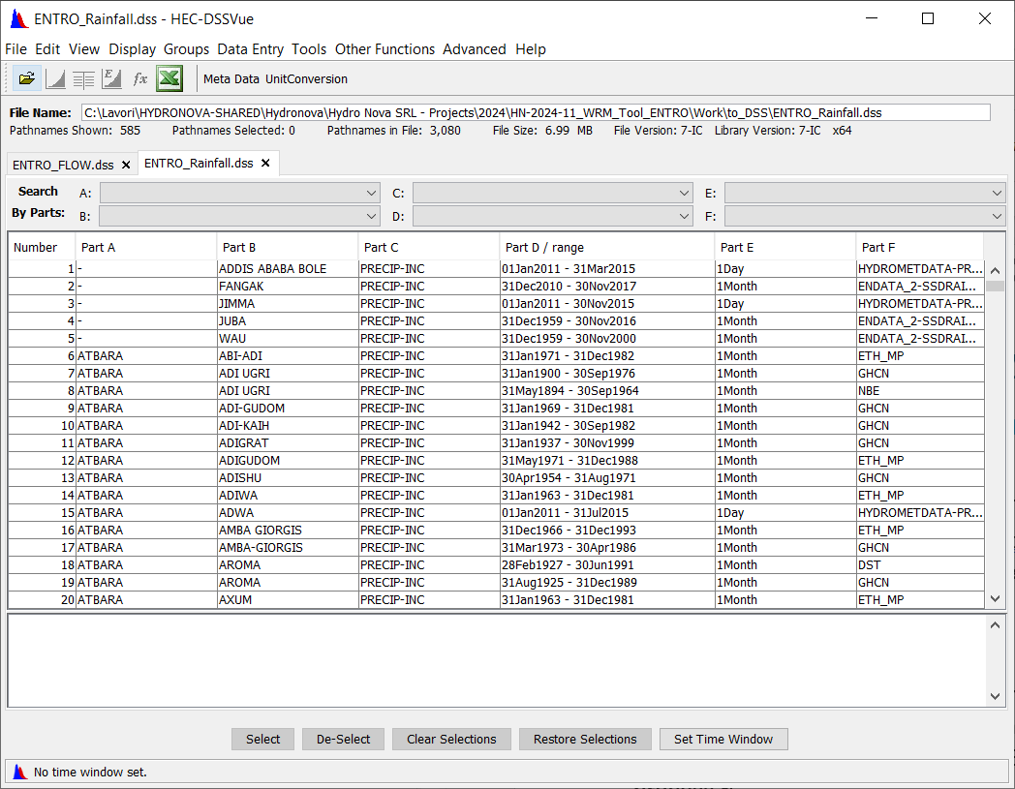
WP1 - Hydrological and hydraulics models development
Hydro-meteo Database implementation
A | B | C | D | E | F
Main Basin | River at Station/Location | Type: Flow/Precipitation | Range | Time step | SOURCE

Slide 6
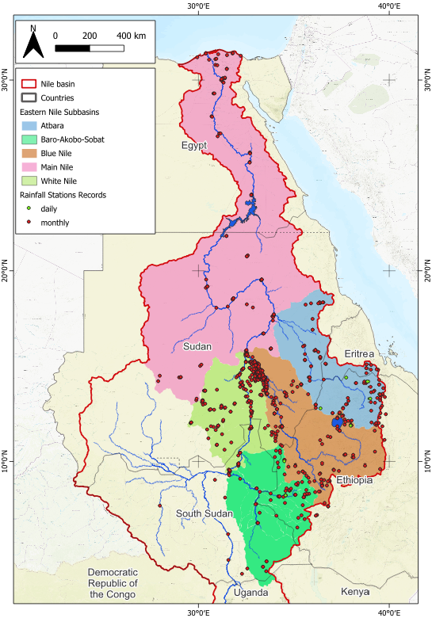
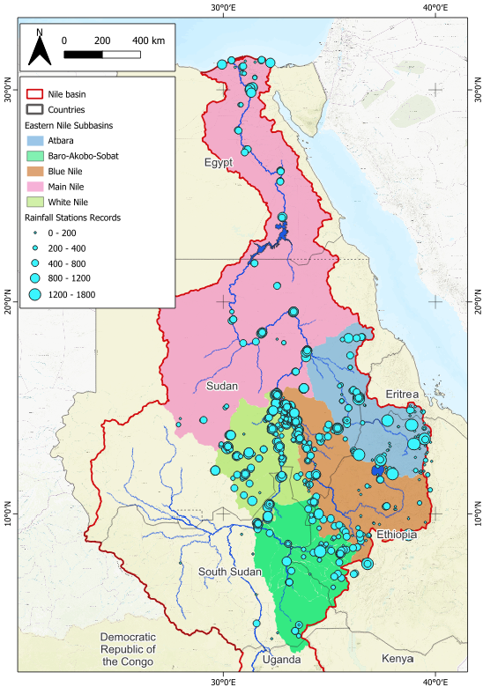
WP1 - Hydrological and hydraulics models development
Hydro-meteo Database implementation

Slide 7
WP1 - Hydrological and hydraulics models development
Hydro-meteo Database implementation

Slide 8
WP1 - Hydrological and hydraulics models development
Hydro-meteo Database implementation
 | Count of STATION
Atbara | 93
daily | 6
monthly | 87
Baro-Akobo-Sobat | 72
daily | 2
monthly | 70
Blue Nile | 232
daily | 16
monthly | 216
Main Nile | 94
monthly | 94
White Nile | 256
daily | 1
monthly | 255
Grand Total | 747

Slide 9
WP1 - Hydrological and hydraulics models development
Hydro-meteo Database implementation
 | Count of STATION
White Nile | 256
PRECIPITATION | 256
Main Nile | 94
PRECIPITATION | 94
Blue Nile | 232
MAX TEMPERATURE | 2
MIN TEMPERATURE | 2
PRECIPITATION | 228
Baro-Akobo-Sobat | 72
PRECIPITATION | 72
Atbara | 93
PRECIPITATION | 93
Grand Total | 747

Slide 10
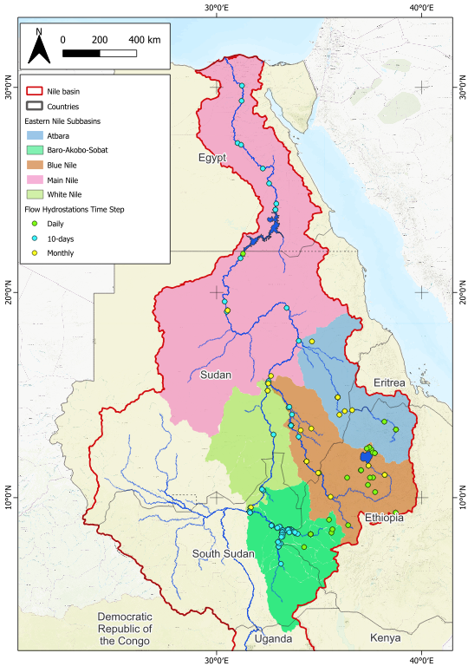

WP1 - Hydrological and hydraulics models development
Hydro-meteo Database implementation

Slide 11
WP1 - Hydrological and hydraulics models development
Hydro-meteo Database implementation

Slide 12
WP1 - Hydrological and hydraulics models development
Hydro-meteo Database implementation
Subbasin | Number of Stations
ATBARA | 11
10-days | 3
daily | 2
monthly | 6
BARO-AKOBO-SOBAT | 69
10-days | 62
daily | 6
monthly | 1
BLUE NILE | 44
10-days | 11
daily | 24
monthly | 9
MAIN NILE | 19
10-days | 14
monthly | 4
10 days | 1
WHITE NILE | 20
10-days | 9
daily | 8
monthly | 3
Total | 163

Slide 13
WP1 - Hydrological and hydraulics models development
Hydro-meteo Database implementation
Subbasin | Number of Stations
ATBARA | 11
FLOW | 11
BARO-AKOBO-SOBAT | 69
FLOW | 69
BLUE NILE | 44
FLOW | 44
MAIN NILE | 19
FLOW | 19
WHITE NILE | 20
ELEVATION | 6
FLOW | 14
Total | 163

Slide 14
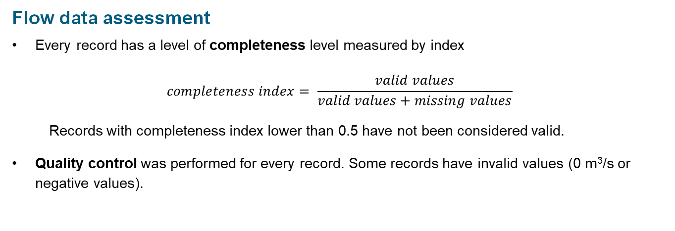
WP1 - Hydrological and hydraulics models development
Hydro-meteo Database implementation
Flow data assessment
Every record has a level of completeness level measured by index
$$completeness index= \frac{valid values}{valid values+missing values}$$
Records with completeness index lower than 0.5 have not been considered valid.
Quality control was performed for every record. Some records have invalid values (0 m³/s or negative values).

Slide 15
WP1 - Hydrological and hydraulics models development
Hydro-meteo Database implementation
Flow data assessment
 | Count of STATION | Average of COMPLETENESS | Min of COMPLETENESS | Max of COMPLETENESS
ATBARA | 11 | 0.85 | 0.37 | 1.00
10-days | 3 | 0.57 | 0.37 | 0.79
daily | 2 | 0.93 | 0.93 | 0.94
monthly | 6 | 0.96 | 0.76 | 1.00
BARO-AKOBO-SOBAT | 69 | 0.49 | 0.12 | 1.00
10-days | 62 | 0.44 | 0.12 | 1.00
daily | 6 | 0.89 | 0.77 | 1.00
monthly | 1 | 1.00 | 1.00 | 1.00
BLUE NILE | 44 | 0.87 | 0.19 | 1.00
10-days | 11 | 0.80 | 0.36 | 1.00
daily | 24 | 0.85 | 0.19 | 1.00
monthly | 9 | 1.00 | 1.00 | 1.00
MAIN NILE | 19 | 0.94 | 0.33 | 1.00
10-days | 14 | 0.91 | 0.33 | 1.00
monthly | 4 | 1.00 | 1.00 | 1.00
10 days | 1 | 1.00 | 1.00 | 1.00
WHITE NILE | 20 | 0.81 | 0.02 | 1.00
10-days | 9 | 0.68 | 0.02 | 1.00
daily | 8 | 0.89 | 0.26 | 1.00
monthly | 3 | 1.00 | 1.00 | 1.00
Grand Total | 163 | 0.71 | 0.02 | 1.00

