Slide 1
Eastern Nile Technical Regional Office (ENTRO)
Consultancy service for the Development of the Eastern Nile Water Resources Models and Tools
Nile Cooperation for Climate Resilience
Training of Trainers in Eastern Nile Water Resources Models and Tools
HEC-ResSim
6 – 10 May 2025

Slide 2
Schedule
BASIC PRINCIPLES
Operational goals by purpose
Reservoir system data requirement
Simulation considerations
INTRODUCING RESSIM
Download
GUI
Modules
Directory
WATERSHED SETUP MODULE
Background maps
Stream alignment
Schematic elements
Watershed configuration
RESERVOIR NETWORK MODULE
Create network
Routing reaches
Element properties: junctions
Element properties: reaches
Element properties: diversions
Element properties: reservoirs
Reports
Alternatives
SIMULATION
Create a simulation
Computing a simulation
Viewing the results
Calibration
Connection with Network Module
Reports

Slide 3
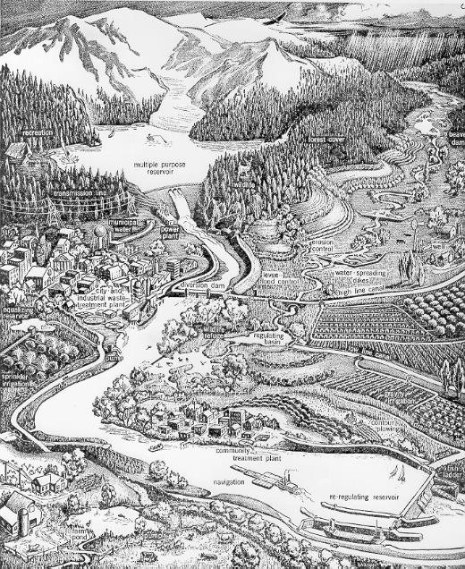
1. Basic principles
Reservoir operation is the act or process of storing water in and releasing water from a reservoir.
Basic principles for simulating reservoir operation
Operational goals by purpose
Reservoir system data requirements
Physical data
Operational data
Simulation considerations

Slide 4
1. Basic principles
1.1 Operational Goals by purpose
Purpose | Operational Goals
Flood Control | Reduce or minimize damages
Hydropower | Meet load, no spill
Water Supply for Irrigation, M&I | Meet seasonal diversion demands

Slide 5
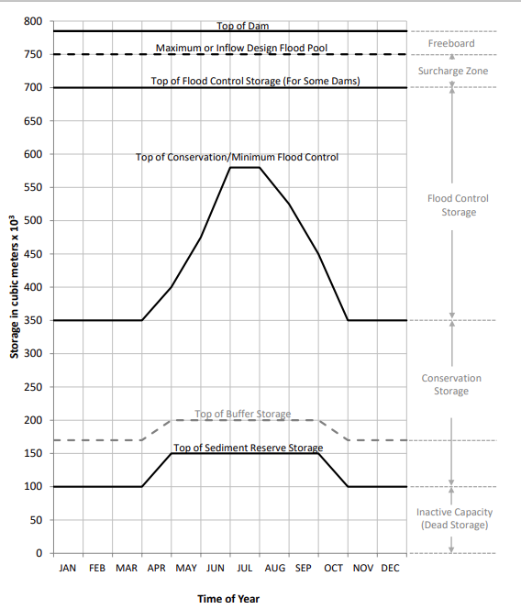
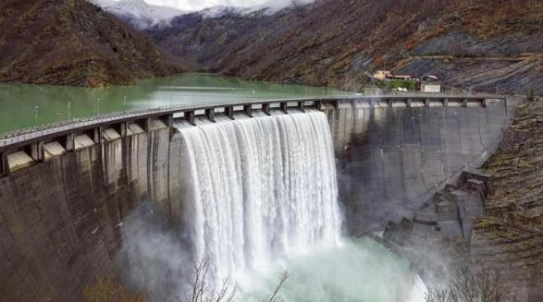
1. Basic principles
1.1 Operational Goals by purpose
FLOOD CONTROL
To reduce or minimize damages and to not endanger the dam, a reservoir must:
Release flood storage as quickly as possible (through spillways)
Let enough space in the flood control storage
Notes:
Operation of Storage Space. Flood control reservoirs are designed to minimize flooding downstream by capturing upstream runoff and releasing it from storage at a controlled rate.
In some cases, pool elevations are drawn down through the fall and winter to provide more storage in early spring for the runoff season and are then allowed to increase to provide water for other purposes in the late summer.
Releases.
(Flood control releases are guided by predetermined flow limits at downstream locations (control points) to help prevent damages. Downstream control points are typically stream gauges located in communities along the river)

Slide 6
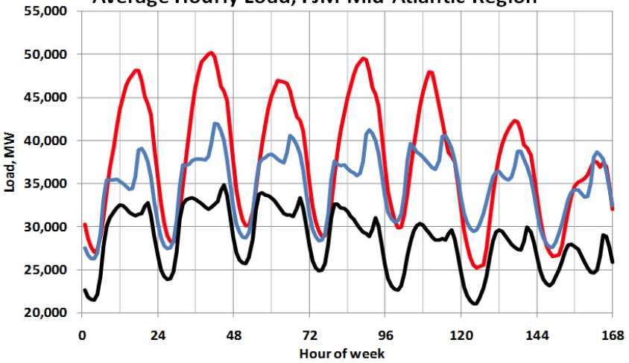
1. Basic principles
1.1 Operational Goals by purpose
HYDROPOWER
To meet the daily, weekly, seasonal power demand, a reservoir must:
Release water when needed
Notes:
Reservoir projects with hydropower generally fall into two distinct categories: storage reservoirs with sufficient capacity to regulate flow on a seasonal, daily or hourly basis, and run-of-river projects in which storage capacity is minor relative to the volume of flow.

Slide 7
1. Basic principles
1.1 Operational Goals by purpose
WATER SUPPLY
To provide water for:
Irrigation
Municipality
Industry
A reservoir must store much water as possible, in order to release it when needed.
Notes:
Irrigation water supply. The requirements vary seasonally, and the agricultural growing season begins in the spring months. The diversion requirements gradually increase as the summer progresses, reaching their maximum amounts in July or August. They then recede to relatively low amounts by late summer. By the end of the growing season, irrigation diversions are terminated, except for minor amounts of water that may be necessary for domestic use, stock water, or other purposes.
Municipality and industry demand are constant during the year, with daily and weekly fluctuation.

Slide 8
1. Basic principles
1.1 Operational Goals by purpose
OPERATING CONFLICTS
Flood Control vs Conservation:
Save space for flood control or save water for water supply?
Hydropower vs Conservation:
Release water to meet peak demands or save water to use during the growing season?
Flood Control
Conservation
Notes:
As you may have already guessed.

Slide 9
1. Basic principles
1.2 Reservoir system data requirements
RESERVOIR SYSTEM DATA REQUIREMENT
Physical data
River network
Gage location
Control points
Reservoir EAV curve
Dam specifications
Outlet specification
Spillway specification
Evaporation losses
Leakage losses
Diversions capacity
Routing parameters
…
Operational data
Flow requirement
Minimum navigation depth
HP demand schedule
Irrigation water demand schedule
Operation zone or level
….

Slide 10
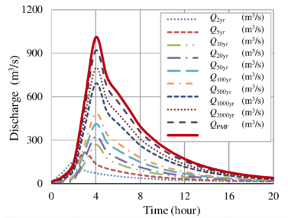
1. Basic principles
1.3 Simulation considerations
SIMULATION CONSIDERATION
Based on the scope of the simulation and on the available data:
Select an appropriate time step
Short: 15 min – 1 h
Long: 6 h – 1 d
Select a simulation length
Days to simulate a particular event
Years to simulate the long term management
Identify flow data
Long time inflow: simulated from HEC-HMS or historic from gauging station?
Event inflow: synthetic hydrographs or recorded event?

Slide 11
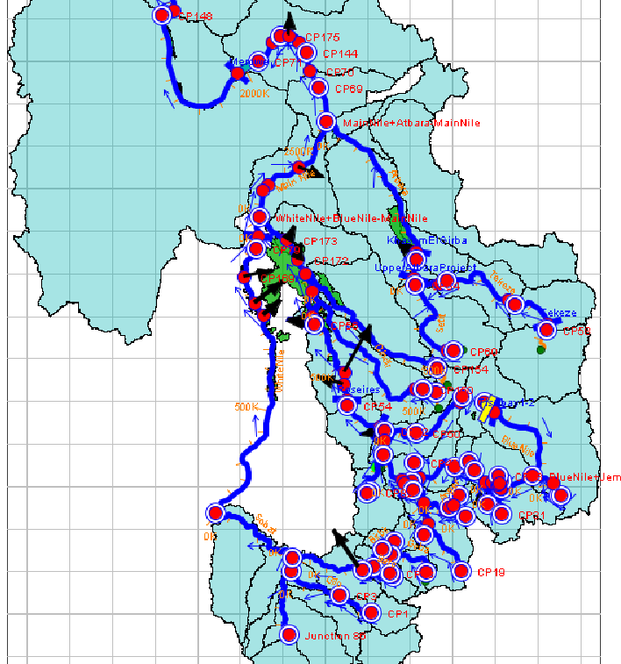
1. Basic principles
1.3 Simulation considerations
SIMULATION CONSIDERATION
Process:
Gather data and rearrange in the needed format
Combine physical, operational data
Set initial conditions
Set time step and duration
Check the results
COMPUTE

Slide 12
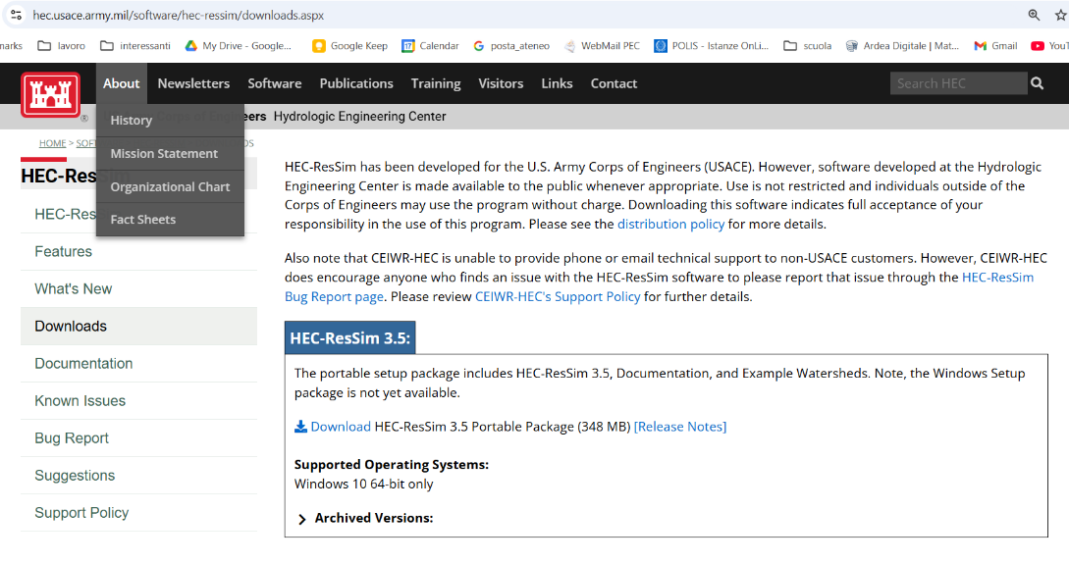
2. Introducing RESSIM
2.1 Download
DOWNLOAD HEC-RESSIM 3.5
https://www.hec.usace.army.mil/software/hec-ressim/downloads.aspx
Notes:
It is a portable package so you need to put it in a safe place.

Slide 13
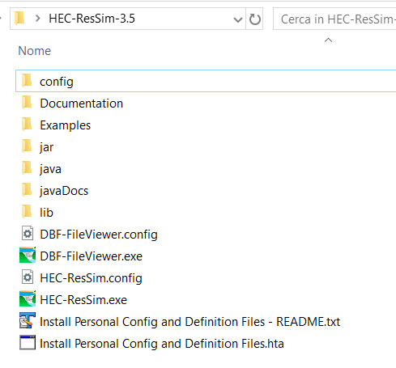
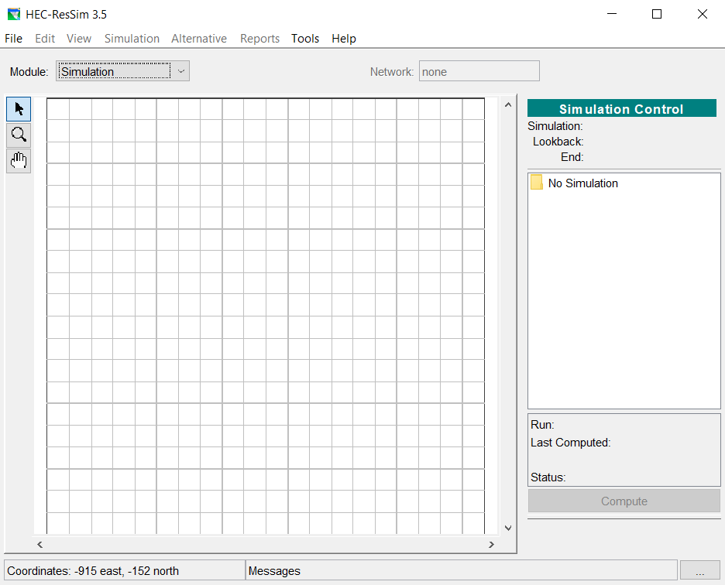
2. Introducing RESSIM
2.1 Download
DOUBLE CLICK ON HEC-ResSim.exe
Notes:
When you open the folder you will find this list.
Double click on HEC-ResSim.exe

Slide 14
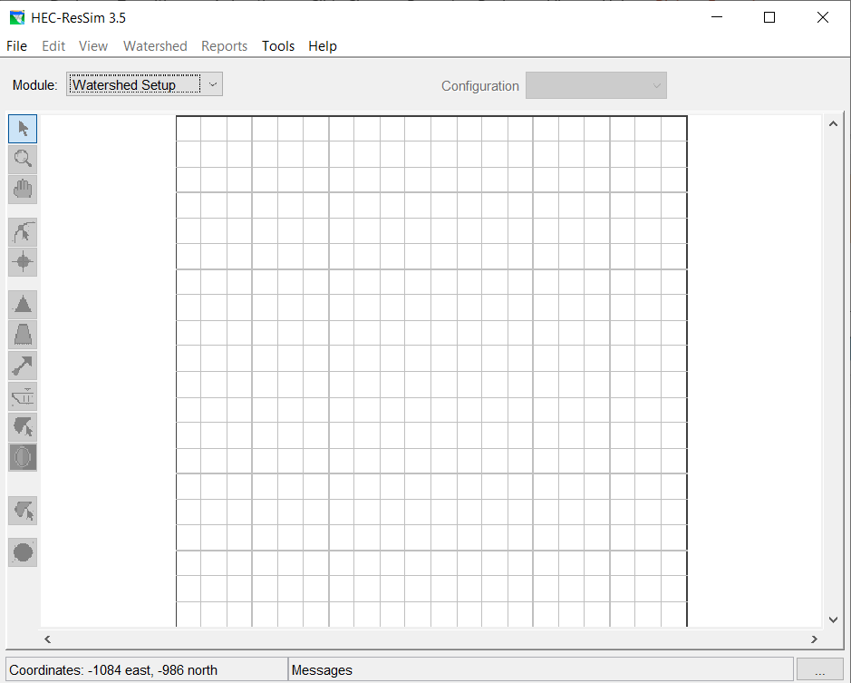
2. Introducing RESSIM
2.2 GUI
Title bar
Menu bar
Module toolbar
Configuration or Network selector
Map toolbar
Map
Graphical User Interface
Status bar
Notes:
From the top down
Title bar: when you open a project, the name of the project will appear in the title bar.
Menu bar: This part will change based on the module you are working on
Configuration or network selector: also this part will change based on the module
Map tool bar: also this part will change based on the module

Slide 15
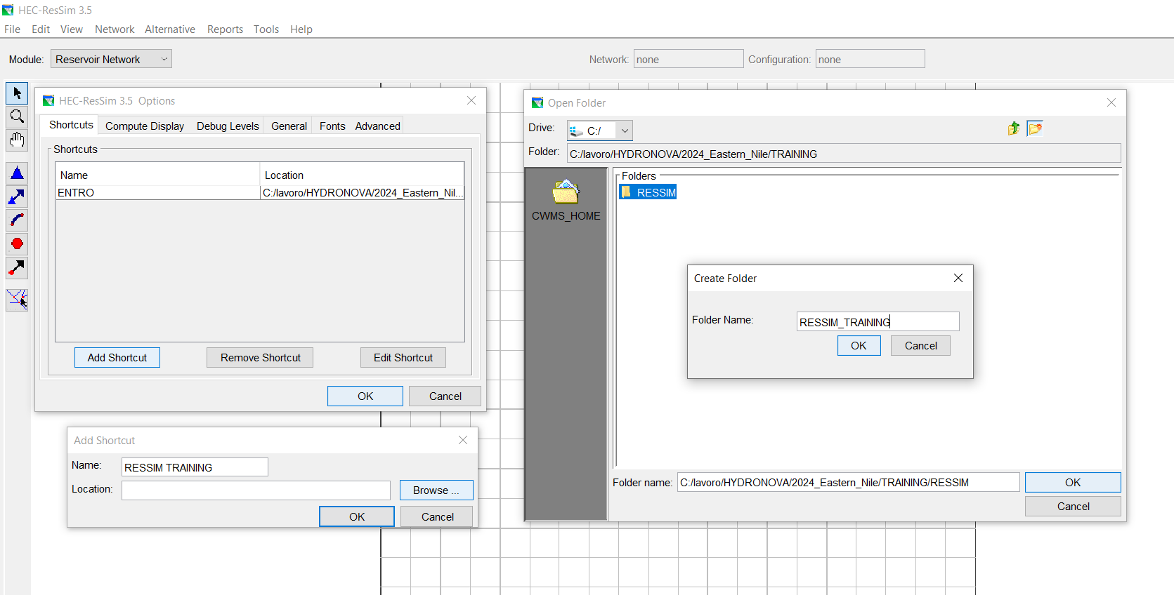
2. Introducing RESSIM
2.2 GUI
Exercise: create a SHORTCUT
Menu bar: Tools – Options
5. Select the parent folder
6. Create a new folder “RESSIM_TRAINING”
2. Add shortcut
3. Name the shortcut: “RESSIM TRAINING”
4. Browse
7. OK to close all the open windows
Notes:
The first step, is to create a space, a folder, in which the project is located. In the RESSIM this space is called SHORTCUT.
First of all open the dropdown menù Tools and choose Options.
A window called «HEC-ResSim 3.5 Options» will appear. Click on Add Shortcut.
A window called «Add shortcut» will Appear.
Choose a name for your space «RESSIM TRAINING».
Select the location, that is the parent folder clicking on BROWSE.
Create a new folder named «RESSIM_TRAINING».
CLICK OK TO CLOSE ALL THE OPEN WINDOW

Slide 16
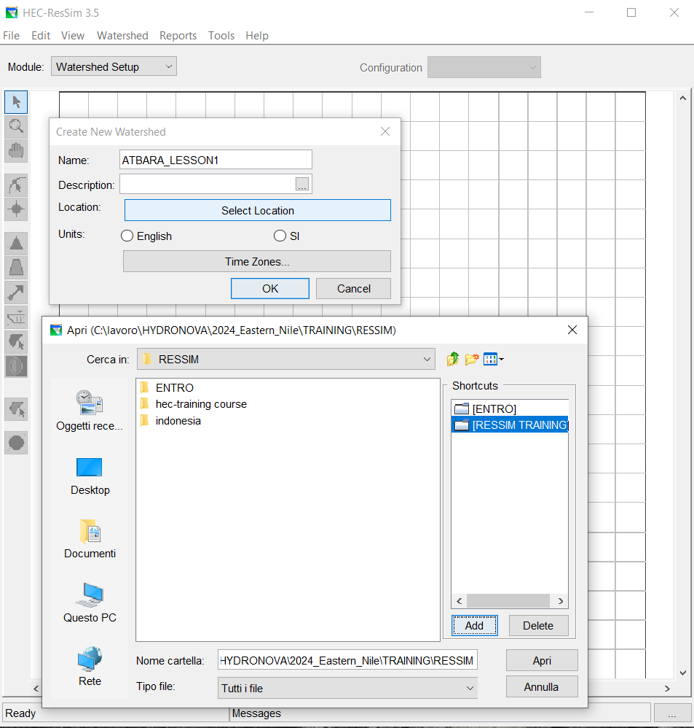
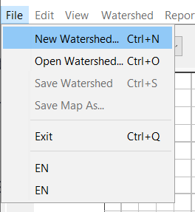
2. Introducing RESSIM
2.2 GUI
Exercise: create a WATERSHED
Module toolbar on Watershed setup
Menu bar: File – new watershed
Name the project “ATBARA_LESSON1”
Click on select location.
Choose the shortcut “RESSIM TRAINING” (double click)
Click on “OPEN”

Slide 17
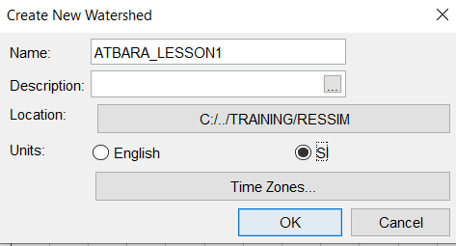
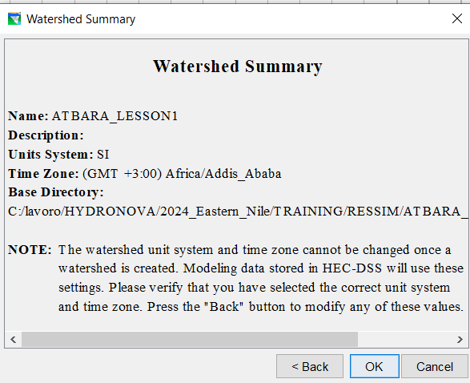
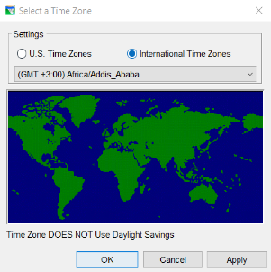
2. Introducing RESSIM
2.2 GUI
Exercise: create a WATERSHED
7. Choose “SI” as Units for the project
9. OK to close all the open windows
10. Receipt
8. Select time zone in the “International Time Zones”
(any time zone
GMT +3.00)
Notes:
If everything went well, this window appears on the screen, a sort of receipt.
Go to the project and explore the interface. Switch between the modules to see how the interface changes.

Slide 18
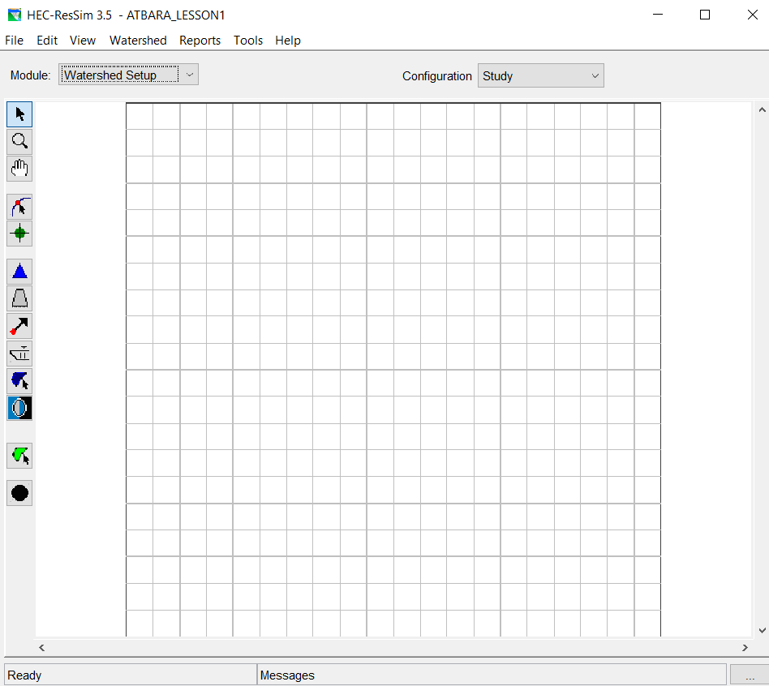
2. Introducing RESSIM
2.3 Modules
Switch between the modules:
The user interface will change
Notes:
If everything went well, this window appears on the screen, a sort of receipt.
Go to the project and explore the interface. Switch between the modules to see how the interface changes.

Slide 19
2. Introducing RESSIM
2.3 Modules
1 - WATERSHED SETUP MODULE
stream alignment
Basemaps
Reservoir position
Diversion position
Computation points
2 - RESERVOIR NETWORK MODULE
reservoirs
junctions
reaches
diversions
state variables
3 – SIMULATION MODULE
time window
WATERSHED CONFIGURATION
Select hydraulics elements
ALTERNATIVES
networks
operations
initial conditions
boundary conditions
Notes:
The design of the ResSim user interface separates the model development process into three major stages called modules: Watersehd setup, reservoir network, simulation.
The purpose of the watershed setup is to provide a common framework for defining the features of a watershed. In this module you can add background basemaps, add the stream aligmnets, the existing and future projects position. In the same module you can create different watershed configuration depicting for example the existing and the future configuration.
The purpose of the Reservoir Network is to add physical and operational data of the hydraulic elements (reaches, junction, diversions, reservoirs…). Each network is tied to a watershed configuration. For each network it is possible to build different alternatives. Every alternatives contains information about the operational data, the initial and boundary conditions.
The purpose of the simulation module is to select a time window and run the simulation. From the simulation module it is possible temporarily modify the network to check the answer of the system, it is also possible to save the eventual changes, applying them to the network.

Slide 20
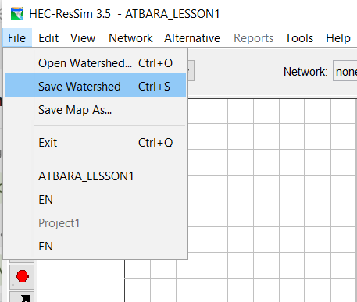
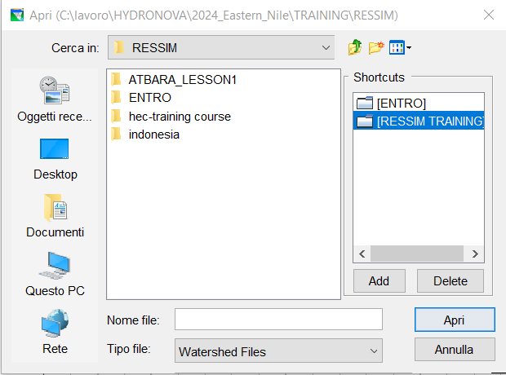
2. Introducing RESSIM
2.3 Modules
Exercise: Close and Open projects
Save Watershed on File dropdown menu
Close the ResSim
Re-open the ResSim and go to Open Watershed on File dropdown menu
In the window “RESSIM_Training” between the available shortcut
Double click on ATBARA_LESSON1
Choose ATBARA_LESSON1.wksp
Open

Slide 21
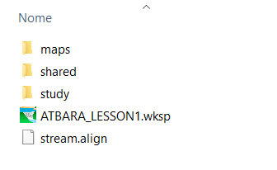
2. Introducing RESSIM
2.3 Directory
DIRECTORY
“maps”: for the georeferenced files
“shared”: for the initial and boundary conditions
“study”: contains all the project elements
“*.wksp”: is the project
Stream.align: contains the stream alignment you draw in the project.
Notes:
Go to the folder that contains the project.
When a project is empty you will find three folders: maps, shared, study.

Slide 22
3. Watershed Setup module
WATERSHED SETUP MODULE
Objectives:
Insert background maps
Create Stream Alignment
Create schematic elements
Create two watershed configurations

Slide 23
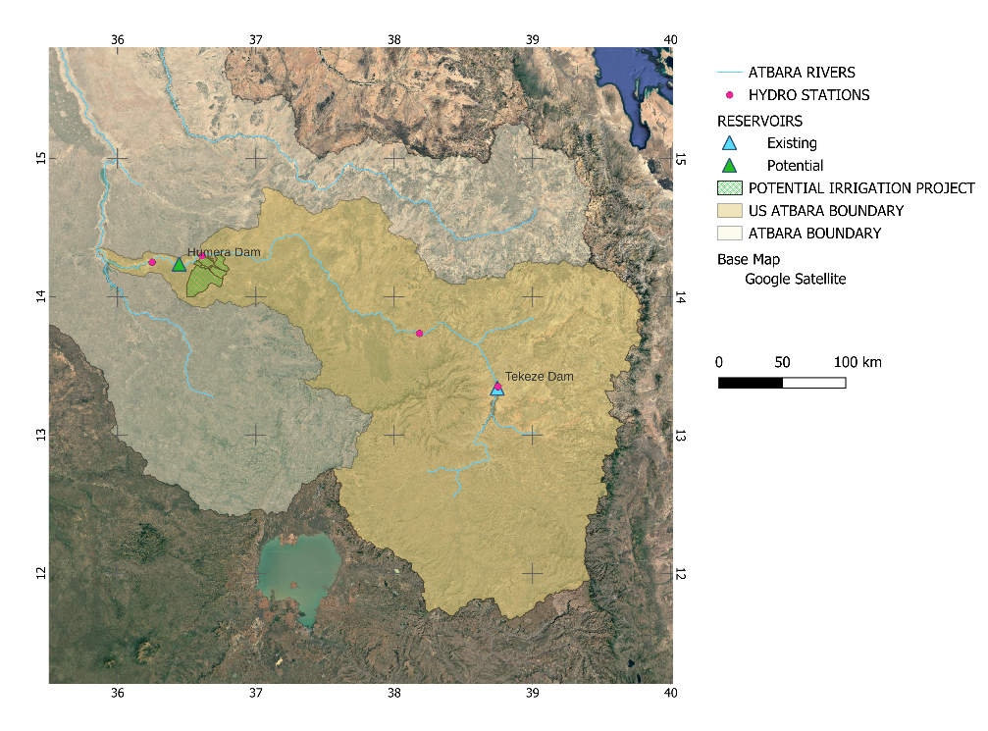
3.1 Watershed Setup module. Backgorund maps

Slide 24
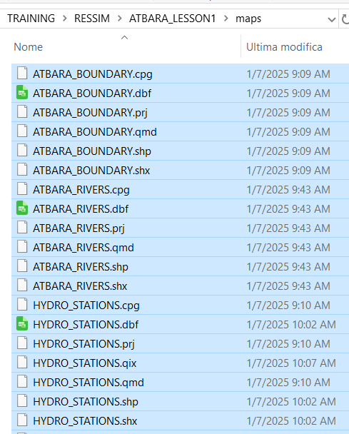
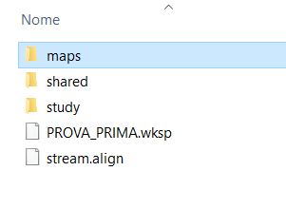
3. Watershed Setup module
3.1 Background maps
Exercise: past the SHP into the maps folder
Copy the content of the folder “SHP”
Past in the folder “maps” of the project
Supported file types:
SHP
DEM
DXF
ASCII
Raster
same CRS

Slide 25
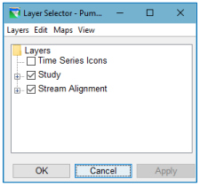
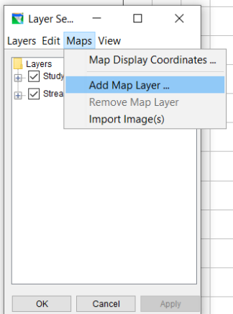
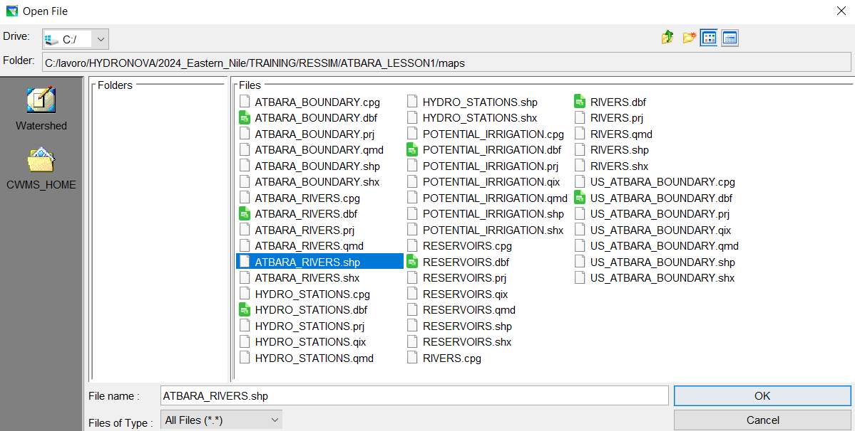
3. Watershed Setup module
3.1 Background maps
1
Exercise: load the basemaps into the project
“View” menù -> Layer: a dialog will appear
“Maps” menù -> add map layer
select -> GIS elements (*.shp) -> OK
2
3

Slide 26
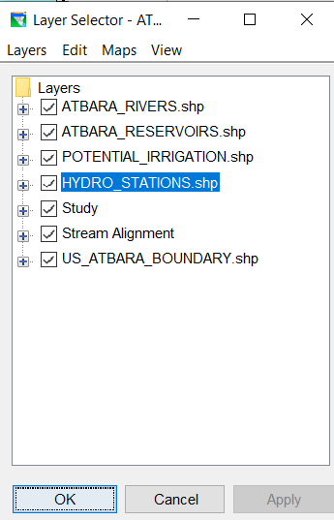
3. Watershed Setup module
3.1 Background maps
Exercise: load the basemaps into the project
LOAD all the shp files (Maps -> Add map layer)
Move river layer to the top (select layer, Edit -> move to top)
Move basin layer to the bottom (select layer, Edit -> move to bottom)
Change colour to river: BLUE (double click on layer, select colour))
Add label on Reservoir layer (double click on layer, go to Labels, Label features using: name)
Save watershed (file menu)

Slide 27
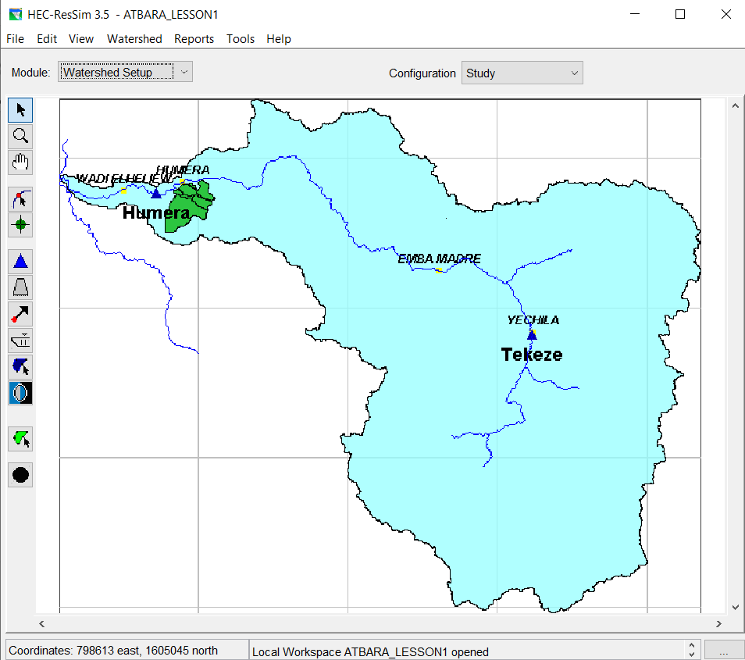
3. Watershed Setup module
3.1 Background maps

Slide 28
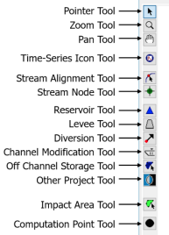
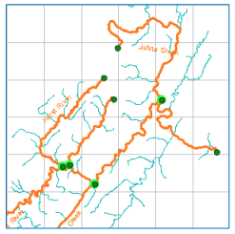
3. Watershed Setup module
3.2 Stream Alignment
(Light blue lines: background shp)
Orange lines: streams
Dark green: nodes
Bright green halo: stream junctions
STRAM ALIGNMENT
Notes:
Defining the stream alignmet means representing the river system of the watershed. It indicates where the rivers, the confluences, the bifurcations, the reservoirs occur.
It also imposes a flow direction for reaches.
It is made up of:
Streams
Stream nodes
Stream junctions

Slide 29
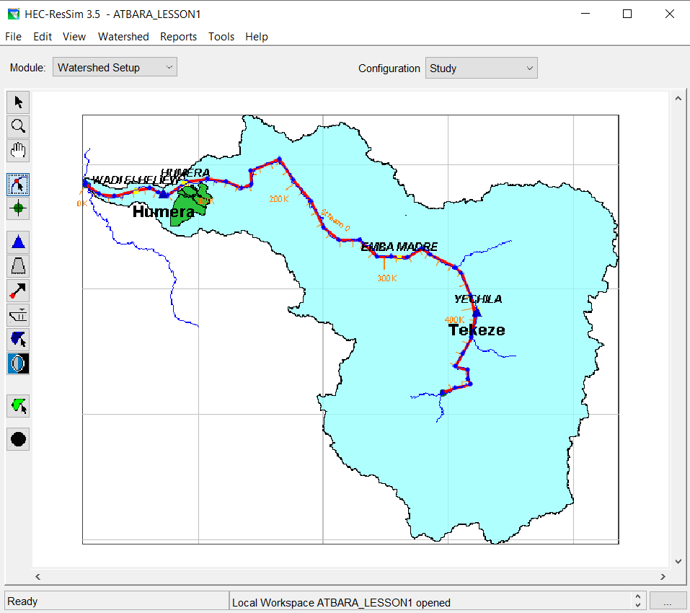
3. Watershed Setup module
3.2 Stream Alignment
Exercise: create a stream
Select the stream alignment tool on the map toolbar
Hold down the CTRL key. Starting from the US end, draw the US vertex of the stream by clicking with the left button
While continuing to hold down the CRTL key, continue to click from the US end to the DS end.
To place the last point, release the CTRL key and click on the DS end of the River
Give a name to your river (stream 0)
Save watershed
Notes:
A STREAM is a poyline along the rivers axis.
When you create a strem, you will draw it from US to DS, as a series of points.
For each stream you create ResSim will create two stream Nodes: one Us and one DS.

Slide 30
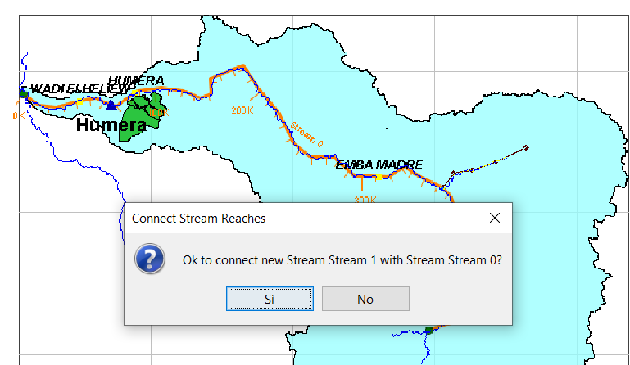
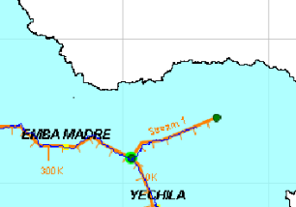
3. Watershed Setup module
3.2 Stream Alignment
Exercise: create a stream junction
Select the stream alignment tool on the map toolbar
Create a new stream: holding down the CRTL key draw the vertex of the new river
The last vertex should be on the existing stream (Stream 0)
After naming the new river (River 1),
The Connect stream reaches dialog
will appear. Click YES to connect the
two rivers
Orange lines: streams
Dark green: nodes
Bright green halo: stream junctions
Notes:
Where multiple stream are connected, a stream junction is automatically created.
Save your work

Slide 31
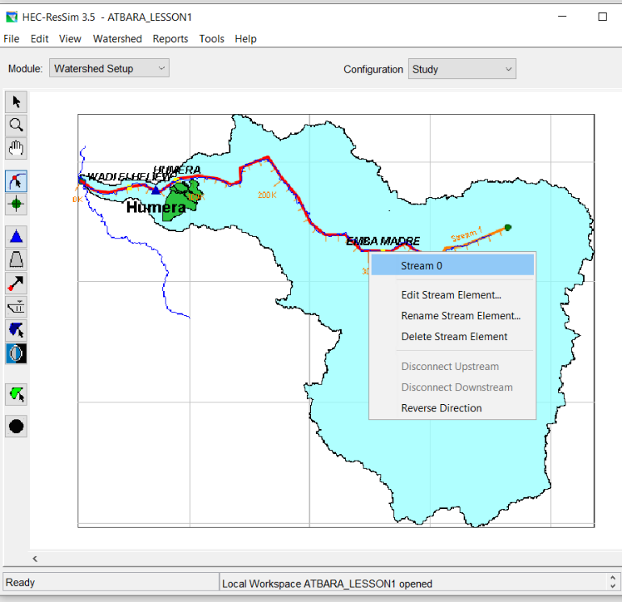
3. Watershed Setup module
3.2 Stream Alignment
Exercise: edit a stream
Select the stream alignment tool on the map toolbar
Double click on the stream.
You can:
Reshape the polyline
Rename the stream
Delete the stream
Disconnect the stream
Reverse direction
…
Save your work

Slide 32
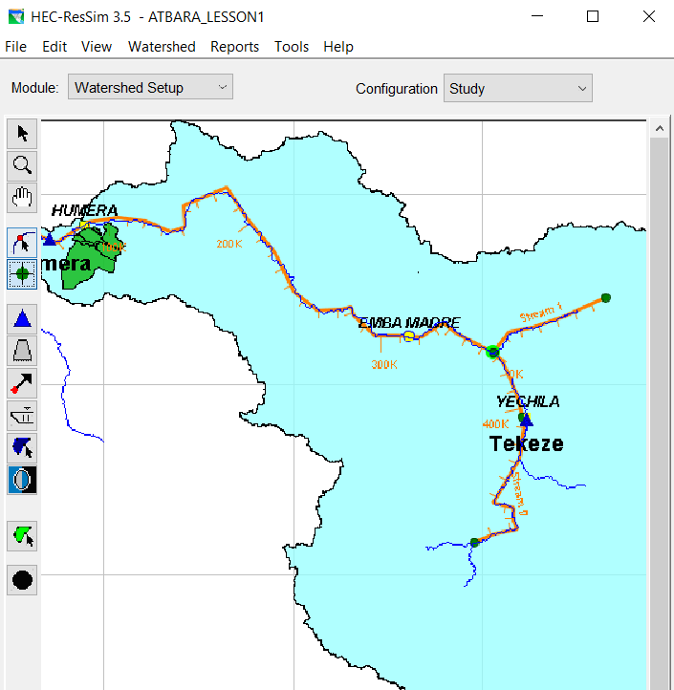
3. Watershed Setup module
3.3 Schematic elements
SCHEMATIC ELEMENTS
Geographically referenced elements
Study configuration: contains all the elements
We will add:
1 computation point
2 Reservoirs
1 diversion
ACTIVE CONFIGURATION
reservoir
levee
diversion
SCHEMATIC ELEMENTS
Computation points
Notes:
The Ressim map tool bar provides the tools for drawing and aditing the geographically referenced schematic elements.
When you add a schematic elements it becomes part of the active configuration.
At this point of the project there is justo 1 active configuration called STUDY. It is a superset of alla configurations, it includes all the elements you draw.
Later on we will build the existing and future configuration.

Slide 33
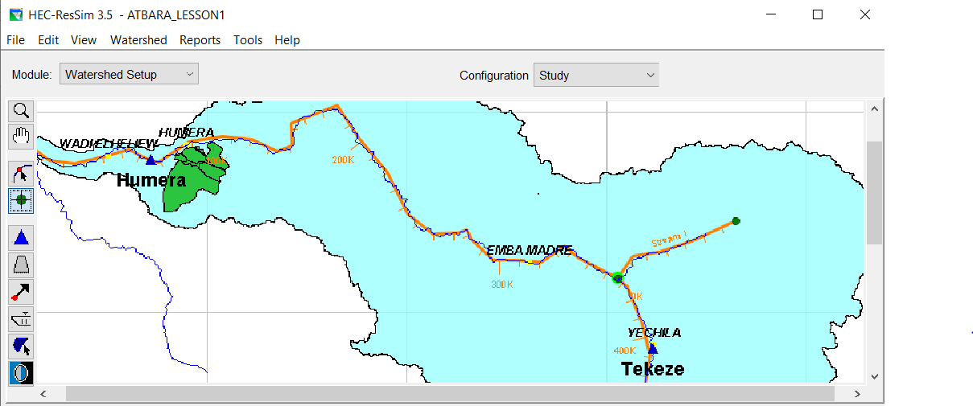
3. Watershed Setup module
3.3 Schematic elements
ADD COMPUTATION POINTS
Point not related with projects: gage locations or inflow location
Exercise:
4 gage location:
Yechila
Embamadre
Humera
Wadi El Heliew
Choose the one not related with any project
Notes:
Computation point are location where time series information will be computed.
Ressim automatically generate computation point when projects are placed on the stream alignment, so you should create computation point at locations that are not project relates, such as inflow and gage locations.
The only one not related with any project is EmbaMadre.
Yechila can be considered as the DS point of the Tekeze DAM
Humera can be considered as the US point of the Humera dam
Wadi El Hilew can be considered as the DS point of Hjumera dam

Slide 34
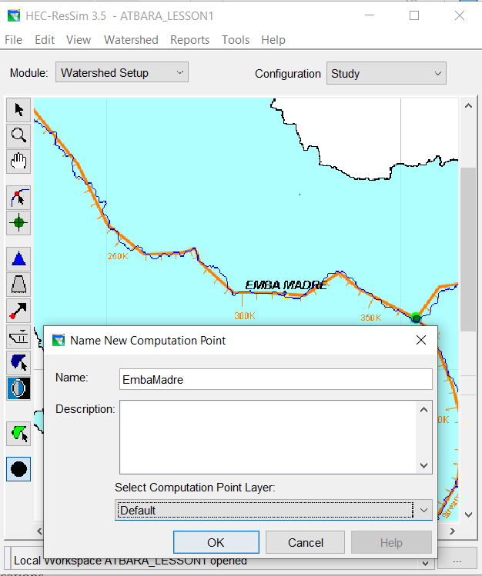
3. Watershed Setup module
3.3 Schematic elements
Exercise: add computation points
Select computation point on the map toolbar
Hold CTRL key
Click on the stream in proximity of Embamadre
Type «EMBAMADRE» on the dialog
OK
Save your work

Slide 35
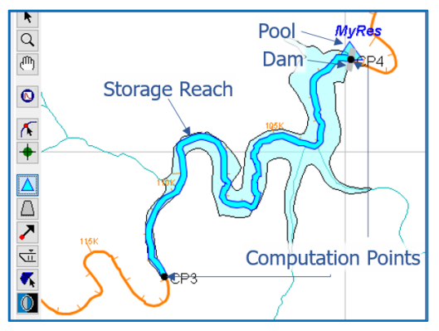
3. Watershed Setup module
3.3 Schematic elements
RESERVOIRS
A basin reservoir is made of:
A storage reach (cyan)
A pool (cyan triangle)
A dam (small grey rectangle)
Two or more computation points (black points) at the upstream and downstream points

Slide 36
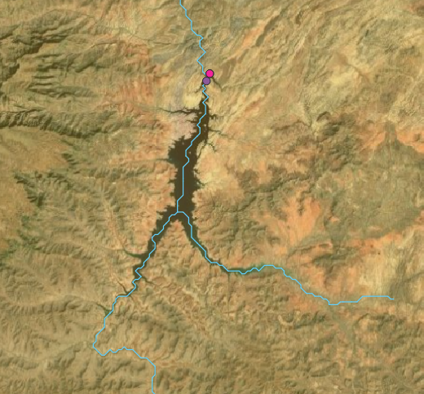
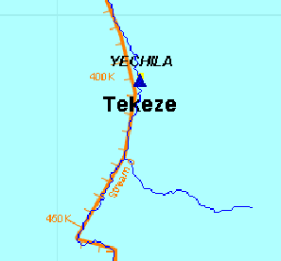
3. Watershed Setup module
3.3 Schematic elements
Exercise: add reservoirs
Two reservoirs:
Tekeze: existing dam
Humera: potential dam
Tekeze dam
Satellite photo
Model

Slide 37
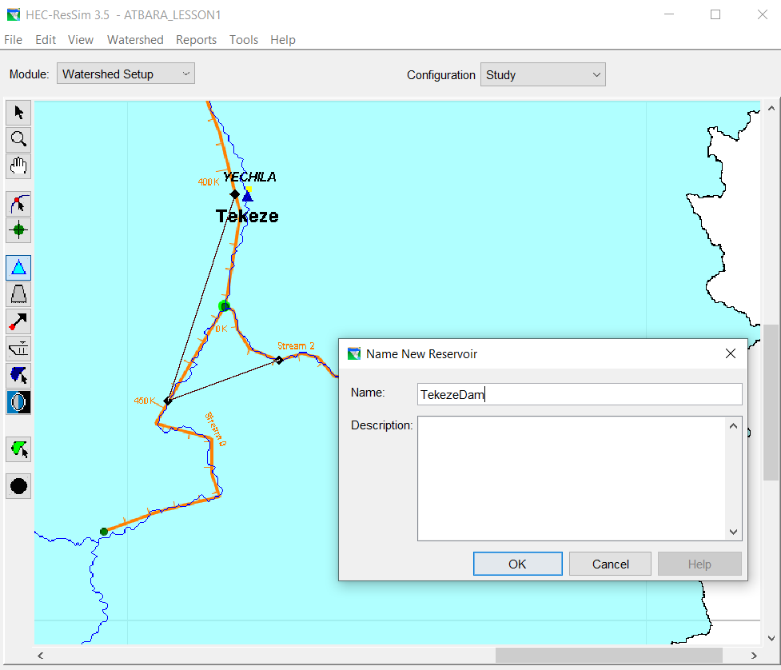
3. Watershed Setup module
3.3 Schematic elements
Exercise: add reservoirs
Create the tributary on the right (name it stream 2)
Hold down the CTRL key
Click on the US point of the dam on stream 2
Continue holding down the CRTL key
Click on the US point of the dam on stream 0
Release the CTRL key
Click on the downstream point of the dam
Name it “TekezeDam”
Save your work

Slide 38
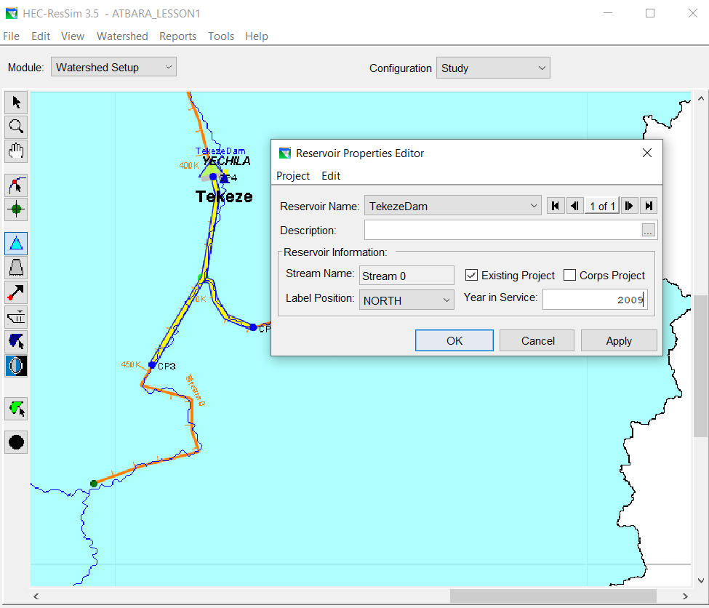
3. Watershed Setup module
3.3 Schematic elements
Exercise: edit reservoirs
Right click on the dam -> edit
Change the year in service: 2009
Save your work

Slide 39
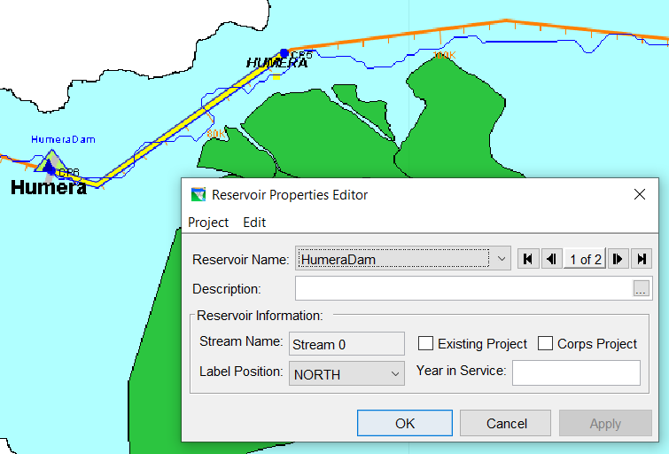
3. Watershed Setup module
3.3 Schematic elements
Exercise: add and edit reservoirs
Draw the Humera dam
In the edit dialog unselect Existing project and delete Year in Service
Save your work

Slide 40
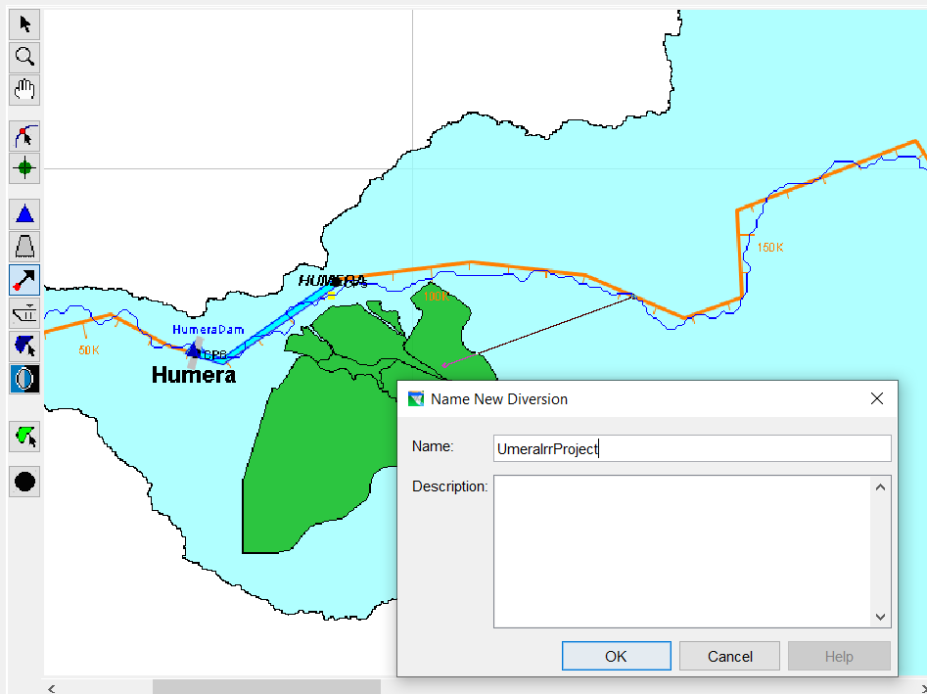
3. Watershed Setup module
3.3 Schematic elements
DIVERSION
Assume a diversion from the river from the stream.
Exercise: add a diversion
Select the diversion button
Hold down the CTRL key
Select a point on the stream (US the Humera dam)
Release the CTRL key
Select the DS point inside the Irrigation project
Call the diversion HumeraIrrProject
Save your work

Slide 41
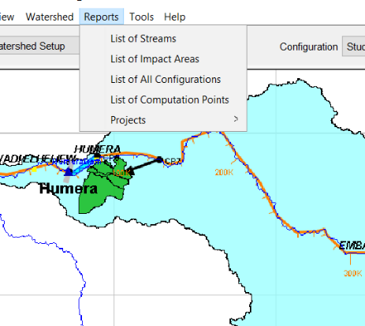
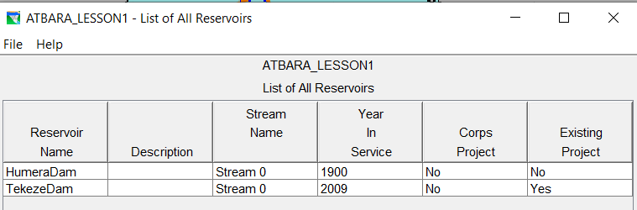
3. Watershed Setup module
3.3 Schematic elements
Exercise: check the reports
In the menu bar select the Report drop down menu.
Select
List of streams
List of computation points
List of reservoirs (projects)

Slide 42
3. Watershed Setup module
3.4 Watershed configuration
WATERSHED CONFIGURATION
Specific physical arrangement of projects to be used as template for the network
1 - WATERSHED SETUP
stream alignment
Reservoir position
Diversion position
Computation points
2 - RESERVOIR NETWORK
reservoirs
junctions
reaches
diversions
state variables
WATERSHED CONFIGURATION 1
Set of hydraulics elements
WATERSHED CONFIGURATION 2
Another set of hydraulics elements
Notes:
A WATERSHED CONFIGURATION IS A specific physical arrangement of projects that will later be used as a tamplate to create network model.
Configurations should be created to reflect particular watershed conditions (physical arrangement of projects) needed for your study. For example, you might create a configuration named Existing Conditions and another named Future Conditions in which one or more projects have been added or removed with respect to the Existing Conditions configuration.
To create or edit watershed configurations, you must be in the Watershed Setup module:

Slide 43
3. Watershed Setup module
3.4 Watershed configuration
WATERSHED CONFIGURATION 1: EXISTING CONFIGURATION
Hydraulics elements:
Tekeze Dam
Humera irrigation diversion
WATERSHED CONFIGURATION 2:
FUTURE CONFIGURATION
hydraulics elements:
Tekeze Dam
Humera Dam

Slide 44
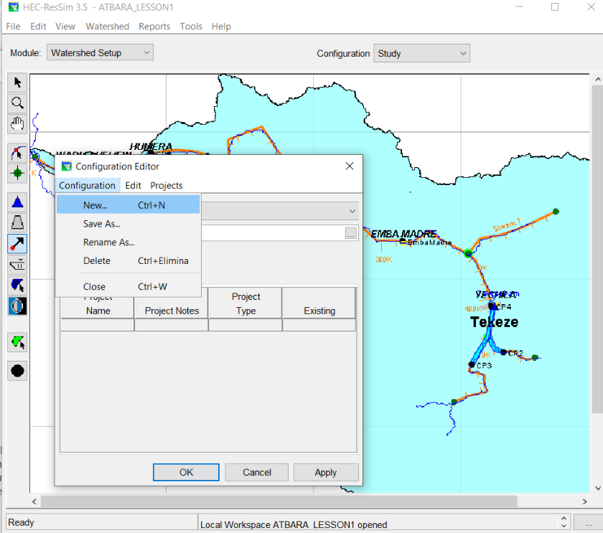
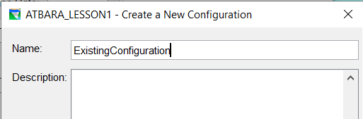
3. Watershed Setup module
3.4 Watershed configuration
Exercise: create a configuration
Go to the menu bar, select Watershed, a dialog will appear
Go to Configuration in the menu bar, choose New, a dialog will appear
Set the name «ExistingConfiguration»
1
2
3
Notes:
Go to the menu bar, select Watersehd, a dialog will appear
Go to Configuration in the menu bar, choose New, a dialog will apppear
Set the name «ExistingConfiguration»

Slide 45
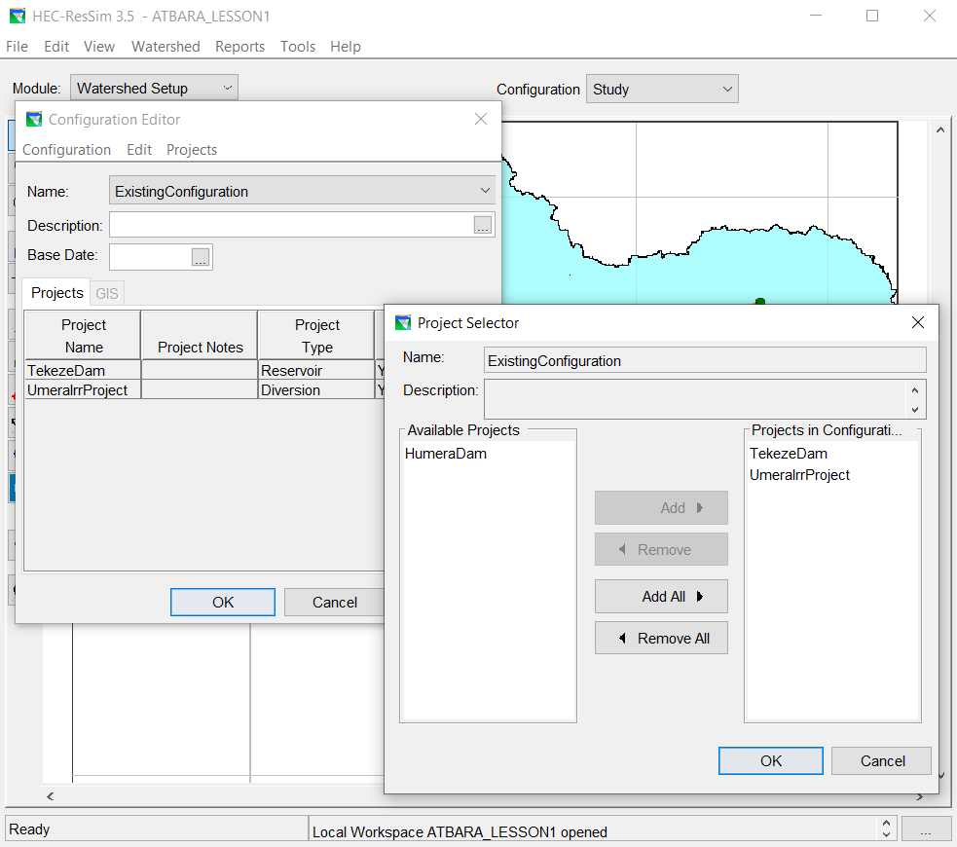
3. Watershed Setup module
3.4 Watershed configuration
Exercise: create a configuration
Note the list of projects already in the configuration.
To add other projects:
Go to project in the menu bar, choose edit project list.
A dialog will appear. Eventually add new projects on the right panel
Close alle the dialog clicking on OK, Apply.
Save your work
Notes:
Note that the projects inside the configuration is already the project we decided to model.
This is because we previously stated that the projects already exist
To add other project go to ….

Slide 46
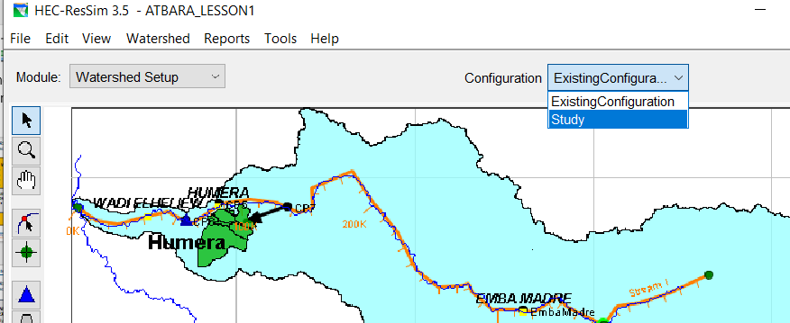
3. Watershed Setup module
3.4 Watershed configuration
Note that you can swap between the two existing configurations:
Study
ExistingConfiguration
Exercise: create a configuration
Create a new configuration called FutureConfiguration.
Hydraulic elements:
Tekeze dam
Humera dam
(without Humera Irrigation diversion)
Save your work

Slide 47
4. Reservoir Network module
RESERVOIR NETWORK MODULE
Objectives:
Create networks
Create routing reaches
Element properties: junction
Element properties : reaches
Element properties : diversions
Element properties : reservoirs
Reports
Alternatives
1 - WATERSHED SETUP
2 - RESERVOIR NETWORK
3 - SIMULATION
WATERSHED CONFIGURATION
ALTERNATIVES

Slide 48
4. Reservoir Network module
RESERVOIR NETWORK MODULE
Swap to the Reservoir network module from the module toolbar
New GUI
It contains:
The model schematic
Elements with physical and operational data
Reservoir
Diverted Outlets
Diversions
Routing reaches
Junctions
Notes:
A reservoir network is the principal component of your ResSim model. It contains the model schematic, its elements, and all their physical and operational data. The model schematic elements include reservoirs, routing reaches, junctions, diversions, and diverted outlets.
Reservoirs and Diversions are the operational elements—they make decisions about the movement of water through the network.
Junctions are connectors—they connect all other schematic elements to one another. Junctions also provide connection to inflow data.
Diverted Outlets are a hybrid of a diversion and a reservoir outlet group. As an outlet group, they are effectively a sub-element of a reservoir. As a diversion, they take the water allocated to them and deliver it to wherever the diversion is connected.
Reaches route flow through the network, from one junction to another.

Slide 49
4. Reservoir Network module
4.1 Create networks
Exercise: add a new network
Network Menu -> New. A dialog opens.
Enter a name: “Existing” and a description.
Choose the base configuration: “ExistingConfiguration”.
Click “NEW” to close the dialog
Optional: You can start from scratch and create each element of the Network configuration system.
Save your work

Slide 50
4. Reservoir Network Module
4.1 Create networks
Exercise: create the Future network
Create a network called “Future” starting from the FutureConfiguration
Save your work

Slide 51
4. Reservoir Network Module
4.2 Routing reaches
ROUTING REACHES
Connectivity between elements (reservoirs, junctions, diversions)
From US to DS
Exercise:
Go to the Existing Network (network – open)
Select the Reach tool
Point to the upstream junction
Hold down the Ctrl key and click on the US junction to start the upstream end of the reach.
Release the Ctrl key and move the mouse pointer along the stream alignment, then click on the DS junction.
Let the default name or rename it, OK.
Save your work
Notes:
Routing reaches are elements that establish the connectivity of the reservoir network schematic. By adding a routing reach between two junctions, you can connect the reservoir network so that water will transverse through the routing reach from upstream to downstream
Routing Reaches are drawn from upstream to downstream. You connect two adjacent junctions (typically, computation points added to the network's Configuration in the Watershed Setup Module) by drawing a routing reach..

Slide 52
4. Reservoir Network Module
4.2 Element properties: junctions
JUNCTIONS
The elements are:
Reservoirs
Diversions
Reaches
Junctions
Diverted Outlets
From the Map Display
Using either the Pointer Tool or the specific element's Tool ,
right-click on the element in the Map Display area and select Edit or
Double left click
Notes:
Once you have created a reservoir network and established its connectivity,
you will need to specify the properties of the elements in the network. To do so, you will use ResSim's specialized network element editors.

Slide 53
4. Reservoir Network Module
4.3 Element properties: junctions
Junction data:
Info
Local Flow
Rating Curve, and
Observed Data.
LOCAL FLOW
You must identify al least one inflow at each headwater junction
Inflow at other junction are optional
Each inflow is identified by a unique Name and Factor
Notes:
The Junction Editor has four tabs on which you will define your junction data:
Info
Local Flow
Rating Curve, and
Observed Data.
In this exercise we will add an inflow to the location
The Local Flow tab of the Junction Editor contains a table where you can identify one or more inflows entering the river system at this junction.
You must identify at least one inflow at ea
ch headwater junction in your watershed; inflows at all other junctions are optional. Each inflow is identified by a unique Name and Factor.
Factor: The factor value is provided to enable you to provide a weighting of the values in the associated inflow hydrograph. The time series will be linked later on.

Slide 54
4. Reservoir Network Module
4.3 Element properties: junctions
BurdanaInflow
Factor: 1
Exercise:
Add inflow to the junctions highlighted in the figure
When you add an inflow, a white halo appears around the junction
EmbamadreInflow
Factor: 1
TekezeInflow2
Factor: 1
Save your work
TekezeInflow1
Factor: 1
Notes:
Exercise:
Add inflow to the junctions as in figure.
When you add a junction, then a visual clue will appear in your model schematic in the map display. This visual clue appears as a white circle or halo around the junction

Slide 55
4. Reservoir Network Module. Element properties: junction
4.3 Element properties: junctions
Junction data:
Info
Local Flow
Rating Curve, and
Observed Data.
OBSERVED DATA
We can link each junction with observed data
Select the variable “Flow” Observed
Notes:
The Junction Editor has four tabs on which you will define your junction data:
Info
Local Flow
Rating Curve, and
Observed Data.
In this exercise we will add an inflow to the location
The Local Flow tab of the Junction Editor contains a table where you can identify one or more inflows entering the river system at this junction.
You must identify at least one inflow at ea
ch headwater junction in your watershed; inflows at all other junctions are optional. Each inflow is identified by a unique Name and Factor.
Factor: The factor value is provided to enable you to provide a weighting of the values in the associated inflow hydrograph. The time series will be linked later on.

Slide 56
4. Reservoir Network Module
4.3 Element properties: junctions
Exercise: Add observed flow
Add observed flow in the junction corresponding to:
YECHILA
EMBAMADRE
HUMERA
WADI EL HELIEW
Save your work
Notes:
The Junction Editor has four tabs on which you will define your junction data:
Info
Local Flow
Rating Curve, and
Observed Data.
In this exercise we will add an inflow to the location
The Local Flow tab of the Junction Editor contains a table where you can identify one or more inflows entering the river system at this junction.
You must identify at least one inflow at ea
ch headwater junction in your watershed; inflows at all other junctions are optional. Each inflow is identified by a unique Name and Factor.
Factor: The factor value is provided to enable you to provide a weighting of the values in the associated inflow hydrograph. The time series will be linked later on.

Slide 57
4. Reservoir Network Module
4.4 Element properties: reaches
The elements are:
Reservoirs
Diversions
Reaches
Junctions
Diverted Outlets
REACHES
From the Map Display
Using either the Pointer Tool or the specific element's Tool ,
Right-click on the element in the Map Display area and select Edit or
Double left click
Notes:
Once you have created a reservoir network and established its connectivity,
you will need to specify the properties of the elements in the network. To do so, you will use ResSim's specialized network element editors.

Slide 58
4. Reservoir Network Module
4.4 Element properties: reaches
REACHES
REACH EDITOR
The reached editor has three tables:
Routing
Losses
Observed data
Routing
Losses
Observed data
Notes:
The Reach Editor has three tabs with which to define your reach data:
Routing,
Losses, and
Observed Data.
There are nine routing methods to choose from (similar to the HMS model), each of them need a set parameters.
The Losses tab of the Reach Editor provides two options for computing losses in the routing reach:
Constant Seepage The flow (in cms or cfs) lost to the reach through the soil. This value will be constant throughout the simulation.
Seepage as a function of Flow.
Assume that there is no routing: all the water entering the US section, exit through the DS section at the same time step.

Slide 59
4. Reservoir Network Module
4.5 Element properties: diversions
The elements are:
Reservoirs
Diversions
Reaches
Junctions
Diverted Outlets
DIVERSIONS
Remove water from the system
Connected:
Part of the water came back to the system
Not connected:
It removes water completely
Notes:
Another element
Diversions remove water from your river system at junctions in your reservoir network
If a diversion is connected at its downstream end to another junction in the network, that diversion is said to be "connected" and the downstream junction will receive the routed diversion flow as inflow. Connected diversions have a reach component to allow you to specify the routing and channel losses through the diversion reach. If a diversion is not connected at its downstream end, it is said to be "unconnected", and it removes the diversion quantity of flow from the network completely.

Slide 60
4. Reservoir Network Module
4.5 Element properties: diversions
Exercise: Connect the diversion in the watershed menu and update the network.
Go back to the Watershed Setup module and to the Study Configuration.
Select the diversion button
Double click on the diversion
Hold down the CTRL key
Add two point inside the diversion clicking in the desired position
Move the DS end to the US end of Humera dam
A dialog will appear, YES
Save your work

Slide 61
4. Reservoir Network Module
4.5 Element properties: diversions
Exercise: Connect the diversion in the watershed menu and update the network.
Go back to the reservoir network module
Open the Network menu
Select Update from configuration
Yes on the dialog
Save your work

Slide 62
4. Reservoir Network Module
4.5 Element properties: diversions
Two considerations:
The diversions have always priority
The diversion is allowed to have negative flow
Diversion editor:
Very similar to the Reach editor
You can choose from different method
Notes:
Diversions take priority over a reach or reservoir that may be connected to the outflow of the junction, so if there is not enough flow entering the diversion's source junction to meet the specified diversion quantity, the diversion will get all there is, and the downstream element will receive zero inflow. Although unusual, a diversion is allowed to have a negative diversion quantity; a negative diversion will be seen as inflow to the junction.

Slide 63
4. Reservoir Network Module
4.5 Element properties: diversions
Exercise:
Open the DIVERSION.xls in the path MATERIAL/ELEMENTS
Open the editor of the diversion (right click and editor)
Choose monthly varying method
Copy the DIVERTED WATER COLUMN
In the losses editor, choose RETURN RATIO, and set it to 0.15
Save your work
Notes:
There can be some issues while copiyng the number. These are Problems caused by the language settings on your computer. To avoid this, please manually copy the numbers, or triy substitute the . With a comma or viceversa

Slide 64
4. Reservoir Network Module
4.6 Element properties: reservoirs
RESERVOIRS
Store water from the system
Release water to the system
Physical properties:
Pool
Dam
Outlets
Power plant
Pumps
Diverted outlets
Operations:
Guide curve
Rules
The elements are:
Reservoirs
Diversions
Reaches
Junctions
Diverted Outlets

Slide 65
4. Reservoir Network Module
4.6 Element properties: reservoirs
Editor

Slide 66
4. Reservoir Network Module
4.6 Element properties: Reservoirs, physical data
Physical tab
Notes:
The Physical tab of the Reservoir Editor uses a "tree structure" to represent the hierarchical relationship between the reservoir and its elements. This tree structure is called the Reservoir Tree and is shown at the left side of the Physical Tab of the Reservoir Editor.

Slide 67
4. Reservoir Network Module
4.6 Element properties: Reservoirs, physical data
Default elements
the Pool
the Dam
top of dam
Spillway
Power plant
Optional elements:
Controlled Outlets,
Uncontrolled Outlets,
Power Plants,
Pumps,
Outlet Groups,
Diverted Outlets,
Evaporation, Seepage, and Leakage losses
Tailwater Elevation and Forebay Head Loss
Notes:
By default, each reservoir has two elements:
the Pool
the Dam
Other Elements that can be added to the Reservoir Tree include:
Controlled Outlets ,
Uncontrolled Outlets ,
Power Plants ,
Pumps ,
Outlet Groups ,
Diverted Outlets ,
Evaporation , Seepage , and Leakage losses, and
Tailwater Elevation and Forebay Head Loss specifications.
When you select an element (node) in the Reservoir Tree The Edit Panel to the right of the Reservoir Tree will display the edit pane for the selected component

Slide 68
4. Reservoir Network Module
4.6 Element properties: Reservoirs, physical data
Exercise: physical tab of Tekeze dam, the pool
In the reservoir network “Existing”
Double click on the Tekeze dam, the reservoir editor will appear
Open the xls file
…\MATERIALS\ELEMENTS\RESERVOIRS.xlsx
Select the pool node
Copy the pool curve EAV in the editor
Click “Apply”
Notes:
By default, each reservoir has two elements:
the Pool
the Dam
Other Elements that can be added to the Reservoir Tree include:
Controlled Outlets ,
Uncontrolled Outlets ,
Power Plants ,
Pumps ,
Outlet Groups ,
Diverted Outlets ,
Evaporation , Seepage , and Leakage losses, and
Tailwater Elevation and Forebay Head Loss specifications.
When you select an element (node) in the Reservoir Tree The Edit Panel to the right of the Reservoir Tree will display the edit pane for the selected component

Slide 69
4. Reservoir Network Module
4.6 Element properties: Reservoirs, physical data
Exercise: physical tab of Tekeze dam, the pool
Right click on the pool node
Select Add Pool Evaporation
Copy and past the monthly evaporation
Apply
Exercise: physical tab of Tekeze dam, the dam
Click on the Dam node
Copy and past
Elevation at top of dam (weir crest)
Length at top of dam (weir length)
Apply
Notes:
Below the name of the Dam, the Dam pane contains a non-editable table displaying the Composite Release Capacity of the dam.

Slide 70
4. Reservoir Network Module
4.6 Element properties: Reservoirs, physical data
Exercise: physical tab of Tekeze dam, the dam
Right click on the Dam
Type of available outlets:
Controlled (mechanism)
Uncontrolled (gates fully open)
Power plants
Pumps
Outlet groups
Other elements:
Tailwater elevation (for the HP generation)
Forebay Head losses
Notes:
Unless you only want to model dam overflow, you will need to add one or more outlets to the dam to enable water to pass through it into the downstream system.
Outlet types available in ResSim include:
Controlled Outlets can be used to represent any outlet that has some mechanism, like a gate or valve, which can be used to adjust the release capacity of the outlet.
Uncontrolled Outlets can be used to represent any outlet whose release capacity cannot be adjusted; i.e. it is always fully open (e.g., gates, valves)
Power Plants are a special type of controlled outlet that can be used to represent a hydropower generation facility fed by a reservoir (e.g., weirs, culverts).
Pumps are another special type of controlled outlet that can be used to represent a pump or the "reverse" half of a reversible turbine in a pumpback system.
Outlet Groups are used to combine one or more outlets so that they can be operated together as a single unit.
Leakage is a loss of water from the reservoir pool that passes "through" the dam into the downstream system.
Tailwater Elevation is a feature you may need add to the dam or an outlet so that it can compute head, the difference between pool elevation and tailwater, for the purpose of computing power generation or determining the ability to pump.
Forebay Head Loss is a feature you can add to the dam or an outlet so that it can adjust the current pool elevation to reflect the elevation of water at the face of the outlets for the purpose of computing release capacity

Slide 71
4. Reservoir Network Module
4.6 Element properties: Reservoirs, physical data
Exercise: physical tab of Tekeze dam, the dam
Right click on the Dam
Add 1 controlled outlet
Add 1 uncontrolled outlet
Add 1 Power plant
Right click on the Power Plant
Add Tailwater
Copy and past the physical characteristics to the dam elements
Check the composite Release Capacity on the dam node
Save your work

Slide 72
4. Reservoir Network Module
4.6 Element properties: Reservoirs, Operation
Operations tab

Slide 73
4. Reservoir Network Module
4.6 Element properties: Reservoirs, Operation
Guide Curve Operation is the process of determining and making releases from a reservoir in order to maintain the reservoir pool at its target elevation. Thus, the guide curve is the target or desired pool elevation for the reservoir.
Reservoir Operation
Is the act of
storing water in and
releasing water from a reservoir.
The operations are based on two concept:
Reservoir operating zones. An operating zone is a horizontal slice of the reservoir pool for which the goals and constraints differ from those in another zone of the reservoir.
Notes:
Reservoir operation is the act or process of storing water in and releasing water from a reservoir. The operations in the RESSIM are based on a concept called Guide Curve Operation

Slide 74
4. Reservoir Network Module
4.6 Element properties: Reservoirs, Operation
top of dam
Guide Curve Operation
flood control
B
The choice of release rules depends on the free surface elevation at a given moment of the year.
A: Below GC -> Close the gates
B: Above GC -> Open the gates
How much? How? Which ones?
Guide Curve
conservation
Keep storage space for the flood
A
Store the flood and release it later
min hydropower
inactive
Notes:
So, if the pool is below the guide curve, guide curve operation would reduce or suspend releases in order to refill the pool; if the pool is above the guide curve, then releases would be increased up to maximum capacity in order to draw the pool back down to the guide curve elevation.

Slide 75
4. Reservoir Network Module
4.6 Element properties: Reservoirs, Operation
To ResSim, the primary reservoir operating objective is to maintain the pool at, or return the pool to, the guide curve elevation as soon as possible.
Operational rules that reflect the goals and constraints on the reservoir operation act as limits on the guide curve operation.
Notes:
So, if the pool is below the guide curve, guide curve operation would reduce or suspend releases in order to refill the pool; if the pool is above the guide curve, then releases would be increased up to maximum capacity in order to draw the pool back down to the guide curve elevation.

Slide 76
4. Reservoir Network Module
4.6 Element properties: Reservoirs, Operation
Operation set
reservoirs' operating plans, made of:
Zones
Rules
Allocation Release
Exercise: make an operation set
Operation menu
New
Name: Base
Ok
Notes:
An Operation Set is the operation plan or scheme upon which a reservoir bases its decisions regarding how much water to release at each timestep of a simulation run. You can define multiple operation sets for each reservoir.
Zones are operational subdivisions of the Reservoir Pool. Each zone is defined by a curve describing the top of the zone. When you create an operation set, ResSim establishes a default set of zones within the operation set. These zones are Flood Control, Conservation, and Inactive. The Inactive zone is a special zone in the operation set. It represents the "dead" storage of the reservoir. The reservoir cannot release water from the Inactive pool, and rules cannot be added to this zone. The Guide Curve is identified by selecting the top of one of your operational zones to represent the target elevation of the reservoir. By default, ResSim assigns the Guide Curve to the top of the Conservation zone.
Rules represent the goals and constraints upon the release(s). Rules can be applied to selected zones of the reservoir to describe the different factors influencing the release decision when the reservoir elevation is within each zone. Release Allocation is the specification of how the release from the reservoir is divvied up across the reservoir's outlets.

Slide 77
4. Reservoir Network Module
4.6 Element properties: Reservoirs, Operation
Exercise: zones
Insert the top of each zone as specified in the xls file
Usually is a function of time, but it can be function of each variable in the model (define button) or ir can be imported as a dss
Zones top all along a year
Save your work
Notes:
when you create a new Operation Set, ResSim automatically creates a Zone-Rules tree that contains three default reservoir operation zones: Flood Control, Conservation, and Inactive.
You will need to define the curve representing the top of each zone you create. The default definition of a zone is a linear function of date and is specified with a table of dates and elevations. The first date in the table is always 01Jan and the table is expected to represent the shape of the level over a single year

Slide 78
4. Reservoir Network Module
4.6 Element properties: Reservoirs, Operation
Operation rules
Operational goals for each zone of the operation set
Each zone can contain a different set of rules
Each outlet can have different type of rules
Rule can be prioritized
Notes:
Operation Rules represent the operational goals and constraints for each zone of the operation set. Each zone can contain a different set of rules depending on how the regulation plan describes the flow limits and requirements for that operating zone.

Slide 79
4. Reservoir Network Module
4.6 Element properties: Reservoirs, Operation
Release decision process
1. Determing allowable release range
Minimum allowable release
2. Calculate the desired guide curve release
Based on the conservation of mass:
3. Comparing 1 and 2 and decide
Check the active rules base on the zone
Maximum allowable release
It depend on physical and operation constrains
Inflow – outflow = change in storage
Activate the rules from the highest priority to the lowest
Notes:
The logic under the release decision process is this:
1 2 e 3
1. The allowable release range is defined by a minimum allowable release and a maximum allowable release. The reservoir's physical and operational constraints are used to determine the allowable release range.
2. The desired guide curve release is, by definition, the release the reservoir should make to get to or stay at guide curve in this timestep. This calculation derives from the basic Conservation of Mass Equation:
Inflow minus Outflow equals Change in Storage.
3. decide. If the level of the reservoir is above the Guide curve, the reservoir shall release. If we are in the flood control zone, Ressim check the active rules, activate the rules from the highest priority to the lowest,

Slide 80
4. Reservoir Network Module
4.6 Element properties: Reservoirs, Operation
Exercise: zones
Insert the top of each zone as specified in the xls file
Usually is a function of time, but it can be function of each variable in the model (define button) or it can be imported as a dss
The table is expected to represent the shape of level over a single year
Notes:
when you create a new Operation Set, ResSim automatically creates a Zone-Rules tree that contains three default reservoir operation zones: Flood Control, Conservation, and Inactive.
You will need to define the curve representing the top of each zone you create. The default definition of a zone is a linear function of date and is specified with a table of dates and elevations. The first date in the table is always 01Jan and the table is expected to represent the shape of the level over a single year

Slide 81
4. Reservoir Network Module
4.6 Element properties: Reservoirs, Operation
Rules
Learn to manage the rules from the Zone-Rules Tree:
When you click on a rule on the Zone-Rules Tree, the edit Panel to the right displays the corresponding rule
You can choose from which outlet the release pass
You can choose among a high number and type of rules

Slide 82
4. Reservoir Network Module
4.6 Element properties: Reservoirs, Operation
Exercise: add Energy demand Rule
Right click on the Conservation zone
Add new rule
A dialog will open
Name: HP demand
Release from Power Plant
Rule Type: Schedule

Slide 83
4. Reservoir Network Module
4.6 Element properties: Reservoirs, Operation
Exercise: add Energy demand Rule
Copy and past the demand from the xls file
Click on the Power generation pattern

Slide 84
4. Reservoir Network Module
4.6 Element properties: Reservoirs, Operation
Exercise: add Energy demand Rule
Select Specify pattern for each day
Suppose a reduction factor 0.2 for the night 19:00 – 05:00
Suppose a reduction factor 0.5 for the week end
Save your work

Slide 85
4. Reservoir Network Module
4.6 Element properties: Reservoirs, Operation
Exercise: add Energy demand Rule
Right click on the Flood control zone
Click on Use existing
Select the rule to be added in the zone

Slide 86
4. Reservoir Network Module
4.6 Element properties: Reservoirs, Operation
Exercise: add Irrigation demand Rule
Right click on the Conservation zone
Add new rule
Name: IRRIGATION
Release from: Controlled Outlet
Rule Type: Release Function

Slide 87
4. Reservoir Network Module
4.6 Element properties: Reservoirs, Operation
Exercise: add Irrigation demand Rule
Copy and past information from the xls file
Add the same rule in the flood control zone
Save your work

Slide 88
4. Reservoir Network Module
4.6 Element properties: Reservoirs, Operation
Exercise: add specified release from the dam
Copy and past information from the xls file
Add the rule in the conservation zone
Why not in the flood control zone?
Save your work

Slide 89
4. Reservoir Network Module
4.6 Element properties: Reservoirs, Operation

Slide 90
4. Reservoir Network Module
4.6 Element properties: Reservoirs, Operation
Exercise: Add Humera dam with its specification in the future network
Only if we have time
Save your work

Slide 91
4. Reservoir Network Module
4.7 Reports
Reports:
List of all the elements by type
Very useful in large models
Very useful to correct any errors
Save your work

Slide 92
4. Reservoir Network Module
4.8 Alternatives
Each Alternative
Reservoir network
Selection of one operation set per reservoir
Specification of initial condition of each reservoir
Specification of input time series
Specification of observed data
Notes:
Each alternatives represents the combination of a reseroir

Slide 93
4. Reservoir Network Module
4.8 Alternatives
Exercise:
Access the alternative editor
Create a new alternative: alternative menu, new. The new alternative dialog will open
Enter a name and description (optional)
Notes:
Each alternatives represents the combination of a reseroir

Slide 94
4. Reservoir Network Module
4.8 Alternatives
Exercise: Run control
Select a time step: 1 day
Flow computation method: program determined. (data type: period average or instant values?)
Compute unregulated flows: without reservoirs.
Notes:
Each alternatives represents the combination of a reseroir

Slide 95
4. Reservoir Network Module
4.8 Alternatives
Exercise: Operations
Select the operation tab.
Choose the operation set for each reservoir
Alternative menu: save
Notes:
Each alternatives represents the combination of a reseroir

Slide 96
4. Reservoir Network Module
4.8 Alternatives
Exercise: Lookback or Initial conditions
Initial conditions
Elevation: 1140 (top of conservation)
Releases: 0
Alternative menu: save
Notes:
Each alternatives represents the combination of a reseroir

Slide 97
4. Reservoir Network Module
4.8 Alternatives
Exercise: Time-Series or Boundary conditions
Copy the INFLOWS.dss file from the MATERIALS folder
Paste into the “shared” folder in your model directory
Go to the Time-Series tab
Click the “Select DSS path” button
A DSS dialog will open
Notes:
Each alternatives represents the combination of a reseroir

Slide 98
4. Reservoir Network Module
4.8 Alternatives
Exercise: Time-Series or Boundary conditions
Choose the inflow as showed in the figure
Notes:
Each alternatives represents the combination of a reseroir

Slide 99
4. Reservoir Network Module
4.8 Alternatives
Exercise: Observed data
Copy the OBSERVED_FLOW.dss file from the MATERIALS folder
Paste into the “shared” folder in your model directory
Go to the “OBSERVED” tab
Click the “Select DSS path” button
A DSS dialog will open
Notes:
Each alternatives represents the combination of a reseroir

Slide 100
4. Reservoir Network Module
4.8 Alternatives
Exercise: Observed data
Choose the dss as in figure
We can change the name of the control point
Save your work
Notes:
Each alternatives represents the combination of a reservoir

Slide 101
5. Simulation Module
5.1 Create a simulation
Select Simulation on the Module list
Note the Simulation control panel
Notes:
The Simulation Module provides the tools you will need to create and run Simulations
The Simulation Control Panel shows the time window for the currently opened simulation and provides controls to manipulate the simulation and alternatives

Slide 102
5. Simulation Module
5.1 Create a simulation
Exercise: create a simulation
Check the input data opening the dss file:
Data from 1972 to 2023
Check the observed flow:
For Yechila (blue line) and Emba Madre (red line) data goes from 1995 to 2004
Simulation period should cover the period in which data overlap
1995 to 2004

Slide 103
5. Simulation Module
5.1 Create a simulation
Exercise: create a simulation
Simulation menù: New
The simulation editor will open
Change the name: “Sim1”
Enter a Start date. It must occur after the Lookback Date.
01jan1995 00:00
Enter a Lookback Date. The Lookback is the "warm-up" period before the Simulation begins.
01jan1994 00:00
Enter an End Date.
01jan2005 00:00
Select the alternative

Slide 104
5. Simulation Module
5.2 Computing a simulation
Exercise: computing a simulation
Compute
A dialog with message output will open.
If computation stops, look for error here
Save your work
Notes:
If there are errors or any problems during the execution process, you can review the Message Output Text area of the compute window. The Compute Log can also provide information regarding any errors

Slide 105
5. Simulation Module
5.3 Viewing the results
Exercise: Check the results – the plots
On the gauging stations Yechila and Emba Madre.
Right click on the control point
Plot
Observed data
Look back
start
Calculated data
end

Slide 106
5. Simulation Module
5.3 Viewing the results
Exercise: Check the results – the plots
On the reservoir.
Right click on the reservoir
Plot
Pool top zones - purple
Computed levels - green
Inflows - black
Ouflows - green

Slide 107
5. Simulation Module
5.3 Viewing the results
Overtopping from the crest dam
Exercise: Check the results – the plots
On the reservoir.
Right click on the reservoir
Plot releases
Zoom on 1996
From irrigation outlet
From Power plant
From Spillway and from the crest

Slide 108
5. Simulation Module
5.3 Viewing the results
Exercise: Check the results – the plots
PROBLEMS:
Dam overtopping
ACTIONS:
Save enough space to store floods
Modify the guide curve
Overtopping

Slide 109
5. Simulation Module
5.3 Viewing the results
from spillway
Exercise: Check the results – release decision report
Right click on the reservoir
release decision report
Zoom on 21 august 1996
from power plant
from irrigation outlet
overtopping
inflowing in the dam
outflowing from the dam
Current Pool level
Next step Pool level

Slide 110
5. Simulation Module
5.4 Calibration
Calibration 1
Try to fit the observed value
In this case it is impossible because Tekeze was completed in 2009, but we have data
2001 – 2004 at Yechila
1994 – 2002 at Embamadre
Calibration 2
Try to avoid problems simulating the correct behavior of the dam
Avoid power shortages
Avoid irrigation shortages
Avoid overtopping
…

Slide 111
5. Simulation Module
5.4 Calibration
Exercise: modify GUIDE CURVE
PROBLEMS:
Dam overtopping
ACTIONS:
Save enough space to store floods
Modify the guide curve

Slide 112
5. Simulation Module
5.4 Calibration
Exercise: modify GUIDE CURVE
Force the dam to release more water in summer by lowering the GC

Slide 113
5. Simulation Module
5.4 Calibration
Exercise: modify GUIDE CURVE
Right click on the dam
Edit
Operations tab
Change the guide curve
Check the plots

Slide 114
5. Simulation Module
5.4 Calibration
Exercise: modify GUIDE CURVE
Check the level plots
Overtop
Flood control

Slide 115
5. Simulation Module
5.4 Calibration
Exercise: modify GUIDE CURVE
Check the release plot to verify that irrigation and energy demand have been met
Save your work

Slide 116
5. Simulation Module
5.5 Connection with Network module
SAVE TO BASE DIRECTORY
When you edit model data from the Simulation Module, your changes apply only to an individual Alternative and are saved in your Simulation directory
You can try many different operations and rules without changing the network module
If you want to save your changes
Right click on the current simulation
Select save to base directory

Slide 117
5. Simulation Module
5.5 Connection with Network module
REPLACE FROM BASE DIRECTORY
While editing Simulation data, if you need to revert to the original Alternative data (as it exists in the Reservoir Network module), you can replace the changed data in your Simulation directory with data from the Base directory.
You can try many different operations and rules without changing the network module
If you want to return to the initial status
Right click on the current simulation
Select replace from base directory

Slide 118
5. Simulation Module
5.6 Reports
SOME USEFUL REPORTS
Open the Reports summary
Click on power summary
Save your work
Notes:
Each alternatives represents the combination of a reseroir

Slide 119
5. Simulation Module
Exercise for the existing conditions:
Try to double the energy production without affecting the irrigation needs.
Try to double the irrigation need without affecting the energy production.
Try to add a rule to have a minimum flow of 200 m3/s at a DS control point (Embamadre)
Exercise for the future conditions:
Make a future network
Make an alternative
Make a future simulation
Notes:
Each alternatives represents the combination of a reseroir

