Slide 1
Eastern Nile Technical Regional Office (ENTRO)
Consultancy service for the Development of the Eastern Nile Water Resources Models and Tools
Nile Cooperation for Climate Resilience
Training of Trainers in Eastern Nile Water Resources Models and Tools
HEC-RAS
6 – 10 May 2025

Slide 2
Introduction
Part 1

Slide 3
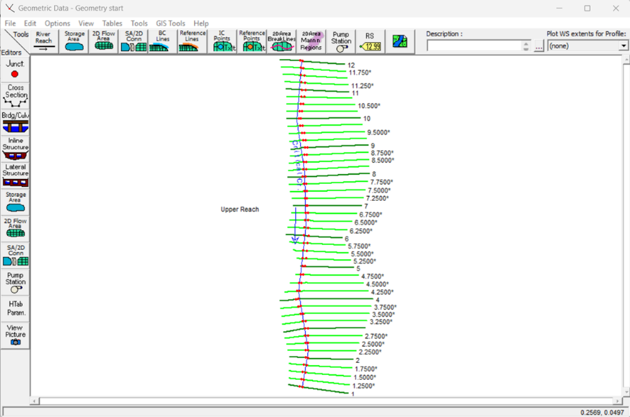
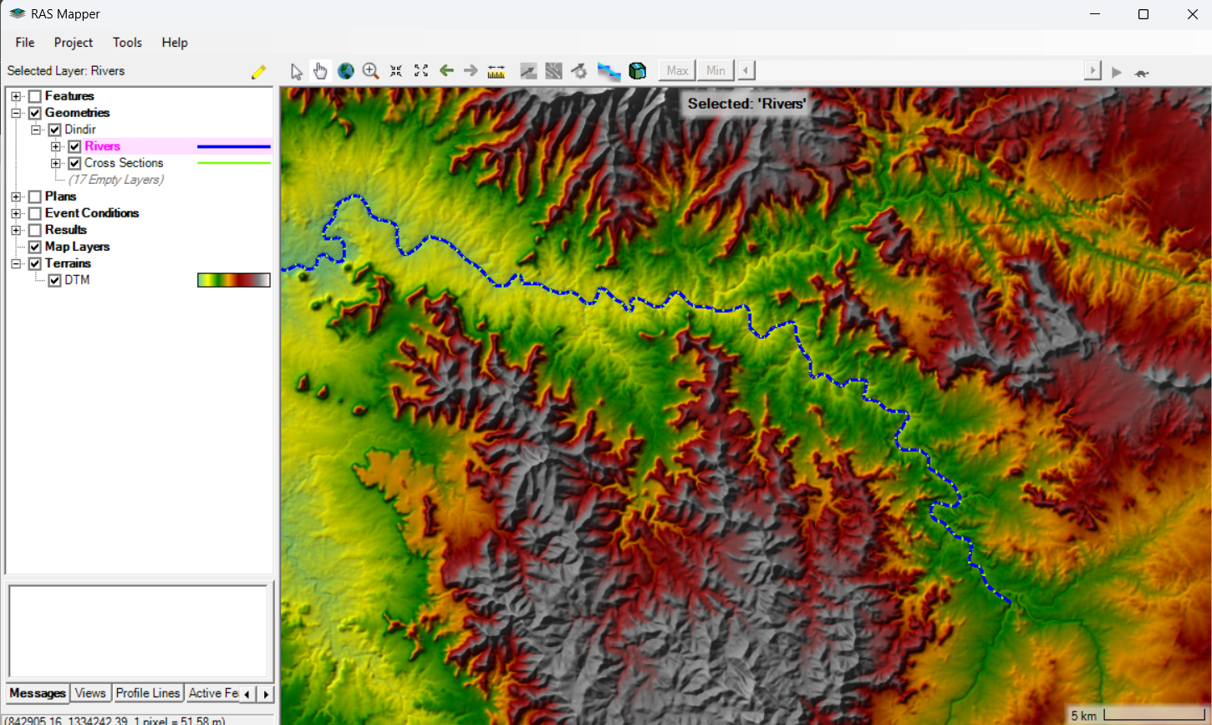
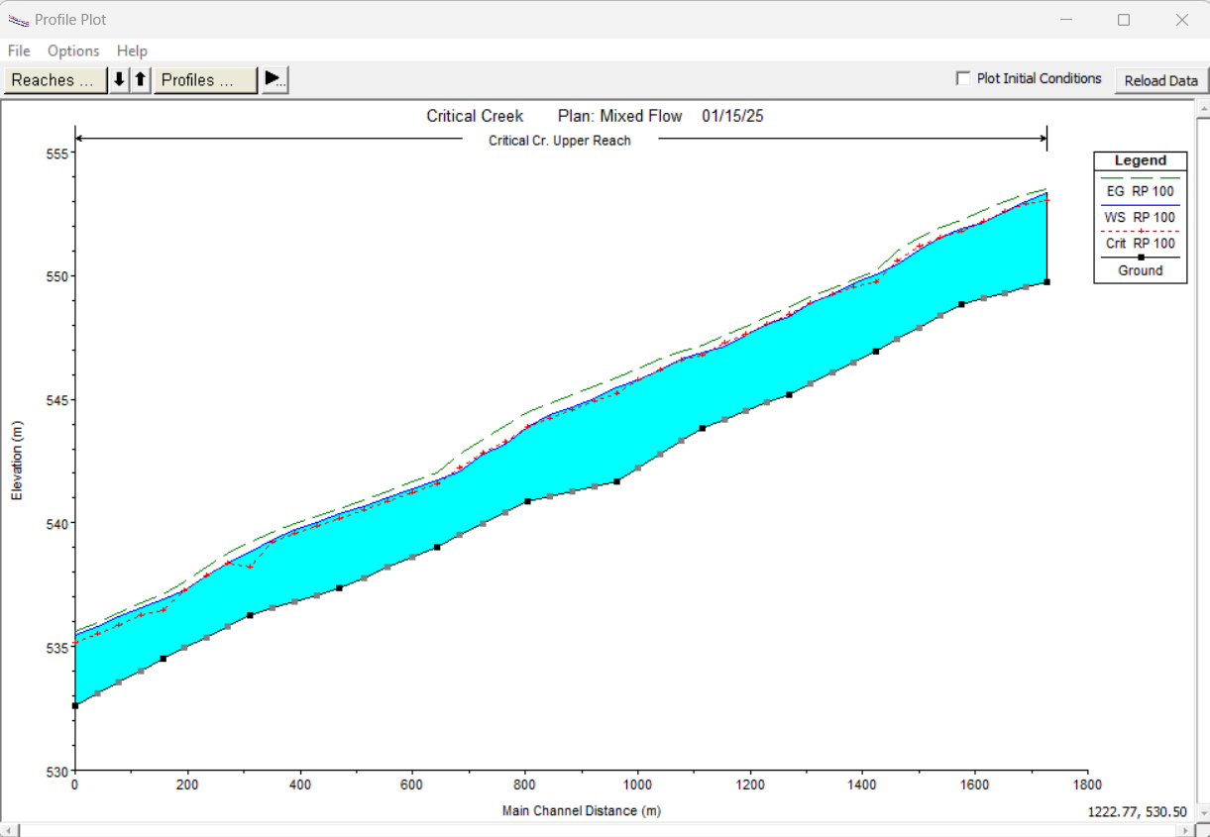
Introduction
US Army Corps of Engineers
Hydrologic Engineering Center
River Analysis System

Slide 4
Introduction
This software allows the user to perform:
one-dimensional steady flow calculations
one and two-dimensional unsteady flow calculations
sediment transport/mobile bed computations
water temperature/water quality modeling

Slide 5
Hydraulic Model

Slide 6
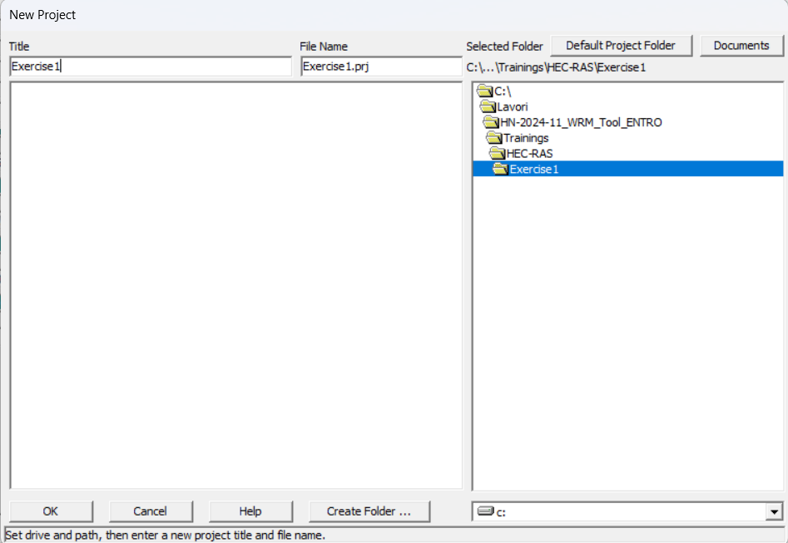
Hydraulic Model
Starting a New Project

Slide 7
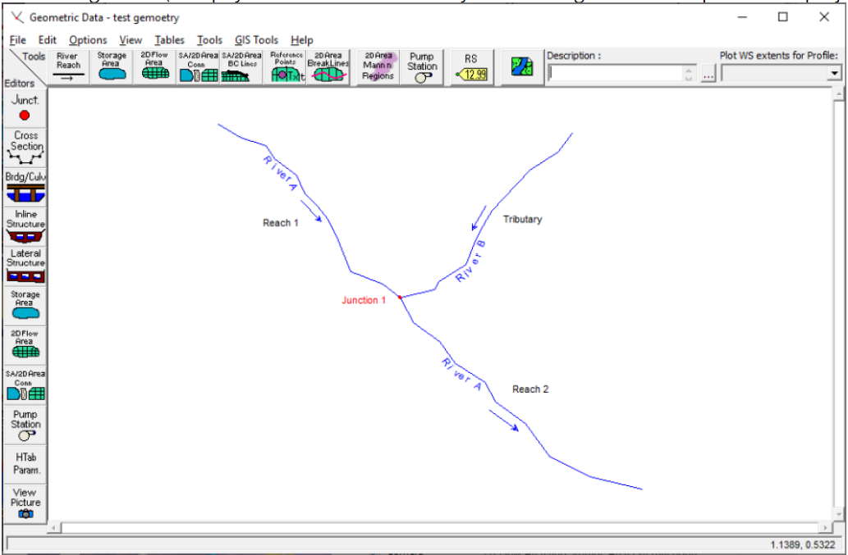
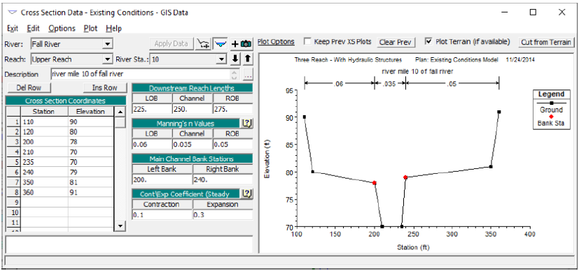
Hydraulic Model
Entering Geometric data

Slide 8
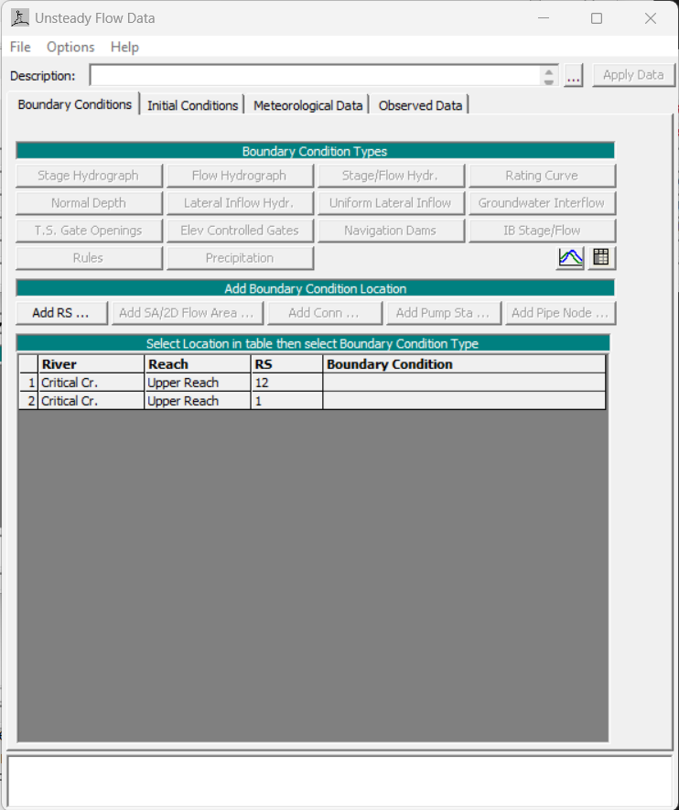
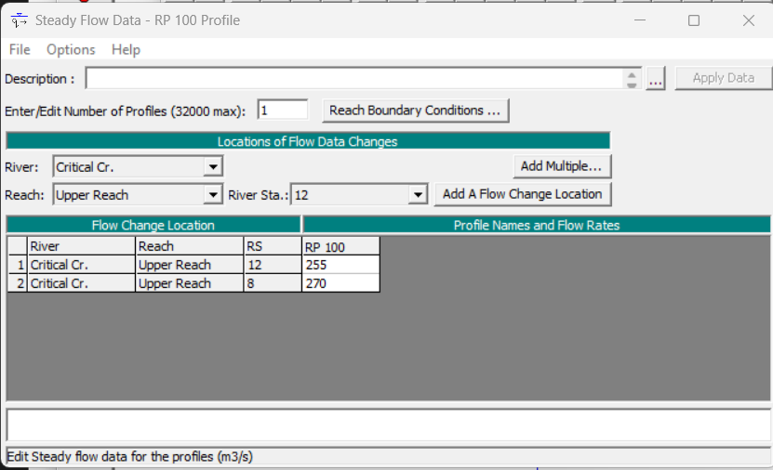
Hydraulic Model
Entering Flow Data and Boundary Conditions
Steady Flow Analysis
Unsteady Flow Analysis

Slide 9
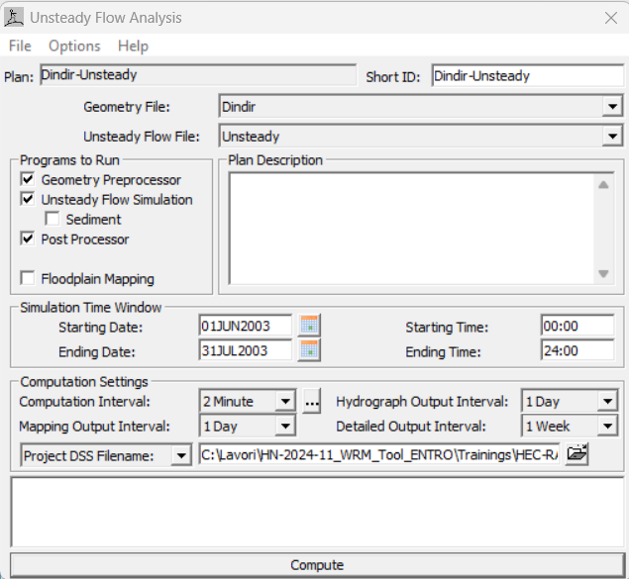
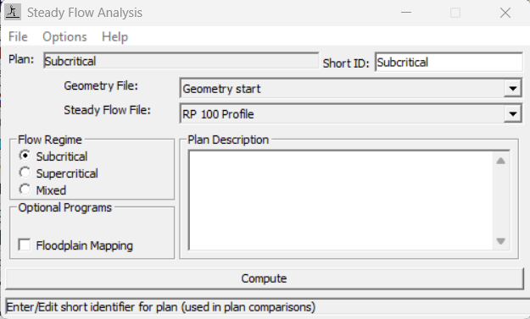
Hydraulic Model
Performing the hydraulic computations
Steady Flow Analysis
Unsteady Flow Analysis

Slide 10
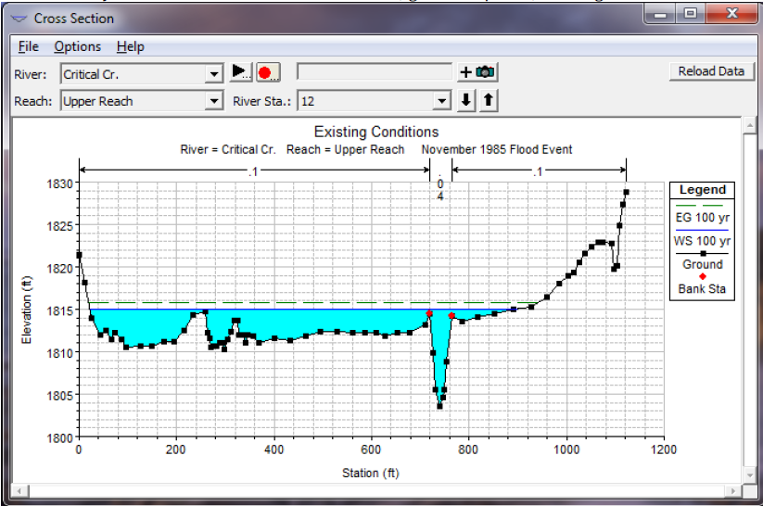
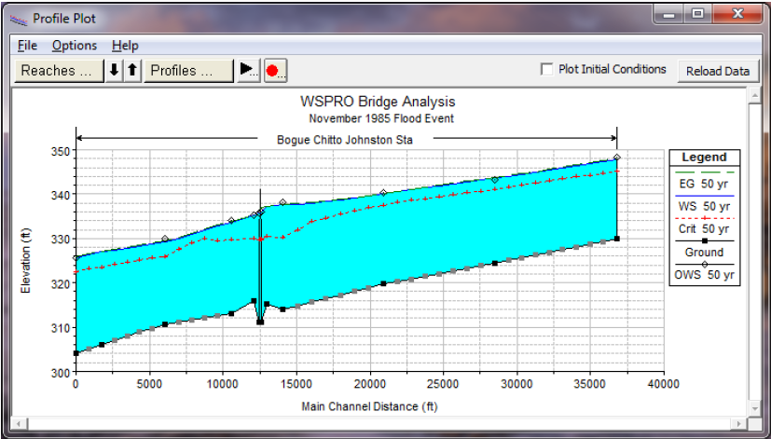
Hydraulic Model
Viewing Results

Slide 11
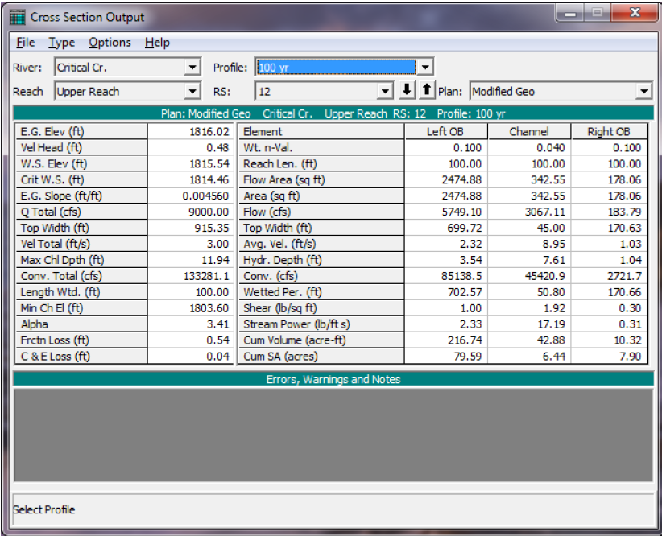
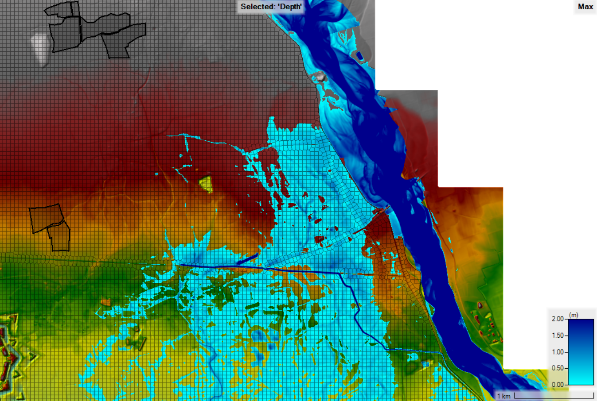
Hydraulic Model
Viewing Results

Slide 12
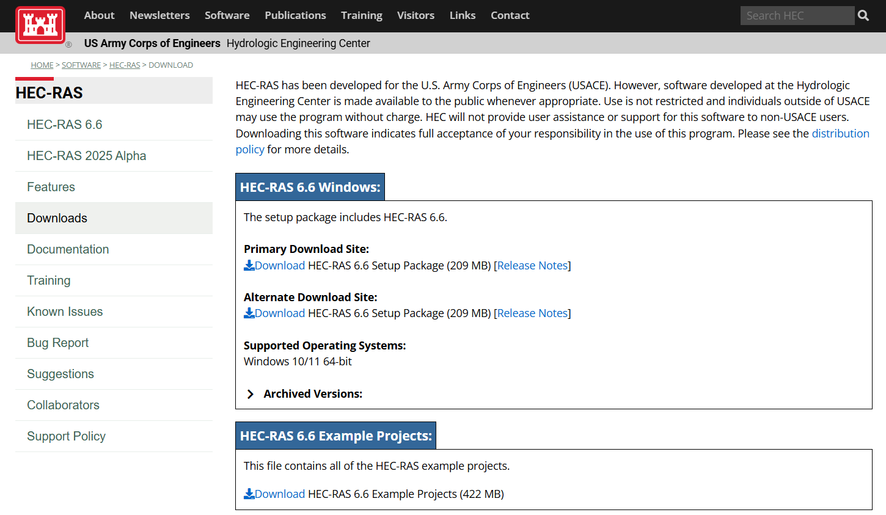
How to install HEC-RAS
https://www.hec.usace.army.mil/software/hec-ras/download.aspx
Notes:
Download the setup program from our web page: www.hec.usace.army.mil.
Place the setup program in a temporary directory and execute it from there.
Follow the setup instructions on the screen.

Slide 13
HEC-RAS User Interface
Description
Related File

Slide 14
HEC-RAS User Interface
Project
The Project file is an ASCII file containing basical information for the project:
Title of the Project
List of all the files used in the project
Project Unit System
All the files created by Hec-Ras have the same name of the project file, the only difference being the extension of each file.

Slide 15
HEC-RAS User Interface
Plan
The plan files contain alle the information that define the simulation. Different plan files identify different simulations: *.p01 , *.p02 etc.

Slide 16
HEC-RAS User Interface
Geometry
The geometry files contain all the information defining the geometry of the model (river/reach connectivity, cross sections, profiles, hydraulic structures…).
It is possible to create many geometries, with the extensions *.g01 , *.g02, etc..

Slide 17
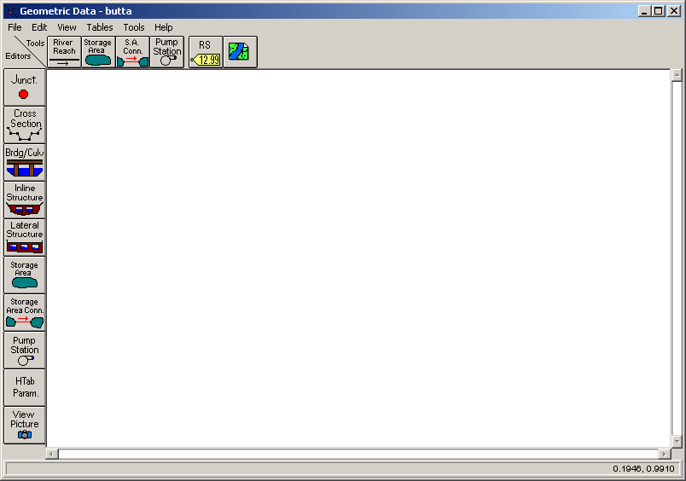
HEC-RAS User Interface
Geometry

Slide 18
HEC-RAS User Interface
Steady Flow
The Steady flow files contain all the information on flow/boundary conditions necessary to perform a steady flow simulation (number of profiles to be computed, flow data, boundary conditions..)
It is possible to create many Steady flow files, with the extensions *.f01 , *.f02, etc..

Slide 19
HEC-RAS User Interface
Unsteady Flow
The Unsteady flow files contain all the information on flow/boundary conditions necessary to perform an unsteady flow simulation (flow hydrographs upstream, starting flow conditions, downstream boundary conditions…).
It is possible to create many Unsteady flow files, with the extensions *.u01 , *.u02, etc..

Slide 20
Geometry Implementation
In the geometry window it is possible to build the model adding step by step what is necessary to define a good schematization of the system, for the implementation of the simulations

Slide 21
Geometry Implementation
The first step is to define the model schematization, digitizing the rivers to be simulated.
Each reach is defined by River and Reach
The boundaries of the reaches can be:
Beginning or end of the model;
Junction or split.

Slide 22
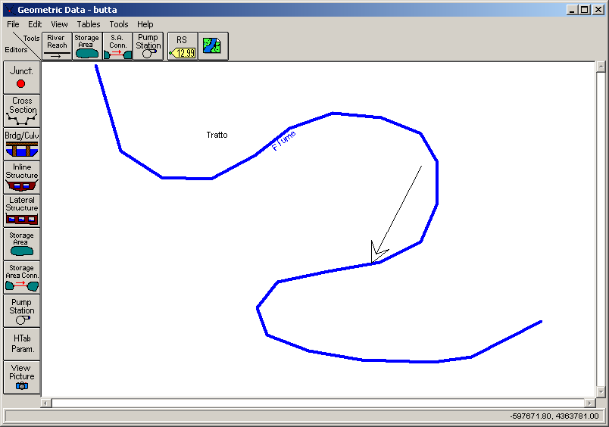
Geometry Implementation
Digitization from upstream towards downstream
Coordinates have no influence on the results of the model
The shape of the reaches has no importance. The model can’t see curves

Slide 23
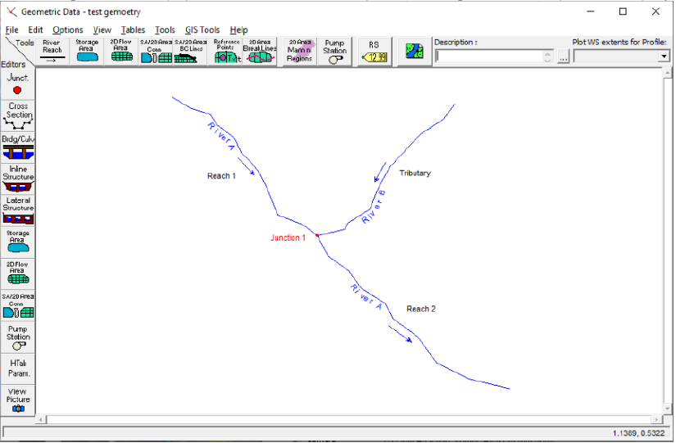
Geometry Implementation

Slide 24
Geometry Implementation
Cross sections
Cross sections represent the most important part of the model: 3D continuous features are schematized in single elements.
In order to build a good model it is necessary to know all the options allowed by the numerical code for the cross section definition.

Slide 25
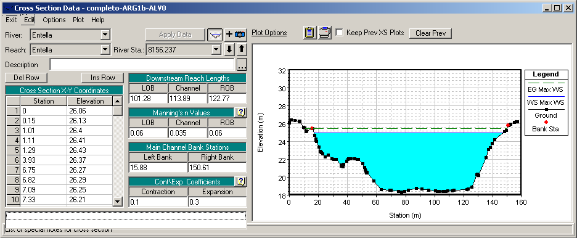
Geometry Implementation
Cross sections
Cross sections represent the most important part of the model: 3D continuous features are schematized in single elements.
In order to build a good model it is necessary to know all the options allowed by the numerical code for the cross section definition.

Slide 26
Cross Section
Each cross section is identified by
River
Reach
River Station

Slide 27
Cross Section
Each cross section is identified by
River
Reach
River Station
River Stations increase from downstream to upstream
River Stations don’t identify the distances between sections
TIP: model implementation is easier if River Stations define the distances between cross sections, along the Main Channel

Slide 28
Cross Section
x,y coordinates

Slide 29
Cross Section
Main Channel Definition
Left and Right Bank

Slide 30
Cross Section
Roughness definition
Manning n values for:
Left Overbank (LOB)
Main Channel (Channel)
Right Overbank (ROB)

Slide 31
Cross Section
Downstream length
Distance:
Left Overbank
Main Channel
Right Overbank

Slide 32
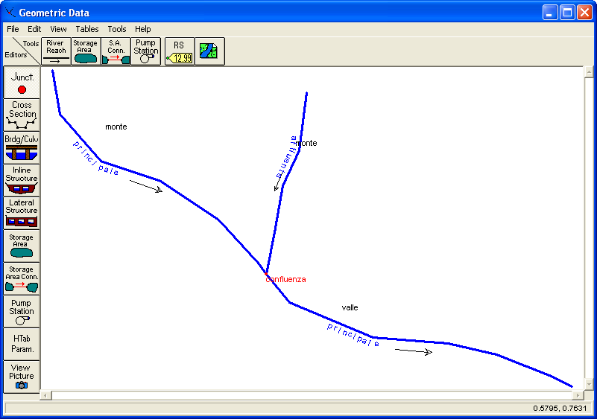
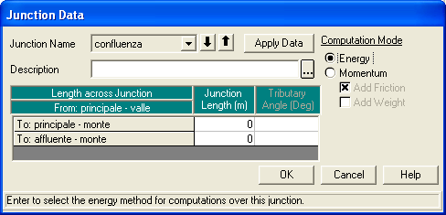
Junctions

Slide 33
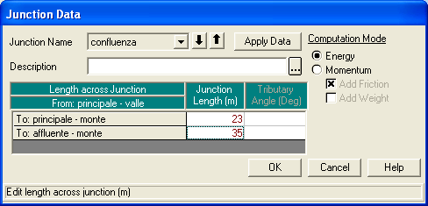
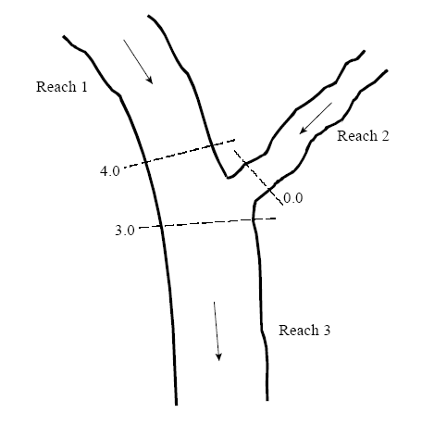
Junctions
The length across the junction has to be defined, in terms of distance between theXS in the reaches. The distance assigned in the XS editor is not valid.

Slide 34
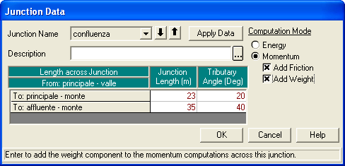
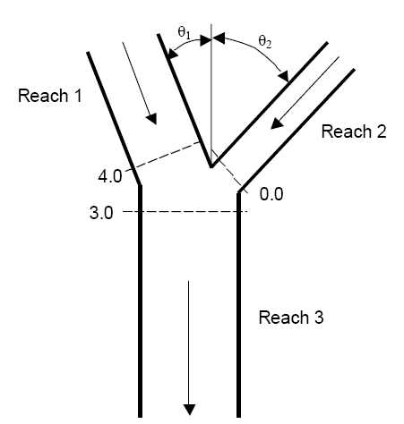
Junctions
Computation mode in the junctions:
energy balance
momentum balance
For the momentum balance the angles between the reaches have to be defined

Slide 35
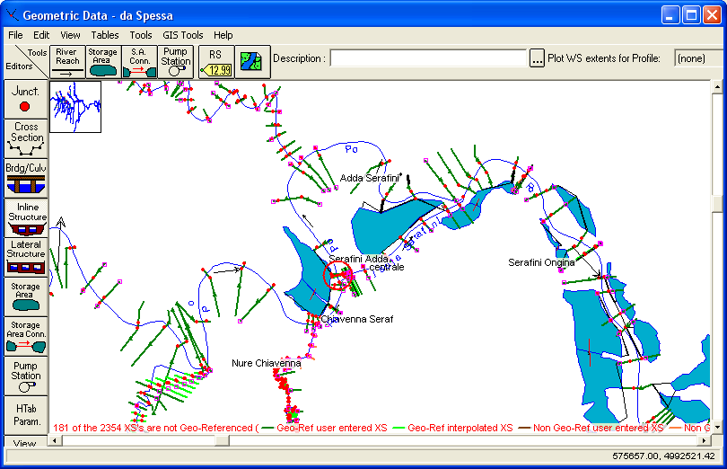
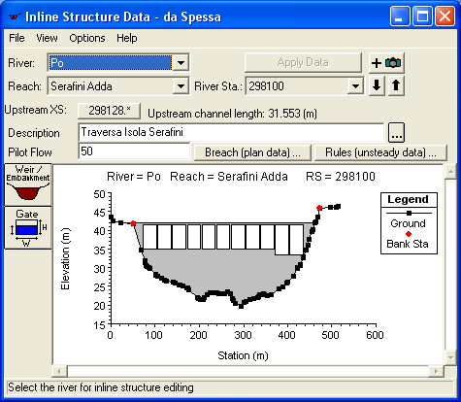
Inline Structures

Slide 36
Inline Structures
Like XS and bridges, Inline Structures are defined by:
River
Reach
River Station

Slide 37
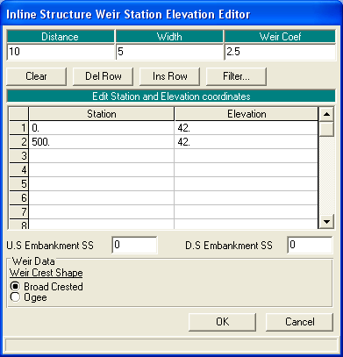
Inline Structures

Slide 38
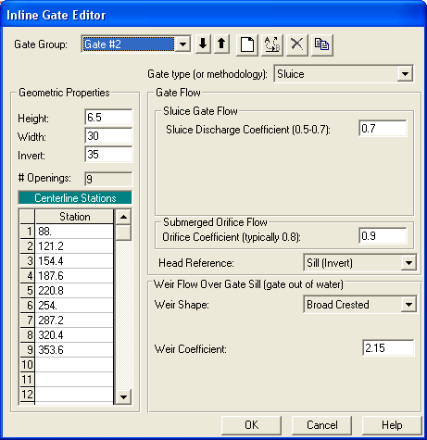
Inline Structures

Slide 39
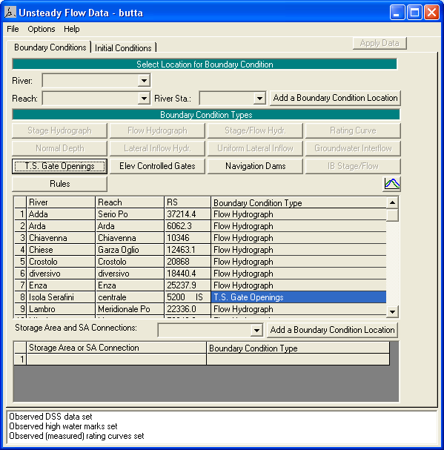
Inline Structures
If gates are present Time Series Gate Openings
MUST be defined in Unsteady Flow Data

Slide 40
Introduction
Part 2

Slide 41
Introduction
This exercise will explain how to create a geometry based on topographic information (es DTM).
This operation can be done using RAS Mapper
The main steps are:
Import a DTM (raster format) as a terrain
Import River Reach (shp format)
Import Cross Sections location
Extract Cross Sections profiles from the terrain
Import Banks location (shp format)
Set roughness coefficient
Add terrain modifications

Slide 42
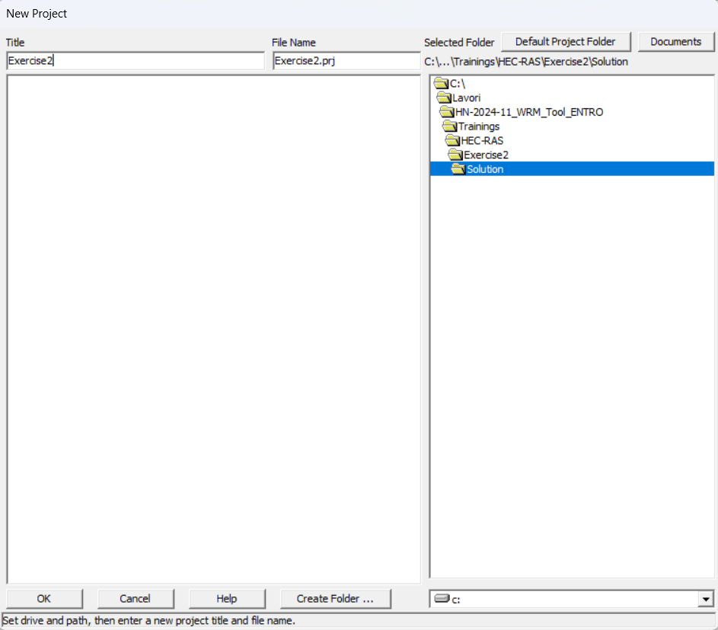
New project
From the File Menu → New Project
Chose the folder in which you want to save the project
Set the Title of the Project → ‘Exercise1’
Click OK

Slide 43
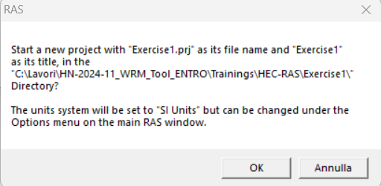
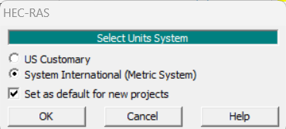
New project
Check if the units system are ‘SI Units’
Confirm
If they are not, confirm and then change them:
From the Option Menu → Units System (US Custumary/SI)
Set System International (Metric System)
Check the tab ‘Set as default for new projects’

Slide 44
New project
You can easily check the units system of the current project at any time

Slide 45
Ras Mapper
The HEC-RAS Mapper module is an interface accessed from the main HEC-RAS program and provides a geospatial visualization of HEC-RAS geometry, simulation results, and other pertinent geospatial data to assist users to efficiently create river hydraulic models.
RAS Mapper provide the user with tools
To edit HEC-RAS data layers
To edit generic shapefiles
To visualize results

Slide 46
Ras Mapper
Open the Ras Mapper

Slide 47
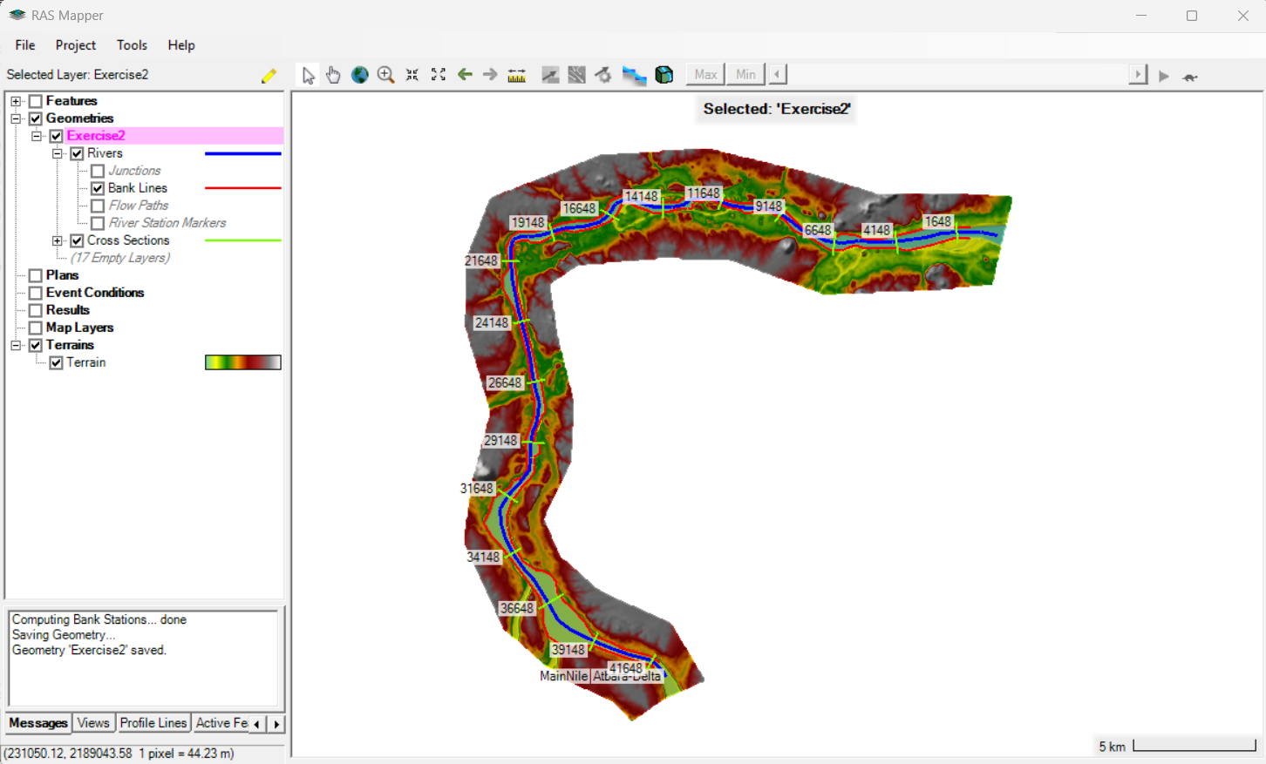
Ras Mapper
The RAS Mapper interface, shown below, is comprised of a menu system, data layers list, status window and the mapping window.
Menu system
Data Layer List
Status Window
Mapping Window

Slide 48
Creation of a Terrain
Before creating a terrain, move to the folder in which you just create the RAS project «Exercise1»
Create a new folder → Terrain
Copy the «DTM.tif» file you can find in the shared materials in Terrain folder

Slide 49
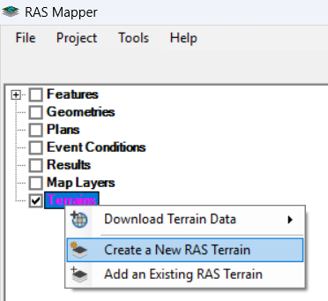
Creation of a Terrain
Go back to RAS Mapper window
Check the box associated to the Terrain Layer to turn it on
Right click on Terrain → Create a New RAS Terrain

Slide 50
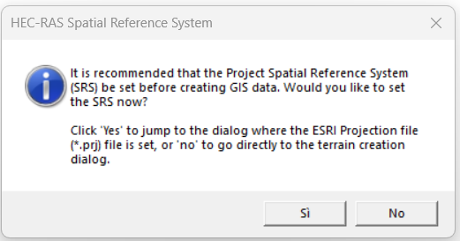
Creation of a Terrain
You can firstly set a Project Spatial Reference System or you can upload a terrain file and use its projection as projection for the project.
This dialog box warn you that you have not set a Project Spatial Reference System yet.
Click No to confirm you want to upload a DTM anyway

Slide 51
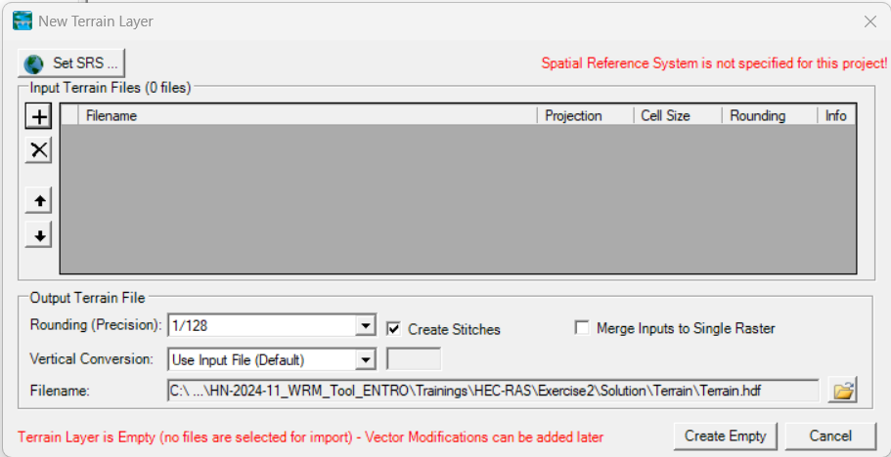
Creation of a Terrain
Click on the ‘+’ button and search for the file you want to upload as terrain
Select the ‘DTM.tif’ file you can find in the folder ‘Terrain’ and confirm
Click Yes to confirm you want the file’s spatial reference system to be used for this RAS model
Click Create

Slide 52
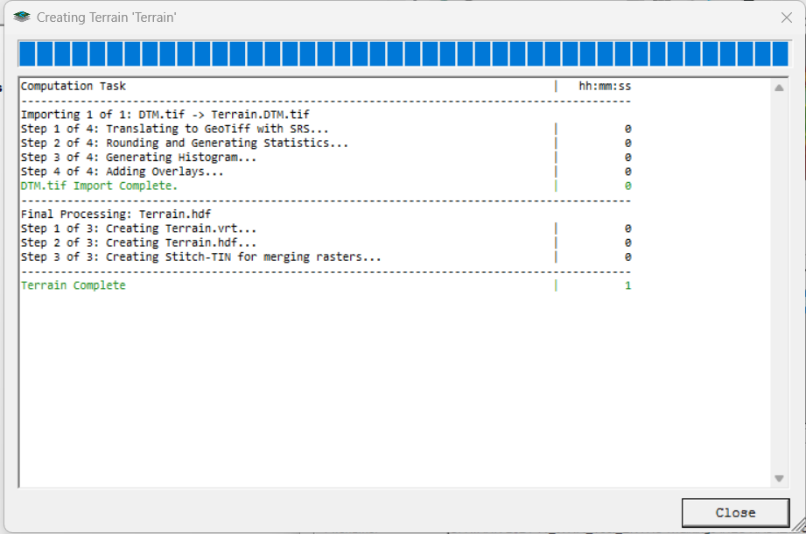
Creation of a Terrain
The process of terrain creation can take some time, depending on the weight of the file you select
At the end, click Close and you will be able to see the Terrain in the main window of RAS Mapper

Slide 53
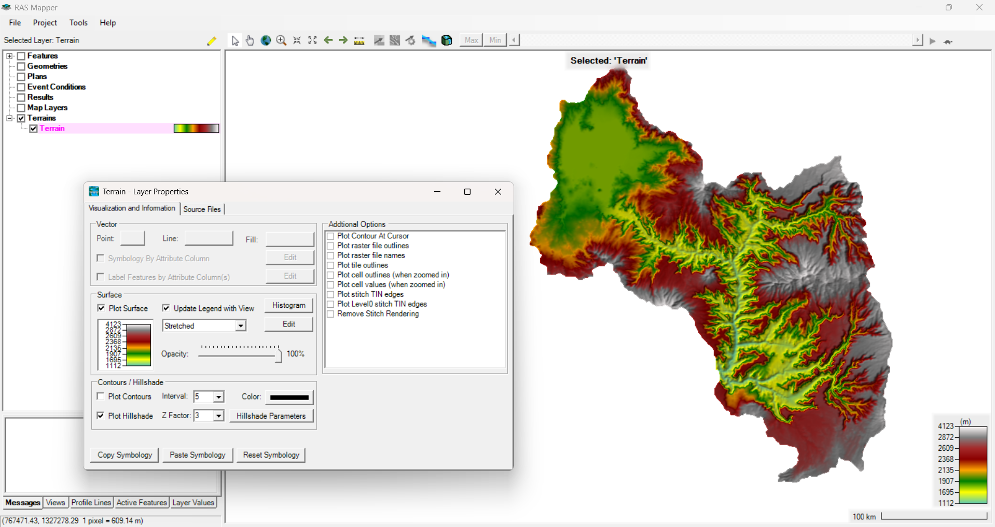
Creation of a Terrain
Double click on the name of the terrain you have just created
Check the option ‘Update Legend with View’, in this way the colour scale bar of the terrain wil automatically update according to the current zoom

Slide 54
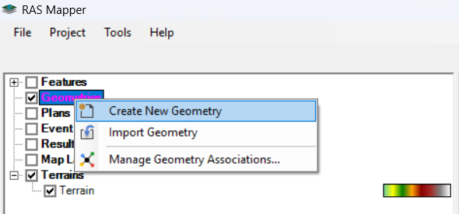
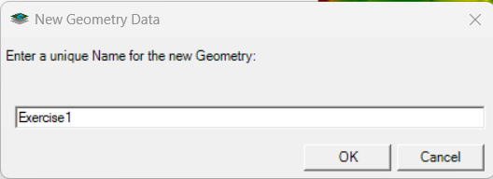
Geometry
Check the box associated to the Geometry Layer to turn it on
Right click on Geometry → Create New Geometry
Name the New Geometry as ‘Exercise1’

Slide 55
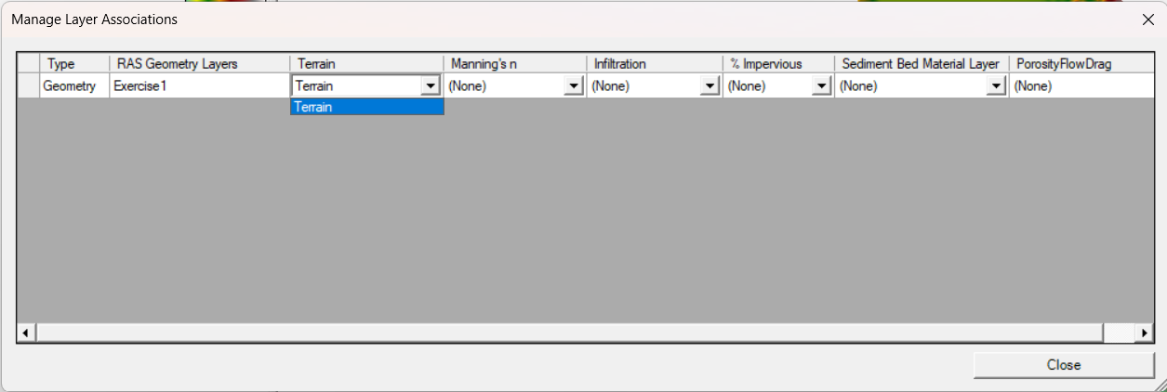
Geometry
From the Manage Layer Associations menu the user can set the terrain to be used for each geometry in case there are multiple terrains loaded in the same project.

Slide 56
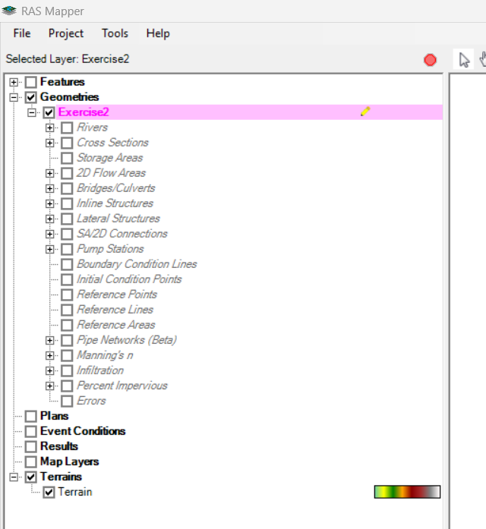
Geometry
Select the new geometry and Click on Start Edit
A menu with many voices will open
Each of them is a layer which can contain some geometry features and can be modified

Slide 57
Geometry
When you select one of these layers, it will automatically turn on and this tool bar will appear
The Add New Features button let you create new elements, digitalizing them on the RAS Mapper window
The Edit Features button let you modify existing elements
The Undo end Redo buttons let you go back to the previous action

Slide 58
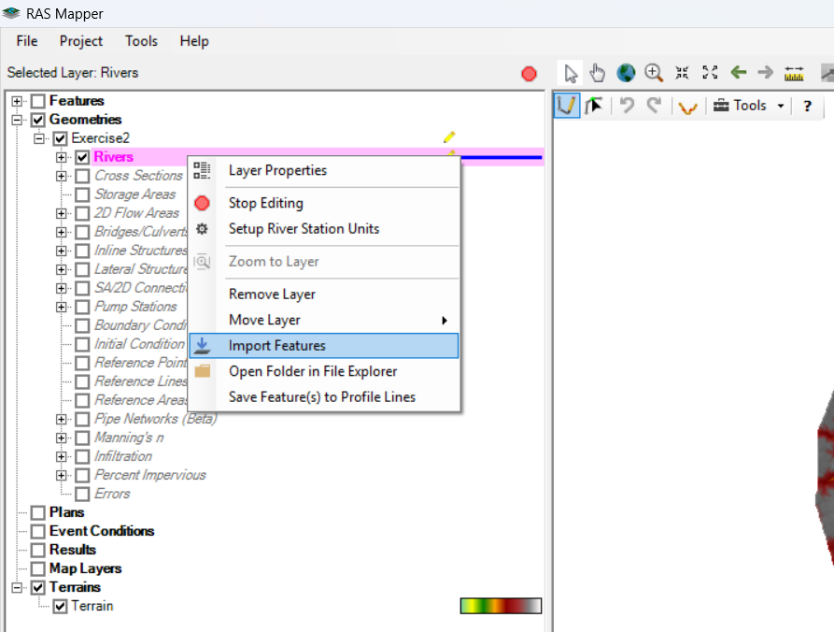
Geometry - River
Select the layer ‘River’
Right click on it
Select ‘Import Features’

Slide 59
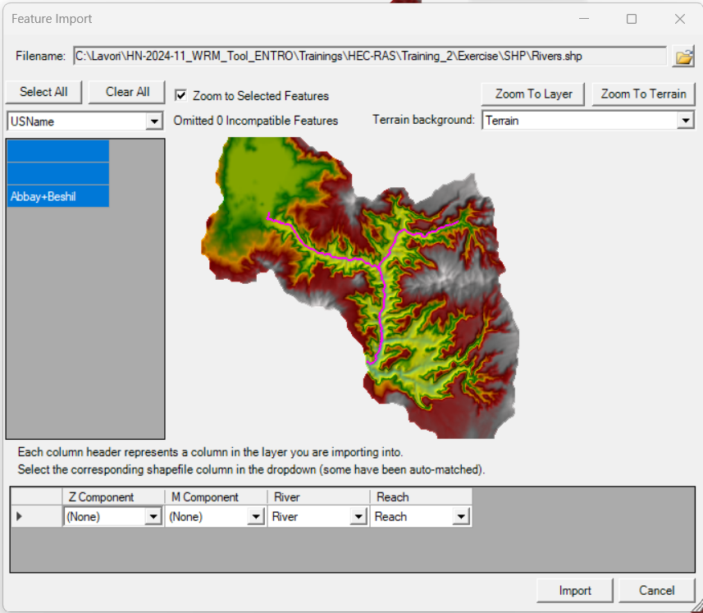
Geometry - River
Click the button of the top right of the menu to select the file you want to import
Select the ‘River.shp’ file (located in ‘SHP’ folder)
A preview of the features contained in the file will be displayed in the window
Click Import

Slide 60
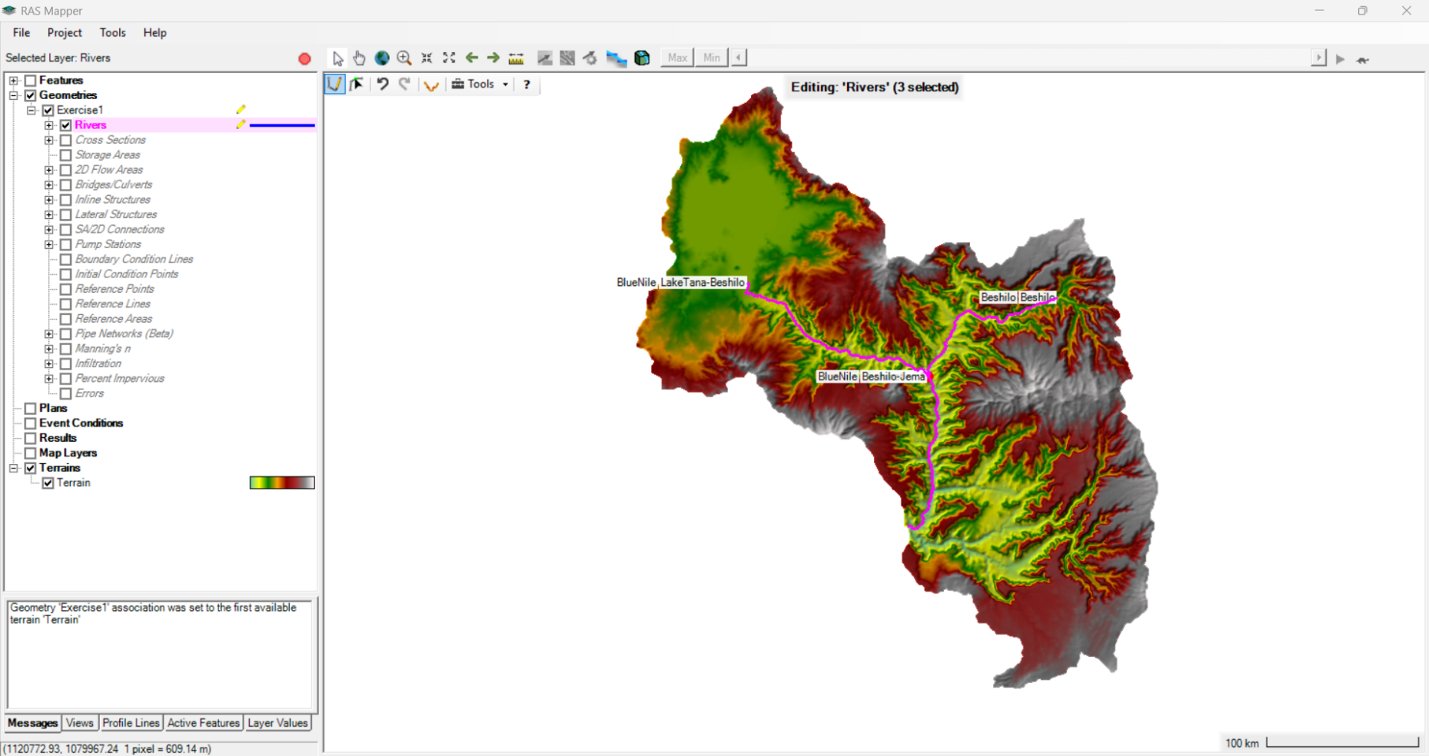
Geometry – River
Click the red button to stop editing the geometry and Save

Slide 61
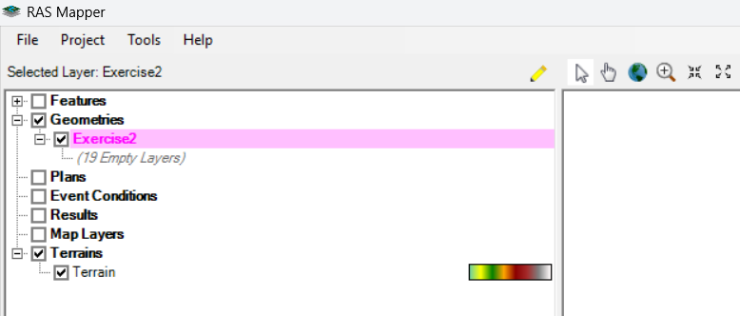
Geometry – Cross Sections
Select the new geometry ‘Exercise1’
Press the button Edit to turn on the editing mode

Slide 62
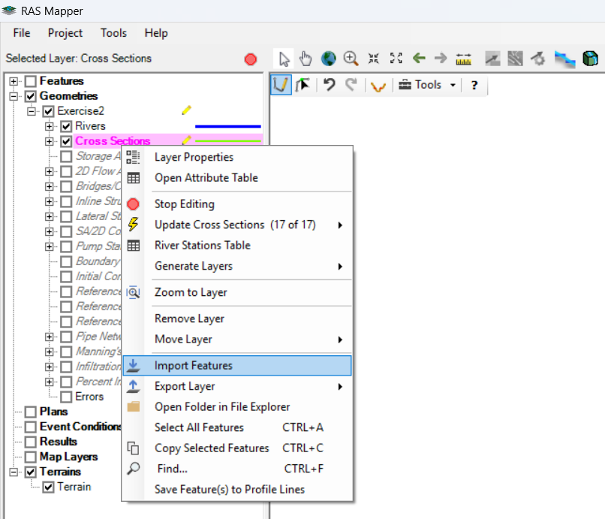
Geometry – Cross Sections
Select the layer ‘Cross Sections’
Right click on it
Select ‘Import Features’

Slide 63
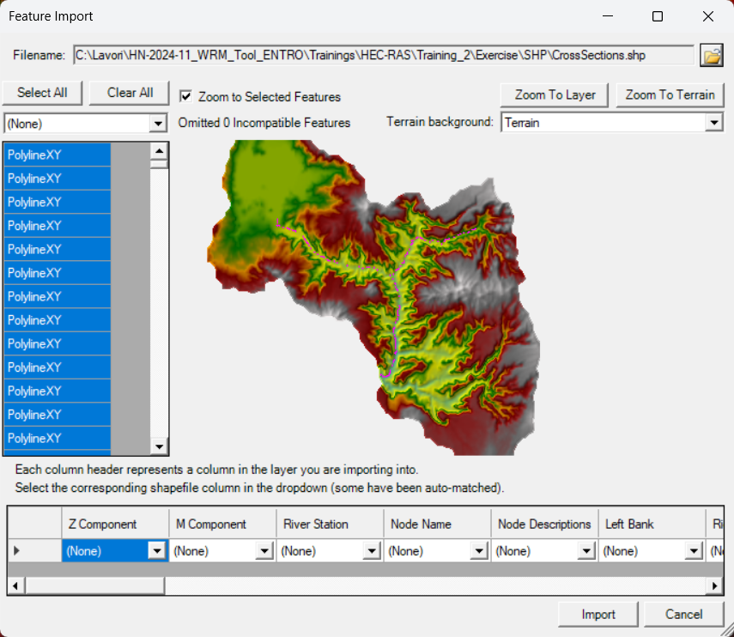
Geometry – Cross Sections
Click the button of the top right of the menu to select the file you want to import
Select the ‘CrossSections.shp’ file (located in ‘SHP’ folder)
A preview of the features contained in the file will be displayed in the window
Click Import

Slide 64
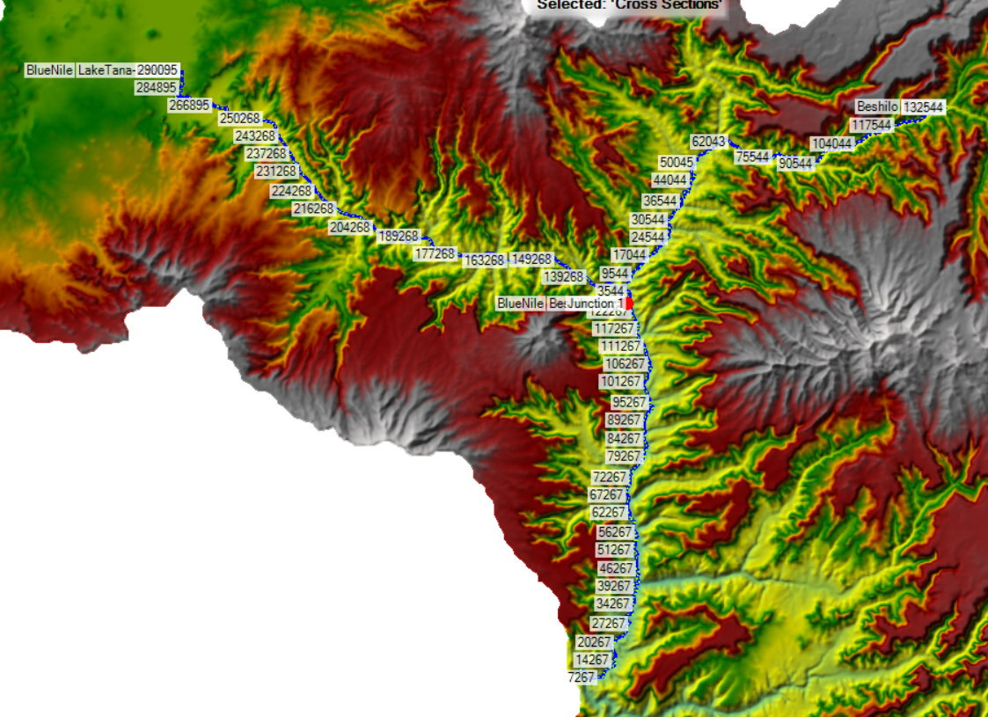
Geometry – Cross Sections
The Cross Sections imported will be displayed in RAS Mapper window
Notice the automatic computation of the river stations from downstream to upstream

Slide 65
Geometry – Cross Sections
When you import Cross Sections from a shapefile, you just import the spatial information, no data about station and elevation of the profile are available.
You can get this information from the Terrain:
Right click on Cross Sections layer from the left menu
Update Cross Sections → Elevation Profiles from Terrain

Slide 66
Geometry – Cross Sections
Click the red button to stop editing the geometry and Save

Slide 67
Geometry – Cross Sections
You can check the profile from the Geometry Data Window:
From the main HEC-RAS menu open the Geometry Data Window
From the File Menu → Open Geometry Data
Select ‘Exercise1’

Slide 68
Geometry – Cross Sections
From the Cross Section menu you can look at the Cross Sections profiles obtained from the Terrain

Slide 69
Geometry – Banks
When you create a Cross Section, the Banks stations are automatically set to the first and last point of the Cross Section.
You can change Banks Stations:
From the Bank Station Table
From the Cross Section Data Editor
From the Graphic XS Editor
Another way to modify the Bank Stations is from Ras Mapper.
You can digitalize a polyline along the river extension intersecting the Cross Sections, each intersection is the position of the bank for that Cross Section.

Slide 70
Geometry – Banks
Click + from the Rivers Layer
Turn on the layer Bank Lines→ the red lines rapresent the current Bank Stations position (they intersect each Cross Section at its extremity)

Slide 71
Geometry – Banks
Select Bank Lines layer and turn on the edit mode
Select the Edit Features button

Slide 72
Geometry – Banks
Drag the mouse on the main window to select the two Bank Lines, the selected features will turn pink
Right click on the selected Featured → Delete Selected

Slide 73
Geometry – Banks
Now you can digitalize new Banks Lines, clicking on Edit Feature Button
You can also import already existing polylines:
Right click on Bank Lines Layer from the left menu → Import Features

Slide 74
Geometry – Banks
Select the file ‘Banks.shp’ (in SHP folder)
Check the preview then click Import

Slide 75
Geometry – Banks
The imported polylines have been digitalized according to the DTM and rapresent the position of the banks for all the Cross Sections of the current geometry.
To update the Bank Station:
Select Cross Sections Layer
Right Click on it → Update Cross Sections → Banks Stations

Slide 76
Geometry – Banks
Stop editing and Save
Move the Geometry Data Window
Select Cross Sections Menu and check the new Bank Stations locations

Slide 77
Geometry – Banks
Banks stations are automatically set to the first and last point of each Cross Section
There are 3 way to modify them:
From the Bank Station Table
From Tables Menu → Bank Station
Set a value for Left and Right Bank Station (the values have to be one of the station of the Cross Section)

Slide 78
Geometry – Banks
2. From the Cross Section Data Editor
Click Cross Section
Set a value for Left and Right Bank Station (the values have to be one of the station of the Cross Section) in the table

Slide 79
Geometry – Banks
3. From the Graphic XS Editor
From the Tools Menu → Graphical Cross Section Editor
Click on Set Bank Station button
Click on the Cross Section plot to set the banks position

Slide 80
Geometry – Manning’s n values
Go back to the Geometry Data Editor window
From the Tables Menu → Manning’s n or k values
Fill the table with the values shown below (you can select an entire column and click ‘Set Values’ to assign a costant value)
Click OK when finished

Slide 81
Geometry – Terrain modification
Some modifications can be applied directly on the Terrain from Ras Mapper
Right click on the Terrain → Clone Terrain
Keep as name for the new Terrain ‘Terrain.Clone’

Slide 82
Geometry – Terrain modification
Select Terrain.Clone
Right click on Modification → Add Modification → Lines → Channel
Provide a name and click OK

Slide 83
Geometry – Terrain modification
Select the new Channel layer
Right click → Import Features
From the menu select the SHP ‘DTM_Modification.shp’ in the Material folder
Import

Slide 84
Geometry – Terrain modification
Look at the new channel in the Terrain.Clone

Slide 85
Geometry – Terrain modification
Manage Geometry Association

Slide 86
Geometry – Terrain modification
Update the Cross Section profiles using the new terrain information

Slide 87
Introduction
Part 3

Slide 88
Introduction
This exercise will explain how to create an unsteady flow simulation with HEC-RAS
The main steps will be:
Set the Htab parameters
Create an Unsteady Flow File with boundary conditions and initial conditions
Create a Plan
Perform an Unsteady Flow Analysis
Check the results

Slide 89
Open project
Open Ras Mapper
Click on Map Layer → Reference Layers → Add Reference Layer
Broswe to SHP folder and select ‘Catchments.shp’

Slide 90
Open project
The uploaded layer contains the shape of the hydrological catchment to which the River Network belongs
In ‘Exercise1’ folder you can find also a DSS File. It contains the flow hydrograph of the catchment obtained from a HMS hydrological model
Purpose of this exercise is to perform an unsteady Flow Analysis of Upper Dindir River using this flow data
Notice that the flow hydrograph will be used as follow:
BN_GUMMERA flow will be used as boundary condition at the most upstream cross section of Blue Nile River
BN_KESSIE flow will be used both as a boundary condition at the most upstream cross section of Beshilo River and both as a distributed contribute along the river network

Slide 91
Htab parameter
In order to speed up the Unsteady Flow calculations, the Geometric Preprocessor is used to process the geometric data into a series of hydraulic properties tables, rating curves, and family of rating curves.
Cross sections are processed into tables of elevation versus hydraulic properties of areas, conveyance, and storage.
The user is required to set an interval to be used for spacing the points in the cross section tables. The interval can be the same for all cross sections or it can vary from cross section to cross section.
This interval is very important, it will define the limits of the table that is built for each cross section. On one hand, the interval must be large enough to cover the full range of stages that may be incurred during the unsteady flow simulations. On the other hand, if the interval is too large, the tables will not have enough detail to accurately depict changes in area, conveyance, and storage with respect to elevation.
If the computed water surface goes above the table, properties are extrapolated by extending the last to points linearly. This extrapolation can often cause the model to go unstable.

Slide 92
Htab parameter
The interval for the cross section tables can be defined selecting the
HTab Parameters button from the Geometric Data editor

Slide 93
Htab parameter
Select All Rivers from the dropdown menu

Slide 94
Htab parameter
The columns are automatically filled with some default values. In this case, the calculated tables do not seem to be enough for the simulation.
Click on ‘Starting El’ to select the entire column
Click on ‘Copy Invert’, the starting elevation of each Cross Section will be set equal to its invert elevation
Click on the cell ‘Increment’ to select the entire column
Click ‘Set Values’ and enter 0.3. This value will be adopted for all cells in the column
Click on the cell ‘Points’ to select the entire column
Click ‘Set Values’ and enter 100. This value will be adopted for all cells in the column
Check if the new table extension is large enough

Slide 95
Htab parameter
You should have obtained this:

Slide 96
Boundary Conditions
The unsteady Flow Simulation needs:
Boundary Condition
at all of the external boundaries of the system
at any desired internal locations (optional)
Initial Condition
initial flow at the beginning of the simulation.
This information can be entered in an Unsteady Flow File, from the Unsteady Flow Data Editor
Notes:
The user is required to enter boundary conditions at all of the external boundaries of the system, as well as any desired internal locations, and set the initial flow and storage area conditions at the beginning of the simulation.

Slide 97
Boundary Conditions
River, Reach, and River Station locations of the external bounds of the system will automatically be entered into the table
In this case, in the table you see the firsts and the last XS of the system

Slide 98
Boundary Conditions
Boundary conditions are entered by first selecting a cell in the table for a particular location, then selecting the boundary condition type that is desired at that location. Not all boundary condition types are available for use at all locations. The program will
automatically gray-out the boundary condition types that are not relevant when the user highlights a particular location in the table.

Slide 99
Boundary Conditions
Select the Upstream Cross Section of River ‘Blue Nile’ Reach ‘LakeTana-Beshilo’ (RS 290095)
Select Flow Hydrograph from the Boundary Condition Types
The Flow Hydrograph Window will open to let the user enter the data

Slide 100
Boundary Conditions
The user has the option of entering a flow hydrograph directly into a table.
Select Enter Table option
Set a Data time interval (only regular time series data)
Enter the hydrograph ordinates into the table

Slide 101
Boundary Conditions
The user can read the data from a HEC-DSS (HEC Data Storage System) file
Select Read from DSS before simulation option
Click on Select DSS file and Path

Slide 102
Boundary Conditions
Select the desired DSS file by using the browser button at the top
Once a DSS file is selected, a list of all of the DSS pathnames within that file will show up in the table.

Slide 103
Boundary Conditions
Select the DSS pathname with Part B ‘BN_GUMMERA’
Click Ok
From the Flow Hydrograph Window set
Min Flow: 30
Click Ok

Slide 104
Boundary Conditions
Repeat the same procedure for the Upstream Cross Section of River ‘Beshilo’ (RS 132544)
Select the DSS pathname with Part B ‘BN_KESSIE’
Click Ok
From the Flow Hydrograph Window set
Min Flow: 20
Multiplier: 0.07
Click Ok

Slide 105
Boundary Conditions
The Uniform Lateral Inflow Hydrograph is used as an internal boundary condition. This option allows the user to bring in a flow hydrograph and distribute it uniformly along the river reach between two user specified cross section locations.
Click Add RS…
Select River → Beshilo
Select Reach → Beshilo
Select the Cross Section RS 131044 from the list on the left
Click on the Arrow to move it in the Selected Location List
Click OK

Slide 106
Boundary Conditions
Select the Cross Section RS 804826.7 from the Boundary Condition Location
Select Uniform Lateral Inflow from the Boundary Condition Types
Select the second-last RS from the menu on the top
Select Read from DSS before simulation option
Click on Select DSS file and Path and search for the same DSS file and pathname chosen before
Set Multiplier: 0.18
Click OK

Slide 107
Boundary Conditions
BN_KESSIE
Uniform Lateral Inflow
Multiplier: 0.18
BN_GUMMARA
Flow
Multiplier: 1
BN_KESSIE
Flow
Multiplier: 0.07
BN_KESSIE
Uniform Lateral Inflow
Multiplier: 0.55
BN_KESSIE
Uniform Lateral Inflow
Multiplier: 0.20
Normal Depth 0.001

Slide 108
Boundary Conditions
Select the Downstream Cross Section (RS 267)
Select Normal Depth as Boundary Condition Types
Set Friction Slope: 0.01
Click OK

Slide 109
Boundary Conditions
You should have obtained this
File menu → Save Unsteady Flow Data as
Save as ‘Unsteady’

Slide 110
Initial Conditions
In addition to the boundary conditions, the user must establish the initial conditions of the system at the beginning of the unsteady flow simulation.
Initial conditions consist of flow and stage information at each of the cross sections, as well as elevations for any storage areas defined in the system.
The most common method for establishing initial conditions is to enter flow data for each reach and have the program perform a steady flow backwater run to compute the corresponding stages at each cross section. This option also requires the user to enter a starting elevation for any storage areas that are part of the system.
Initial conditions are established from within the Unsteady Flow Data editor by selecting the Initial Conditions tab.

Slide 111
Initial Conditions
Click on Initial Condition Tab
Insert as Initial Flow as shown in the picture
File Menu → Save Unsteady Flow Data

Slide 112
Unsteady Flow Analysis
Once all of the geometry and unsteady flow data have been entered, the user can begin performing the unsteady flow calculations.
Go to the HEC-RAS main window
Select Unsteady Flow Analysis button
The Unsteady Flow Analysis window will appear

Slide 113
Unsteady Flow Analysis
The first step in performing a simulation is to put together a Plan.
The Plan defines which geometry and unsteady flow data are to be used
The Plan provides a description and short identifier for the run
The Plan includes information about Programs to Run, Simulation Time Window, Computation Settings and Simulation Options

Slide 114
Unsteady Flow Analysis
Geometry File and Unsteady Flow File are automatically selected.
If the project has multiple Geometry File or Unsteady Flow File you can chose which ones to use from the drop down menu

Slide 115
Unsteady Flow Analysis
Program to Run
Check the box
Geometry Preprocessor (process the geometric data into a series of hydraulic properties tables, rating curves..)
Unsteady Flow Simulation (perform the unsteady flow calculations)
Post Processor (compute hydraulic output variables that are not computed by the Unsteady Flow computational engine)

Slide 116
Unsteady Flow Analysis
Simulation Time Window
The user is required to enter a time window that defines the start and end of the simulation period.
The date must have a four-digit year.
The time field is entered in military style format (i.e. 1p.m. is entered as 1300).
Enter the date as shown in the Figure
In order to run unsteady flow simulations, WINDOWS date settings must be changed to the english date properties

Slide 117
Unsteady Flow Analysis
In order to run unsteady flow simulations, WINDOWS date settings must be changed to the english date properties
Click the Start button, search for Control Panel, and then select Control Panel
Select Region in the Control Panel options
The Region dialog box appears
Select ‘English (USA)’

Slide 118
Unsteady Flow Analysis
Computation Settings
The computation interval is the time step used in the unsteady flow calculations. This is probably one of the most important parameters.
The computation interval should be based on several factors as velocity, Cross Sections shape, input Hydrograph, Structures…
In general using small Computational Interval will provide more accurate computation, but it may cause the model to take a lot longer to run.
Set Computation interval equal to 2 Minute

Slide 119
Unsteady Flow Analysis
Computation Settings
The Hydrograph Output Interval is used to define at what interval the computed stage and flow hydrographs will be written to HEC-DSS output file.
This interval must be equal to or larger than the selected computation interval.
Set Hydrograph Output Interval equal to 1 Hour

Slide 120
Unsteady Flow Analysis
Computation Settings
The Detailed Output Interval field allows the user to write out profiles of water surface elevation
and flow at a user specified interval during the simulation.
Profiles are not written for every
computational time step because it would require too much space to store all of the information for most jobs.
The selected interval must be equal to or greater than the computation interval.
Set Detailed Output Interval equal to 1 Week

Slide 121
Unsteady Flow Analysis
Computation Settings
Mapping Output Interval.
This field is used to enter the interval at which the user will be able to visualize mapping output within HEC-RAS Mapper.
Set Mapping Output Interval equal to 1 Hour

Slide 122
Unsteady Flow Analysis
Computation Settings
The row Project DSS Filename shows the position of the HEC-DSS file where the program will write output results.

Slide 123
Unsteady Flow Analysis
From the Options menu of the Unsteady Flow Analysis window other options are available.
Select Stage and Flow Output Locations option. This option allows the user to specify locations where they want to have hydrographs computed and available for display. By default, the program sets locations of the first and last cross section of every reach.
Select one of the cross section from the list
Click the arrow
Confirm OK

Slide 124
Unsteady Flow Analysis
Go back to the Unsteady Flow Analysis window
File menu → Save Plan as
Save the plan ‘Dindir-Unsteady’
Click Compute to perform the simulation

Slide 125
Results
Go back to the main HEC-RAS menu
Click on the Hydraulic Property Tables button
The Property Tables window will open
From here the user can see how the Geometric Preprocessor has processed the geometric data into a series of hydraulic properties tables, rating curves..
From Option menu → Variables the user can chose which variables to show
Plots and tables are available for all the Cross Sections

Slide 126
Results

Slide 127
Results
Go back to the main HEC-RAS menu
Click on the Plot Stage and Flow Hydrograph button
The Stage and Flow window will open
From here the user can see the hydraulic output variables computed by the Post Processor
Plots and tables are available only for first and last Cross Sections, and the ones selected in Stage and Flow Output Locations list

Slide 128
Results
You can select the Cross Section you want to plot

Slide 129
Results
You can decide which variables to plot

Slide 130
Results
You can decide to see the output results in graphical or tabular format

Slide 131
Results
Go back to the main HEC-RAS menu
Click on the View Profile button
The Profile Plot window will open

Slide 132
Results
From Option menu you can Zoom in and Zoom out
With the Play button you can see Profiles in different time interval

