Slide 1

Eastern Nile Technical Regional Office (ENTRO)
Consultancy service for the Development of the Eastern Nile Water Resources Models and Tools
Nile Cooperation for Climate Resilience
Training of Trainers in Eastern Nile Water Resources Models and Tools
HEC-DSSVue
6 – 10 May 2025

Slide 2
1.1 HEC-DSSVue OVERVIEW
HEC = Hydrologic Engineering Center
DSS = Data Storage System
Vue = Visual Utility Engine
HEC-DSSVue is a database system designed to efficiently store and retrieve scientific data that is typically sequential. Such data types include, but are not limited to,
time series data,
curve data,
spatial-oriented gridded data,
and others.
The system was designed to make it easy for users and application programs to retrieve and store data. HEC-DSS is incorporated into most of HEC’s major application programs.
Notes:
The U.S. Army Corps of Engineers’ Hydrologic Engineering Center Data Storage System, or HEC-DSS, is a database system designed to efficiently store and retrieve scientific data that is typically sequential.

Slide 3
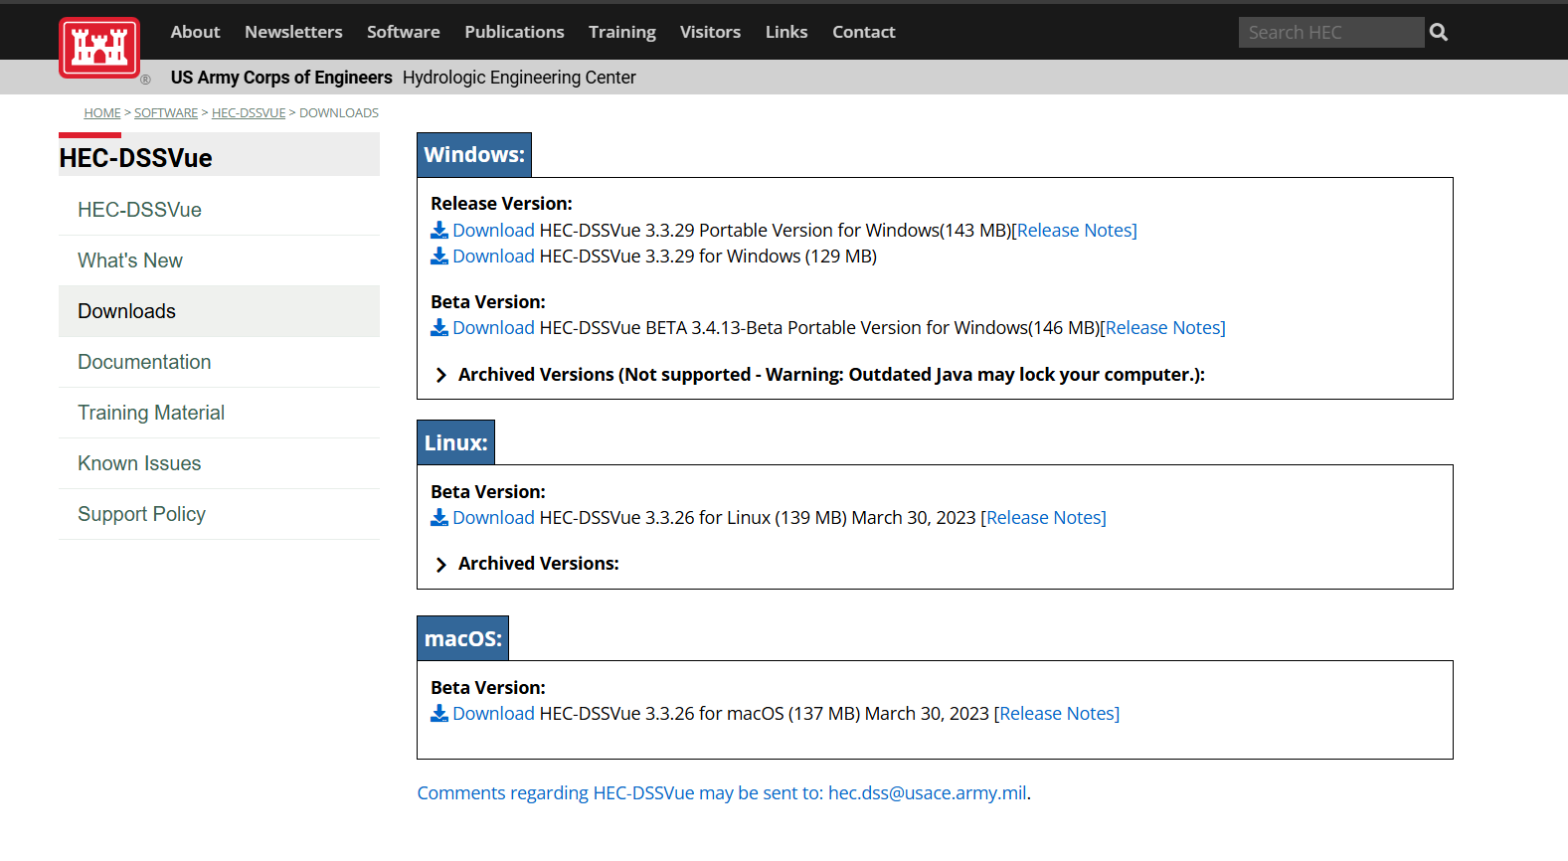
1.1 HEC-DSSVue OVERVIEW
HEC-DSS Vue Download
https://www.hec.usace.army.mil/software/hec-dssvue/downloads.aspx

Slide 4
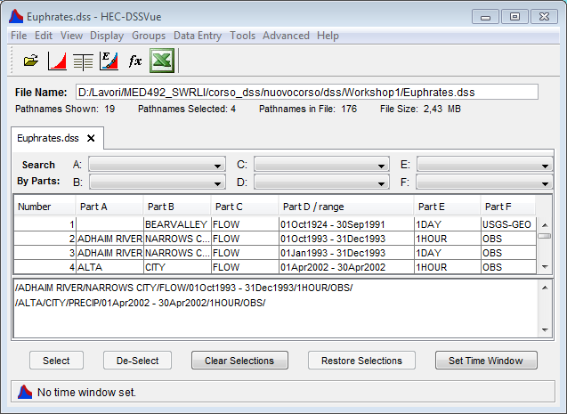
1.1 HEC-DSSVue OVERVIEW
Main Window
Menu Bar
Tool Bar
Current File
File Tabs
Pathname Filters
Pathname List
Selection List
Selection Buttons
Message Bar

Slide 5
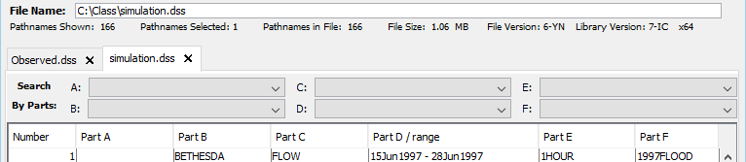
1.1 HEC-DSSVue OVERVIEW
The File Tab
Several HEC-DSS files may be open at one time, each in its own tab.
  This allows data from different files to be plotted, tabulated, or edited together

Slide 6
1.1 HEC-DSSVue OVERVIEW
Current File Info
Information about the file opened in the current tab is shown in the region above the tabs.
  The absolute path to the file
  The number of pathnames…
    Shown - in the pathname list.
    Selected – either in the selection box or highlighted.
    In the file.
  The File size
  The version of the HEC-DSS library the file was last written with…
  The version of the HEC-DSS library currently used by HEC-DSSVue

Slide 7
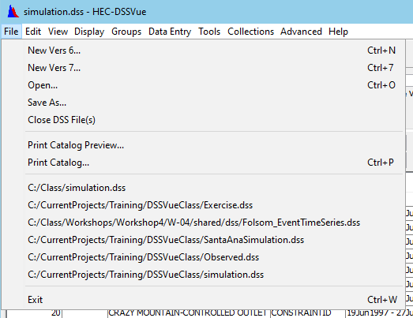
1.1 HEC-DSSVue OVERVIEW
The File Menu
New Vers 6…
New Vers 7…
Open…
Save As…
Close DSS File(s)
Print Catalog…
list of recently
opened files
Exit

Slide 8
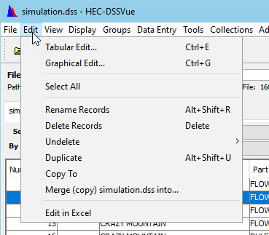
1.1 HEC-DSSVue OVERVIEW
The Edit Menu
Tabular Edit…
Graphical Edit…
Select All
Rename Records
Delete Records
Undelete
Duplicate
Copy to
Merge (copy) current-file into…
Edit in Excel
Notes:
Tabular Edit - Opens a simple table with the cells of the table editable – for the selected records
Graphical Edit – Opens the graphical editor – for the selected records. The GE includes features to “draw” the changes to the data in a plot
Select All – selects all the records in the current view of the pathname list and puts them in the selection list
Rename Records – provides a dialog to rename the selected records …by pathname parts
Delete Records – deletes the selected records
Undelete – opens a dialog that lists the records that have been “deleted” and that have not been “recycled”.
Duplicate – makes a copy of the selected records and saves them in the current DSS file. A “rename” dialog is opened so that the copied records can be assigned new and unique pathnames.
Copy to – copies the selected records into another DSS file
Merge – copies the current file into another dss file.
Edit in Excel – Opens Microsoft Excel, exports the data into a workbook, and returns the data back to dssvue when “saved”

Slide 9
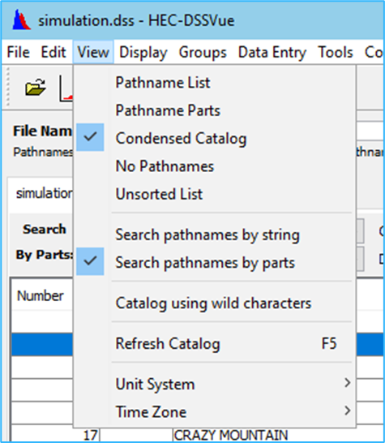
1.1 HEC-DSSVue OVERVIEW
The View Menu (Catalog Options)
Pathname List (Catalog) Options
  Pathname List
  Pathname Parts
  Condensed Catalog
  No Pathnames
  Unsorted List
  Refresh Catalog
Filter Options
  Search pathnames by string
  Search pathnames by parts
Unit System
Time Zone

Slide 10
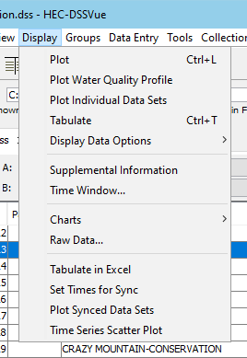
1.1 HEC-DSSVue OVERVIEW
The Display Menu
Plot
Plot Individual Data Sets
Tabulate
Display Data Options
  Normalize
  Sync data sets
Supplemental Information
Time Window
Charts
  Pie Chart
  Histogram
Tabulate in Excel

Slide 11
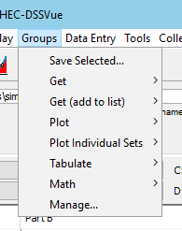
1.1 HEC-DSSVue OVERVIEW
The Groups Menu
Groups allows you to save and access frequently used datasets
Save Selected…
  Creates a group
Get
  Makes the group of pathnames “selected”
Get (add to list)
Plot
Plot Individual Sets
Tabulate
Math
Manage
  Edit, rename, delete, etc. groups

Slide 12
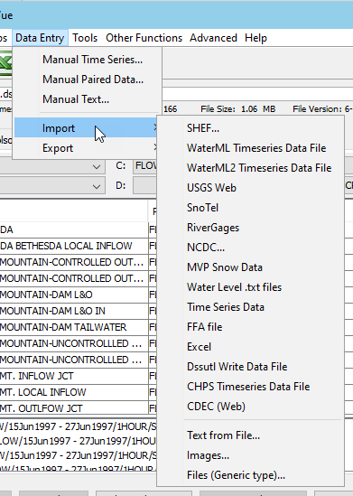
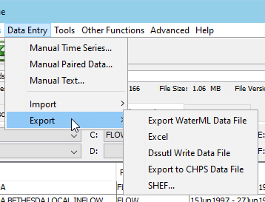
1.1 HEC-DSSVue OVERVIEW
The Data Entry Menu
Manual Time Series…
Manual Paired Data…
Manual Text…
Import
  SHEF
  USGS
  …
Export
  Excel
  SHEF
  DSSUtil Write Data File

Slide 13
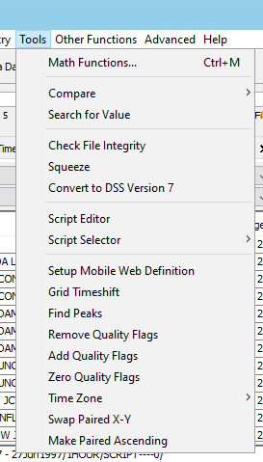
1.1 HEC-DSSVue OVERVIEW
The Tools Menu
Math Functions…
Compare
    Files
    Files with Options
    Data Sets
    Data Sets with Options
Search for Value
Check File Integrity
Squeeze (defragment)
Convert to DSS Version 7
Script Editor
Script Selector
Several Plugin Entries

Slide 14
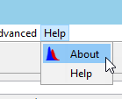
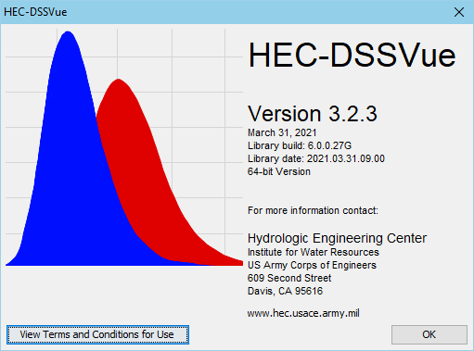
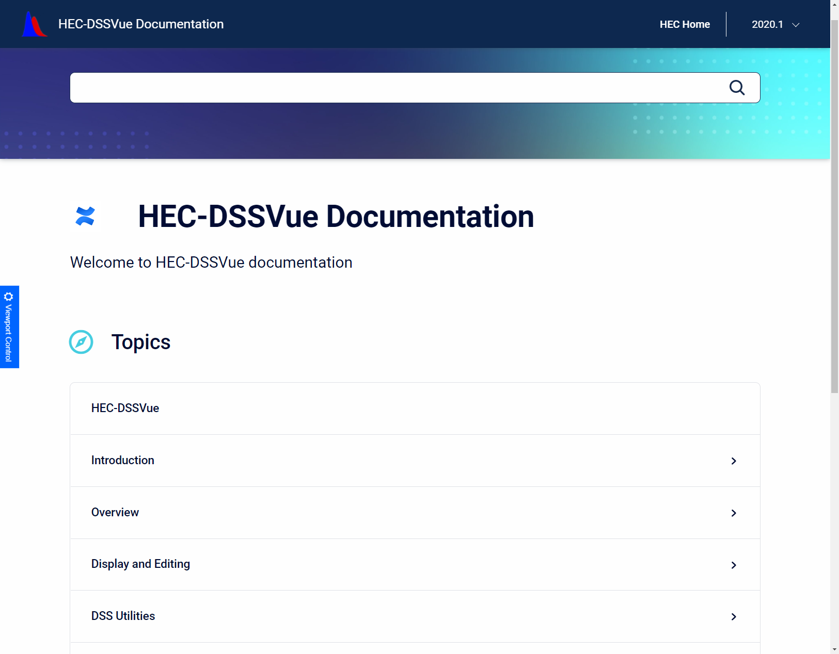
1.1 HEC-DSSVue OVERVIEW
The Help Menu
About
  Shows the version, library, and build numbers
  Provides access to the “Terms and Conditions”
Help – F1
  Brings up the User’s Manual on HEC-DSSVue web site

Slide 15
1.2 Cataloging and filtering records
Data types that can be stored in the DSS
Time Series data
  regular interval time series
  irregular interval time series
Paired data
curves
Notes:
Data types that can be stored include:
Time series data:
regular-interval time series, which are data that occurs at a standard time interval; this kind of data are stored in blocks whose length depend on the time interval. For example hourly data is stored with a block length of a month, daily data is stored with a block length of a year;
irregular-interval time series, which does not have a constant time interval between values. This type of data is stored with a date/time stamp for each element;
Paired data, which are data that defines a curve, generally for rating curves, flow-frequency curves, area-elevation curve. One block of paired data may contain several curves within it as long as the record has common set of ordinates.
Data are stored in blocks.

Slide 16
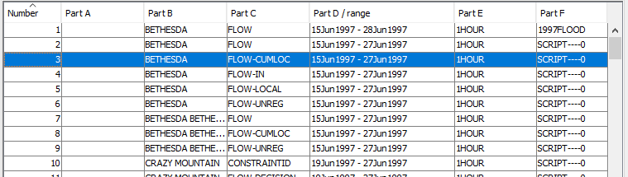
1.2 Cataloging and filtering records
The Pathname List
Is a list of the data records contained in the current HEC-DSS file.
Also known as the CATALOG
Sortable
Filterable
Condensable

Slide 17
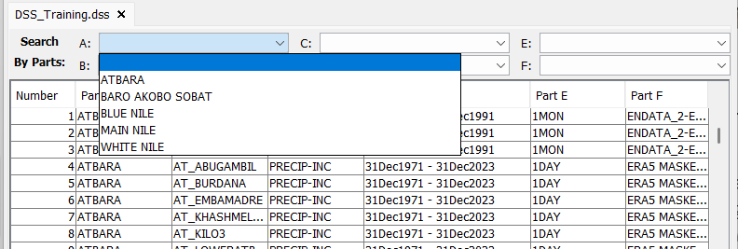
1.2 Cataloging and filtering records
Pathname filters
Filters can be used to display in the pathname list only those records whose pathnames include the selected filters.
Filters can be by Pathname part or Search String

Slide 18
1.2 Cataloging and filtering records
Pathname filters
Part Description
A Group, basin, river, region or study name
B Location or gage name
C Data parameter
D Starting date for block
E Time interval
F Version or additional information

Slide 19
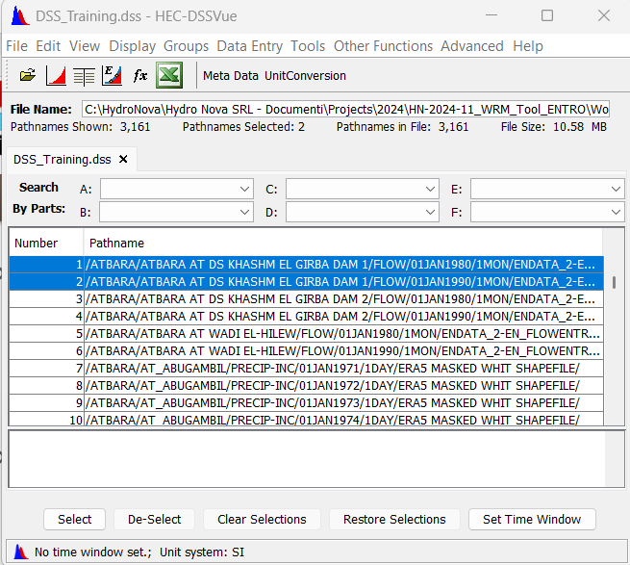
1.2 Cataloging and filtering records
Exercise 1
Pathname List
View → Pathname List
Control the time data set for flow recorded Atbara at Khashm El Girba Dam 1 in the Atbara River, with time step of 1 month
There are two pathnames, corresponding at two blocks or records (1980s, 1990s)
Notes:
The time data set recorded at Narrow city in the Adhaim river has been splitted into three block:
one for october 1993, one for november, one for december

Slide 20
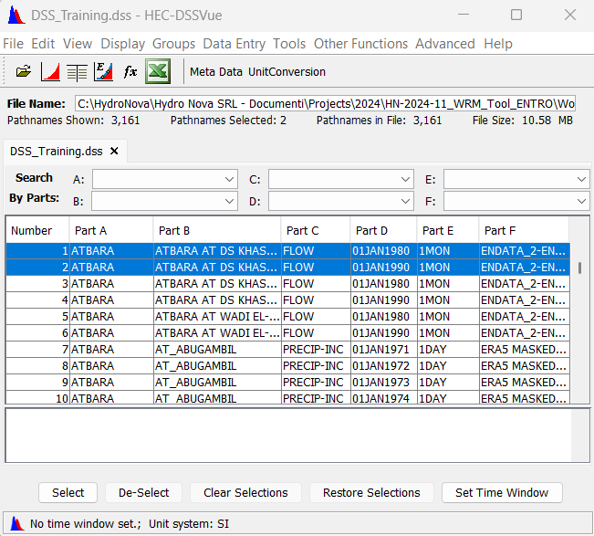
1.2 Cataloging and filtering records
Exercise 1
Pathname part
Control the time data set:
A: ATBARA
B: ATBARA AT DS KHASHM EL GIRBA DAM 1
C: FLOW
D: 01 JAN 1980
01 JAN 1990
E: 1MON
F: ENDATA_2-EN_FLOW.XLS
Two blocks or records

Slide 21
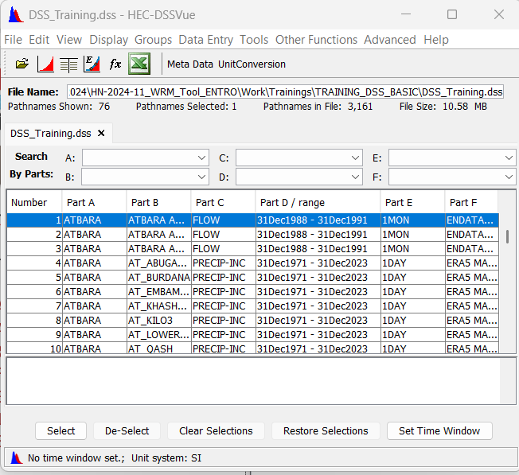
1.2 Cataloging and filtering records
Exercise 1
Condensed catalog
Control the time data set:
A: ATBARA
B: ATBARA AT DS KHASHM EL GIRBA DAM 1
C: FLOW
D: 31 DEC 1988 – 31DEC1991
E: 1MON
F: ENDATA_2-EN_FLOW.XLS
Two blocks have been
condensed into one row

Slide 22
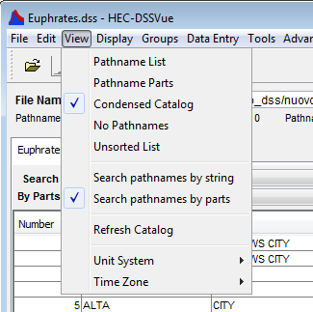
1.2 Cataloging and filtering records
Exercise 1
Filters
Open the view menu
Two main catalog filters:
Search pathnames by strings
Search pathname by parts
Notes:
Open the DSS file named “Euphrates”. There are three main catalog views in DSSVue: Pathname List, Pathname Parts, and Condensed Catalog. These catalog options are available under the View menu and can be selected one at a time. each catalog view will display a list of records sorted in ascending order from top to bottom and sorted in alphabetical order (A Part first, then B, C, D, E, and lastly F Part) from left to right. As for the No Pathnames option under the View menu, it is typically used to access very large databases using only scripted functions, because generating other types of catalog views for large databases could take a significant amount of time.

Slide 23
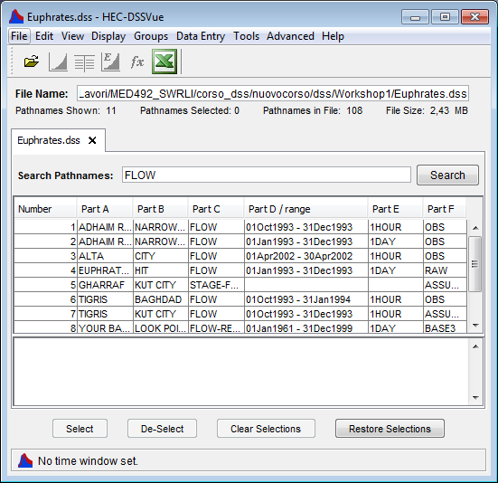
1.2 Cataloging and filtering records
Exercise 1
Search Pathname by strings
type: FLOW in the search pathname dialog box and click search button
the program will list in the main view only the records whose pathname contains the word «FLOW»

Slide 24
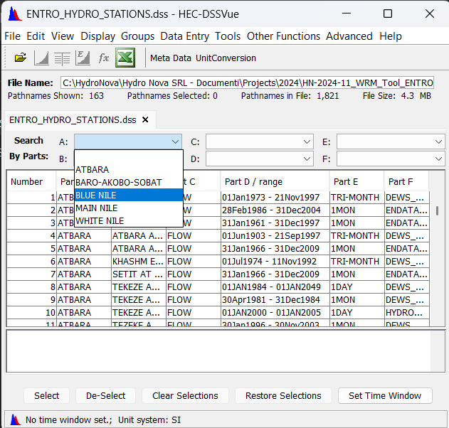
1.2 Cataloging and filtering records
Exercise 1
Search Pathname by parts:
click on the drop-down menu of the A part and choose BLUE NILE
Notes:
THE TIME SERIES LISTED IN THE MAIN VIEW HAS BEEN REDUCED TO 4

Slide 25
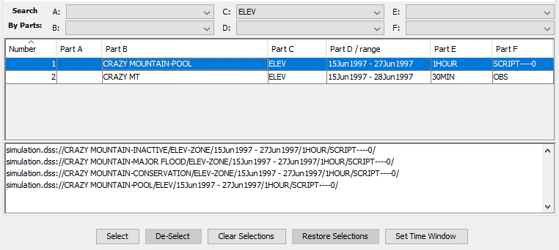
1.3 Selecting data
Before you can use many DSSVue functions, you must identify the datasets you want to work with, i.e., you must add them to the Selection List. To do so…
  click to highlight a record in the Pathname List
  double-click to add it to the Selection list or press the Select Button
  use the rest of the Buttons to modify the selection list
Notes:
The pathname will appear in the selection area

Slide 26
1.3 Selecting data
Exercise 2
Five selection buttons:
Highlight one record and click the select button: the pathname will appear in the selection list
Select the the pathname in the selection list and click De-Select button
Double click on three pathname in the pathname list, they will appear in the selection list.
Click on the Clear Selections Button to remove all the pathnames from the selection list
Notes:
The pathname will appear in the selection area

Slide 27
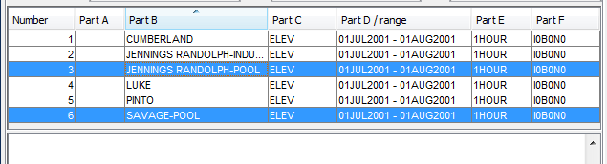
1.3 Selecting data
Quick selection
You can highlight pathnames in the main list, then plot, tabulate, etc. without formal selection
  HOWEVER - If you have pathnames in the Selection List, they will always override highlighted pathnames
Notes:
The pathname will appear in the selection area

Slide 28
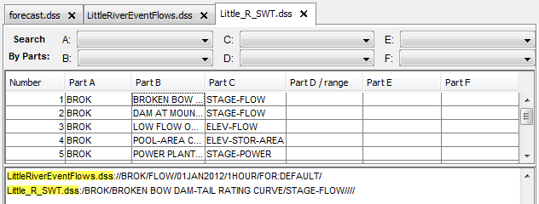
1.3 Selecting data
Selecting from Multiple Files
You can select datasets from multiple files to access together (e.g., plot or perform a math function)
The name of the source file will show before the pathname in the selection list
Notes:
The pathname will appear in the selection area

Slide 29
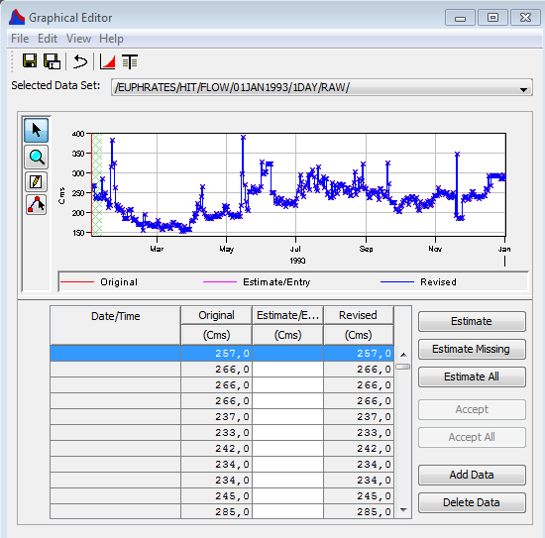
1.3 Selecting data
After selecting the data you can:
Plot and tabulate
Copy rename merge delete
Editing data
Manipulate with mathematical functions
Notes:
The pathname will appear in the selection area

Slide 30

1.3 Selecting data
Tool bar
Some common features were added as buttons on the tool bar for quick, easy access
  File Open
  Plot
  Tabulate
  Graphical Editor
  Math Functions
  Tabulate in Excel
  Add more buttons – with scripts or plug-ins

Slide 31

1.4 Plotting data
Plot button
Plotting of a single record
Plotting of multiple records in the same viewport (same parameters)
Plotting of multiple records in different sub-viewports (different parameters)

Slide 32
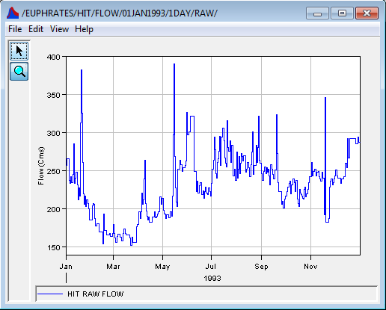
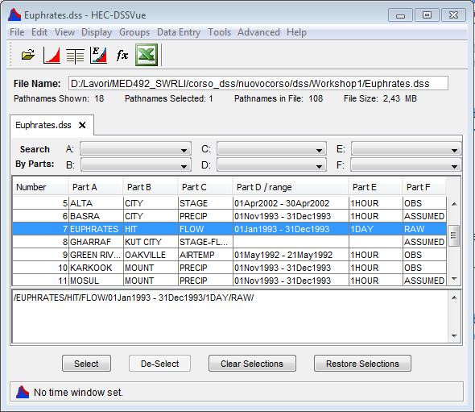
1.4 Plotting data
Exercise 3
1. Single record
Select one record
Click the plot button
Notes:
Highlight any row in the list of pathnames.
Double click on the row, or alternatively press the Select button at the bottom of the main DSSVue window. The complete pathname should appear in the Selected Records section of the main window.
Try plotting and then tabulating, Separate windows should pop up.
open the file menu of the graph window anch choose tabulate. a pop up window will appear, containing a table.
close the plot and table windows
In the main DSSVue window, deselect the pathname in the Selected section by highlighting and then pressing the De-Select button at the bottom of the main window.

Slide 33
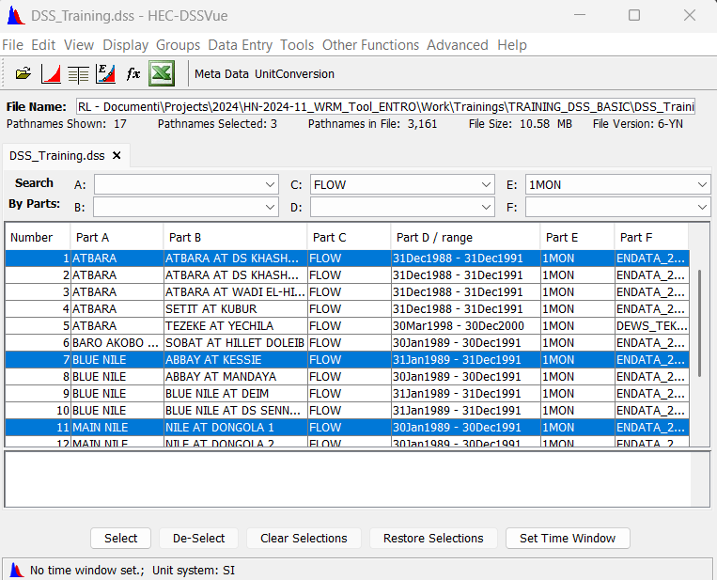
1.4 Plotting data
Exercise 3
2. Multiple records in the same viewport
Selection of three records:
Choose FLOW in the C drop-down menu and 1MON in the E drop-down menu
Select the three record with B Part:
  ATBARA AT DS KHASHM EL GIRBA DAM 1
  ABBAY AT KESSIE
  NILE AT DONGOLA 1
Click the plot button
Notes:
Selection of three record:
Choose FLOW in the C drop-down menu and 1HOURS in the E drop-down menu
Select the three record with B Part: Narrows City, Baghdad, Kut City

Slide 34
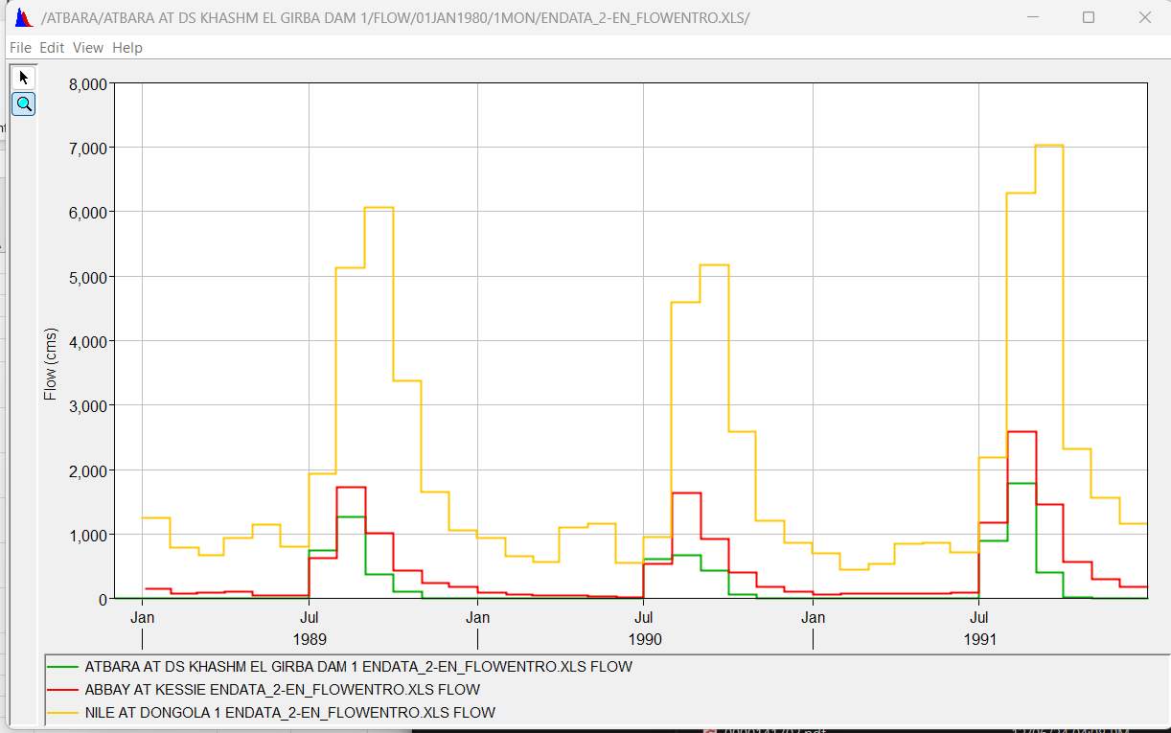
1.4 Plotting data
Exercise 3
2. Multiple records in the same viewport

Slide 35
1.4 Plotting data
Exercise 3
3. Multiple records in different sub-viewports
Selection of two records:
ATBARA/ATBARA AT DS KHASHM EL GIRBA DAM 1/FLOW/31Dec1988 - 31Dec1991/1MON/ENDATA_2-EN_FLOW.XLS/
ATBARA/AT_ABUGAMBIL/PRECIP-INC/31Dec1971 - 31Dec2023/1DAY/ERA5 MASKED WHIT SHAPEFILE/

Slide 36
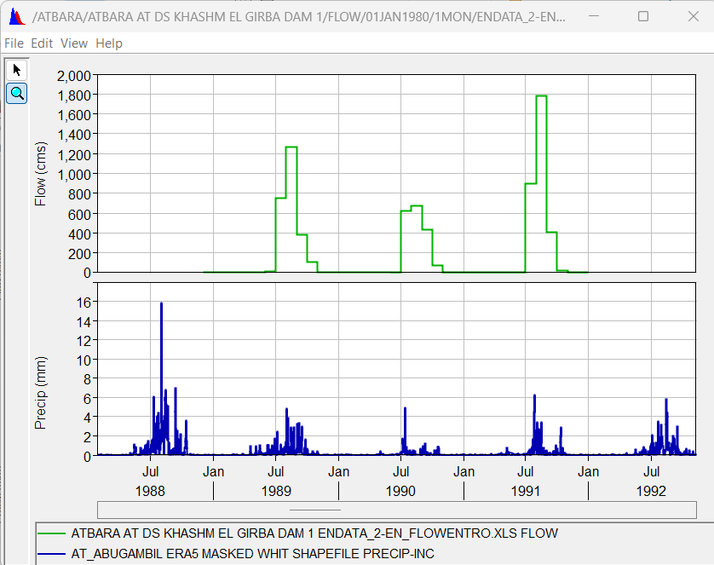
1.4 Plotting data
Exercise 3
3. Multiple records in different sub-viewports
Two viewports
two y axis:
Flow
Precipitation
One x axis:
The plots are synchronized

Slide 37
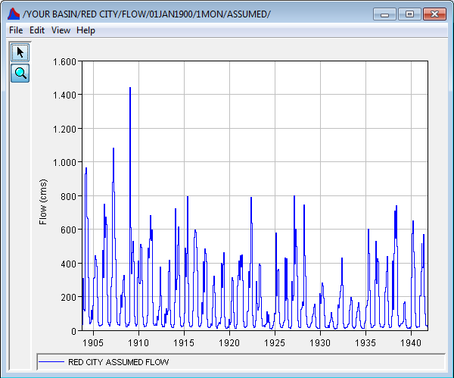

1.4 Plotting data
Exercise 4
Zoom tool
Zoom in
Select the area you want to zoom in
Zoom out
Right mouse button
Text box with value
Move the zoom tool over the point on the curve you are pointing to
Notes:
To enlarging sections of the plot, move the mouse to one corner of the area you want to zoom-in to, press and hold down the left mouse button while dragging the mouse to the opposite corner and the release the button. To zoom-out, press the right mouse button. The graph is zoomed-out in increments. You can hover the zoom tool over a curve, which will pop up a text box with the date and value of the point on the curve you are pointing to

Slide 38
1.4 Plotting data
Customizing Plot
title
viewport
curve
label
axis
legend

Slide 39
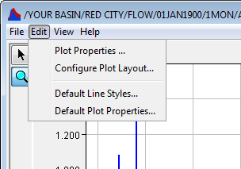
1.4 Plotting data
Customizing Plot
Customize individual plot
Default properties for plots
Template
You can save the individual plot settings in a template (Save Template in the File menu), and apply the template in a new plot (Apply Template in the File menu)
Notes:
To configure the default appearance of all plots, you need to use the Default Plot Properties Editor and Default Line Style Options Editor. All settings you specify in these editors will apply to all new plots you open.
To customize individual plots, you can use the Plot Properties Editor and the Viewport Properties Editor. Also, using right-click shortcut menus, you can access specialized editors for individual plot features.
Additionally, once you have customized an individual plot, you can Save its settings as a Template that you can apply to other plots. To create a template based upon a plot, you will use the Save template option in the File menu of the plot window likewise. To apply a template to a new plot, you will use the Apply Template option in the File menu of the new plot window.

Slide 40
1.4 Plotting data
Exercise 5
Open the record:
ATBARA/ATBARA AT DS KHASHM EL GIRBA DAM 1/FLOW/31Dec1988 - 31Dec1991/1MON/ENDATA_2-EN_FLOW.XLS/
Open the plot properties edit menu;
In the curves-style menu, change weight line and fill above with a color and a pattern;
In the curves-legend item menu, write a legend in the text box, choose a color and a size;
In the title menu, write a title in the text box;
In the Legend menu choose a position for the legend;
In the Layout menu choose a background color.

Slide 41
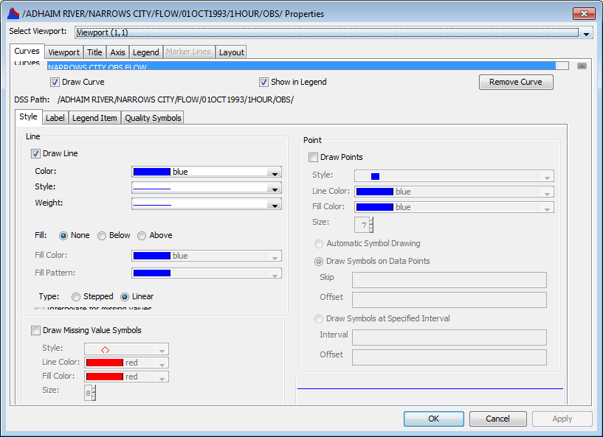
1.4 Plotting data
Exercise 5
Notes:
In the curves-style menu, change weight line and fill above with a color and a pattern;
In the curves-legend item menu, write a legend in the text box, choose a color and a size;
In the title menu, write a title in the text box;
In the Axis menu choose a position for the legend;
In the Layout menu choose a background color.

Slide 42
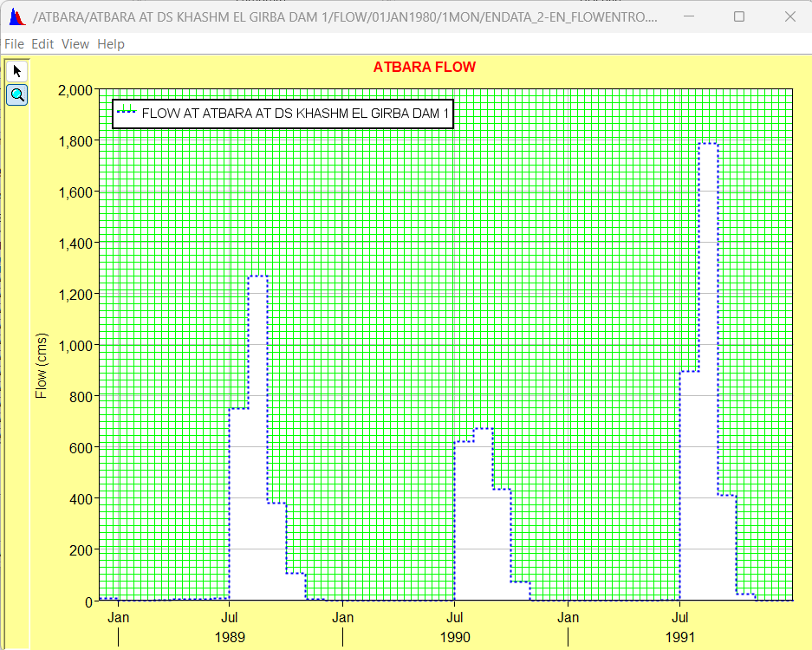
1.4 Plotting data
Exercise 5
Notes:
In the curves-style menu, change weight line and fill above with a color and a pattern;
In the curves-legend item menu, write a legend in the text box, choose a color and a size;
In the title menu, write a title in the text box;
In the Axis menu choose a position for the legend;
In the Layout menu choose a background color.

Slide 43
1.5 Tabulating data
Tabulate button
To create a table:
Select one record
Tabulate from the display menu of the main window
Click on the tabulate button
Tabulate command in the file menu of the plot window
Notes:
To create a table from the Display menu, select Tabulate or You can also click on the Tabulate button. From a plot window, you can also tabulate data using the Tabulate command in the plot’s File menu. Likewise, to open a plot from a table, you can use the Plot command in the table’s File menu.

Slide 44
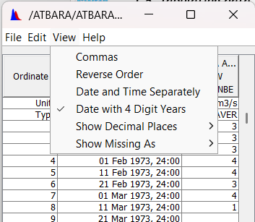
1.5 Tabulating data
Exercise 6
Example: tabulate the record
ATBARA/ATBARA AT DS KHASHM EL GIRBA DAM 1/FLOW/31Dec1988 - 31Dec1991/1MON/ENDATA_2-EN_FLOW.XLS/
To customize a table → View menu
Show date and time separately
Show Decimal Places
Show missing as – M –
…
Notes:
You can customize the resulting table’s display from the View menu by choosing to show:
Commas in tabulated numbers.
The date and time of the data can be tabulated in separate columns by selecting Date and Time Separately.
You can also display the Date with 4 Digit Years as opposed to the default setting that shows the date and time in one column and displays the date with 2 digit years.
The number of Decimal Places you wish to display.
Show quality as symbol, or as hex. The available quality settings are: R(ejected), M(issing) and Q(uestionable).
You can change to Show Missing values as blanks (the default), “-901.0”, “M”, or “-M-”

Slide 45
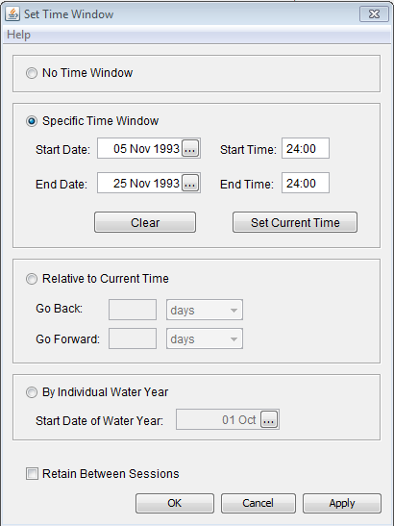
1.6 Setting the time window
No time window
Specific time window
Relative to current time window
By individual water year
Notes:
Clic the set time window buttom. The set time window dialog will open (Figure 1‑13);
You may either use the current time window (no Time Window), enter the specific dates and times, set a time window relative to the current time or access DSS data by water year
To keep your setting for the next time you run DSSVue, select Retain between session.

Slide 46
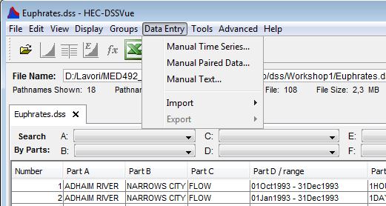
1.7 Entering data into HEC-DSS
Data Entry Menu of the main view
Time Series data entry
Paired data entry

Slide 47
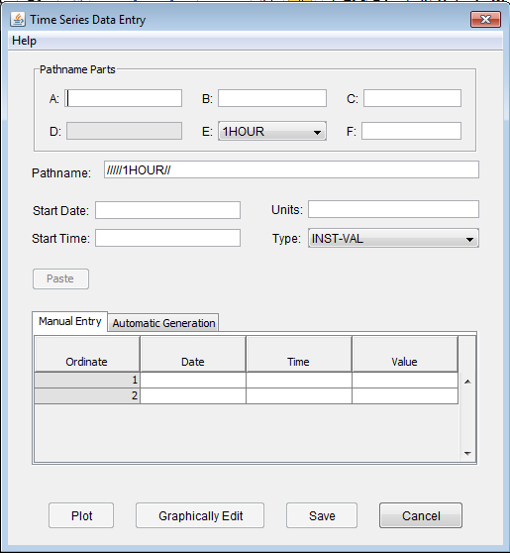
1.7 Entering data into HEC-DSS
Time Series data Entry dialog box
Part Description
A Group, basin, river, region or study name
B Location or gage name
C Data parameter
D Starting date for block
E Time interval
F Version or additional information
Notes:
From the Data Entry menu, select Manual Time Series. The Time Series Data Entry dialog box will appear (Figure 1‑15)
Type the Name Parts into the A, B, C and F boxes; then select the appropriate time interval for the E box.
Enter the start date and the start time. The date and time is then show in part D.
Enter the units and form the Type list select a data Type (PER-AVER, INST-VAL, PER-CUM, and INST-CUM).
PER-AVER: Period average (for example daily or monthly average flows). Used for long periods;
INST-VAL: Instantaneous value (for example measured stage or temperature);
PER-CUM: Period Cumulative (for example daily flow depth)
INST-CUM: Instantaneous Cumulative
Type or past the data value into the third column or insert the end date and time and the fill value in the Automatic generation menu.

Slide 48
1.7 Entering data into HEC-DSS
Time Series Data Entry dialog box
  Type
  PER-AVER: Period average (for example daily or monthly average flows). Used for long periods;
  INST-VAL: Instantaneous value (for example measured stage or temperature);
  PER-CUM: Period Cumulative (for example daily flow depth)
  INST-CUM: Instantaneous Cumulative
Notes:
From the Data Entry menu, select Manual Time Series. The Time Series Data Entry dialog box will appear (Figure 1‑15)
Type the Name Parts into the A, B, C and F boxes; then select the appropriate time interval for the E box.
Enter the start date and the start time. The date and time is then show in part D.
Enter the units and form the Type list select a data Type (PER-AVER, INST-VAL, PER-CUM, and INST-CUM).
PER-AVER: Period average (for example daily or monthly average flows). Used for long periods;
INST-VAL: Instantaneous value (for example measured stage or temperature);
PER-CUM: Period Cumulative (for example daily flow depth)
INST-CUM: Instantaneous Cumulative
Type or past the data value into the third column or insert the end date and time and the fill value in the Automatic generation menu.

Slide 49
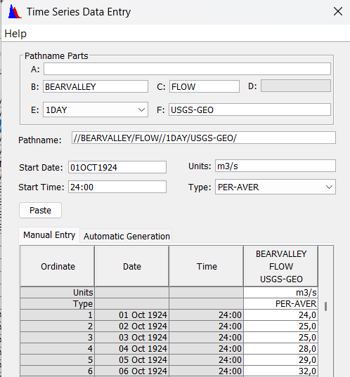
1.7 Entering data into HEC-DSS
Exercise 7
Regular interval Time Series
Open BearValley.xls, containing daily flow data
Fill out the boxes as shown in figure
Copy and paste the values in the value column
Notes:
Open the Excel spreadsheet called BearValley.xls (desktop\ DSS\ Workshop1). In the spreadsheet there are daily flow data start from 01OCT1924 at 24:00 hour, ending date and time at 30Sep1991, 24:00.
From the Data Entry menu, select Manual Time Series. The Time Series Data Entry dialog box will appear (Figure 1‑16);
Type BEARVALLEY in the B box; FLOW in the C box; choose 1DAY in the E box; type USGS-GEO in the F box;
Type 01OCT1924 in the start date box and 2400 in the start time box; type CFS in the units box; choose PER-AVER in the Type box;
Copy the value in the column D of the spreadsheet and paste into the Time Series Data Entry table;
Eventually plot the data;
Save and close.

Slide 50
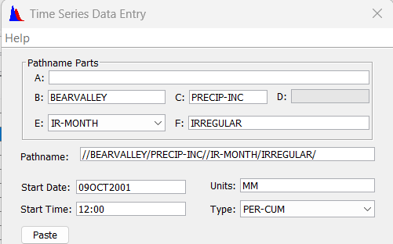
1.7 Entering data into HEC-DSS
Exercise 8
Irregular interval Time Series
Fill out the boxes as shown in figure
Notes:
Open a new Manual Time Series Data Entry screen and enter value data below. The pathnames should be similar for both sets of regular data with the exception of the parameter type (C part), which should be “PRECIP-INC”, select “E part” of “IR-MONTH”.

Slide 51
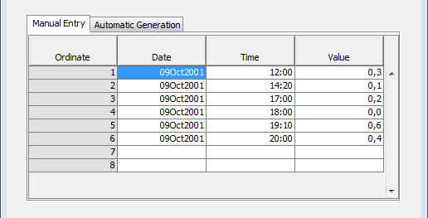
1.7 Entering data into HEC-DSS
Exercise 8
Irregular interval Time Series
Fill out the table with the values provided in the table
Date / Time | Precip (mm)
09Oct2001 / 12:00 | 0.3
09Oct2001 / 14:20 | 0.1
09Oct2001 / 17:00 | 0.2
09Oct2001 / 18:00 | 0.0
09Oct2001 / 19:10 | 0.6
09Oct2001 / 20:00 | 0.4
Notes:
Fill out the cells in the dialog box using the values show in the table

Slide 52
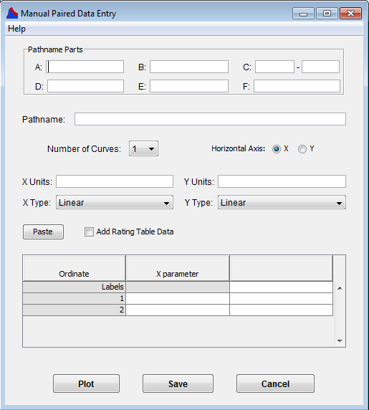
1.7 Entering data into HEC-DSS
Paired data Entry dialog box
Notes:
To enter paired data manually:
From the Data Entry menu, choose Paired Data. The Manual Paired Data Entry dialog box (Figure 1‑19) will open.
Type the Pathname Parts into the A, B, C, D, E, and F boxes. Be sure the “C” part contains both an X parameter and a Y parameter, separated by a hyphen (e.g., STAGE-FLOW or ELEV-DAMAGE).
Select the Number of Curves for the Y parameter from the list.
Enter the X Units (related to the first parameter) and the Y Units (related to the second parameter).
Choose the X Type and Y Type from the lists. The available options are Linear, Log, and Probability.
In the table, the Y ordinates column will split into individual columns according to the Number of Curves you have specified.
Type the data values into the X ordinates and Y ordinates columns.
To view the data in plot form, click the Plot button, save it.

Slide 53
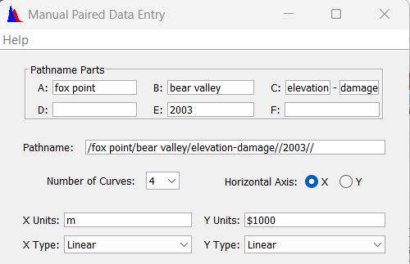
1.7 Entering data into HEC-DSS
Exercise 9
Paired data Entry
Open BearValley.xls, third sheet elevation-damage
Fill out the top portion of the screen boxes as shown in figure
Notes:
The economics department in 2003 developed an elevation damage relationship for the year 2003 for Fox Point, which is in the second sheet (Elevation Damage) of BearValley.xls. Open this sheet and review the data. Damages are reported in thousands of dollars ($1000).
There are 4 curves here (don’t count the X ordinate column as a curve).
Open a paired data entry screen. Fill out the top portion of the screen using your best estimate at pathname parts and label names.

Slide 54
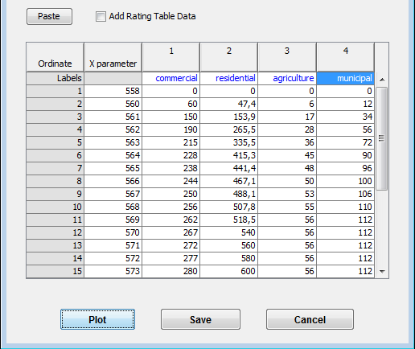
1.7 Entering data into HEC-DSS
Exercise 9
Paired data Entry
Select the Excel data set.
Copy the data and paste it into the data entry screen.
Plot your data
save it and close the data entry screen.
Notes:
Now select the Excel data set. Copy the data and paste it into the data entry screen. Plot your data, save it and close the data entry screen.

Slide 55
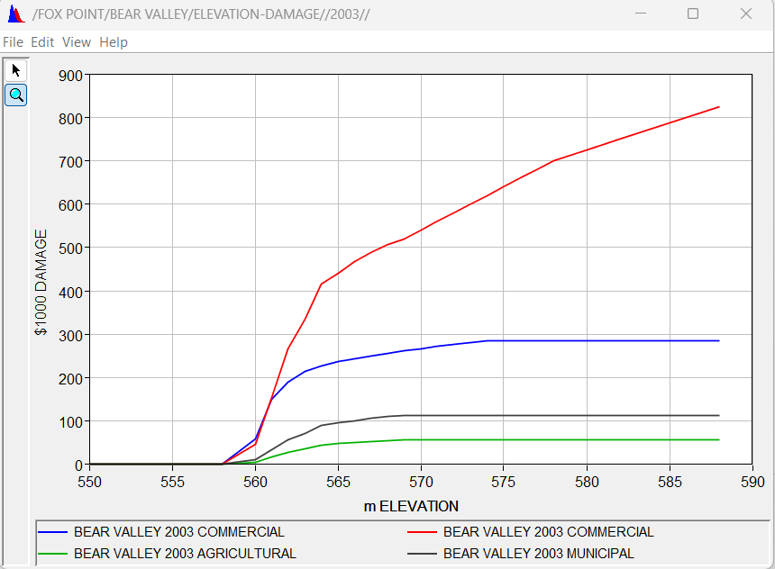
1.7 Entering data into HEC-DSS
Exercise 9
Paired data Entry
Notes:
Now select the Excel data set. Copy the data and paste it into the data entry screen. Plot your data, save it and close the data entry screen.

Slide 56
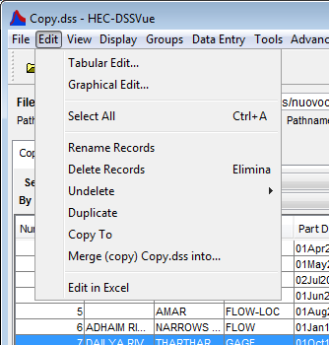
2.1 Utilities
Utilities:
  Rename
  Delete
  Duplicate
  Copy
  Merge

Slide 57
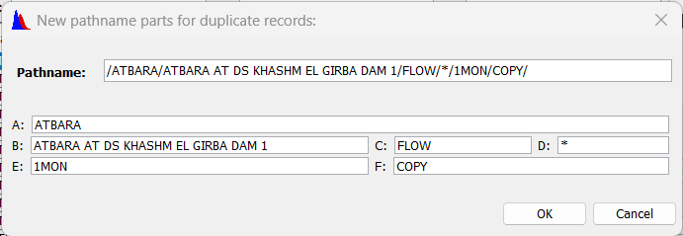
2.1 Utilities: duplicating records
Exercise 10
Duplicating single record
Select the record named:
/ATBARA/ATBARA AT DS KHASHM EL GIRBA DAM 1/FLOW/31Dec1988 - 31Dec1991/1MON/ENDATA_2-EN_FLOW.XLS/
From the Edit menu, select Duplicate.
Parts A, B, C and F boxes be change based on your new choice, you cannot change the D or E parts for time series data.
Notes:
The duplicate command in the Edit menu duplicates records in the same HEC-DSS file, giving the new records different pathnames.
Select the record named /GREEN RIVER/OAKVILLE/STORAGE/22Apr1992 - 21May1992/1HOUR/OBS/
From the Edit menu, select Duplicate. The New Pathname Parts for Duplicate Records dialog box will open (Figure 2‑2).
Parts A, B, C and F boxes be change based on your new choice, you cannot change the D or E parts for time series data.

Slide 58
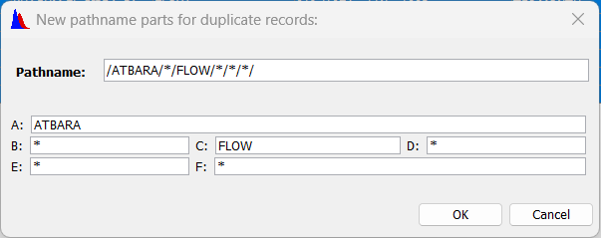
2.1 Utilities: duplicating records
Exercise 11
Duplicating multiple records
Select the records having the A part=ATBARA and C part=FLOW
and duplicate them by changing part F to “duplicated”
DUPLICATED
Notes:
For multiple records, pathname parts that are the same for all records will show up in the dialog, while different parts (such as having pathnames with C parts of FLOW and STORAGE), will be displayed with an asterisk (*).

Slide 59
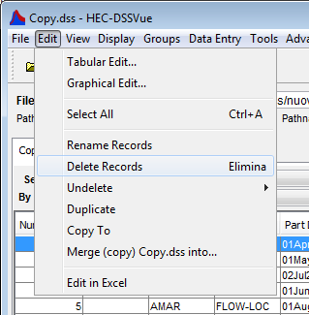
2.1 Utilities: deleting records
Exercise 12
Deleting records
Select the records having F part=DUPLICATED
Select Delete Records in the Edit menu OR click the canc/del key of your keyboard
Notes:
To delete records from a HEC-DSS file:
Select the record or records to delete.
From the Edit menu, select Delete Records. A dialog box will confirm that you want to delete those records. If the number of data sets is four or less, their pathnames will be displayed in the dialog.
Click OK. A confirmation message will appear, stating that the records have been deleted.

Slide 60

2.1 Utilities: undoing deletions
Edit menu → Undelete
All
Select:
  List of the previously deleted pathnames.
Last
Notes:
When you delete data from a HEC-DSS file, the data is marked as missing but it is not actually removed from the file until you run a Squeeze of the file (will se in the next sections). You can recover deleted records with the Undelete command.
From the Edit menu, point to Undelete.
To undelete all records click All. A dialog box will appear to confirm that you want to undelete all of the records in the file. Click OK. A confirmation message will appear that states the records have been undeleted.
To undelete the records that you have just deleted click Last Deleted. A dialog box will confirm that you want to undelete the records that you just deleted. Click OK. A confirmation message will appear that states the records have been undeleted.
If you click Select, a list of the previously deleted pathnames will open. Check the boxes next to the records that you want to undelete, or click Select All to undelete all records in the list. You can unselect the checked records by clicking Unselect All. Once you have made your selection, click OK to undelete those records and close the dialog. Alternatively, you can click Apply to undelete the records and leave the dialog box open. A confirmation message will appear stating that the records have been undeleted.

Slide 61

2.1 Utilities: undoing deletions
Exercise 13
Undoing deletions
Select the records of the dss file with:
  A= MAIN NILE,
  E= 1MON
Press delete in the Edit menu
Press Undelete – select in the Edit menu. Choose only the record whose part B= NILE AT TAMANIAT

Slide 62

2.1 Utilities: renaming records
Exercise 14
Rename command allows to change the A, B, C, F parts of a pathname
Open
ATBARA/TEZEKE AT YECHILA/FLOW/30Mar1998 - 30Dec2000/1MON/DEWS_TEKEZE/
Substitute the F part with «Not complete»
NOT COMPLETE
Notes:
The Rename Records command opens a pathname editor, which allows you to change the common pathname parts of the selected records. To rename HEC-DSS records:
Select the record or records to rename.
For example
/MY BASIN/RIVERSIDE/FLOW/01Mar1990 - 31May1990/1HOUR/OBS/
From the Edit menu, select Rename Records. The Rename Records to: dialog will open, see Figure 2‑4.
You may change one or more pathname parts or the entire record. For example type not reliable in the F part. Note: You cannot change the D or E parts for time series data (use Math Functions to accomplish this).
For multiple records, pathname parts that are the same for all records will show up in the dialog. Where parts differ (such as having pathnames with C parts of FLOW and ELEVATION), the part will be displayed with an asterisk (*).

Slide 63

2.1 Utilities: copying record into another DSS file
Copy To copies the selected records in the current opened file into another
Exercise 15
Select:
/ATBARA/ATBARA AT DS KHASHM EL GIRBA DAM 1/FLOW/31Dec1988 - 31Dec1991/1MON/ENDATA_2-EN_FLOW.XLS/
Edit menu → Copy To
In the Name File box, enter the new file name «Copy» or select an existing DSS file into which you want to copy the record
Notes:
To copy records into another HEC-DSS file.
Steps:
Select the record namely /GREEN RIVER/OAKVILLE/STORAGE/22Apr1992 - 21May1992/1HOUR/OBS/ from (…desktop/dss/Workshop2/Copy.dss file).
From the edit menu, select Copy To. The dialog box shown below will open.
In the File Name box, enter the new file name “new”. This means that a new file named “new” will be created.
Or select an existing HEC-DSS File into which you want to copy the record like "Euphrates.dss" from workshop1 folder, and click Open. A confirmation message will appear stating that the record has been copied to the HEC-DSS file you selected.

Slide 64

2.1 Utilities: merging DSS files
Merge file command copies all of the records in the current opened file into another file
Overwrite any records with the same pathname
Exercise 16
Open the file Copy.dss with the open file button. The file now is open on the same main screen. You can switch between the two files from the main screen
Control the number of records of the file Copy.dss (2 records)
Notes:
Merging copies all of the records in the currently opened HEC-DSS file into another. This is similar to selecting all records then using the Copy Records option, but is much more efficient. However, this option will overwrite any records with the same pathnames and will not splice together time series records
From the Edit menu, click Merge Files. The Merge (copy all records) into HEC-DSS File dialog box will open
select (merge1.dss) into which you want to copy all of the records into and click Open.

Slide 65

2.1 Utilities: merging DSS files
Exercise 16
Switch on the DSS_Training.dss file
From the Edit menu of the file, click Merge Files.
In the File Name box of the dialog box, select Copy.dss, into which you want to copy all of the records into and click Open.
Switch on the Copy.dss file and control the number of records

Slide 66

2.1 Utilities: squeezing HEC-DSS files
SQUEEZE command removes inactive space (accumulated after deleting or renaming records)
SQUEEZE command re-adjust internal HEC-DSS table sizes to optimize access to the data
Once a squeeze has been accomplished, deleted data cannot be recovered
Tools Menu → Squeeze

Slide 67
2.2 Printing, copying, exporting data
xls
doc
png
jpg
…
Printing
Copying
Exporting
Tables
Graphs
Notes:
Use the file Print.dss provided under Desktop\dss\Workshop2
For this workshop use pathname parts from view menu to select the records we want to print or export.

Slide 68

2.2 Printing, copying, exporting data
Printing catalog list
Print or Print Preview commands in the File menu
Print properties Dialog Box will open
Page: Orientation, Scaling, and Selection
Header/Footer: you can type what you want to appear on your printed pages
Table Title: you may edit the Title
Notes:
The Print and Print Preview commands open the Print Properties dialog box (see Figure 2‑6), which offers options on three tabs. The Page tab allows you to specify the page Orientation, Scaling, and Selection, whether Repeat Headers on every page and print the Gridlines. On the Header/Footer tab, you can type what you want to appear on your printed pages. The Table Title tab offers a default title for the table based on the data source. You may edit (change) this title.

Slide 69

2.2 Printing, copying, exporting data
Exercise 17
Printing catalog list
Select records with Part A=ATBARA and Part C=FLOW
Press Print command in the File menu
In the Table Title section write ATBARA HYDRO STATIONS
Select the printer or the PDF file you want to create
Notes:
From the shortcut menu, click Export to export a table to a file. Once the dialog box is open (see Figure 2‑7), you can choose the Field Delimiter (tab, space, comma, or colon), specify Fixed- Width Columns, choose to display Quoted Strings, Include Column Headers, Print Gridlines and Title. Once the save dialog box (Figure 2‑8) is open, put the name of the file (export-table, without extension) in the direction …Desktop\dss\Workshop2, after that you can open it in Microsoft Word or Microsoft Excel or TextPad or any other text editor.

Slide 70


2.2 Printing, copying, exporting data
Exercise 18
Exporting tables
/ATBARA/ATBARA AT DS KHASHM EL GIRBA DAM 1/FLOW/31Dec1988 - 31Dec1991/1MON/ENDATA_2-EN_FLOW.XLS/
Tabulate the selected record
From the shortcut menu, click export. A dialog box will open:
Type Export-table (without extension) in the file name box
Open Export-table with Excel or Word
Notes:
From the shortcut menu, click Export to export a table to a file. Once the dialog box is open (see Figure 2‑7), you can choose the Field Delimiter (tab, space, comma, or colon), specify Fixed- Width Columns, choose to display Quoted Strings, Include Column Headers, Print Gridlines and Title. Once the save dialog box (Figure 2‑8) is open, put the name of the file (export-table, without extension) in the direction …Desktop\dss\Workshop2, after that you can open it in Microsoft Word or Microsoft Excel or TextPad or any other text editor.

Slide 71

2.2 Printing, copying, exporting data
Exercise 19
Copying tables to the clipboard
Open
/ATBARA/ATBARA AT DS KHASHM EL GIRBA DAM 1/FLOW/31Dec1988 - 31Dec1991/1MON/ENDATA_2-EN_FLOW.XLS/
Tabulate the selected record
From the Edit menu, click Copy.
Paste the table into an excel file
Notes:
You can tabulate (or export) data in Microsoft Excel and edit time series data in Excel. Simply select the data sets you wish to tabulate as you normally would and then either press the Excel tool in the toolbar, or from the Display menu, click Tabulate in Excel.
The excel file will be automatically saved in a temporary folder of your computer. Save it in the convenient folder.

Slide 72


2.2 Printing, copying, exporting data
Tabulate in excel
Select any record
Click the Excel button
An excel file will open
Notes:
You can tabulate (or export) data in Microsoft Excel and edit time series data in Excel. Simply select the data sets you wish to tabulate as you normally would and then either press the Excel tool in the toolbar, or from the Display menu, click Tabulate in Excel.
The excel file will be automatically saved in a temporary folder of your computer. Save it in the convenient folder.

Slide 73

2.2 Printing, copying, exporting data
Printing the graphs
Select and plot one record
Select Print Preview in the File menu of the Graph window
A window will open
Press the Print button to print (Select the printer or the PDF file you want to create)
Notes:
You can print the graph of a DSS-HEC data records.
Select and plot the record:
/GREEN RIVER/OAKVILLE/FLOW-RES OUT/01MAY1992/1HOUR/OBS/.
Select Print Preview in the File menu. A window will pop up (Figure 2‑12)
Press the Print Button to print.

Slide 74

2.2 Printing, copying, exporting data
Saving a Graph as image format
Select and plot a record
Save as in the plot’s File menu
Save image as png in the workshop directory
Notes:
The plot can be saved as an image format, saving the plot in *.JPEG format with the Save As option in the plot’s File menu. Save the image to the workshop directory (Desktop\dss\Workshop2). Figure 45 depicts this task.

Slide 75

2.3 Editing tabular data
Editing tabular data
Select one record
Tabulate the record
Edit menu → Allow Editing
Not editable cells change to grey
Notes:
In HEC-DSSVue, you can edit data directly in tables.
From the Edit menu of the table, select Allow Editing to manually edit the data in the table. When this option is checked, the background of non-editable table cells is changed to grey, the Cut and Paste commands become available in the menu, as well as the menu items Insert Rows, Append Rows and Delete Rows. You can also select the tabular edit in the edit menu of the main window.

Slide 76

2.3 Editing tabular data
You can:
Cut, Copy and Paste selected cells from either the Edit menu or the shortcut menu
Clear values
Modify values
Insert new values (manually or pasted from an external file)
Notes:
Select the cells you want to cut (or copy).
From either the Edit menu or the shortcut menu click Cut (or copy).
Select the cells where you want to move the data.
From either the Edit menu or the shortcut menu click Paste.

Slide 77


2.3 Editing tabular data
You can:
Insert, append and delete rows
Sum selected cells
Sum entire column
Notes:
Select the cells you want to cut (or copy).
From either the Edit menu or the shortcut menu click Cut (or copy).
Select the cells where you want to move the data.
From either the Edit menu or the shortcut menu click Paste.

Slide 78


2.3 Editing tabular data
Edit in excel
Select one or more records
Edit menu → Edit in Excel
An excel file opens and you can modify the values
Notes:
Select the cells you want to cut (or copy).
From either the Edit menu or the shortcut menu click Cut (or copy).
Select the cells where you want to move the data.
From either the Edit menu or the shortcut menu click Paste.

Slide 79
2.4 Graphical editing
Graphical editing button
Editing time series in a combined plot/table
Graphical editor button or edit menu→ Graphical Edit
Editable plot of the data on the top of the window and a scrollable table of the data on the bottom of the window

Slide 80

2.4 Graphical editing
Select point tool
Data set
edit point
edit curve
Selected value/row
red line
Viewable rows
green area
Estimate / allow
Point editing
Original
Data set
Estimated
Data set
Accept edited values
Revised
Data set
Add/delete
Irregular interval rows
Notes:
The Graphical Editor displays an editable plot of the data on the top of the window and a scrollable table of the data on the bottom of the window. The area of the data that is visible in the table is marked with a green hash region in the plot. As you scroll through the table, the green hash area moves along with the data that is displayed. When you select a point on the curve or in the table, a red vertical line is drawn at that point to show which value has been selected.
The components of the graphical editor are:
Selected value/row shows what data value is selected in the table. By using Select Point tool move the mouse to that point and press the left mouse button.
Viewable table area indicates the area in the plot that showing data in the table.
Estimate: generates a linear interpolation for selected rows where there is missing data or copies the original data into the editable field.
Estimate All performs this for all rows in the table.
Accept: copies data from the Estimate/Entry (edit) column into the edited column for the selected rows. This is for intermediate saving of the last data edited.
Accept All: copies all data from the edit column into the edited column.
Add: adds rows for irregular-interval time series data. A dialog will be displayed to set the date and time for the row added.
Delete: removes rows for irregular-interval time series data. You cannot remove regular-interval data; you can only change it to missing.
Original column contains the values of the original data set. The values are generally depicted with an orange curve in the plot with each point marked by an “x”. If the value is the same as the one in the Revised column, that point will be over drawn with the blue revised value.
Estimate/Entry (Edit) column is the column where data can be manually entered or edited with the point tool. These values are marked with magenta triangles in the plot. When you are satisfied with the changes, press the Accept or Accept All button and the values will display in the Revised column.
Revised (Edited) column contains the final values that will be saved when Save or Save As is selected. These values are colored blue and marked with an “x”.

Slide 81

2.4 Graphical editing
Estimate:
Generates a linear interpolation for selected rows for missing data or copies the original data into the editable field
Estimate Missing:
Linear interpolation of missing values for all rows in the table
Estimate All:
Same as Estimate button but for all rows in the table
Notes:
Click on the graphical edit button.
Press the Single-Point Edit tool.
Find the new value of the point on the graph that you want to edit and double click the mouse at that location. A magenta triangle will appear in that location and a value will appear in the corresponding row in the estimate entry column.
Press the curve edit tool
Draw a curve in the graph (right click for the final point). A series of magenta triangles will appear in the new desired values and simultaneously the corresponding Estimate/Entry cell will be modified.
Press the Accept button or the Accept All button to accept all edits. This will copy the data from the Estimate/Entry column into the Revised column.
At the end of all of your edits, press the Save or Save As button.

Slide 82
2.4 Graphical editing
Exercise 20
Select one record
And click on the Graphic editor button
Press the single point edit tool
Find the wrong point and estimate a right position. Double click on the that position
Press the curve edit tool
Draw a curve in the graph (right click to stop)
The values in the table change when you draw the new point or the curve
Accept all edit
Save or save as
Notes:
Click on the graphical edit button.
Press the Single-Point Edit tool.
Find the new value of the point on the graph that you want to edit and double click the mouse at that location. A magenta triangle will appear in that location and a value will appear in the corresponding row in the estimate entry column.
Press the curve edit tool
Draw a curve in the graph (right click for the final point). A series of magenta triangles will appear in the new desired values and simultaneously the corresponding Estimate/Entry cell will be modified.
Press the Accept button or the Accept All button to accept all edits. This will copy the data from the Estimate/Entry column into the Revised column.
At the end of all of your edits, press the Save or Save As button.

Slide 83

2.4 Graphical editing
New curve values
Single point and curve edit tools
New single point value
New values
Accept new values
Notes:
Click on the graphical edit button.
Press the Single-Point Edit tool.
Find the new value of the point on the graph that you want to edit and double click the mouse at that location. A magenta triangle will appear in that location and a value will appear in the corresponding row in the estimate entry column.
Press the curve edit tool
Draw a curve in the graph (right click for the final point). A series of magenta triangles will appear in the new desired values and simultaneously the corresponding Estimate/Entry cell will be modified.
Press the Accept button or the Accept All button to accept all edits. This will copy the data from the Estimate/Entry column into the Revised column.
At the end of all of your edits, press the Save or Save As button.

Slide 84

2.4 Graphical editing
You can select more than one record and modify one per time using the others as comparison data
Notes:
Click on the graphical edit button.
Press the Single-Point Edit tool.
Find the new value of the point on the graph that you want to edit and double click the mouse at that location. A magenta triangle will appear in that location and a value will appear in the corresponding row in the estimate entry column.
Press the curve edit tool
Draw a curve in the graph (right click for the final point). A series of magenta triangles will appear in the new desired values and simultaneously the corresponding Estimate/Entry cell will be modified.
Press the Accept button or the Accept All button to accept all edits. This will copy the data from the Estimate/Entry column into the Revised column.
At the end of all of your edits, press the Save or Save As button.

Slide 85

2.5 Math functions
Math functions button
The Math functions are available from the Tools menu or Math Functions Toolbar button and are organized into six categories: Arithmetic, General, Time Functions, Hydrologic, Smoothing, and Statistics.
Each category is a tab on the Math Functions screen

Slide 86

2.5 Math functions
Arithmetic Functions
The Arithmetic tab contains the following functions: Add, Subtract, Multiply, Divide, Exponentiation, Absolute Value, Square Root, Log, Log Base 10, Sine, Cosine, Tangent, Inverse, Accumulation, Successive Differences and Time Derivative
Select one or more record you want to modify
Select the function from the drop-down menu
Insert the required values
Click Compute

Slide 87


2.5 Math functions
Exercise 21
Select one record
Click on Math Function button
Select Arithmetic Tab
Select Add in the Operator dropdown list
Click Constant and specify a value to add
Click Compute
Save as and rename the record

Slide 88

2.5 Math functions
General Functions
The General tab contains the following functions: Units Conversion, Set Units, Set Type, Round to Nearest Whole Number, Truncate to Whole Number, Round Off, Estimate Missing Values, Replace Specific Values, Screen Using Maximum and Minimum, Screen Using Forward Moving Average, Merge Time Series, Merge Paired Data, and Generate Data Pairs
Select one or more record you want to modify
Select the function from the drop-down menu
Insert the required values
Click Compute

Slide 89

2.5 Math functions
Time Functions
The Time Functions tab contains the following functions: Min/Max/Avg… Over Period, Copy in Time, Shift in Time, Change Time Interval, Irregular to Regular, Regular to Irregular, To Irregular using Pattern, and Extract Time Series
Select one or more record you want to modify
Select the function from the drop-down menu
Insert the required values
Click Compute

Slide 90

2.5 Math functions
The Min/Max/Avg… Over Period function generates a time series data set using a variety of functions:
Interpolate at end of Period
Maximum for Period
Minimum for Period
Average over Period
Accumulation over Period
Volume for Period
Integration over Period
Number of Valid Data over Period

Slide 91


2.5 Math functions
Exercise 23
The Accumulation over Period function aggregates the values of the selected record in a new period interval
Select a record with Part E= 1DAY
Choose the Time Functions tab of the Math Functions screen and select the Min/Max/Avg/… Over Period operator from the Function Type list, select Accumulation over Period
Specify the New Period Interval equal to 1YEAR
Click Compute
Save as and rename the record
(Repeat the exercise with accumulation over 1MON and Maximum for Period over 1YEAR)

Slide 92


2.5 Math functions
Exercise 24
The Shift in Time function shifts the times in time series data sets by a specified increment or to start at a specified date and time
Select one record
Choose the Time Functions tab of the Math Functions screen and select the Shift in Time operator
In the Shift by Amount box, enter the amount of the time to shift the data sets by and then select Minute, Hour, Day, Week, Month or Year. To shift data backwards in time, use a negative amount for the time shift
Click Compute
Save as and rename the record

Slide 93

2.5 Math functions
Statistics Functions
The Statistics tab contains the following functions: Basic (statistics), Linear Regression, Cyclic Analysis, Duration Analysis, and Frequency Plot.
Select one or more record you want to modify
Select the function from the drop-down menu
Insert the required values
Click Compute

Slide 94

2.5 Math functions
The Basic function computes the basic statistical values for a regular or irregular interval time series data set. The statistical and informational values displayed are:
Number of valid values
Number of missing values
Last valid value and date and time
Minimum value and date and time
Mean value
Maximum value and date and time
Accumulated value for the time series
Standard deviation
Skew coefficient
Data type ("INST-VAL", "INST-CUM", "PER-AVER", "PER-CUM")
Data Units ("ft", "cfs", etc.)

Slide 95

2.5 Math functions
Exercise 25
The Cyclic Analysis function derives a set of cyclic statistics from a regular interval time series data set.
Select a record with PART E = 1MON
Choose the Statistics tab of the Math Functions screen and select the Cyclic Analysis type
Click Compute
Select the record that calculates the average value (PRECIP-INC-AVER)
Save as and rename the record

Slide 96


2.5 Math functions
Exercise 25
Result of Cyclic Analysis
The obtained record represents the monthly precipitation of an average year

Slide 97
Thank You

